Slide 1
OHT Indicators & Population Segmentation
Noojmawing Sookatagaing OHT Results
January 2024

Slide 2
How to use this report - 1
This report contains two main sections:
  The first section provides your OHT's ranking on 10 overall OHT improvement indicators and 5 improvement indicators for 3 common target populations (mental health, frail older adults, and end of life/palliative care)
  The second section provides your OHT results for 12 indicators stratified by 4 useful sub-groupings (material deprivation, primary care model, CIHI Pop Health Grouper and BC Health System Matrix). The 12 indicators were identified as being most important to OHTs at this time.

Slide 3
How to use this report - 2
Have a look at the spider diagram to see which indicators your OHT appears to be close to the centre. Here you are doing well as compared to other OHTs.
Use the spider diagrams to see which indicators your OHT appears further to the outside. Many other OHTs are doing better than your OHT on this indicator. Is this an area that is important to your OHT? (You can use the provincial report to see which OHTs are ahead of you).
For the indicators that OHTs identified as being most important, you can then look to the second part of the report to find subgroups (by primary care model, material deprivation or health grouping) where you have the greatest opportunity for improvement. These subgroups may point to some conditions that you need to look beyond historical approaches to improvement. You may need additional outreach for low-users or non-rostered patient groups and additional social resources to meet the needs of individuals in high material deprivation (Q4 & Q5).

Slide 4
List of Acronyms
ACSC: Ambulatory Care Sensitive Condition
ADL: Activities of Daily Living
ALC: Alternate Level of Care
CIHI: Canadian Institute for Health Information
ED: Emergency Department
MHA: Mental Health and Addictions
MDS-HSI: Minimum Data Set Health Status Index

Slide 5
Part 1:
Overall and Population-specific HSPN Improvement Indicators

Slide 6
HSPN OHT Improvement Indicators
Total Population
- Premature Mortality
- Cost per Month
- Days in Acute Care
- ALC Days
- ACSC Hospitalizations
- 30D Readmission
- ED Visit managed elsewhere
- 7D Physician Follow up
- Continuity of Care
- Virtual Visits
Mental Health & Addictions Care
- Outpatient visits within 7d of MHA hospital discharge
- ED as first point of contact for MHA
- Frequent (4+) ED visits for MHA
- Repeat ED visits within 30d for MHA
- Rate of ED visits for deliberate self-harm
Older/Frail
Adults
- 2+ fall-related ED visits (among frail)
- Days at home (among frail)
- Change in ADL long form
- Caregiver distress
- Change in MDS-HSI
Palliative &
End-of-Life Care
- Deaths in hospital
- ED visit in the last 30d of life
- Palliative - physician home visits in the last 90d of life
- Palliative home - care in the last 90d of life
- Days at home in the last 6mons of life

Slide 7
Spider Diagrams
Illustrates your OHTs annual rank amongst all OHTs across 10 total population indicators, 5 MHA indicators, 5 older/frail adult indicators, and 5 end of life indicators (2021/22 to 2022/23).
The light grey lines (resembling a spider web) highlight the rank, where closest to the centre indicates the best rank amongst all OHTs.
Data points furthest from the centre indicate worst rank in comparison to other OHTs.
Each indicator is oriented so that best performance is closest to the centre whether best is represented by high (e.g., physician follow-up) or low (e.g., premature mortality) absolute scores.
Spider diagrams measures performance relative to other OHT’s each year.
  Your OHT could have performed better in 2022/23 compared to 2021/22, but if on average the other OHT’s also performed better, your point on your spider diagram may be further away from the centre.
Spider Diagram Interpretation “Try to be SMALL” … on target is better

Slide 8
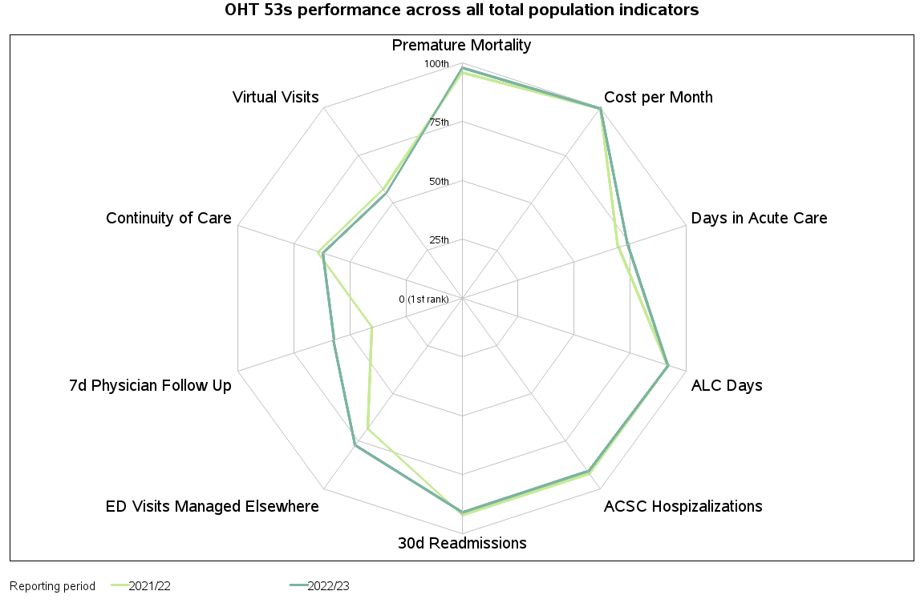
Spider Diagrams for Total Population Indicators

Slide 9
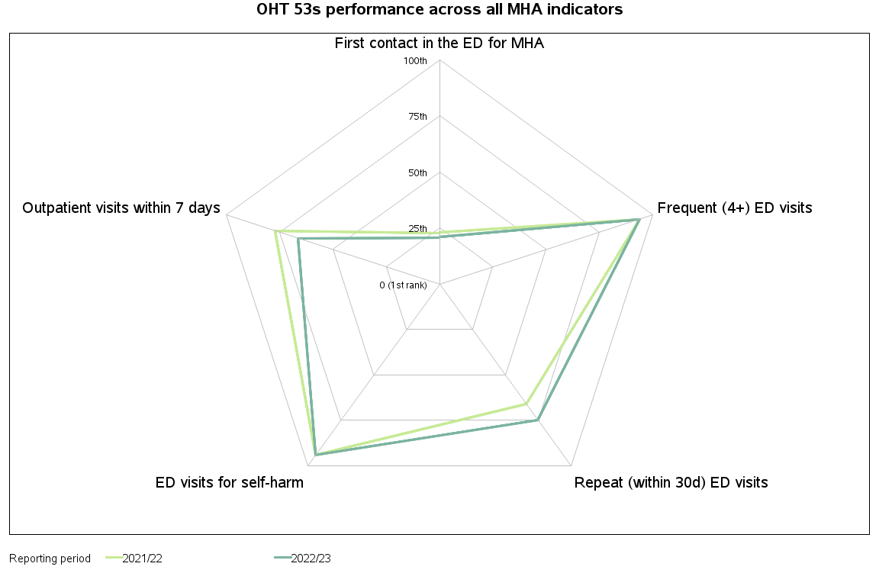
Spider Diagrams for MHA Indicators

Slide 10
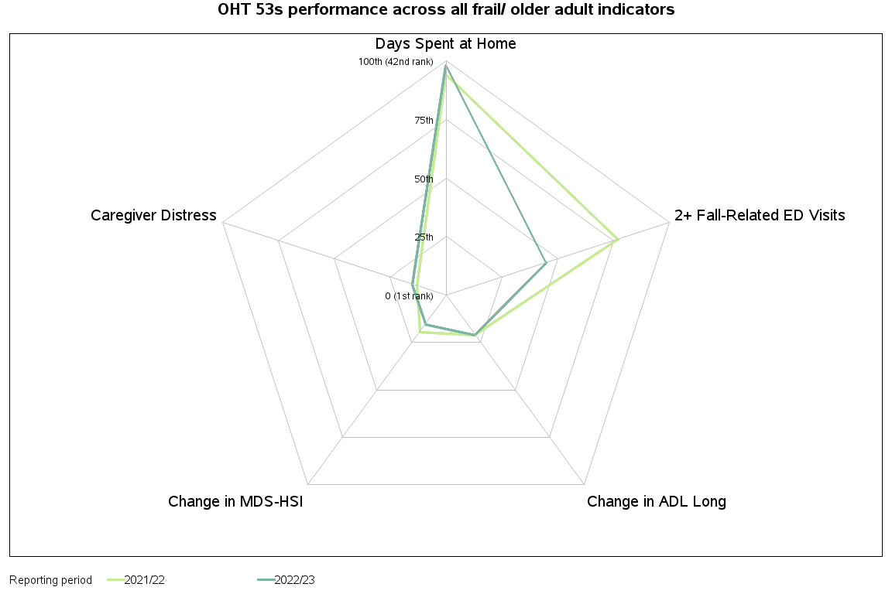
Spider Diagrams for frail/older adults

Slide 11
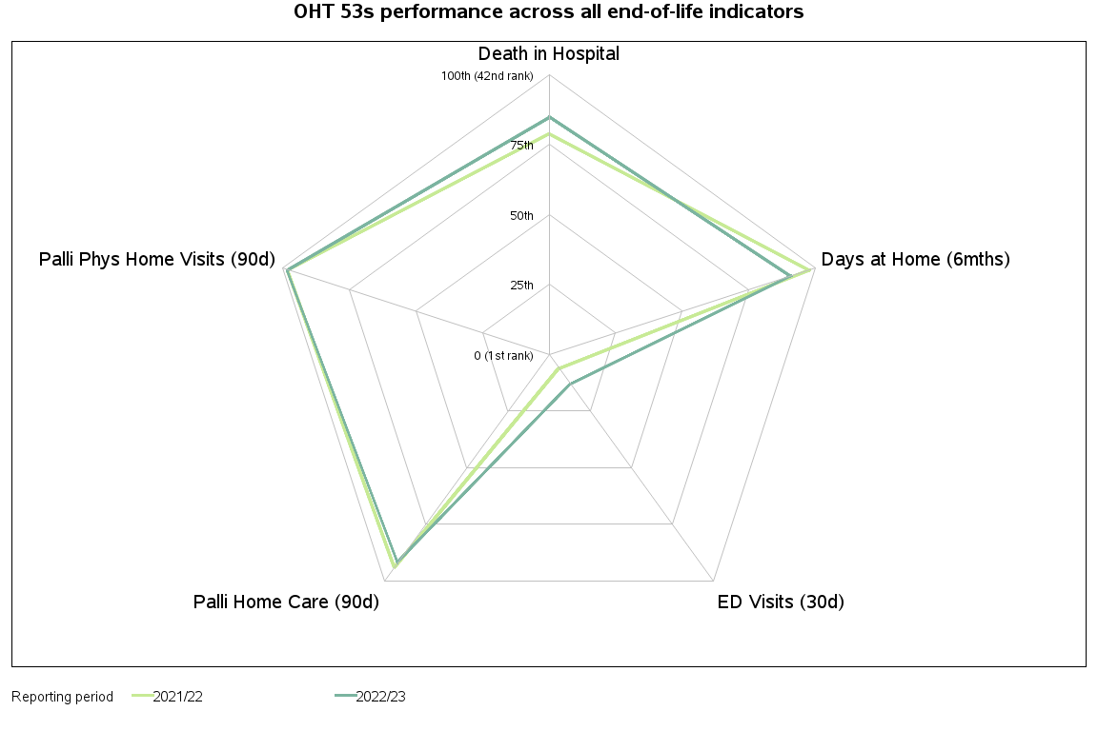
Spider Diagrams for end-of-life Indicators

Slide 12
Introduction to Part 2:
Selecting indicators and defining stratification / segmentation approaches

Slide 13
How did we select indicators for this report?
Surveys were distributed to an OHT representative identified by the OHT evaluation lead contact as best suited to answer a survey about the HSPN Improvement Indicators.
The survey had 3 multiple choice questions, 3 open text comments and 6 sets of indicators and stratifications to rank.
A total of 56 OHTs were invited of whom, 42 responded (75%).
Most respondents held positions as (executive) director of the OHT or OHT operations or lead for analysis or population health.
OHTs were asked whether we should base a report on a complete set of indicators for one topic or to select a few indicators from different indicator sets. OHTs overwhelming preferred the latter approach and provided rankings of the indicators according to the "priority and usefulness for your OHT". We selected up to 3 indicators from each grouping. For the selected indicators, at least 25% of OHTs selected the indicator as top 2 of 10 from overall indicators or at least 45% of OHTs selected the indicator as top 2 of 5 from population-specific indicators.

Slide 14
Top Chosen Indicators:
Total Population
1. ED Visits best managed elsewhere
2. ACSC Hospitalization
3. Physician Continuity of Care
MHA
1. Frequent (4+ ED visits for MHA)
2. Repeat ED visit for MHA (within 30 days)
3. ED as first point of contact for MHA
CQIP
1. ALC
2. Cervical Cancer Screening
3. Breast Cancer Screening
Older/Frail
Adults
1. Repeat fall-related ED visits among those identified as frail
Palliative &
End-of-Life Care
1. Proportion of decedents with home care visits in last 90 days of life
2. Proportion of decedents with 1+ ED visit in last 30 days of life

Slide 15
Indicator Definitions
Indicator | Definition | Quadruple Aim
ED visits best managed elsewhere | Number of low-acuity, unscheduled visits to emergency departments for conditions that could be treated in a primary care setting among persons aged 1 to 74 years of age | Patient Experience (access) & Cost/Efficiency
Hospitalizations for ACSCs | Number of hospital admissions for ambulatory care sensitive conditions (including grand mal status and other epileptic convulsions, chronic obstructive pulmonary disease, asthma, congestive heart failure and pulmonary edema, hypertension, angina, diabetes, and lower respiratory illness) among persons aged 0 to 74 years of age | Health Outcomes
Continuity of care | Average proportion of an attributed person’s physician visits that was with their most regularly seen doctor | Patient Experience
Frequent (4+) emergency department visits for help with MHA | Proportion of individuals with an unscheduled emergency department visit that had 4 or more emergency department visits within a 365-day period | Patient Experience & Cost/Efficiency (Health Service Use)
Repeat emergency visits for MHA (within 30 days) | Proportion of unscheduled emergency department visits for care for MH conditions with a second unscheduled emergency department visit for MH or substance abuse within 30 days | Patient Experience & Cost/Efficiency
First contact in the emergency department for MHA | Proportion of incident unscheduled emergency department visits for MHA-care where the patient had no prior MHA-related contact (hospitalization, emergency department or physician visit) | Patient Experience (Timely Access) & Cost/Efficiency
ALC days | Proportion of days in acute inpatient care that were spent in alternate level of care (ALC) | Patient Experience & Cost/Efficiency
PAP Screening | Proportion of screen eligible patients (women 23-69 years of age) up to date with Papanicolaou (Pap) tests | Patient Experience (access)
Mammogram | Proportion of screen-eligible patients (women 52-69 years of age) up to date with a Mammogram | Patient Experience (access)
Repeat fall-related emergency visits, among those identified as frail | Proportion of older adults >65 years of age identified as being frail that had 2 or more unscheduled emergency department visit for fall-related injuries | Health outcome
Proportion of decedents receiving palliative home care in the last 90 days of life | The proportion of decedents that had one or more palliative home care services (excluding care management and placement services) in their last 90 days of life | Patient Experience (access) & Health Outcome
Proportion of decedents with 1 or more emergency department visits in the last 30 days of life | The proportion of decedents that had one or more unplanned emergency department visits in their last 30 days of life | Patient Experience (access) & Cost/Efficiency

Slide 16
Stratification / Segmentation
For the top chosen indicators, we report on the OHT-specific results by four Stratifications or four ways to Segment the population:
  Neighbourhood Material Deprivation Quintile
  Primary Care Patient Enrolment Model
  CIHI Pop Grouper Health Profile Categories (HPCs)
  BC Health System Matrix Segments

Slide 17
Material Deprivation Quintile
  We use the Material Deprivation Score from the Ontario Marginalization Index to assess equity in OHT indicators across socioeconomic status.
Indicators
Proportion of the population aged 25 to 64 without a high-school diploma
Proportion of families who are lone parent families
Proportion of total income from government transfer payments for population aged 15+
Proportion of the population aged 15+ who are unemployed
Proportion of the population considered low-income
Proportion of households living in dwellings that are in need of major repair
Proportion of OHT population according to Neighbourhood Material Deprivation
Ontario Health Teams. OHT Attributable Populations:

Slide 18
Primary Care Patient Enrolment Models
  Family Health Teams (FHTs): Capitation-based models with additional interprofessional teams
  Capitation Based Models (CAP): Family Health Network (FHN), Family Health Organizations (FHO), and Other (mostly this is the Rural and Northern Model)
  Family Health Groups (FHGs): Partly capitation with after-hours coverage
  Comprehensive Care Model (CCM): Fee for service with rostered patients
  Not rostered / Not attached

Slide 19

CIHI Population Grouping Methodology
From health conditions to health profile categories (HPCs)
Identifies dominant health condition driving an individual’s health profile
16
health profile categories
Summarizes condition by type and severity
Diagnoses
226
health
conditions
164
health profile branches
239
health profile groups
Splits by presence of significant comorbidities

Slide 20

BC Health System Matrix Segment
20

Slide 21
Time Periods for Assigning Stratifications
Assignment to subgroups is based on information on April 1st of the indicator year:
  OHIP address for the individual is used to assign to Material Deprivation Category using the dissemination area and 2021 Census
  Primary care models based on enrolment as at April 1
  CIHI Pop Grouper is based on utilization in the prior fiscal year
  BCHSM classification is based on utilization in prior fiscal year along with conditions diagnosed over different/varying periods of time.
See full technical report for more details :
[https://hspn.ca/wp-content/uploads/2022/03/HSPN_SEGMENTATION_TECH_APPENDIX_March_2022.pdf ]

Slide 22
Part 2:
12 Select Indicators with 4 Stratifications

Slide 23

Rate of ED Visits best managed elsewhere
DEFINITION | Quadruple Aim
Rate of low-acuity, unscheduled visits to emergency departments for conditions that could be treated in a primary care setting among persons aged 1 to 74 years of age | Patient Experience (access)
In this graph the horizontal scale represents the rate of ED visits per 1000 patients. This is calculated as the number of patients admitted to ED with a condition that could be managed elsewhere divided by the population in the OHT attributed population who are aged 1 to 74.
Sample Interpretation: In the most deprived communities (Q5), 28 patients per 1000 person years visit the ED for reasons best managed elsewhere. Lower values are preferred on average and indicate better access to care for low acuity conditions in the community.

Slide 24
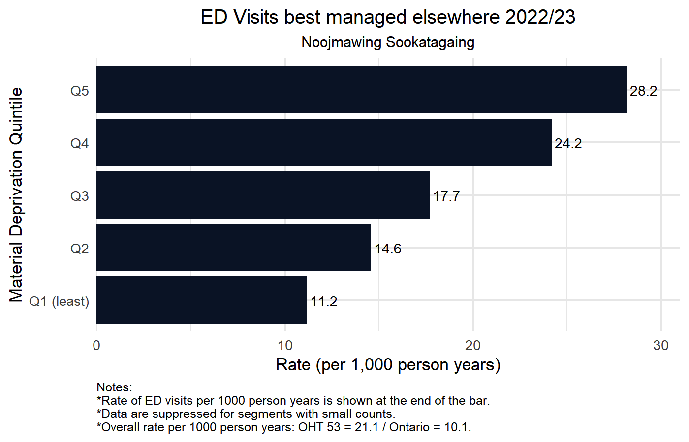
2022/23 Rate of ED Visit best managed elsewhere
by Material Deprivation Quintile
Horizontal axis presents rate of ED visits per 1000 person years that could be treated in alternative primary care setting.
OHT and Ontario average indicated in figure footnote.
Blank rows represent segments
with no events, small counts < 5,
or with < 30 patients in denominator.

Slide 25
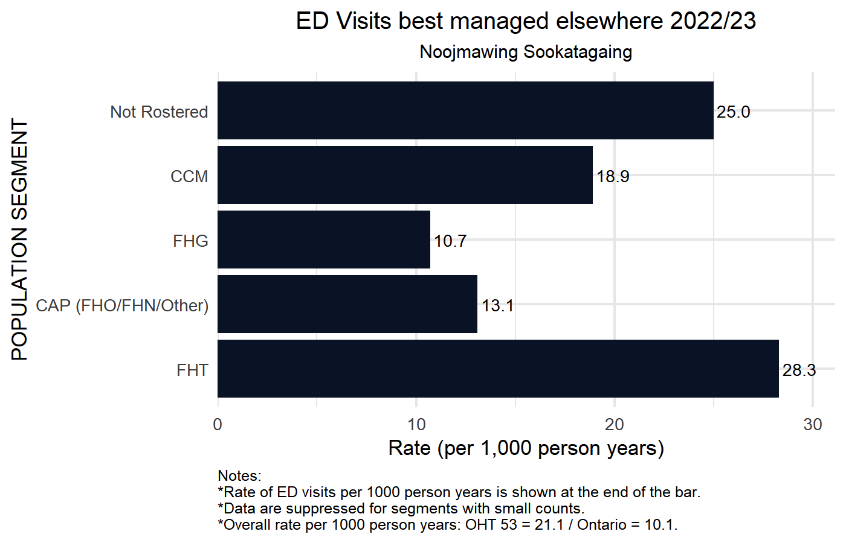
2022/23 Rate of ED Visit best managed elsewhere
by Primary Care Model
Horizontal axis presents rate of ED visits per 1000 person years that could be treated in alternative primary care setting.
OHT and Ontario average indicated in figure footnote.
Blank rows represent segments
with no events, small counts < 5,
or with < 30 patients in denominator.

Slide 26
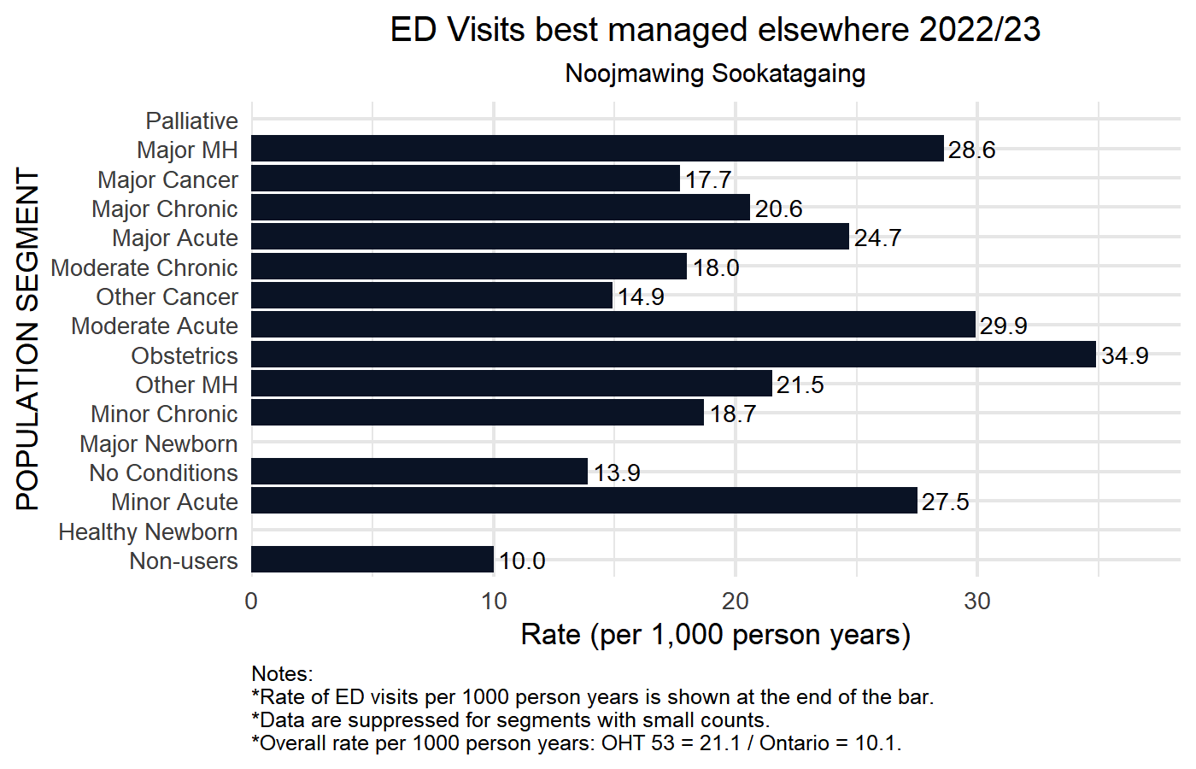
2022/23 Rate of ED Visit best managed elsewhere
by CIHI Population Grouping Methodology
Horizontal axis presents rate of ED visits per 1000 person years that could be treated in alternative primary care setting.
OHT and Ontario average indicated in figure footnote.
Blank rows represent segments
with no events, small counts < 5,
or with < 30 patients in denominator.

Slide 27
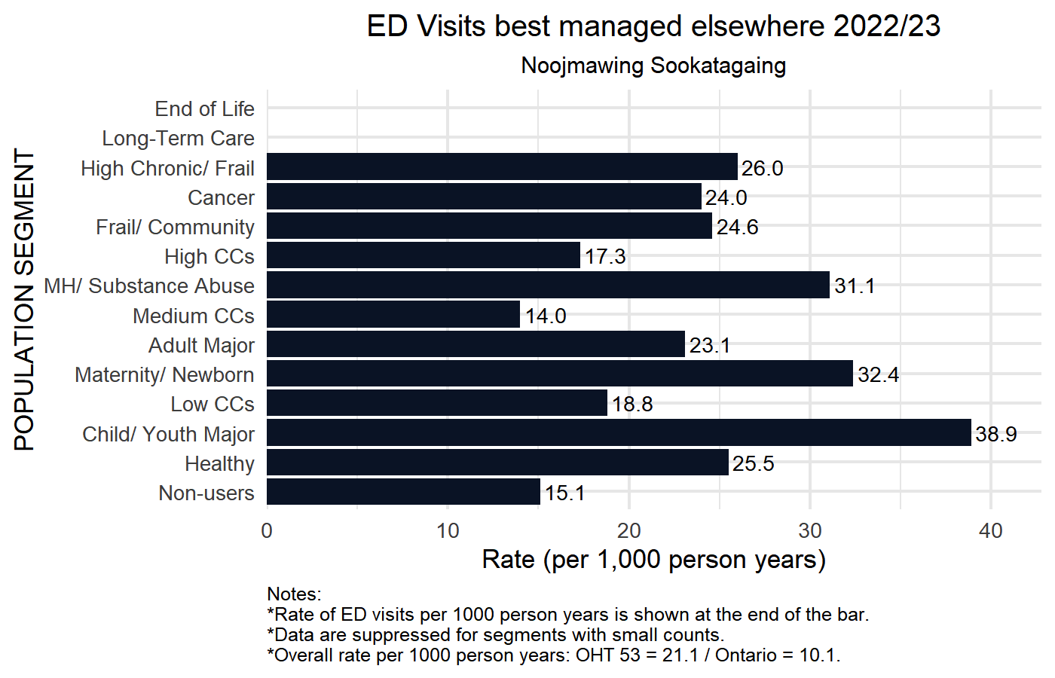
2022/23 Rate of ED Visit best managed elsewhere
by BC Matrix Segment
Horizontal axis presents rate of ED visits per 1000 person years that could be treated in alternative primary care setting.
OHT and Ontario average indicated in figure footnote.
Blank rows represent segments
with no events, small counts < 5,
or with < 30 patients in denominator.

Slide 28
Hospitalizations for ACSCs
DEFINITION | Quadruple Aim
Number of hospital admissions for ambulatory care sensitive conditions (including chronic obstructive pulmonary disease, asthma, congestive heart failure and pulmonary edema, hypertension, angina, diabetes, epilepsy and lower respiratory illness) among persons aged 0 to 74 years of age divided by the OHT population aged 0 - 74. | Health Outcomes
In this graph the horizontal scale represents the rate of ED visits per 1000 patients. This is calculated as the number of patients admitted to ED with a condition that could be managed elsewhere divided by the population in the OHT attributed population who are aged 0 to 74.
Sample Interpretation: In the most deprived communities (Q5), 862 patients per 100,000 person years are hospitalized for ambulatory care conditions. Lower values are preferred on average and indicate a better functioning care in the community/ambulatory settings.

Slide 29
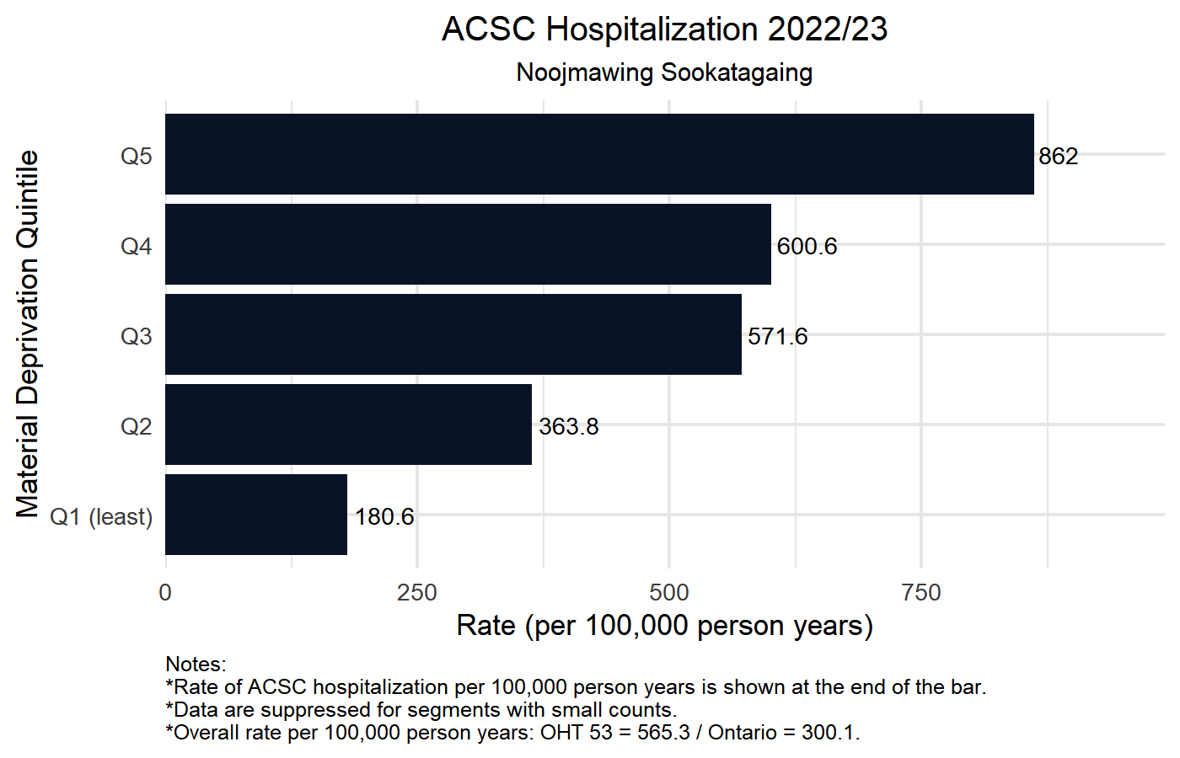
2022/23 Rate of hospitalization for ambulatory care sensitive conditions (ACSC) per 100k by Material Deprivation Quintile
Horizontal axis presents rate of hospitalization for ambulatory care sensitive condition per 100k:
OHT and Ontario average indicated in figure footnote.
Blank rows represent segments
with no events, small counts < 5,
or with < 30 patients in denominator.

Slide 30
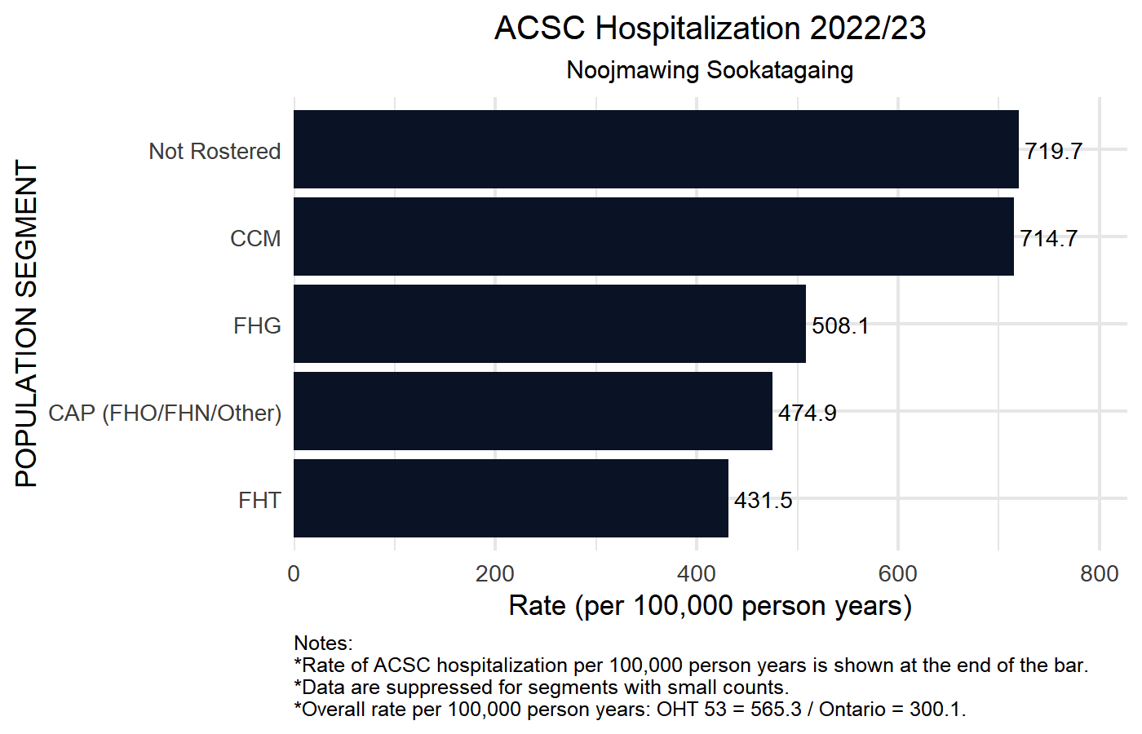
2022/23 Rate of hospitalization for ambulatory care sensitive conditions (ACSC) per 100k by Primary Care Model
Horizontal axis presents rate of hospitalization for ambulatory care sensitive condition per 100k:
OHT and Ontario average indicated in figure footnote.
Blank rows represent segments
with no events, small counts < 5,
or with < 30 patients in denominator.

Slide 31
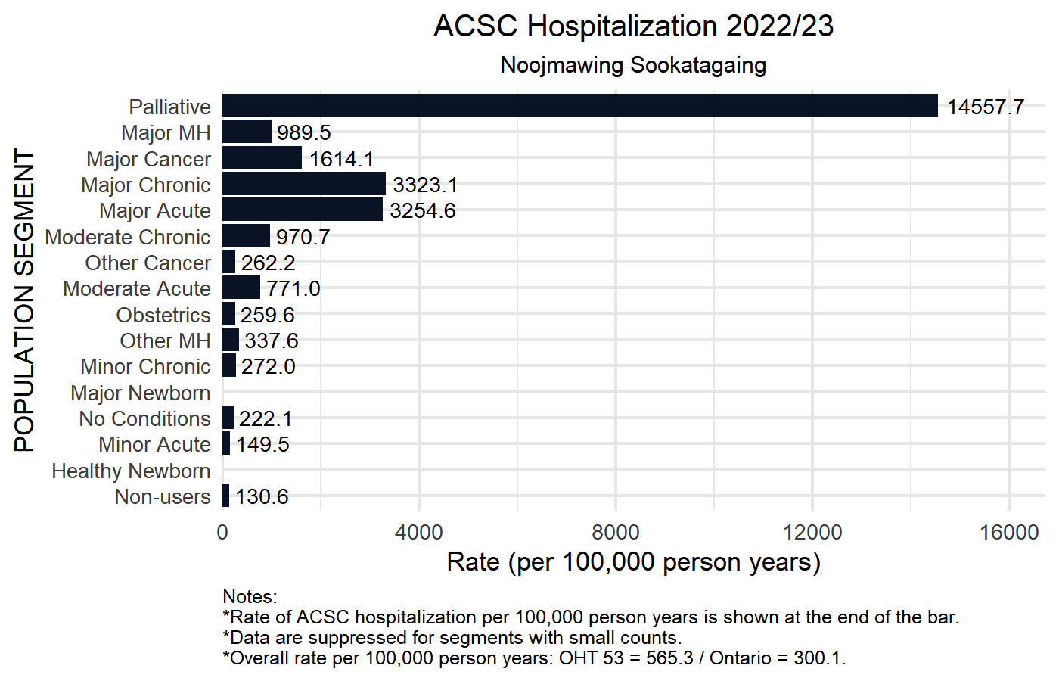
2022/23 Rate of hospitalization for ambulatory care sensitive conditions (ACSC) per 100k CIHI Population Grouping Methodology
Horizontal axis presents rate of hospitalization for ambulatory care sensitive condition per 100k:
OHT and Ontario average indicated in figure footnote.
Blank rows represent segments
with no events, small counts < 5,
or with < 30 patients in denominator.

Slide 32
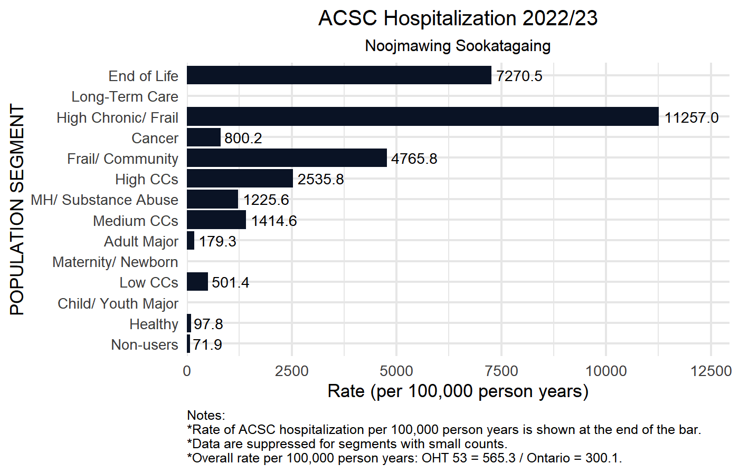
2022/23 Rate of hospitalization for ambulatory care sensitive conditions (ACSC) per 100k by BC Matrix Segment
Horizontal axis presents rate of hospitalization for ambulatory care sensitive condition per 100k:
OHT and Ontario average indicated in figure footnote.
Blank rows represent segments
with no events, small counts < 5,
or with < 30 patients in denominator.

Slide 33
Mean (Average) Physician Continuity of Care
DEFINITION | Quadruple Aim
Average proportion of an attributed person’s physician visits that was with their most regularly seen doctor | Patient Experience
In this graph the horizontal scale represents the average Continuity of Care (CoC) amongst all patients attributed to this OHT where CoC is measured as the proportion of all physician visits that are with the doctor that they see the most often.
Sample Interpretation: In the most deprived communities 61% of patients' visits to the doctor were to the same doctor. Higher numbers indicate greater continuity of care and are an indicator of relationship continuity. Higher values are preferred on average. Specialist direct referrals to other specialists without involvement of a persons' most regularly seen doctor are one of the main ways continuity is decreased.

Slide 34
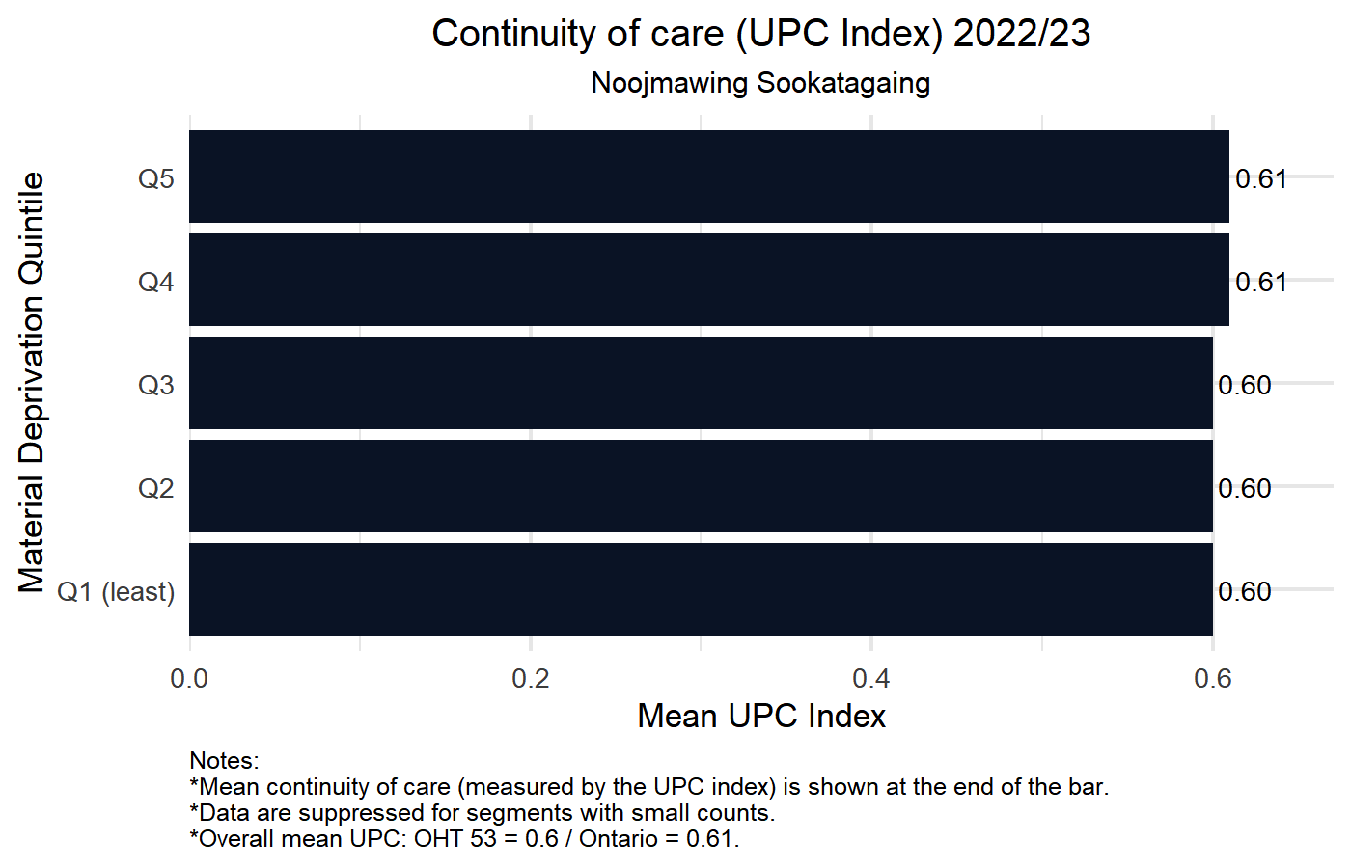
2022/23 Mean continuity of care (measured by the Usual Provider of Care Index)
by Material Deprivation Quintile
Horizontal axis presents the mean continuity of care (measured by the Usual Provider of Care Index):
OHT and Ontario average indicated in figure footnote.
Blank rows represent segments
with no events, small counts < 5,
or with < 30 patients in denominator.

Slide 35
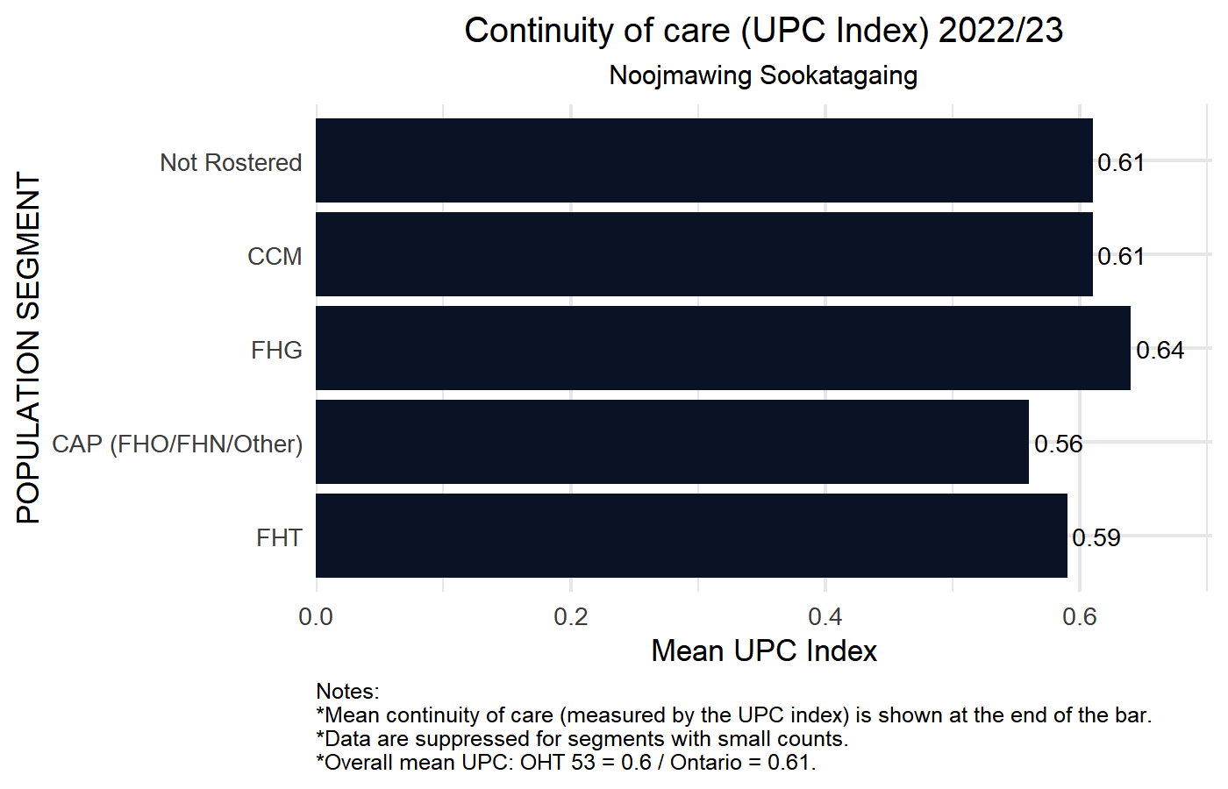
2022/23 Mean continuity of care (measured by the Usual Provider of Care Index)
by Primary Care Model
Horizontal axis presents the mean continuity of care (measured by the Usual Provider of Care Index):
OHT and Ontario average indicated in figure footnote.
Blank rows represent segments
with no events, small counts < 5,
or with < 30 patients in denominator.

Slide 36
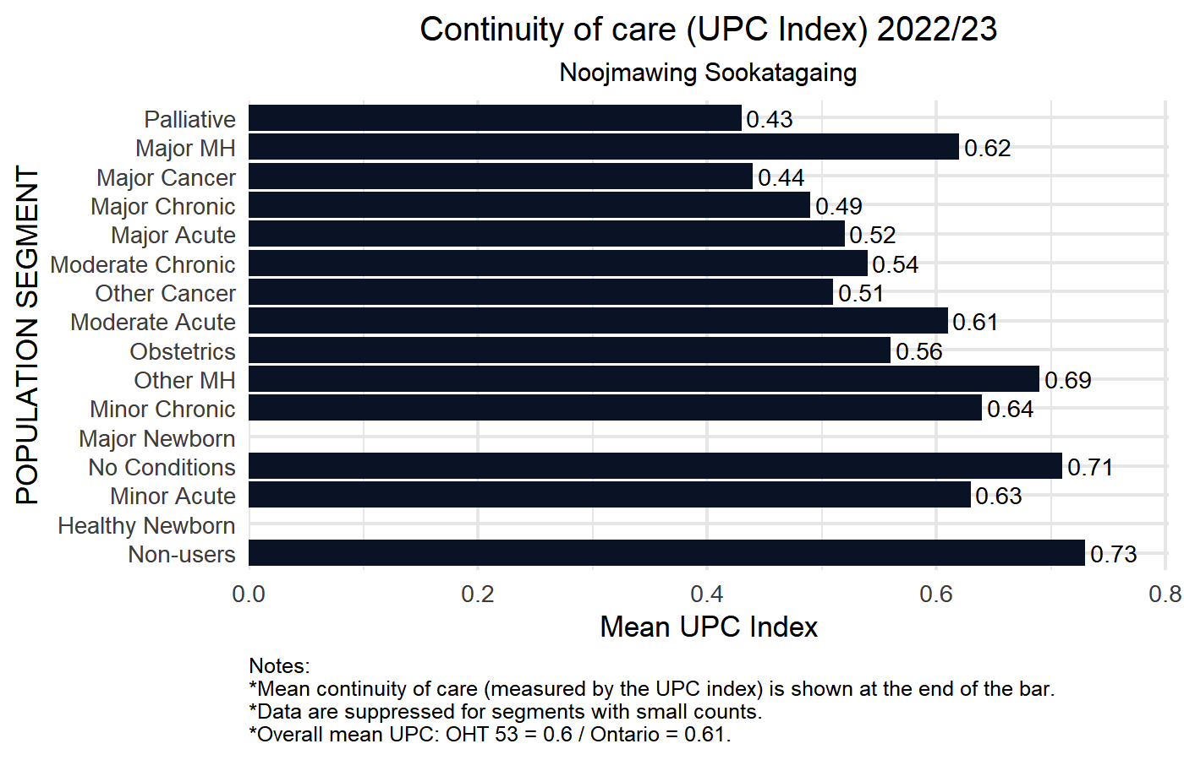
2022/23 Mean continuity of care (measured by the Usual Provider of Care Index)
by CIHI Population Grouping Methodology
Horizontal axis presents the mean continuity of care (measured by the Usual Provider of Care Index):
OHT and Ontario average indicated in figure footnote.
Blank rows represent segments
with no events, small counts < 5,
or with < 30 patients in denominator.

Slide 37
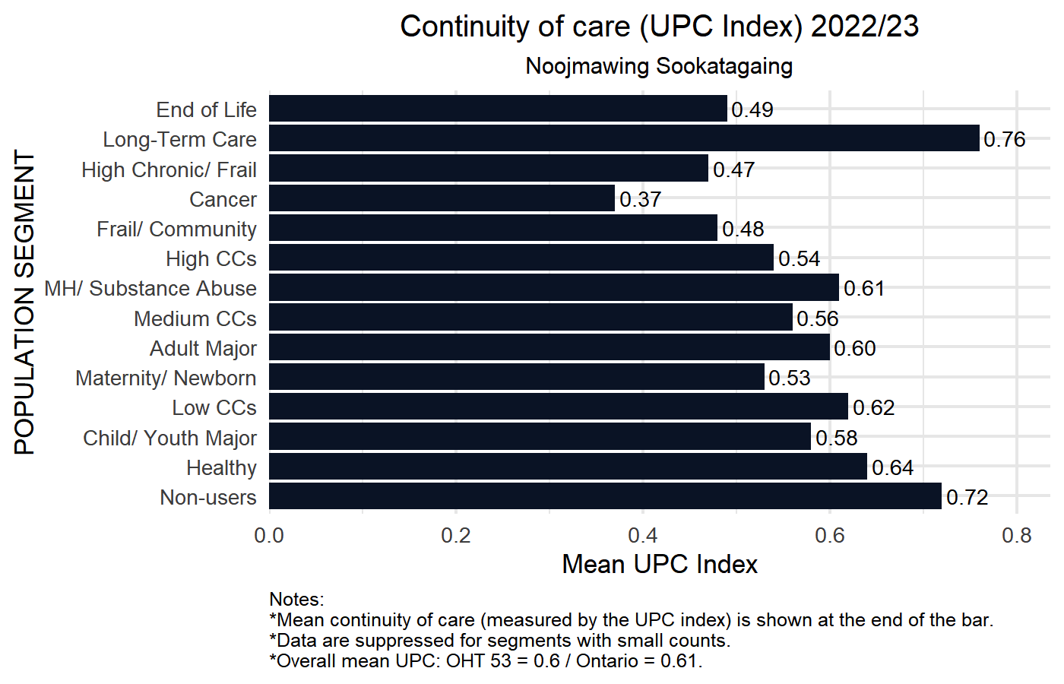
2022/23 Mean continuity of care (measured by the Usual Provider of Care Index)
by BC Matrix Segment
Horizontal axis presents the mean continuity of care (measured by the Usual Provider of Care Index):
OHT and Ontario average indicated in figure footnote.
Blank rows represent segments
with no events, small counts < 5,
or with < 30 patients in denominator.

Slide 38
Alternate Level of Care (ALC) days
DEFINITION | Quadruple Aim
Proportion of days in acute inpatient care that were spent in alternate level of care (ALC) | Patient Experience & Efficiency
In this graph the horizontal axis measures the total number of hospital inpatient days amongst all patients in your OHT attributable population and the colours represent how many of those days are acute versus alternate level of care.
Sample Interpretation: The proportion of inpatient days designated as ALC days in the most deprived communities (Q5) is 23.3%. Lower values are preferred on average and indicate good discharge processes and partnerships between hospital and community settings to accelerate transfer of care to community.

Slide 39
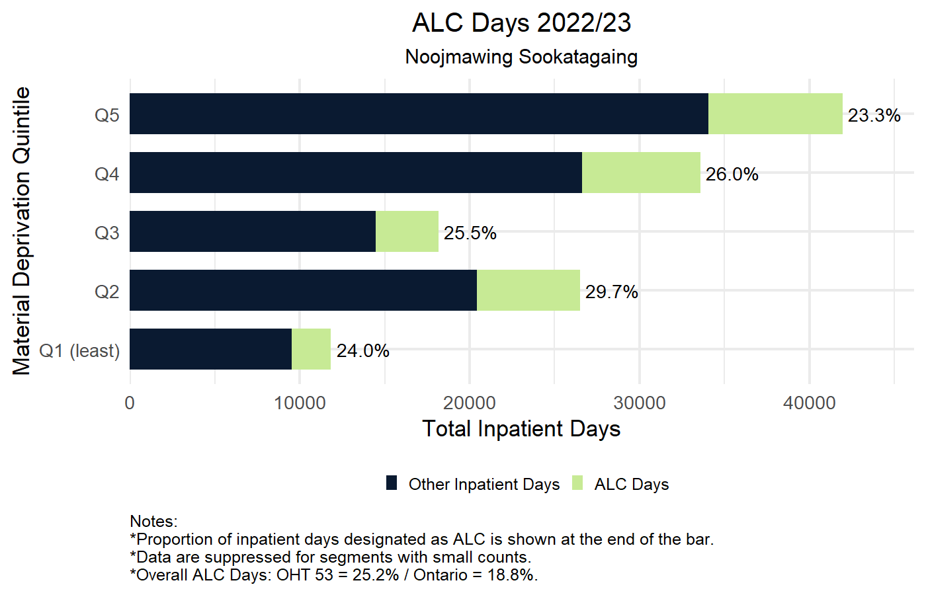
2022/23 ALC Days (percent of acute days) in acute hospitals
by Material Deprivation Quintile
Horizontal axis presents total inpatient days:
Bright green indicates ALC days;
Dark blue represents non-ALC inpatient days;
Percentage to the right is the proportion of inpatient days designated as ALC.
OHT and Ontario average indicated in figure footnote.
Blank rows represent segments
with no events, small counts < 5,
or with < 30 patients in denominator.

Slide 40
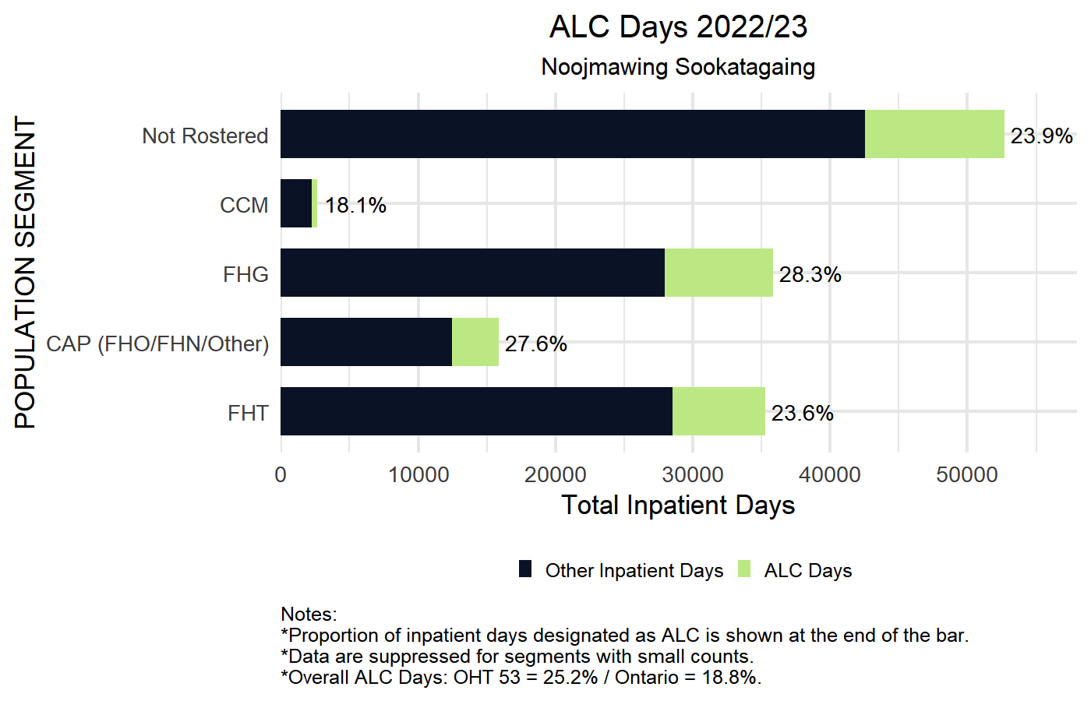
2022/23 ALC Days (percent of acute days) in acute hospitals
by Primary Care Model
Horizontal axis presents total inpatient days:
Bright green indicates ALC days;
Dark blue represents non-ALC inpatient days;
Percentage to the right is the proportion of inpatient days designated as ALC.
OHT and Ontario average indicated in figure footnote.
Blank rows represent segments
with no events, small counts < 5,
or with < 30 patients in denominator.

Slide 41
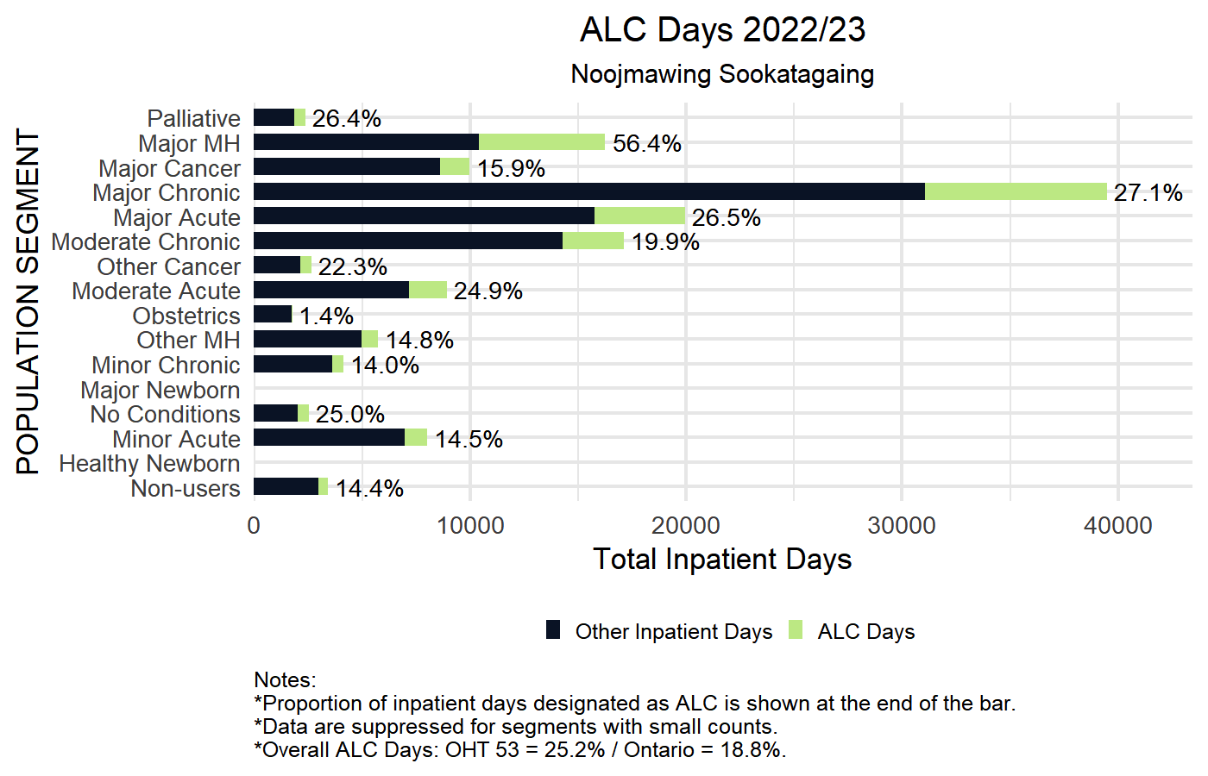
2022/23 ALC Days (percent of acute days) in acute hospitals
by CIHI Population Grouping Methodology
Horizontal axis presents total inpatient days:
Bright green indicates ALC days;
Dark blue represents non-ALC inpatient days;
Percentage to the right is the proportion of inpatient days designated as ALC.
OHT and Ontario average indicated in figure footnote.
Blank rows represent segments
with no events, small counts < 5,
or with < 30 patients in denominator.

Slide 42
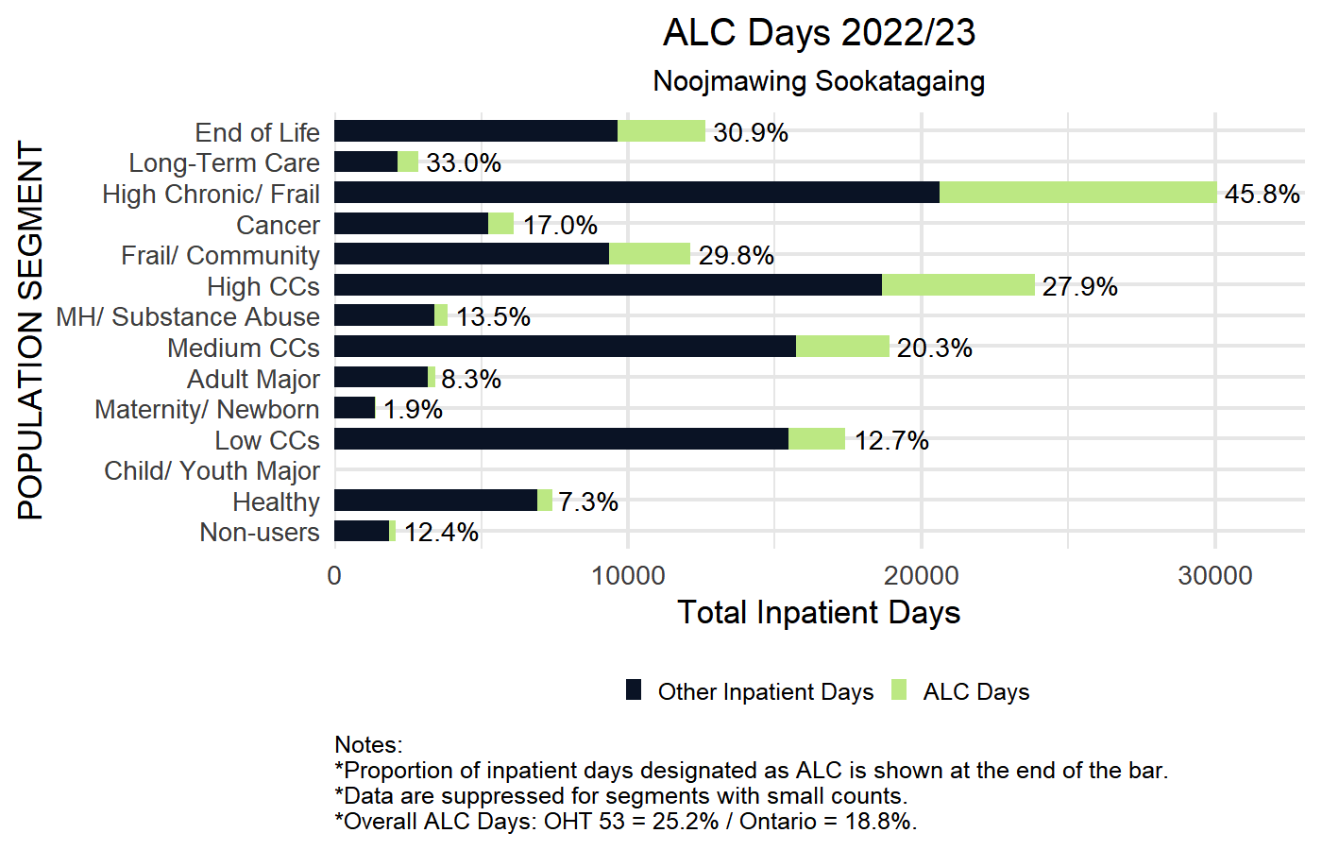
2022/23 ALC Days (percent of acute days) in acute hospitals
by BC Matrix Segment
Horizontal axis presents total inpatient days:
Bright green indicates ALC days;
Dark blue represents non-ALC inpatient days;
Percentage to the right is the proportion of inpatient days designated as ALC.
OHT and Ontario average indicated in figure footnote.
Blank rows represent segments
with no events, small counts < 5,
or with < 30 patients in denominator.

Slide 43
Cervical Cancer Screening with Papanicolaou Test
DEFINITION | Quadruple Aim
Proportion of screen eligible patients (women 23-69 years of age) up to date with Papanicolaou (Pap) tests ) | Patient Experience (access)
In this graph, the horizontal axis measures the total number of individuals who are eligible to have cervical cancer screening in your OHT attributable population and the colours represent how many of these individuals are, and are not, up to date with their Pap test.
Sample Interpretation: 48% of patients in the most deprived communities (Q5) were up to date with their cervical cancer screening. Higher values are preferred and support early detection and better survival amongst women diagnosed with cervical cancer.

Slide 44
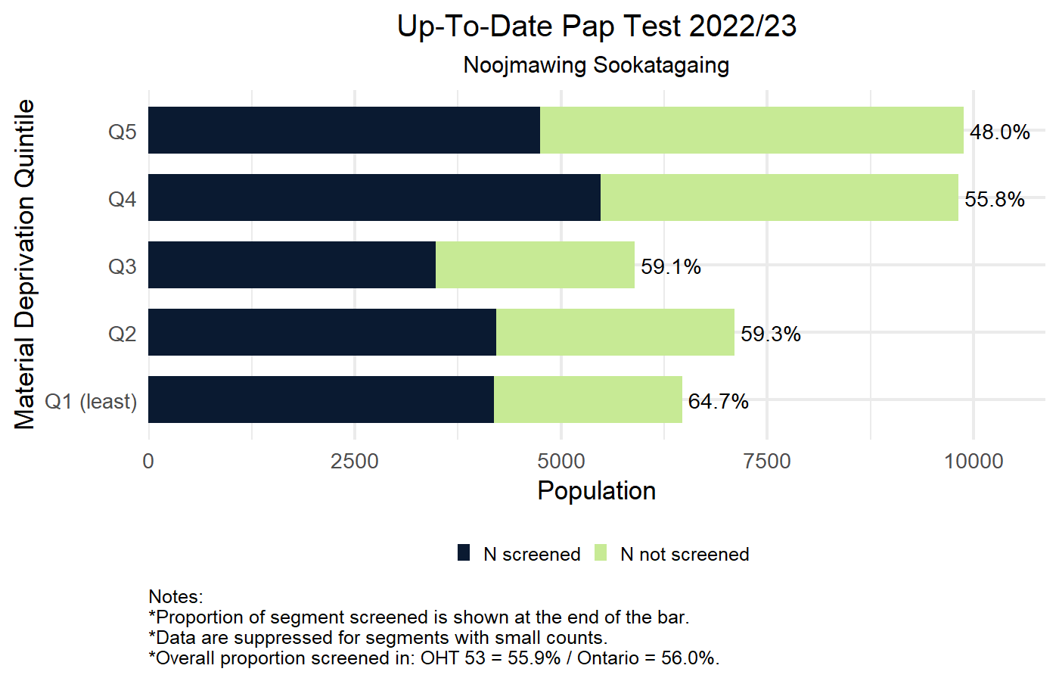
Percentage of screen-eligible patients (women 23-69 yrs of age) up to date with Papanicolaou (Pap) tests on March 31, 2023 by Material Deprivation Quintile
Horizontal axis shows the number of women 23-69 years
Bright green indicates number of women not screened;
Dark blue represents number of women screened;
Percentage to the right is the proportion of each segment screened.
OHT and Ontario average indicated in figure footnote.
Blank rows represent segments
with no events, small counts < 5,
or with < 30 patients in denominator.

Slide 45
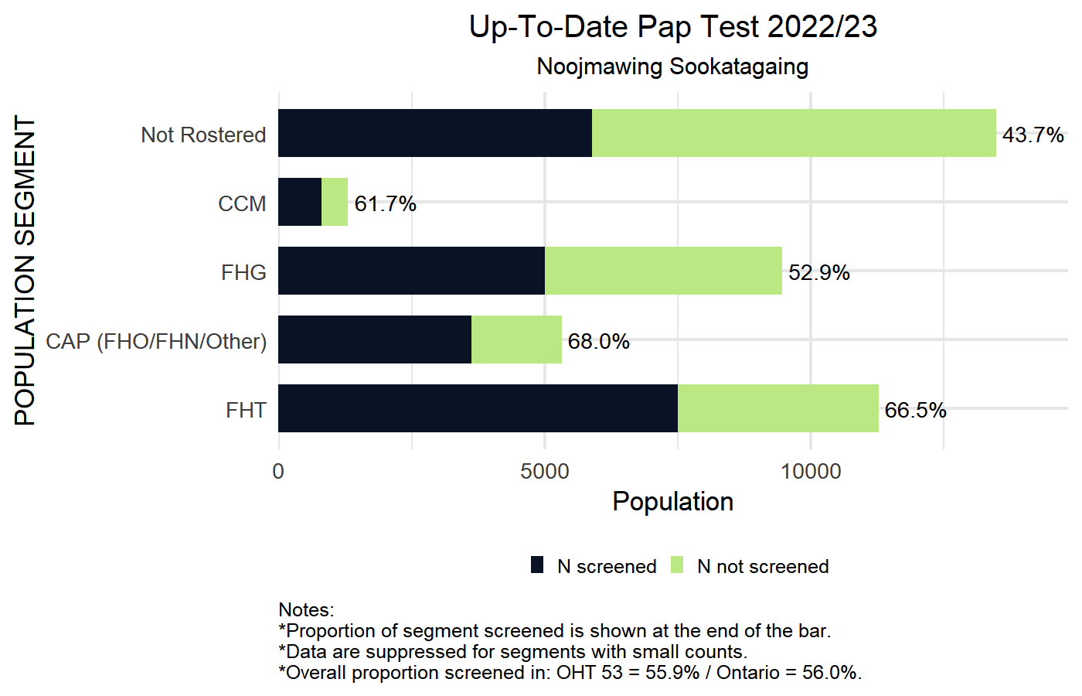
Percentage of screen-eligible patients (women 23-69 yrs of age) up to date with Papanicolaou (Pap) tests on March 31, 2023 by Primary Care Model
Horizontal axis shows the number of women 23-69 years
Bright green indicates number of women not screened;
Dark blue represents number of women screened;
Percentage to the right is the proportion of each segment screened.
OHT and Ontario average indicated in figure footnote.
Blank rows represent segments
with no events, small counts < 5,
or with < 30 patients in denominator.

Slide 46
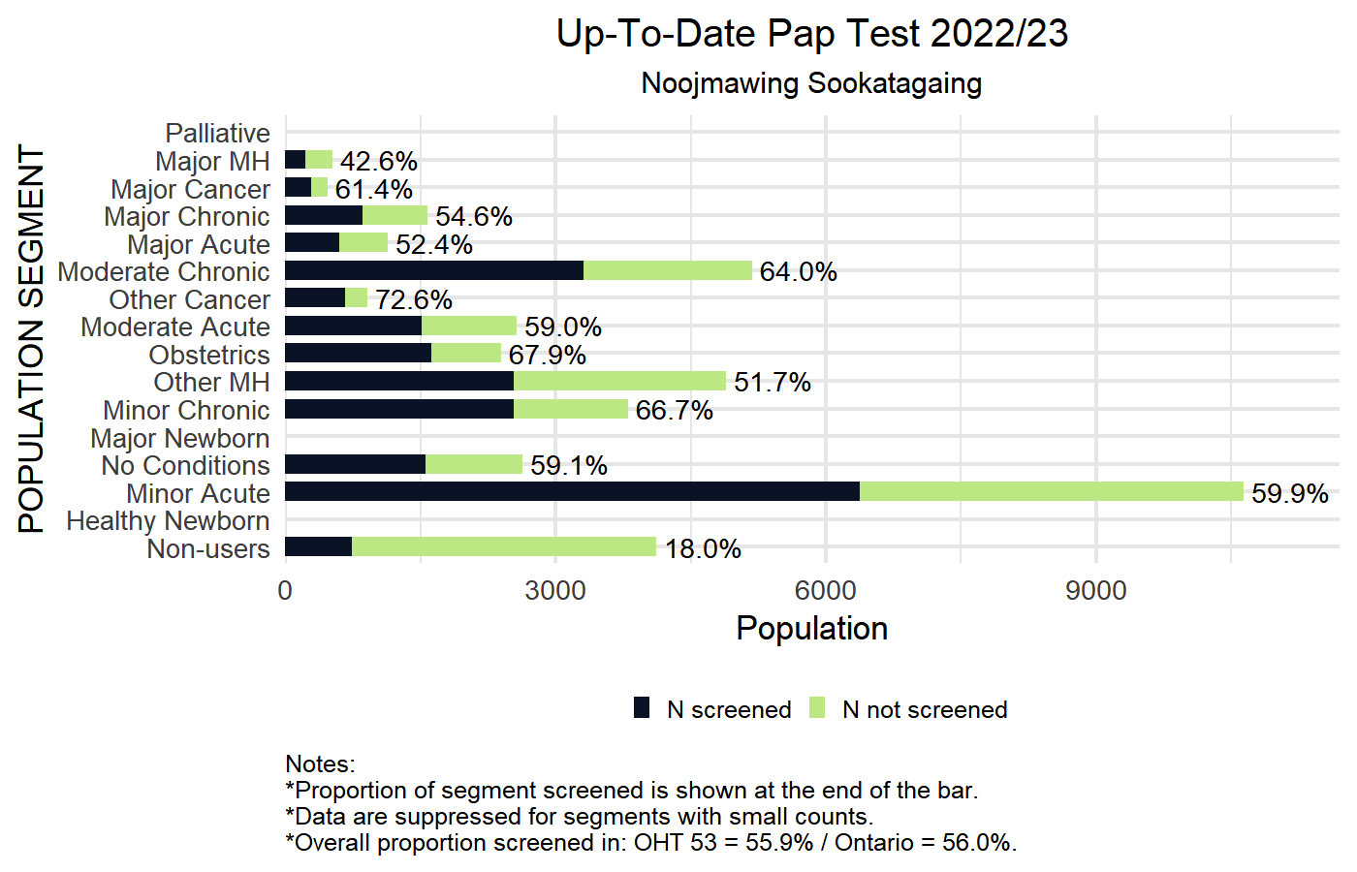
Percentage of screen-eligible patients (women 23-69 yrs of age) up to date with Papanicolaou (Pap) tests on March 31, 2023 by CIHI Population Grouping Methodology
Horizontal axis shows the number of women 23-69 years
Bright green indicates number of women not screened;
Dark blue represents number of women screened;
Percentage to the right is the proportion of each segment screened.
OHT and Ontario average indicated in figure footnote.
Blank rows represent segments
with no events, small counts < 5,
or with < 30 patients in denominator.

Slide 47
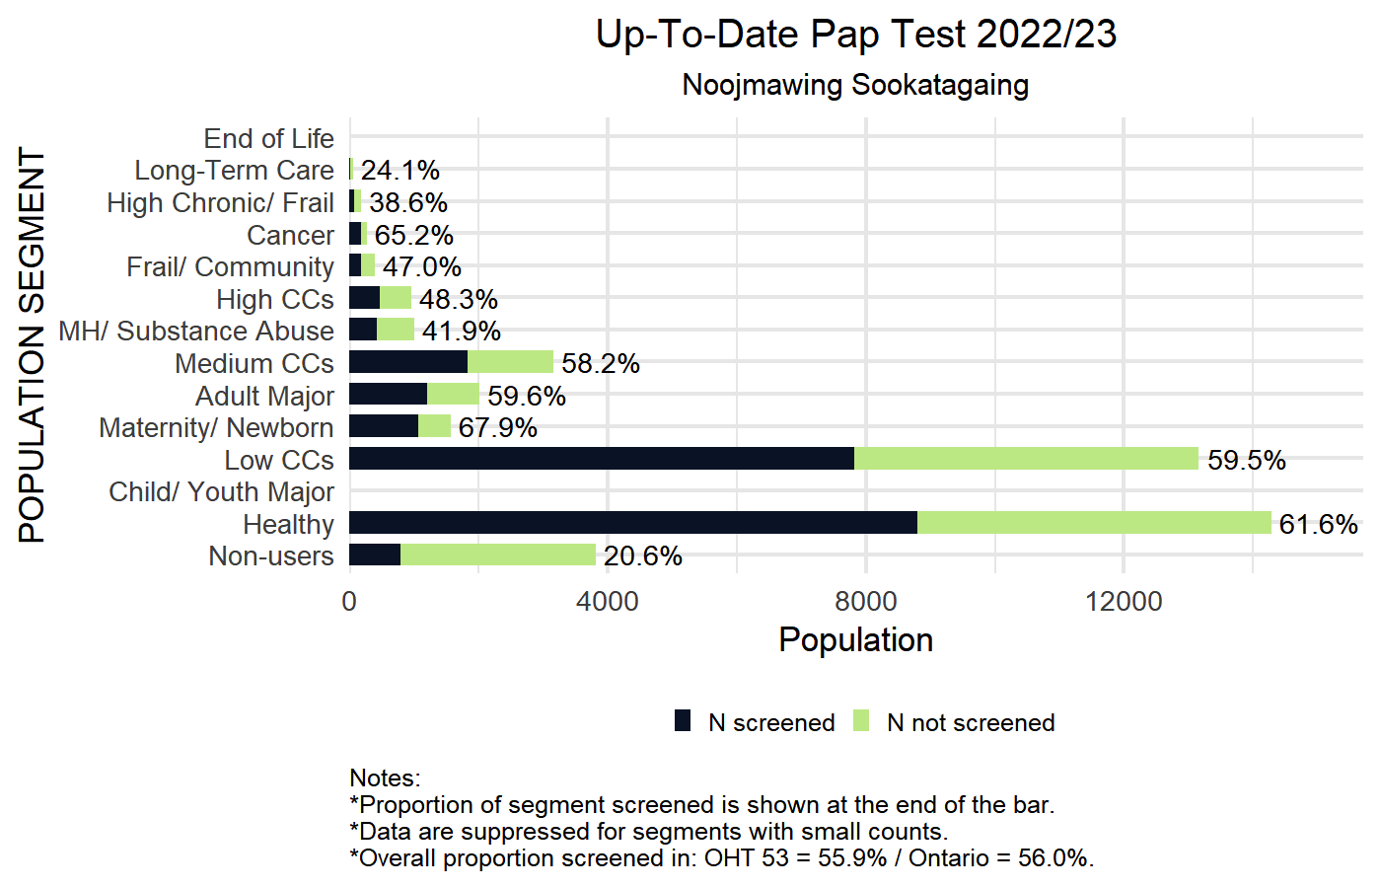
Percentage of screen-eligible patients (women 23-69 yrs of age) up to date with Papanicolaou (Pap) tests on March 31, 2023 by BC Matrix Segment
Horizontal axis shows the number of women 23-69 years
Bright green indicates number of women not screened;
Dark blue represents number of women screened;
Percentage to the right is the proportion of each segment screened.
OHT and Ontario average indicated in figure footnote.
Blank rows represent segments
with no events, small counts < 5,
or with < 30 patients in denominator.

Slide 48
Breast Cancer Screening with Mammogram
DEFINITION | Quadruple Aim
Proportion of screen-eligible patients (women 52-69 years of age) up to date with a Mammogram | Patient Experience (access)
In this graph, the horizontal axis measures the total number of individuals who are eligible to have breast cancer screening in your OHT attributable population and the colours represent how many of these individuals are, and are not, up to date with their Mammogram screening.
Sample Interpretation: 56.2% of patients in the most deprived communities (Q5) were up to date with their Mammogram screening. Higher values are preferred and support early detection and better survival amongst women diagnosed with breast cancer.

Slide 49
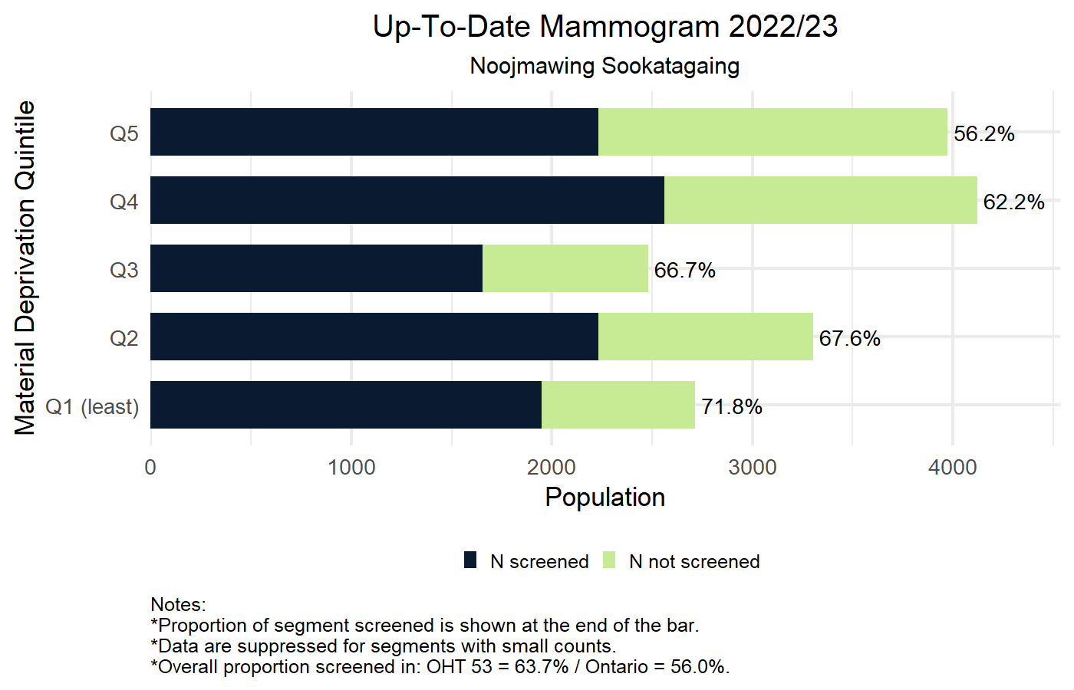
Percentage of screen-eligible patients (women 52-69 years of age) up to date with a Mammogram on March 31, 2023 by Material Deprivation Quintile
Horizontal axis shows the number of women 52-69 years:
Bright green indicates number of women not screened;
Dark blue represents number of women screened;
Percentage to the right is the proportion of each segment screened.
OHT and Ontario average indicated in figure footnote.
Blank rows represent segments
with no events, small counts < 5,
or with < 30 patients in denominator.

Slide 50
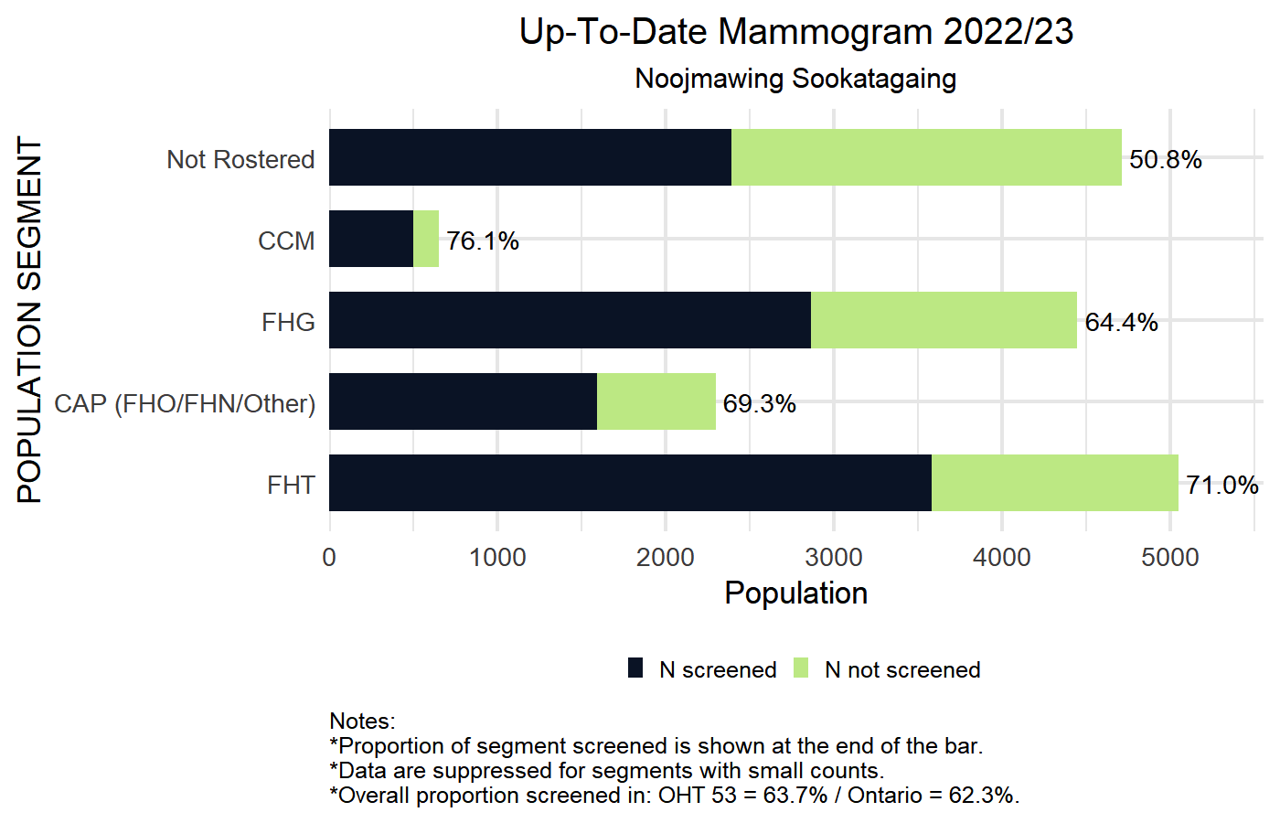
Percentage of screen-eligible patients (women 52-69 years of age) up to date with a Mammogram on March 31, 2023 by Primary Care Model
Horizontal axis shows the number of women 52-69 years:
Bright green indicates number of women not screened;
Dark blue represents number of women screened;
Percentage to the right is the proportion of each segment screened.
OHT and Ontario average indicated in figure footnote.
Blank rows represent segments
with no events, small counts < 5,
or with < 30 patients in denominator.

Slide 51
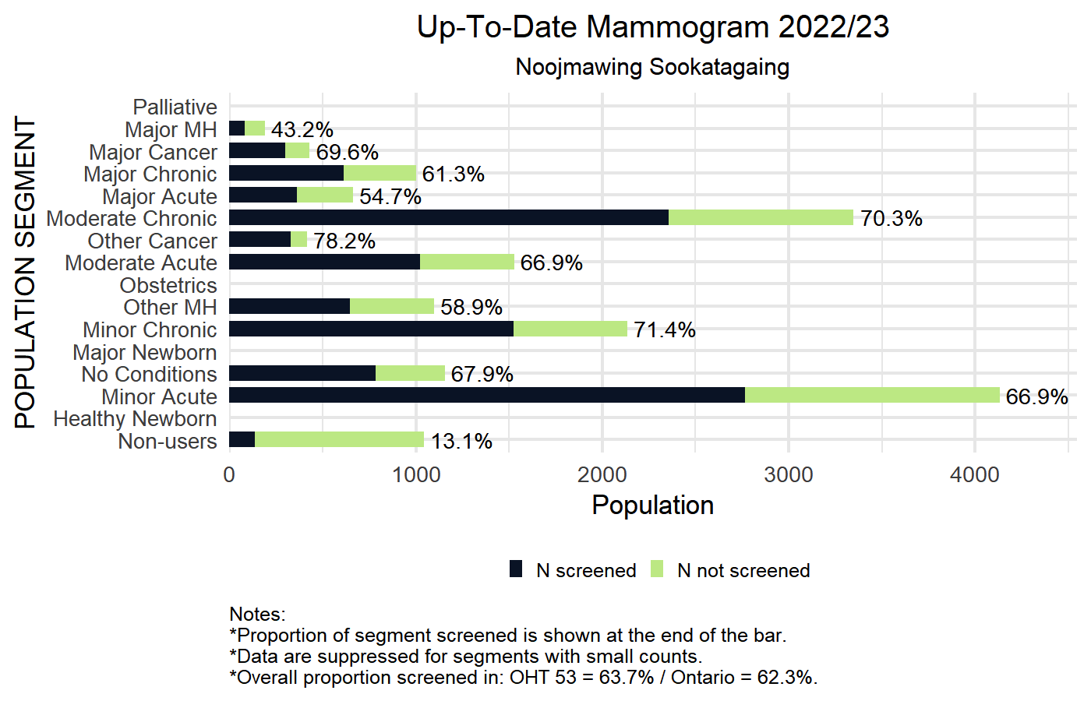
Percentage of screen-eligible patients (women 52-69 years of age) up to date with a Mammogram on March 31, 2023 by CIHI Population Grouping Methodology
Horizontal axis shows the number of women 52-69 years:
Bright green indicates number of women not screened;
Dark blue represents number of women screened;
Percentage to the right is the proportion of each segment screened.
OHT and Ontario average indicated in figure footnote.
Blank rows represent segments
with no events, small counts < 5,
or with < 30 patients in denominator.

Slide 52
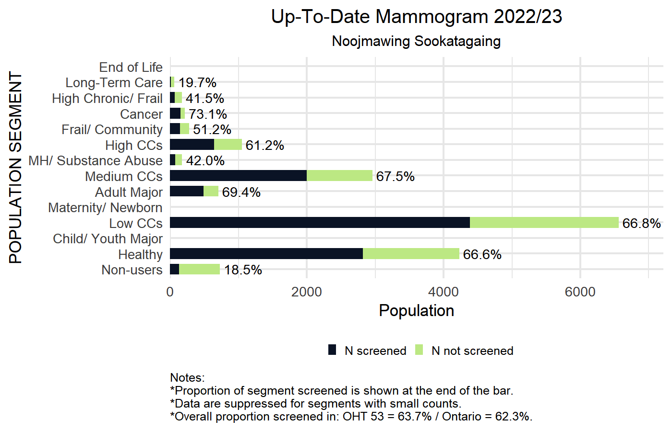
Percentage of screen-eligible patients (women 52-69 years of age) up to date with a Mammogram on March 31, 2023 by BC Matrix Segment
Horizontal axis shows the number of women 52-69 years:
Bright green indicates number of women not screened;
Dark blue represents number of women screened;
Percentage to the right is the proportion of each segment screened.
OHT and Ontario average indicated in figure footnote.
Blank rows represent segments
with no events, small counts < 5,
or with < 30 patients in denominator.

Slide 53
Frequent (4+) emergency department visits for help with MHA
DEFINITION | Quadruple Aim
Proportion of individuals with an unscheduled emergency department visit that had 4 or more emergency department visits for an MHA reason within a 365-day period | Patient Experience (Timely Access) & Cost/Efficiency
In this graph, the horizontal axis counts the total number of individuals in your OHT attributed population who were admitted to ED for an MHA-related reason. The colours represent how many had less than 4 or at least 4 or more ED visits for an MHA-related reason.
Sample Interpretation: 19.2% of patients in the most deprived communities (Q5) had 4 or more unscheduled ED visits related to MHA. Lower values are preferred and indicate that people with mental health and addictions are able to access care in the community.

Slide 54
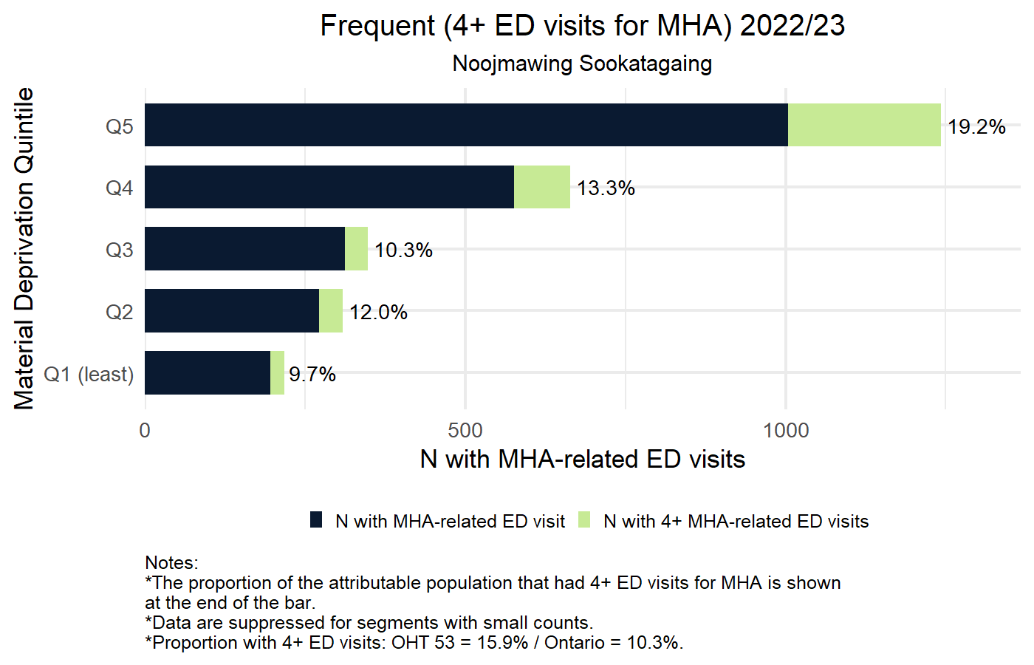
2022/23 Number of patients with Frequent (4+) ED visits for MHA
by Material Deprivation Quintile
Horizontal axis presents number of patients with MHA-related ED visits.
Bright green indicates number of patients with 4 or more MHA-related ED visits;
Dark blue represents number of patients with at least one MHA-related ED visit;
Percentage to the right is the proportion of the attributable population that had 4+ ED visits within a year;
OHT and Ontario average indicated in figure footnote.
Blank rows represent segments
with no events, small counts < 5,
or with < 30 patients in denominator.

Slide 55
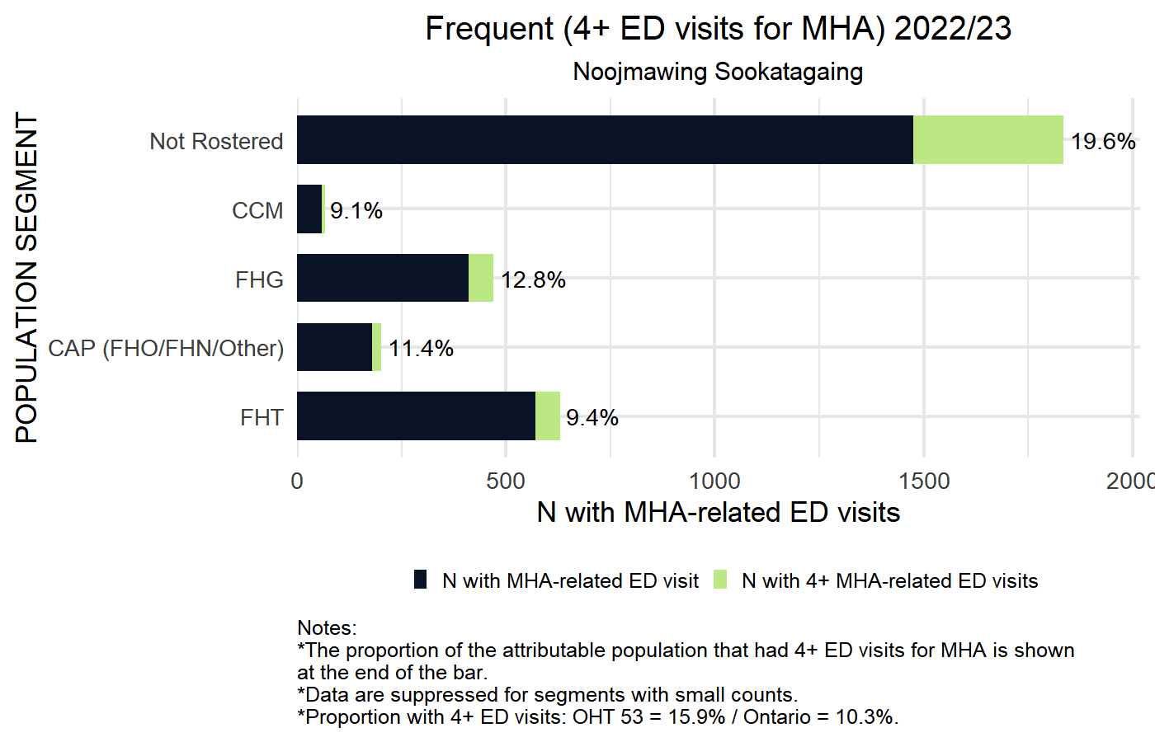
2022/23 Number of patients with Frequent (4+) ED visits for MHA
by Primary Care Model
Horizontal axis presents number of patients with MHA-related ED visits.
Bright green indicates number of patients with 4 or more MHA-related ED visits;
Dark blue represents number of patients with at least one MHA-related ED visit;
Percentage to the right is the proportion of the attributable population that had 4+ ED visits within a year;
OHT and Ontario average indicated in figure footnote.
Blank rows represent segments
with no events, small counts < 5,
or with < 30 patients in denominator.

Slide 56
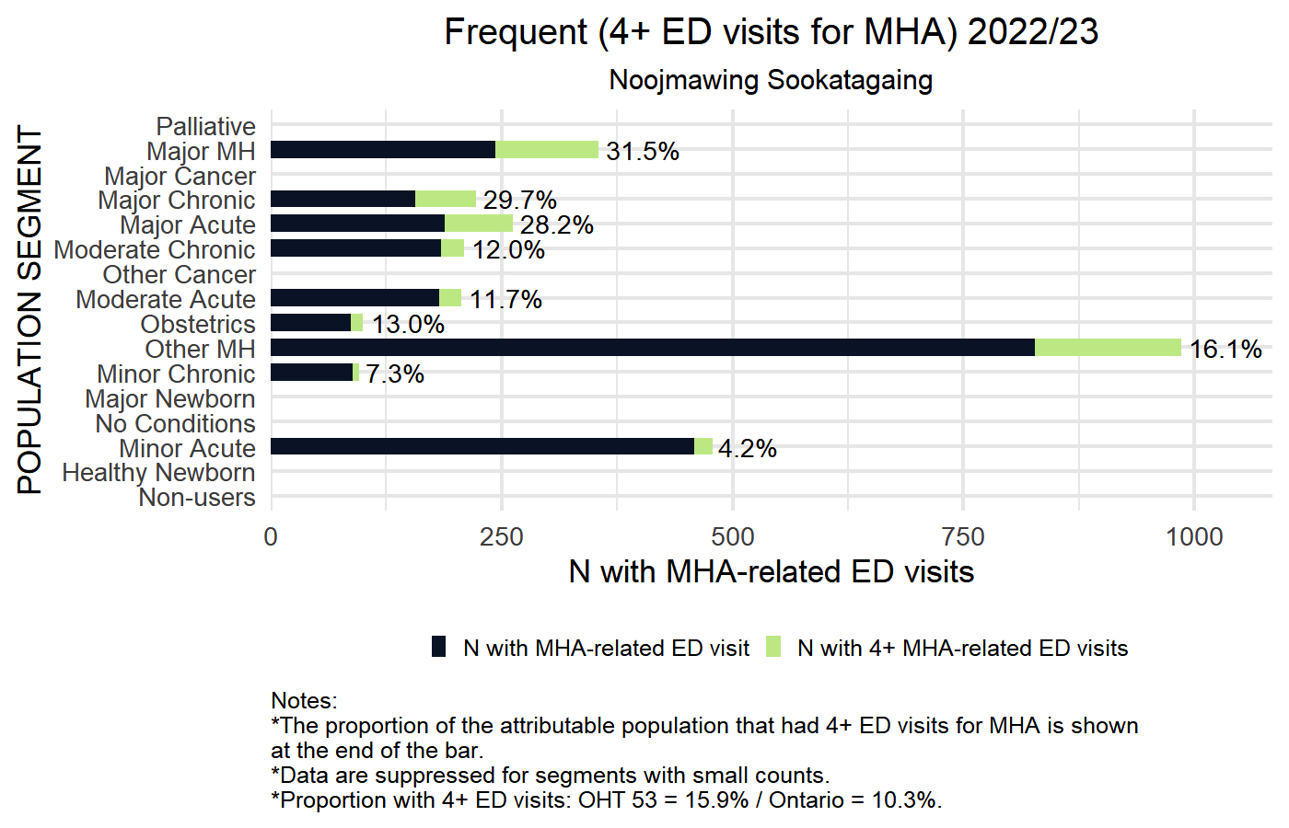
2022/23 Number of patients with Frequent (4+) ED visits for MHA
by CIHI Population Grouping Methodology
Horizontal axis presents number of patients with MHA-related ED visits.
Bright green indicates number of patients with 4 or more MHA-related ED visits;
Dark blue represents number of patients with at least one MHA-related ED visit;
Percentage to the right is the proportion of the attributable population that had 4+ ED visits within a year;
OHT and Ontario average indicated in figure footnote.
Blank rows represent segments
with no events, small counts < 5,
or with < 30 patients in denominator.

Slide 57
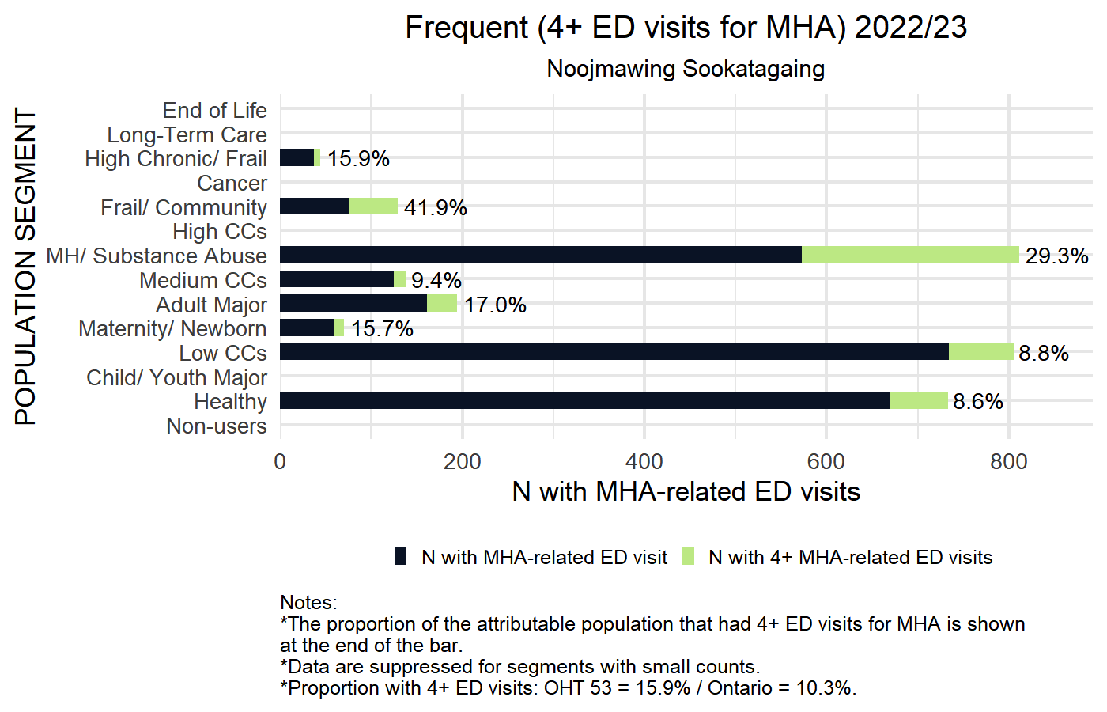
2022/23 Number of patients with Frequent (4+) ED visits for MHA
by BC Matrix Segment
Horizontal axis presents number of patients with MHA-related ED visits.
Bright green indicates number of patients with 4 or more MHA-related ED visits;
Dark blue represents number of patients with at least one MHA-related ED visit;
Percentage to the right is the proportion of the attributable population that had 4+ ED visits within a year;
OHT and Ontario average indicated in figure footnote.
Blank rows represent segments
with no events, small counts < 5,
or with < 30 patients in denominator.

Slide 58
Repeat emergency visits for MHA (within 30 days)
DEFINITION | Quadruple Aim
Proportion of unscheduled emergency department visits for care for MH conditions with a second unscheduled emergency department visit for MH or substance abuse within 30 days | Patient Experience (Health Service Use)
In this graph, the horizontal axis counts the total number of individuals in your OHT attributed population who were discharged from an ED with an MHA-related reason. The colours represent how many did and did not return to the ED for an MHA-related reason within 30 days.
Sample Interpretation: Amongst individuals living in the neighbourhoods with the highest material deprivation who present to ED with an MHA concern, 32.1% had a repeat ED visit for MH or substance abuse within 30 days. Lower values for this indicator are preferred and indicate that good follow-up care was provided for an individual after their first presentation.

Slide 59
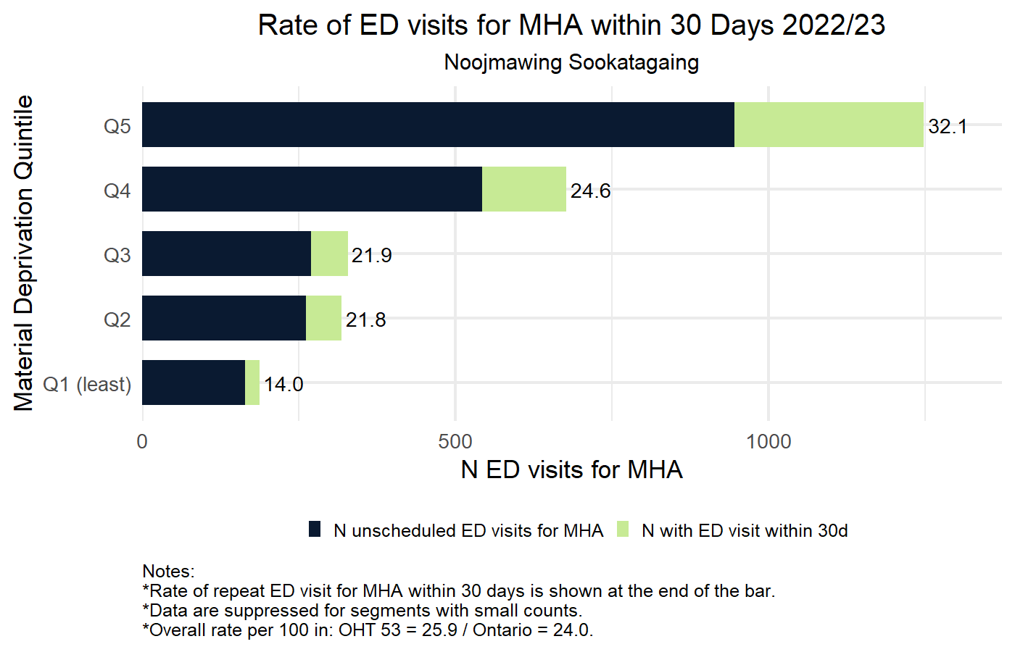
2022/23 Rate of ED visit for MHA within 30 days by Material Deprivation Quintile
Horizontal axis shows the number of ED visits for MHA:
Bright green indicates number of ED visits within 30 days
Dark blue represents the number of ED visits for MHA
Number to the right is the rate of repeat ED visits in the attributable population
Blank rows represent segments
with no events, small counts < 5,
or with < 30 patients in denominator.

Slide 60
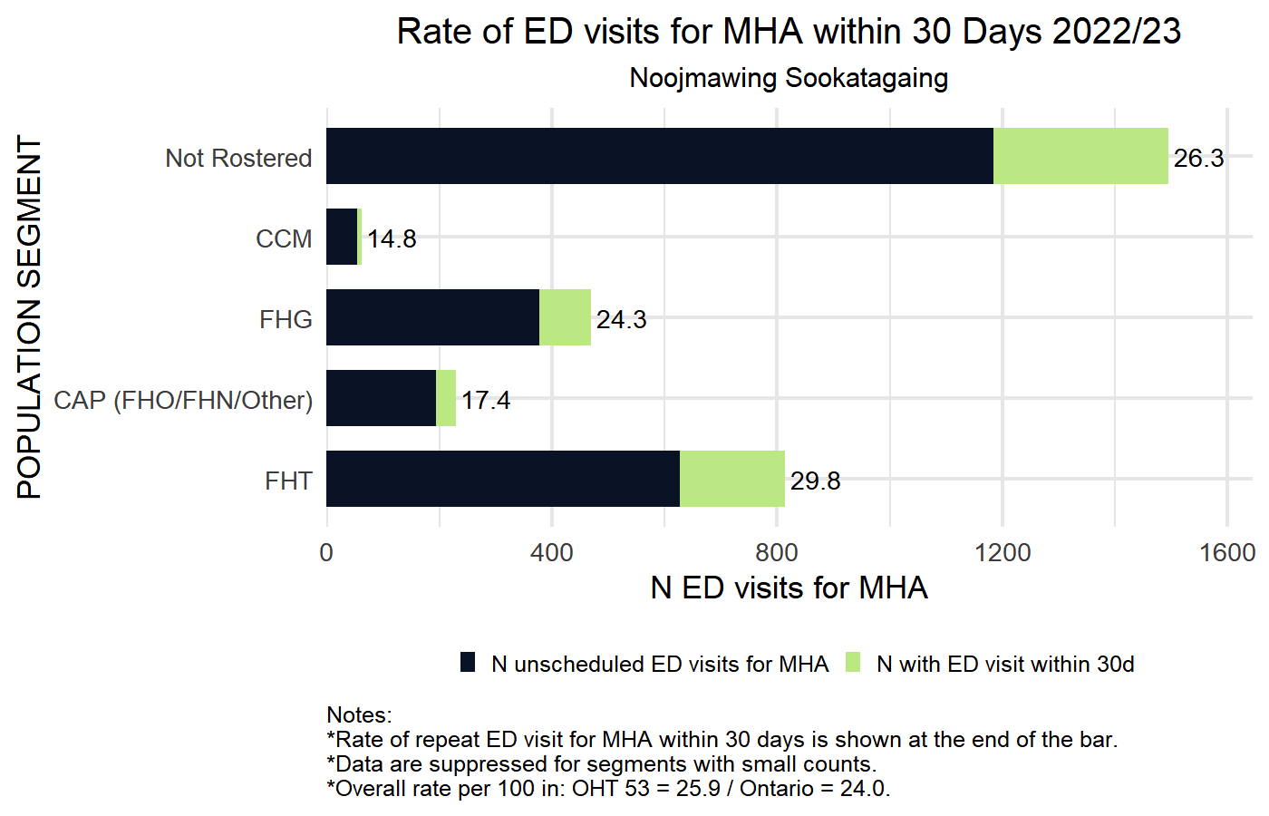
2022/23 Rate of ED visit for MHA within 30 days by Primary Care Model
Horizontal axis shows the number of ED visits for MHA:
Bright green indicates number of ED visits within 30 days
Dark blue represents the number of ED visits for MHA
Number to the right is the rate of repeat ED visits in the attributable population
Blank rows represent segments
with no events, small counts < 5,
or with < 30 patients in denominator.

Slide 61
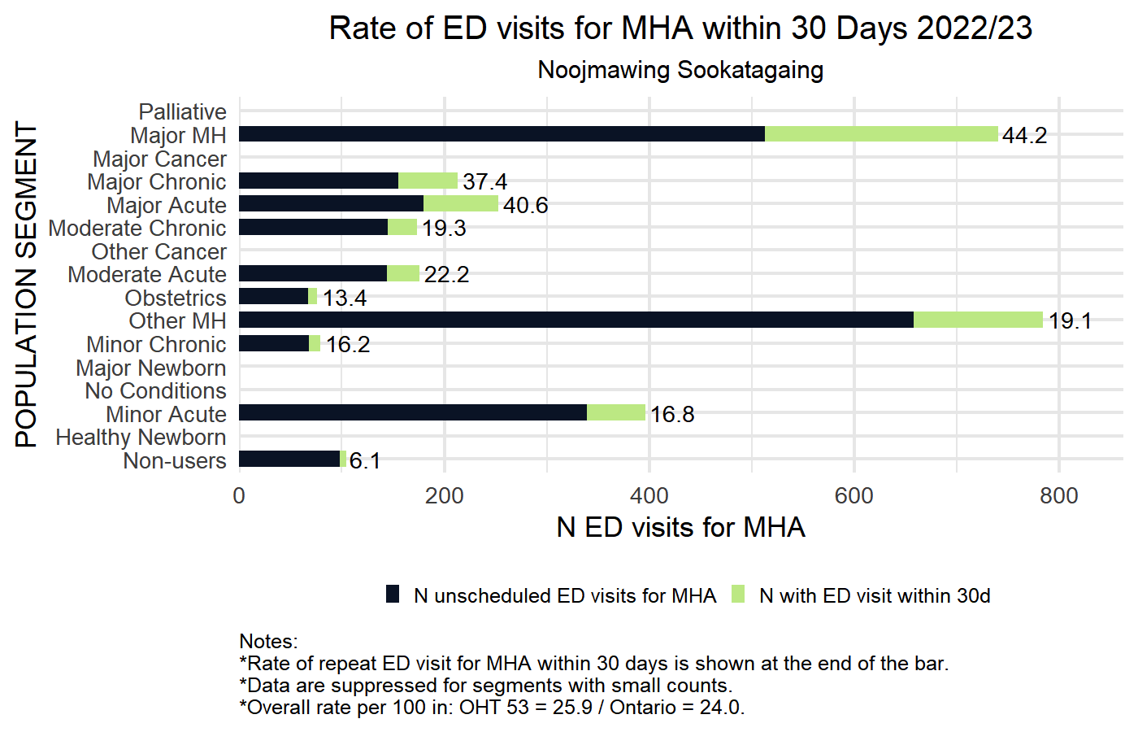
2022/23 Rate of ED visit for MHA within 30 days by CIHI Population Grouping Methodology
Horizontal axis shows the number of ED visits for MHA:
Bright green indicates number of ED visits within 30 days
Dark blue represents the number of ED visits for MHA
Number to the right is the rate of repeat ED visits in the attributable population
Blank rows represent segments
with no events, small counts < 5,
or with < 30 patients in denominator.

Slide 62
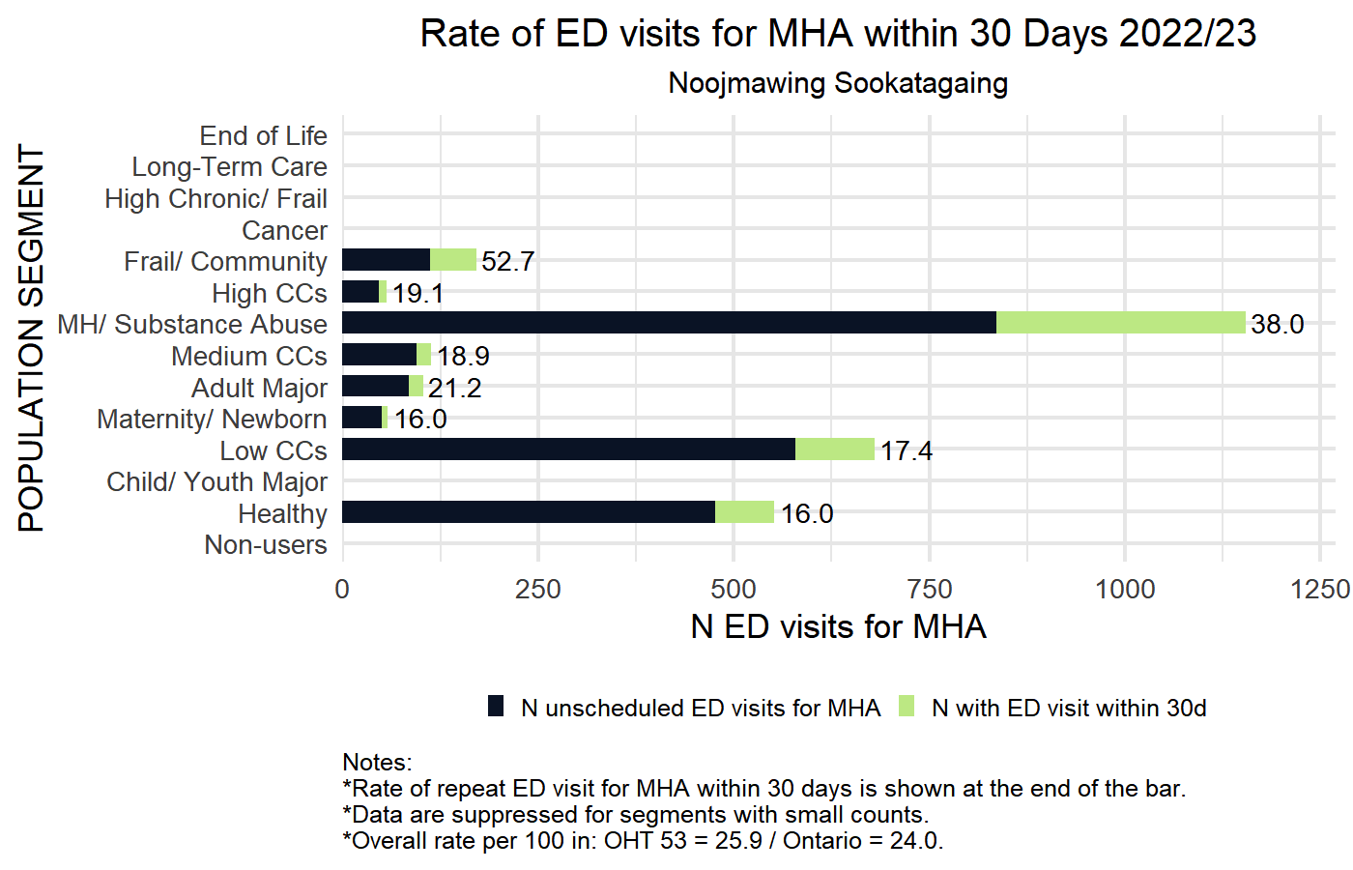
2022/23 Rate of ED visit for MHA within 30 days by BC Matrix Segment
Horizontal axis shows the number of ED visits for MHA:
Bright green indicates number of ED visits within 30 days
Dark blue represents the number of ED visits for MHA
Number to the right is the rate of repeat ED visits in the attributable population
Blank rows represent segments
with no events, small counts < 5,
or with < 30 patients in denominator.

Slide 63
First contact in the emergency department for MHA
DEFINITION | Quadruple Aim
Proportion of incident unscheduled emergency department visits for MHA-care where the patient had no prior MHA-related contact (hospitalization, emergency department or physician visit) | Patient Experience (Timely) Cost/Efficiency
In this graph, the horizontal axis counts the total number of individuals in your OHT attributed population who were admitted to ED for an MHA-related reason. The colours represent how many had already been identified as having an MHA condition versus those presenting for the first time.
Sample Interpretation: Amongst individuals who lived in the most deprived neighbourhoods (Q5 deprivation) and presented to the emergency department for an MHA concern, 32% were presenting for the first time to the health system with an MHA concern. Generally lower values are preferred indicating that people with MHA concerns are identified in the community prior to an urgent care event.

Slide 64
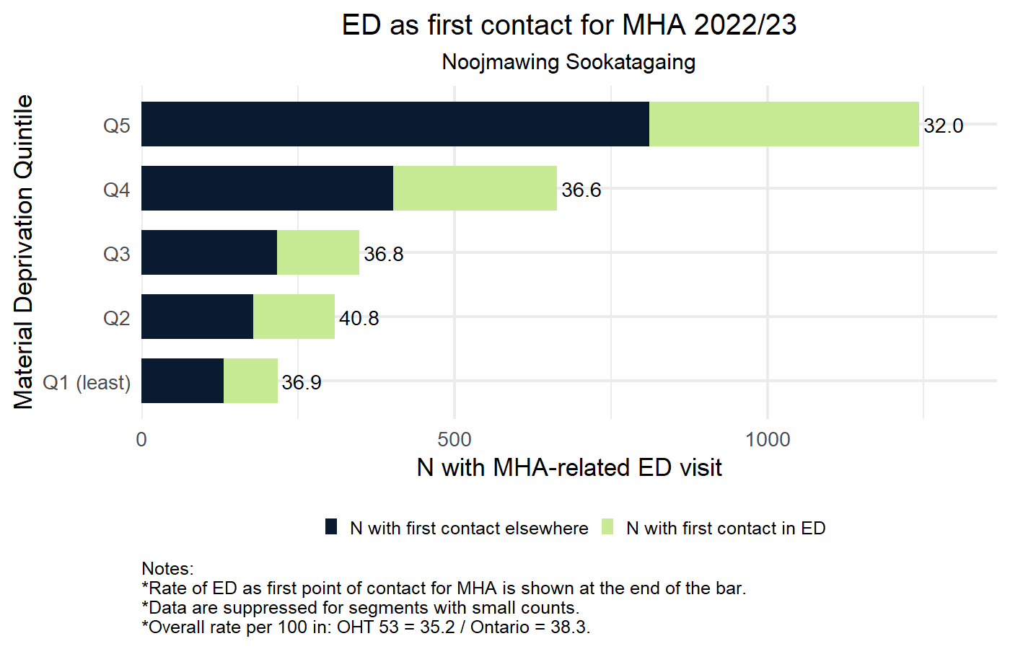
2022/23 Rate of Emergency Department visits as first point of contact for Mental Health and Addictions-related care by Material Deprivation Quintile
Horizontal axis shows the total number of individuals with Mental-Health and Addictions-related ED visit
Bright green indicates number of individuals for whom first contact for MHA was at an ED;
Dark blue represents number of individuals with previous contact for MHA;
Number to the right is the rate of each segment with ED as first point of contact for MHA.
OHT and Ontario average indicated in figure footnote.
Blank rows represent segments
with no events, small counts < 5,
or with < 30 patients in denominator.

Slide 65
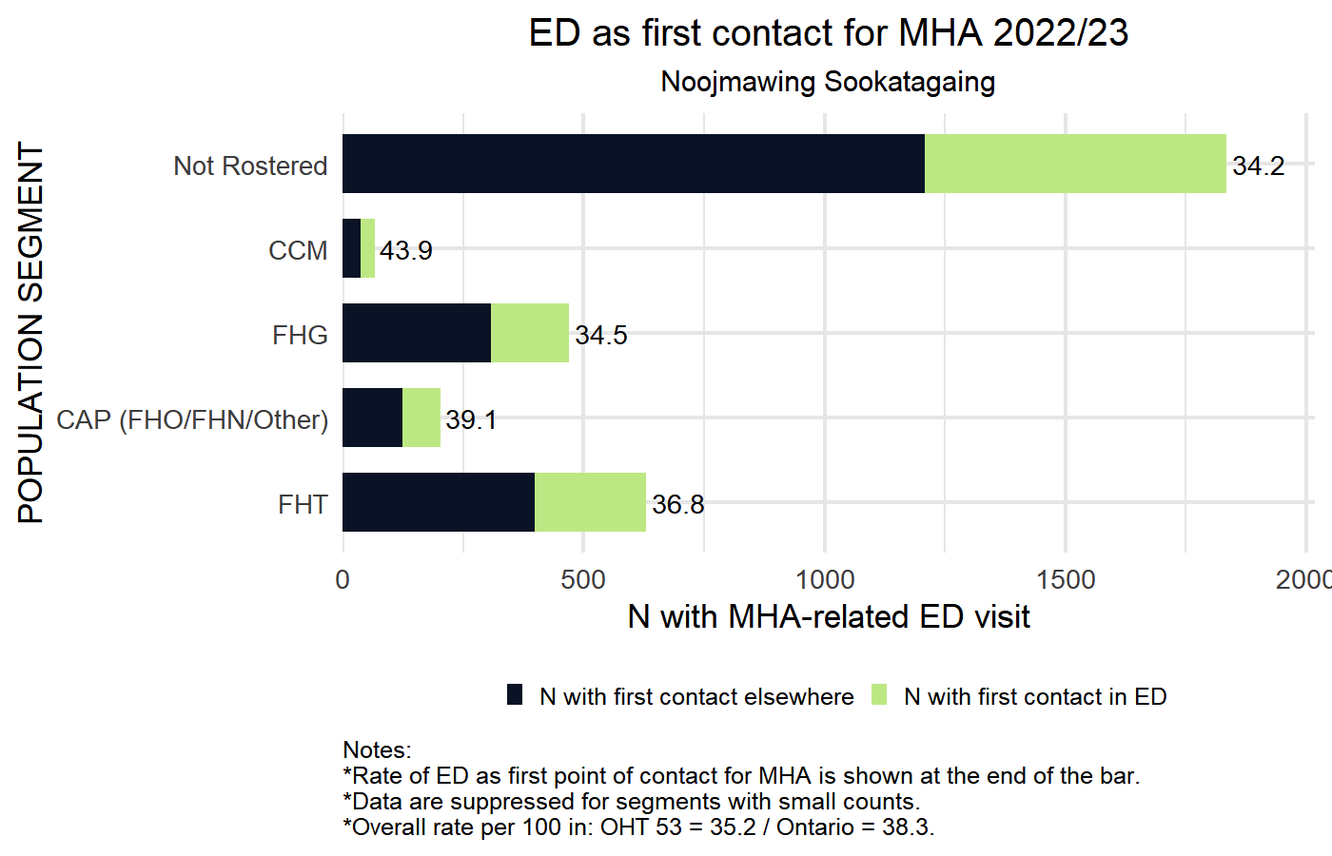
2022/23 Rate of Emergency Department visits as first point of contact for Mental Health and Addictions-related care by Primary Care Model
Horizontal axis shows the total number of individuals with Mental-Health and Addictions-related ED visit
Bright green indicates number of individuals for whom first contact for MHA was at an ED;
Dark blue represents number of individuals with previous contact for MHA;
Number to the right is the rate of each segment with ED as first point of contact for MHA.
OHT and Ontario average indicated in figure footnote.
Blank rows represent segments
with no events, small counts < 5,
or with < 30 patients in denominator.

Slide 66
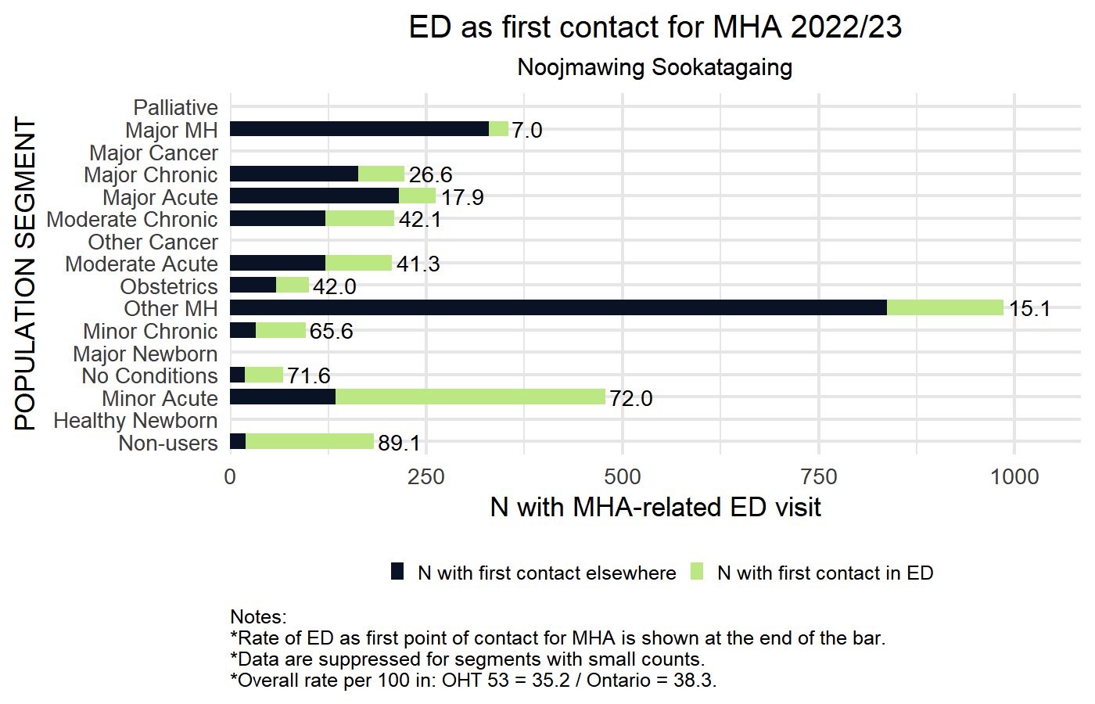
2022/23 Rate of Emergency Department visits as first point of contact for Mental Health and Addictions-related care by CIHI Population Grouping Methodology
Horizontal axis shows the total number of individuals with Mental-Health and Addictions-related ED visit
Bright green indicates number of individuals for whom first contact for MHA was at an ED;
Dark blue represents number of individuals with previous contact for MHA;
Number to the right is the rate of each segment with ED as first point of contact for MHA.
OHT and Ontario average indicated in figure footnote.
Blank rows represent segments
with no events, small counts < 5,
or with < 30 patients in denominator.

Slide 67
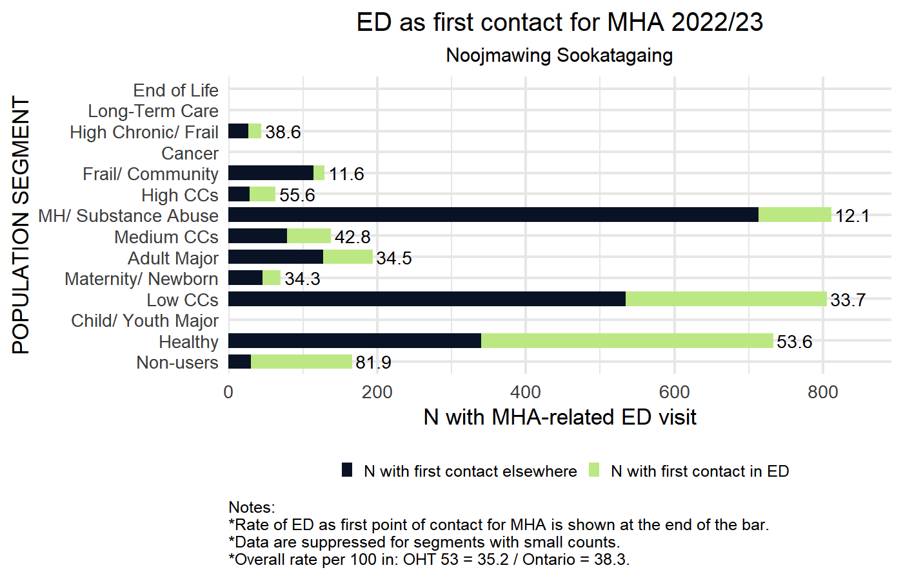
2022/23 Rate of Emergency Department visits as first point of contact for Mental Health and Addictions-related care by BC Matrix Segment
Horizontal axis shows the total number of individuals with Mental-Health and Addictions-related ED visit
Bright green indicates number of individuals for whom first contact for MHA was at an ED;
Dark blue represents number of individuals with previous contact for MHA;
Number to the right is the rate of each segment with ED as first point of contact for MHA.
OHT and Ontario average indicated in figure footnote.
Blank rows represent segments
with no events, small counts < 5,
or with < 30 patients in denominator.

Slide 68
Proportion of decedents receiving palliative home care in the last 90 days of life
DEFINITION | Quadruple Aim
The proportion of decedents that had one or more palliative home care services (excluding care management and placement services) in their last 90 days of life | Patient Experience (access) Health Outcome
In this graph, the horizontal axis counts the total number of individuals in your OHT attributed population who died within the observation year. The colours represent how many did and did not receive palliative home care visit in the last 30 days of life.
Sample Interpretation: 10% of patients (of the OHT attributed patients who died in the reporting period) in the most deprived communities (Q5) received homecare in the last 90 days of life. Higher values are preferred and indicate good community-based care near the end of life.

Slide 69
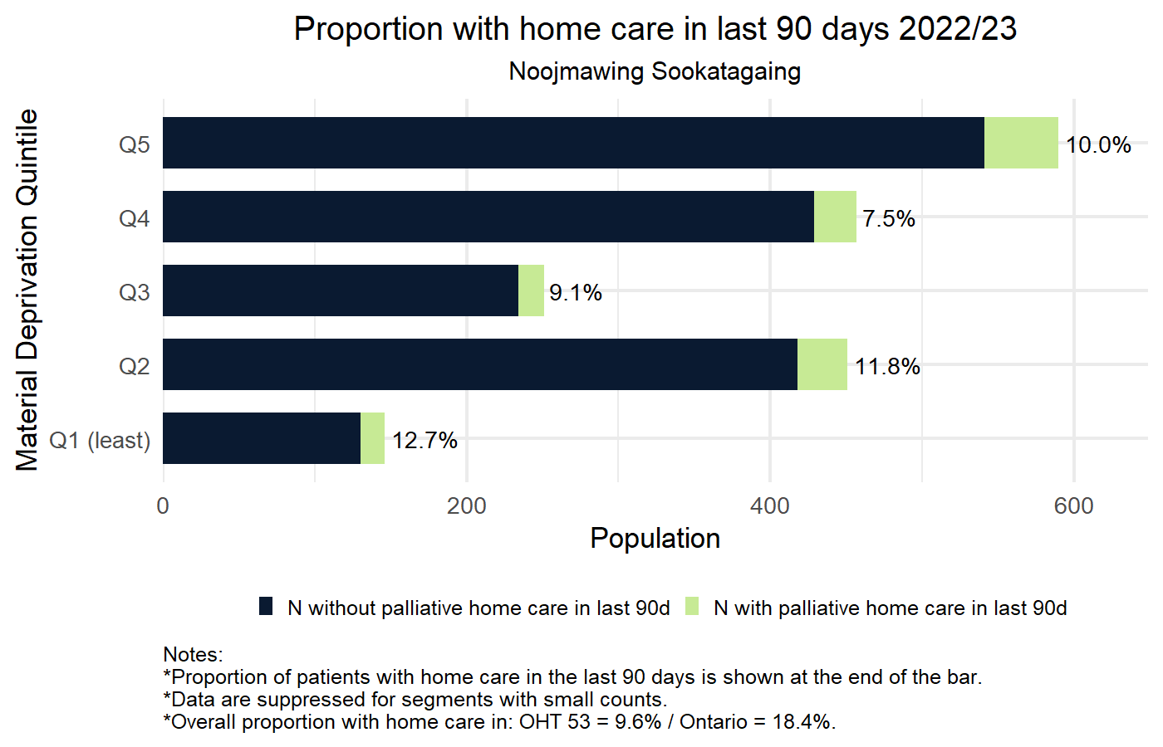
2022/23 Proportion of decedents with home care in last 90 days by Material Deprivation Quintile
Horizontal axis shows the number of OHT attributed patients that died in the reporting period.
Bright green indicates number of individuals that had one or more palliative home care services in their last 90 days of life.
Dark blue represents number of individuals without palliative care services.
Number to the right is the proportion of decedents that had one or more palliative home care service
OHT and Ontario average indicated in figure footnote.
Blank rows represent segments
with no events, small counts < 5,
or with < 30 patients in denominator.

Slide 70
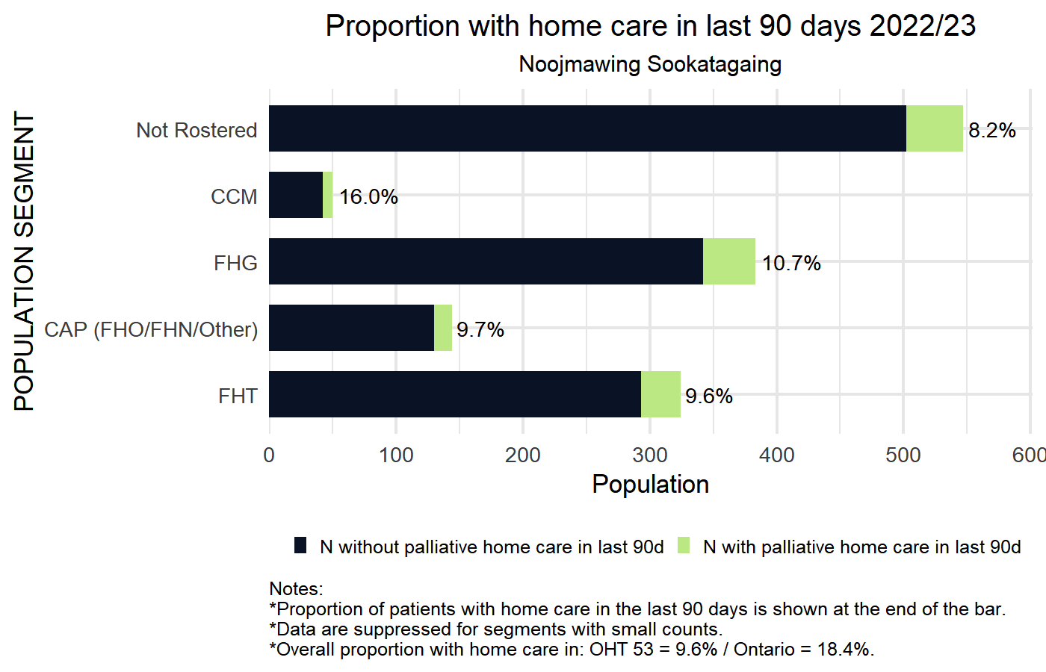
2022/23 Proportion of decedents with home care in last 90 days by Primary Care Model
Horizontal axis shows the number of OHT attributed patients that died in the reporting period.
Bright green indicates number of individuals that had one or more palliative home care services in their last 90 days of life.
Dark blue represents number of individuals without palliative care services.
Number to the right is the proportion of decedents that had one or more palliative home care service
OHT and Ontario average indicated in figure footnote.
Blank rows represent segments
with no events, small counts < 5,
or with < 30 patients in denominator.

Slide 71
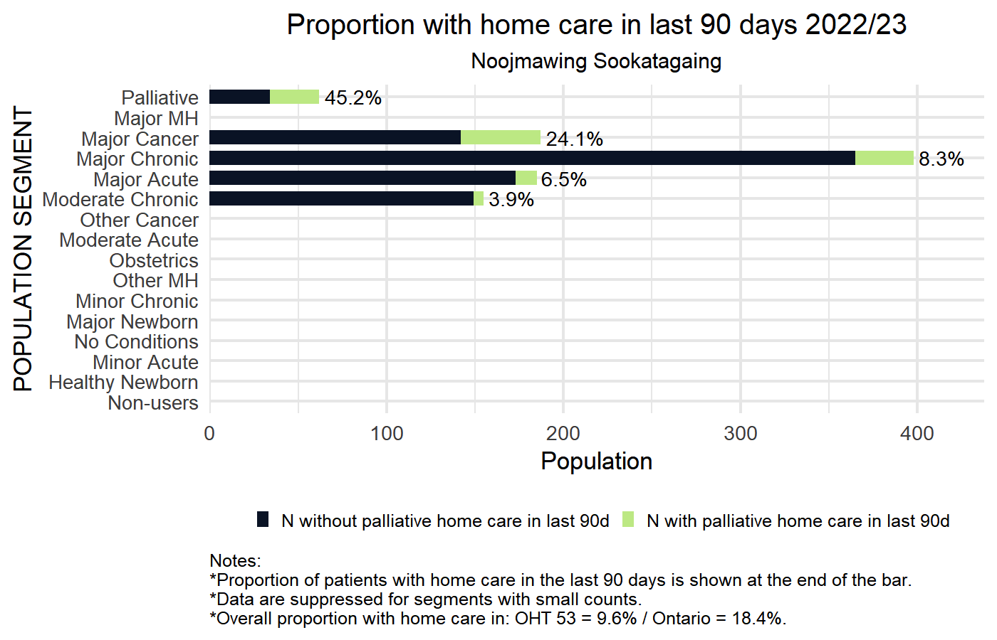
2022/23 Proportion of decedents with home care in last 90 days by CIHI Population Grouping Methodology
Horizontal axis shows the number of OHT attributed patients that died in the reporting period.
Bright green indicates number of individuals that had one or more palliative home care services in their last 90 days of life.
Dark blue represents number of individuals without palliative care services.
Number to the right is the proportion of decedents that had one or more palliative home care service
OHT and Ontario average indicated in figure footnote.
Blank rows represent segments
with no events, small counts < 5,
or with < 30 patients in denominator.

Slide 72
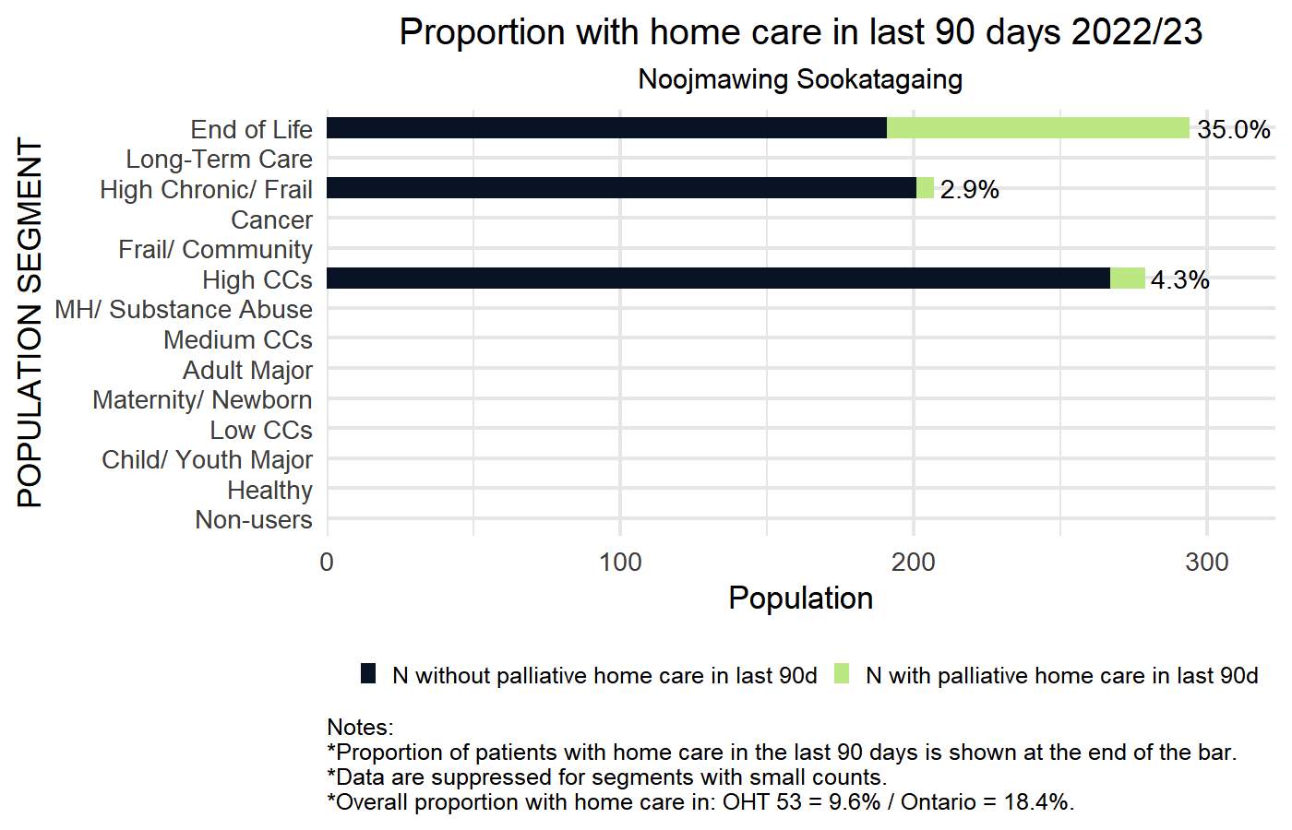
2022/23 Proportion of decedents with home care in last 90 days by BC Matrix Segment
Horizontal axis shows the number of OHT attributed patients that died in the reporting period.
Bright green indicates number of individuals that had one or more palliative home care services in their last 90 days of life.
Dark blue represents number of individuals without palliative care services.
Number to the right is the proportion of decedents that had one or more palliative home care service
OHT and Ontario average indicated in figure footnote.
Blank rows represent segments
with no events, small counts < 5,
or with < 30 patients in denominator.

Slide 73
Proportion of decedents with 1 or more emergency department visits in the last 30 days of life
DEFINITION | Quadruple Aim
The proportion of decedents that had one or more unplanned emergency department visits in their last 30 days of life | Patient Experience (access) & Cost/Efficiency
In this graph the horizontal axis counts the total number of individuals in your OHT attributed population who died within the observation year. The colours represent how many did and did not visit an emergency department in the last 30 days of life.
Sample Interpretation: 55% of patients (of the OHT attributed patients that died in the reporting period) in the most deprived communities (Q5) had one or more ED visit in their last 30 days of life. Lower values are preferred and indicate good care and symptom management for individuals near the end of life.

Slide 74
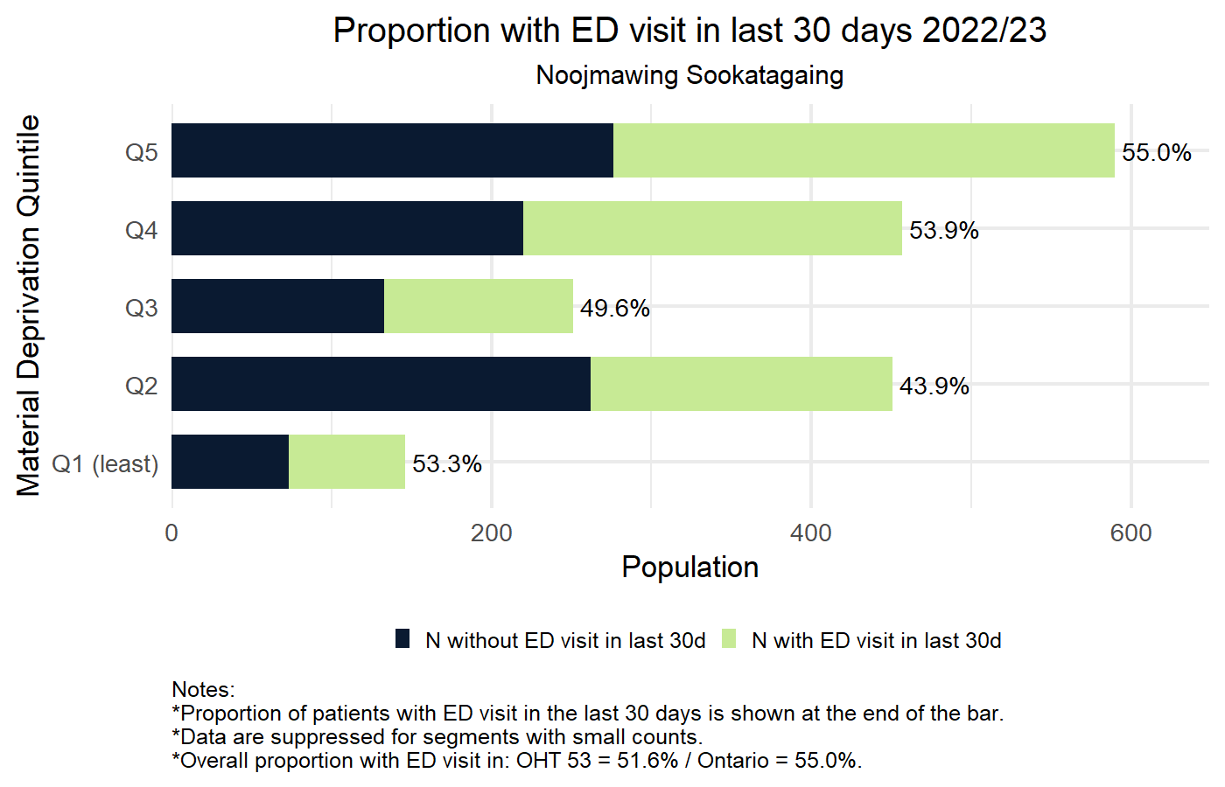
2022/23 Proportion of decedents with ED visit in last 30 days by Material Deprivation Quintile
Horizontal axis shows the number of OHT attributed patients that died in the reporting period.
Bright green indicates number of individuals that had one or more ED visit in their last 30 days of life.
Dark blue represents number of individuals without ED visit in their last 30 days of life.
Number to the right is the proportion of decedents that had one or more ED visit in their last 30 days.
OHT and Ontario average indicated in figure footnote.
Blank rows represent segments
with no events, small counts < 5,
or with < 30 patients in denominator.

Slide 75
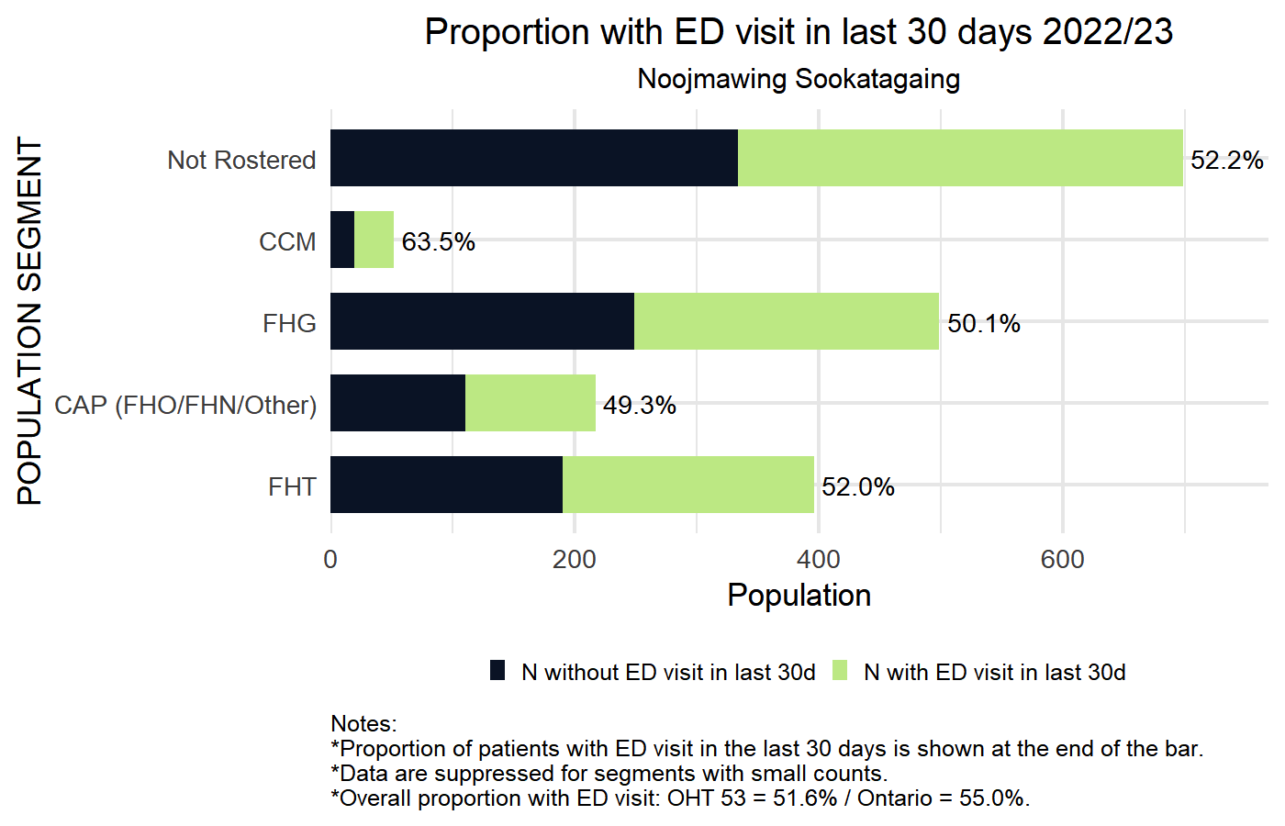
2022/23 Proportion of decedents with ED visit in last 30 days by Primary Care Model
Horizontal axis shows the number of OHT attributed patients that died in the reporting period.
Bright green indicates number of individuals that had one or more ED visit in their last 30 days of life.
Dark blue represents number of individuals without ED visit in their last 30 days of life.
Number to the right is the proportion of decedents that had one or more ED visit in their last 30 days.
OHT and Ontario average indicated in figure footnote.
Blank rows represent segments
with no events, small counts < 5,
or with < 30 patients in denominator.

Slide 76
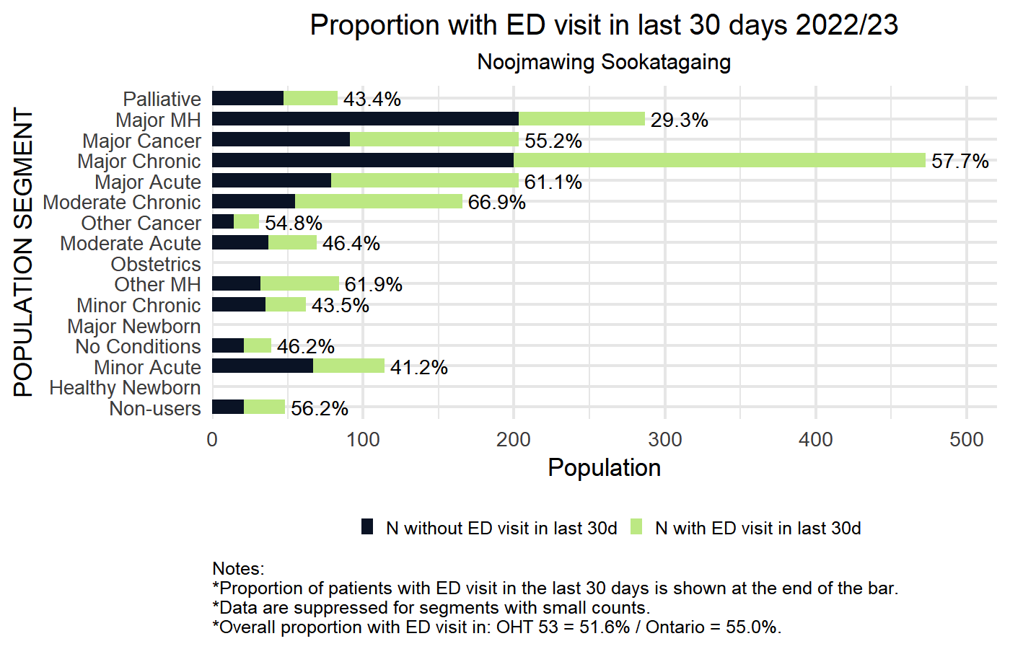
2022/23 Proportion of decedents with ED visit in last 30 days by CIHI Population Grouping Methodology
Horizontal axis shows the number of OHT attributed patients that died in the reporting period.
Bright green indicates number of individuals that had one or more ED visit in their last 30 days of life.
Dark blue represents number of individuals without ED visit in their last 30 days of life.
Number to the right is the proportion of decedents that had one or more ED visit in their last 30 days.
OHT and Ontario average indicated in figure footnote.
Blank rows represent segments
with no events, small counts < 5,
or with < 30 patients in denominator.

Slide 77
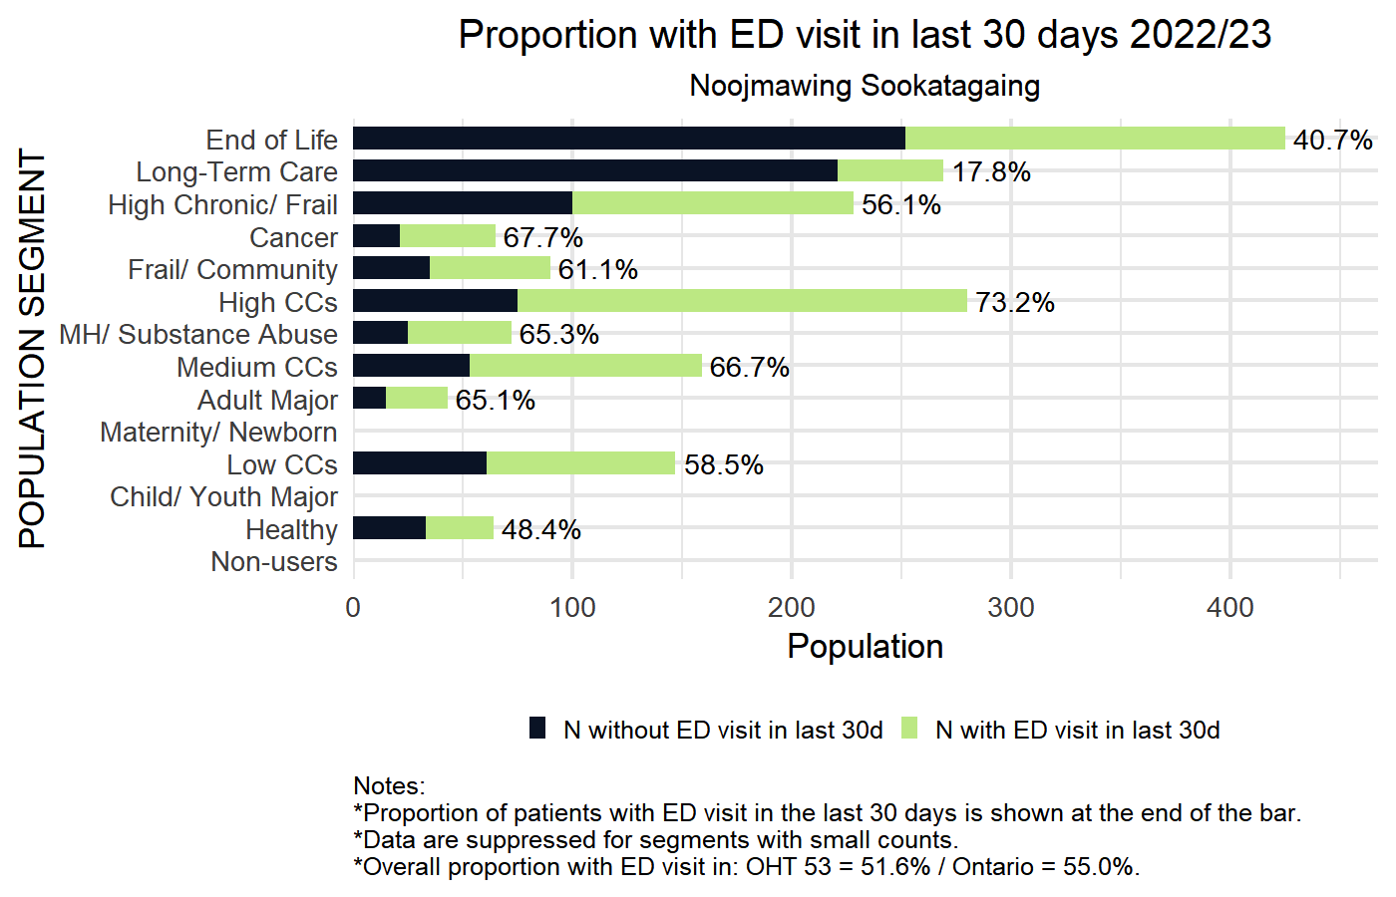
2022/23 Proportion of decedents with ED visit in last 30 days by BC Matrix Segment
Horizontal axis shows the number of OHT attributed patients that died in the reporting period.
Bright green indicates number of individuals that had one or more ED visit in their last 30 days of life.
Dark blue represents number of individuals without ED visit in their last 30 days of life.
Number to the right is the proportion of decedents that had one or more ED visit in their last 30 days.
OHT and Ontario average indicated in figure footnote.
Blank rows represent segments
with no events, small counts < 5,
or with < 30 patients in denominator.

Slide 78
Repeat fall-related emergency visits, among those identified as frail
DEFINITION | Quadruple Aim
Proportion of older adults >65 years of age identified as being frail that had 2 or more unscheduled emergency department visit for fall-related injuries | Health outcome
In this graph, the horizontal axis counts the total number of individuals in your OHT attributed population who were frail while the bright green indicates the number who were admitted to an emergency department two or more times for fall-related injuries.
Sample Interpretation: 2% of frail older adults in the most deprived communities had two or more ED visits for fall-related injuries. Lower values are generally preferred. While staying active may lead to falls, good community-based fall prevention and high levels of physical activity and health should lead to lower rates of injuries resulting from falls and fewer ED visits for fall-related injuries.

Slide 79
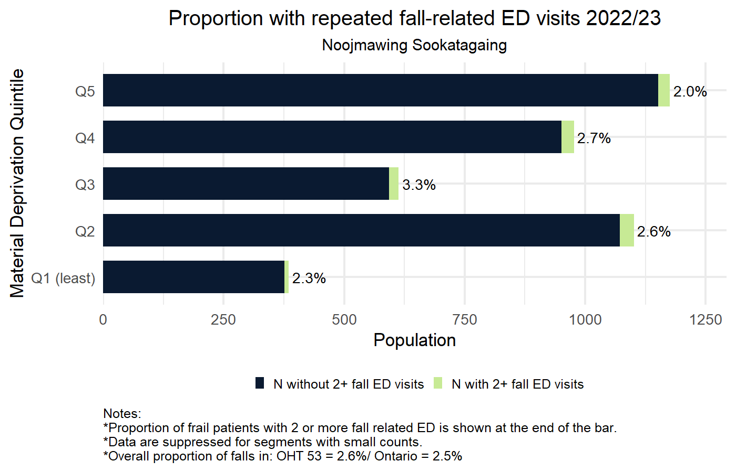
2022/23 Proportion of frail population with repeated fall-related ED visits by Material Deprivation Quintile
Horizontal axis shows the number of OHT attributed population age 66 years or older that were frail.
Bright green indicates number of frail patients with 2 or more fall-related ED visit.
Dark blue indicates the number of frail patients without 2 or more fall-related ED visits.
Number to the right is the proportion frail patients with 2 or more fall-related ED visits.
OHT and Ontario average indicated in figure footnote.
Blank rows represent segments
with no events, small counts < 5,
or with < 30 patients in denominator.

Slide 80
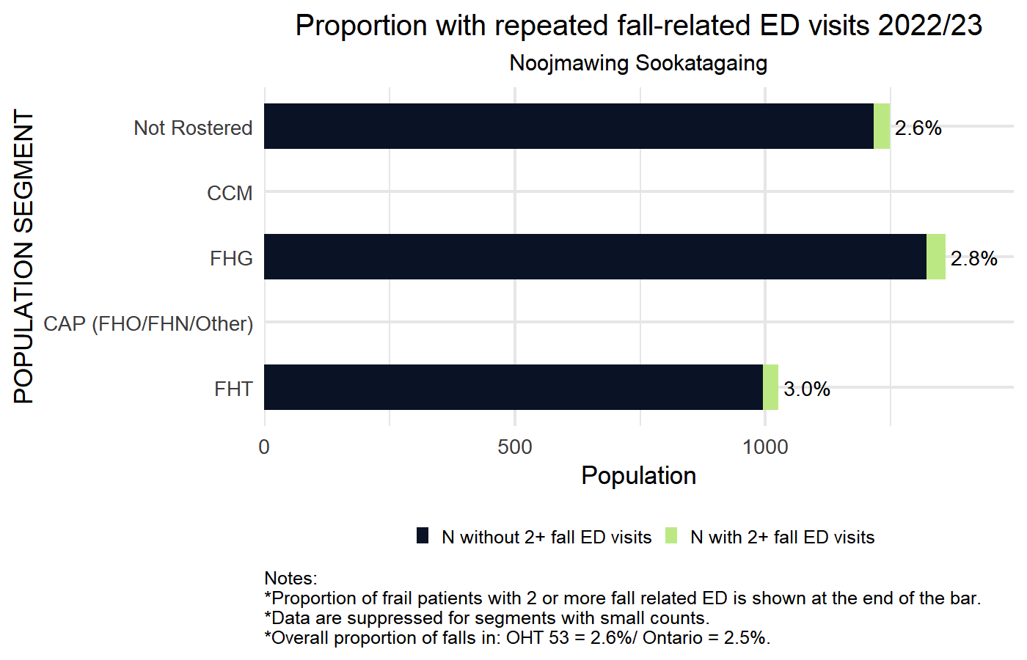
2022/23 Proportion of frail population with repeated fall-related ED visits by Primary Care Model
Horizontal axis shows the number of OHT attributed population age 66 years or older that were frail.
Bright green indicates number of frail patients with 2 or more fall-related ED visit.
Dark blue indicates the number of frail patients without 2 or more fall-related ED visits.
Number to the right is the proportion frail patients with 2 or more fall-related ED visits.
OHT and Ontario average indicated in figure footnote.
Blank rows represent segments
with no events, small counts < 5,
or with < 30 patients in denominator.

Slide 81

2022/23 Proportion of frail population with repeated fall-related ED visits by CIHI Population Grouping Methodology
Horizontal axis shows the number of OHT attributed population age 66 years or older that were frail.
Bright green indicates number of frail patients with 2 or more fall-related ED visit.
Dark blue indicates the number of frail patients without 2 or more fall-related ED visits.
Number to the right is the proportion frail patients with 2 or more fall-related ED visits.
OHT and Ontario average indicated in figure footnote.
Blank rows represent segments
with no events, small counts < 5,
or with < 30 patients in denominator.

Slide 82

2022/23 Proportion of frail population with repeated fall-related ED visits by BC Matrix Segment
Horizontal axis shows the number of OHT attributed population age 66 years or older that were frail.
Bright green indicates number of frail patients with 2 or more fall-related ED visit.
Dark blue indicates the number of frail patients without 2 or more fall-related ED visits.
Number to the right is the proportion frail patients with 2 or more fall-related ED visits.
OHT and Ontario average indicated in figure footnote.
Blank rows represent segments
with no events, small counts < 5,
or with < 30 patients in denominator.

Slide 83
Notes
There is an accompanying report with further details about the indicators included in this report.
For details on specification of BC Health System Matrix and other indicator definitions please see:
    Mondor L, Hall RE, and Wodchis WP. Population Segmentation for Ontario Health Teams using the British Columbia Health System Matrix. Toronto, ON: Health System Performance Network. 2021. available at https://hspn.ca/evaluation/oht/reports/

Slide 84
Notes
This research was supported by a grant from the Ontario Ministry of Health and Long-Term Care (MOHLTC) to the Health System Performance Research Network (Agreement #694). This study was supported by ICES, which is also funded by an annual grant from the MOHLTC. The opinions, results and conclusions reported in this paper are those of the authors and are independent from the funding sources. No endorsement by ICES or the Ontario MOHLTC is intended or should be inferred. Parts of this material are based on data and/or information compiled and provided by CIHI. However, the analyses, conclusions, opinions and statements expressed in the material are those of the author(s), and not necessarily those of CIHI. Parts of this material are based on data and information provided by Cancer Care Ontario (CCO). The opinions, results, view, and conclusions reported in this paper are those of the authors and do not necessarily reflect those of CCO. No endorsement by CCO is intended or should be inferred. Parts of this material are based on data and information provided by Ontario Health (OH). The opinions, results, view, and conclusions reported in this paper are those of the authors and do not necessarily reflect those of OH. No endorsement by OH is intended or should be inferred. We thank the Toronto Community Health Profiles Partnership for providing access to the Ontario Marginalization Index and IQVIA Solutions Canada Inc. for use of their Drug Information File.

Slide 85










Central OHT Evaluation Team
Co-Leads
Dr. Walter P. Wodchis
Dr. Kaileah McKellar
Dr. Gaya Embuldeniya
Chris Bai
Nusrat S. Nessa
Priyanka Gayen
Team Members
Trisha Martin
Vijay Kunaratnam
Emily Charron
Victor Rentes
Notes:
Need to update

Slide 86




THANK YOU!
@infohspn
OHT.Evaluation@utoronto.ca
The Health System Performance Network
hspn.ca

