Slide 1
Considering Evaluation
Learning Health System Series Part 6: Supporting Evaluation in Learning Health Systems: What do OHTs need to know?
HSPN Monthly Webinar
November 26, 2024

Slide 2
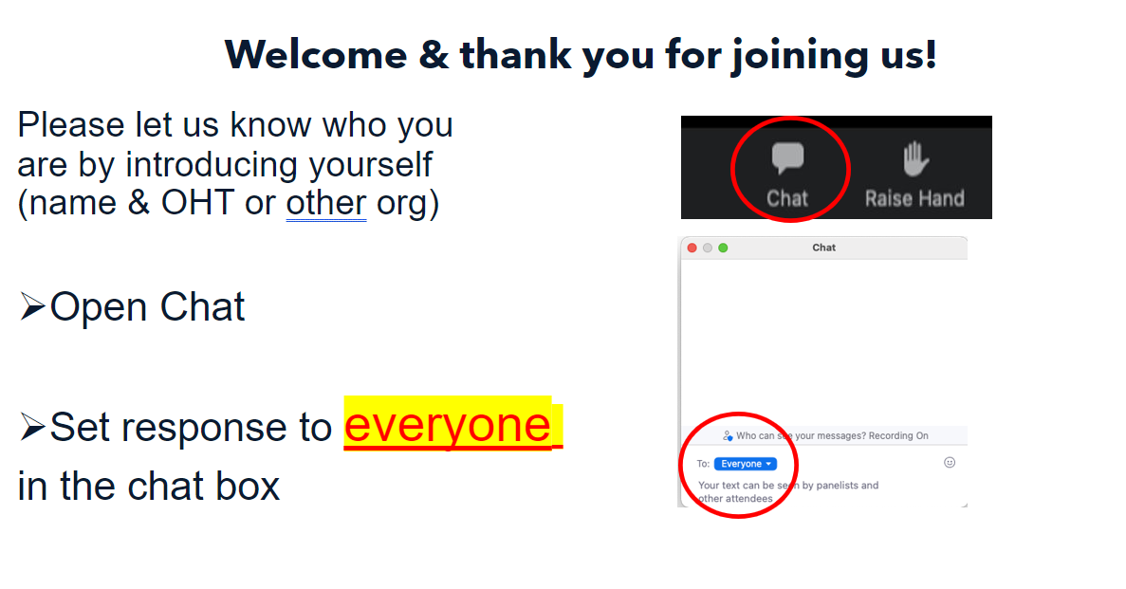

Slide 3
Land Acknowledgement
​
We wish to acknowledge this land on which the University of Toronto operates. For thousands of years it has been the traditional land of the Huron-Wendat, the Seneca, and the Mississaugas of the Credit. Today, this meeting place is still the home to many Indigenous people from across Turtle Island and we are grateful to have the opportunity to work on this land.

Slide 4
Poll 1
Have you joined us for an HSPN webinar previously?
Yes. I have participated previously
No. This is my first event

Slide 5





Today’s event:
Supporting Evaluation in Learning Health Systems: What do OHTs need to know?
Host
Presenters
Dr Catherine Donnelly
Associate Professor
Queen’s University
FLA OHT
Dr. Reham Abdelhalim
Manager, Population Health and Evaluation
Burlington OHT
Dr. Brianne Wood
NOSM
RISE

Slide 6
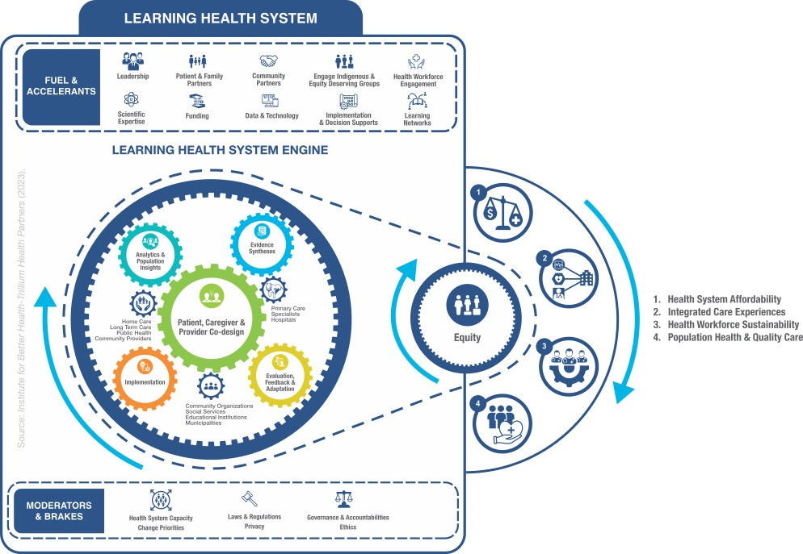
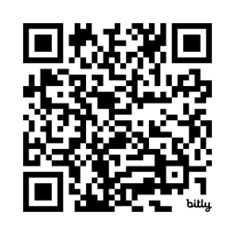
LEARNING HEALTH SYSTEM ACTION FRAMEWORK
SOURCE: Institute for Better Health-Trillium Health Partners (2023).
Notes:
Here is the LHS Action Framework that we have been building and refining at IBH with the help of leaders, patients and community members across Ontario. This is the framework we are now consistently using at IBH and THP.
The framework is presented as a learning engine (a clean engine of course!) that creates motion in a production line. For this engine, the products are the quintuple aim – population health, good health care experiences for patients and caregivers, a sustainable work life for health care providers, affordability, and of course, equity across our communities.
The engine has 5 learning gears and 3 health system gears that describe the intersections of research and care delivery. These gears intersect with each other and result in sustained motion.
Like any engine, the LHS engine requires a constant infusion of fuel and accelerants.
And of course it has brakes and moderators that keep it on course and safe.
The next slides focus on the gears and outputs, as well as the fuels, accelerants, brakes and moderators.

Slide 7
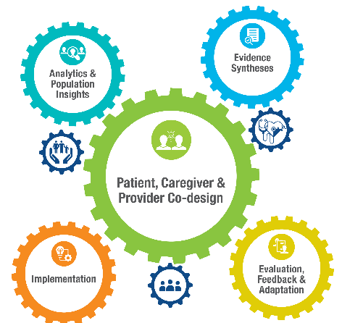

Learning Gear 5: Evaluation, Feedback & Adaptation
Description: Using multiple evaluation methods to measure how well a multicomponent intervention is working on a population and under what conditions. Constant feedback via intervention data is used to adapt the intervention to match patient needs.
Sample Questions: What evaluation logic model should be used? Are change processes being cemented? What degree of “reach” across equity-deserving groups? Are hypothesized outputs/early outcomes being achieved? Are there unintended consequences? What adaptations are needed to cement & scale?
Health System Affinities: Quality Improvement teams, performance management, business Intelligence/decision support/evaluation teams, clinical informatics etc.
Notes:
The last LHS learning gear is rapid cycle evaluation, feedback and adaptation. LHS evaluators rely heavily on realist evaluation methods, using a combination of qualitative, quantitative, and hybrid approaches, staged at the developmental, formative, and summative stages of implementation.
A central focus is to measure how well a multicomponent invention is working for what patient population, and under what conditions. To enable rapid cycle change, early feedback of preliminary data to implementation teams is key so that early changes can be made to the intervention and or implementation strategy.

Slide 8
Poll 2
What is your experience with evaluation? (choose 1)
    I have much experience with evaluation.
    I have good knowledge of evaluation
    I have some exposure to evaluation
    I have no experience with evaluation

Slide 9
The Practice of Evaluation
A Brief Review:
Logic Models
Measures
Study Design

Slide 10
Poll 3: USE THE CHAT FUNCTION !
Open text in the chat.
(think of a program that you are trying to implement)
What word(s) come to mind when I say:
“ You should evaluate your program! ” ?

Slide 11
Operationalizing Evaluation Using Logic Models
Flashback to early HSPN programming:
Logic Models: February 2020
https://www.youtube.com/watch?v=HsJeisL92DY
  Measures for Logic Models: November 2020
  https://youtu.be/ARIDYwkbNS4

Slide 12
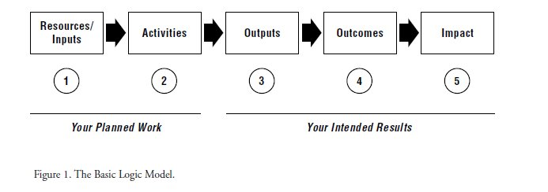
What is a logic model?
Logic models visually summarize how a program is expected to work by listing: what resources will be used, what activities will be completed, and how the activities will lead to outcomes

Slide 13
Logic Model for <Title of Intervention>
Resources/Inputs | Activities/Strategies | Outputs | Outcomes (Short & Long-Term) | Impact
What resources will enable the set of activities? | In order to address the issue, we will conduct the following activities. These activities are required to achieve our desired outcome. | These outputs should help monitor progress towards outcomes. Once completed or underway, the activities will produce the following evidence of service delivery. | We expect that if complete or ongoing, these activities will lead to the following changes in 1-3 years then 4-6 years | What is the goal of the program? What issue are you trying to address? We expect that if complete or ongoing, these activities will lead to the following changes.
Available at https://hspn.ca/evaluation/oht/related/logic-model-resources/

Slide 14
Quadruple Aim Measurement
Measurement
Patient Experience
Organized care that is easy to access
Health Outcomes
Better Patient and Population Health
Cost
Cost containment
Provider Experience
Providers feel supported to organize care for patients
Equity assessed in Each Quadrant

Slide 15
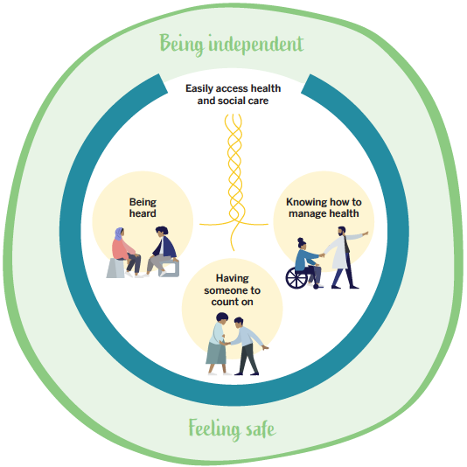
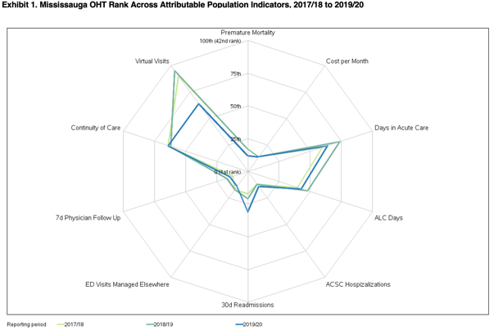

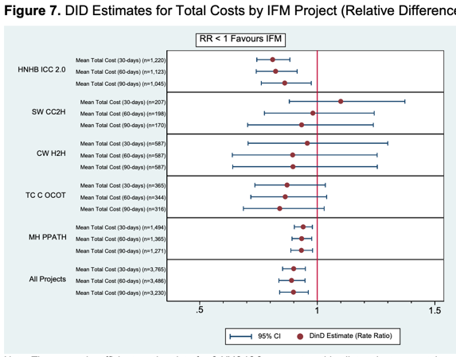
Quadruple Aim Measurement
Meaningful indicators
Provided to teams at
the front lines to
monitor and adjust
+
Robust
Evaluation
Measurement
Patient Experience
Organized care that is easy to access
Health Outcomes
Better Patient and Population Health
Cost
Cost containment
Provider Experience
Providers feel supported to organize care for patients
Equity assessed in Each Quadrant

Slide 16
Measurement: Using Logic Models in Evaluation
Level | Inputs/ resources | Activities (Processes) | Outputs | Short-term Outcomes | Long-term Outcomes | Impact
Description of Logic Model component
Measures (Definition)
Data source
Extraction/ Approach to data capture
Frequency of reporting and audience
Available at https://hspn.ca/evaluation/oht/related/logic-model-resources/
*See Instructions within the notes section
Notes:
Using the Table
Along the top of the table are the components of the logic model. This table is not intended to direct you to have one measure for each component. You may choose that approach; however, you might not have a measure for one component and have multiple for another. The table can be adapted by adding columns or rows to align with your measurement plan. For example, having multiple short-term outcomes may be appropriate for answering an evaluation question, such as ‘Did the coordinated care initiative improve patient experience?’. Additional rows can also be added; examples of additional considerations of the table can be found below. Table 2 below provides example measures are corresponding information.
Description of Logic Model component: This will help define what you are actually trying to measure and remind you how it connects to your OHT’s logic model or strategy. It also allows this table to be used in tandem with the logic model.
Measures (Definition): Here, you should clearly state your measure and how it is defined. In many cases, the definition may be too detailed to fit in this table. If that is the case, provide an overview within this table and additional information in a technical appendix (e.g., numerator and denominator, detailed description of the population or condition included).
Data source: Indicate the source of the data. Ideally, the data collection is integrated into your program delivery process and leverages exciting sources. Some measures may require primary data collection (e.g., measures of provider experience you collect through a survey).
Extraction/ Approach to data capture: In this row, you can answer pertinent information related to how you will gather and track data, the processes involved, and alignment with existing processes?
Frequency of reporting audience: How often will the data be reviewed? Consider how often it is collected and when you would expect to see a change in the data. There may be multiple audiences for reporting. In this row, you should indicate the primary audience. Think about who will use the information to make decisions based on the data and who will need to support the interpretation.

Slide 17
Example designs for evaluation:
Case study: Study what happens during/after implementation
Before and After: measure twice and see if there is a difference
Quasi-experimental: Add a comparison group and/or time-series

Slide 18
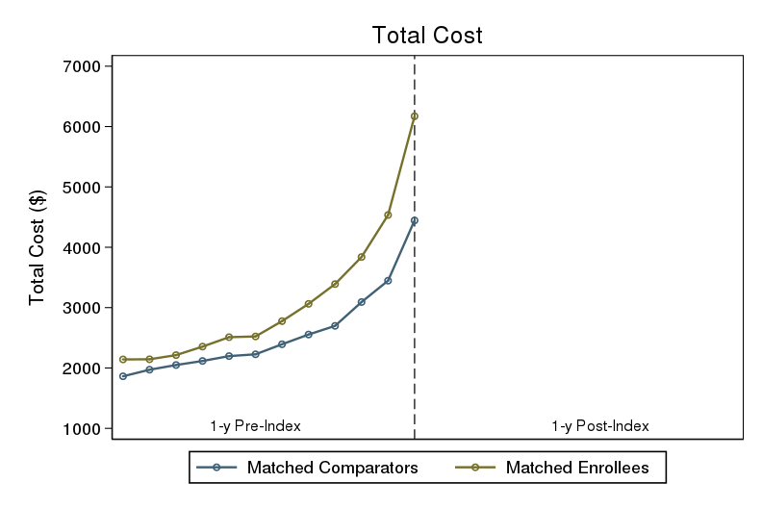
Example: Deep Dive on 3 Health Links
Comparable Pre-index Trajectories in Total System Cost
18

Slide 19
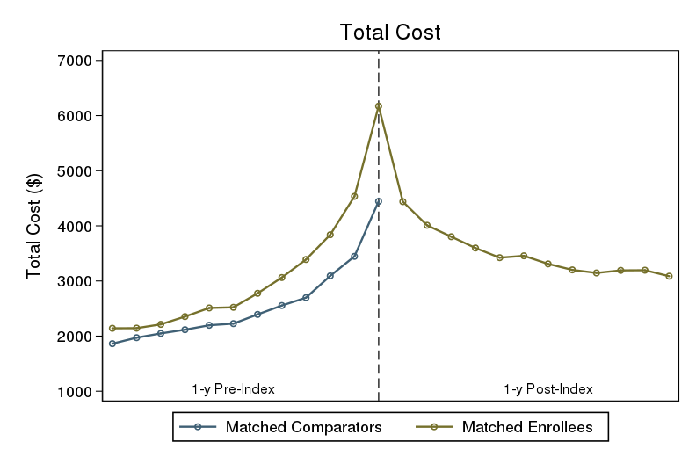
Example: Deep Dive on 3 Health Links
Enrollee Costs Decline after Health Links Start Date
19

Slide 20
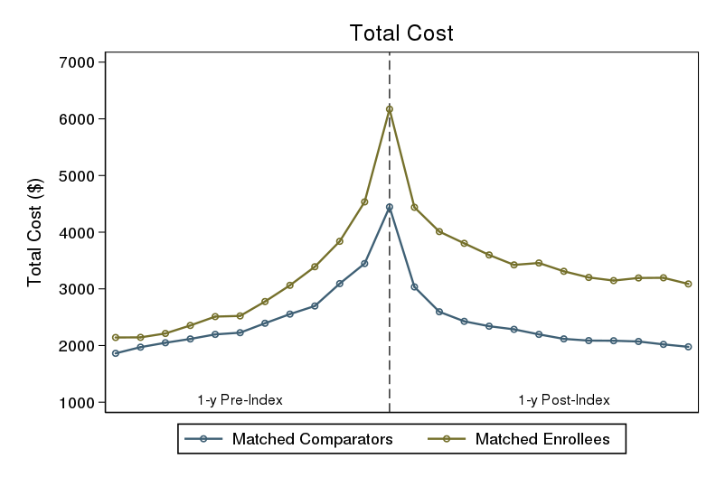
Example: Deep Dive on 3 Health Links
Comparator Costs Decline More Than Enrollee Costs
Robust
Evaluation !
Only known by having a comparator
FOR MORE INFORMATION SEE: Mondor L, Walker K, Bai YQ, Wodchis WP. Evaluation of Health Links on health services utilization in the Central Ontario health region: a propensity-matched difference-in-difference study. CMAJ Open (2017). DOI: https://doi.org/10.9778/cmajo.20170054
20

Slide 21
Learn More: Community of Practice
Evaluation and Performance Improvement for OHTs
Who is it for?
People working on evaluation and performance improvement in OHTs
What can members do?
Share experience across OHTs
Access and share evaluation and measurement resources
Connect at monthly teleconferences
  Second Tuesday of the month, 12:00-1:00 pm
  Past Topics included Using IDS, Evaluating Patient Engagement, Survey Methods

Slide 22
Recent & Upcoming CoP meetings
2nd Tuesday of the month,
12:00-1:00 pm
Oct 8
Assessing Learning Health System Capabilities:
A Self-Assessment Tool for Continuous Improvement
Nov 12
Analyst Café: Sharing experience and challenges across OHTs
Dec 10
Evaluating Digital Health and Virtual Care Solutions
Check the OHT Shared Space for registration after our next meeting

Slide 23

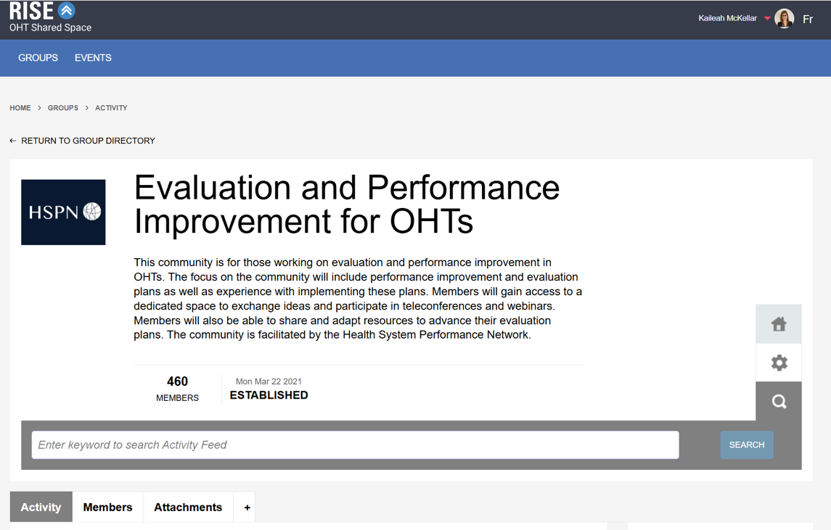
How do I join?
Check the chat box for links
1
Visit the OHT Shared Space and click the “Sign Up” button
On the Collaboratives page, look for the Evaluation and Performance Improvement for OHTs community of practice and click “Join Group”
2
Notes:
Collaborative website link: https://quorum.hqontario.ca/oht-collaboratives

Slide 24
Today’s event:
Supporting Evaluation in Learning Health Systems: What do OHTs need to know?
Host
Presenters
Dr Catherine Donnelly
Associate Professor
Queen’s University
FLA OHT
Dr. Reham Abdelhalim
Manager, Population Health and Evaluation
Burlington OHT
Dr. Brianne Wood
NOSM
RISE

Slide 25


Evaluation: The foundation
Health homes
…. A meandering path
Catherine Donnelly, PhD, OT Reg (Ont.)
Associate Professor, School of Rehabilitation Therapy
Director, Health Services and Policy Research Institute
Chair – QUEST – FLA-OHT

Slide 26
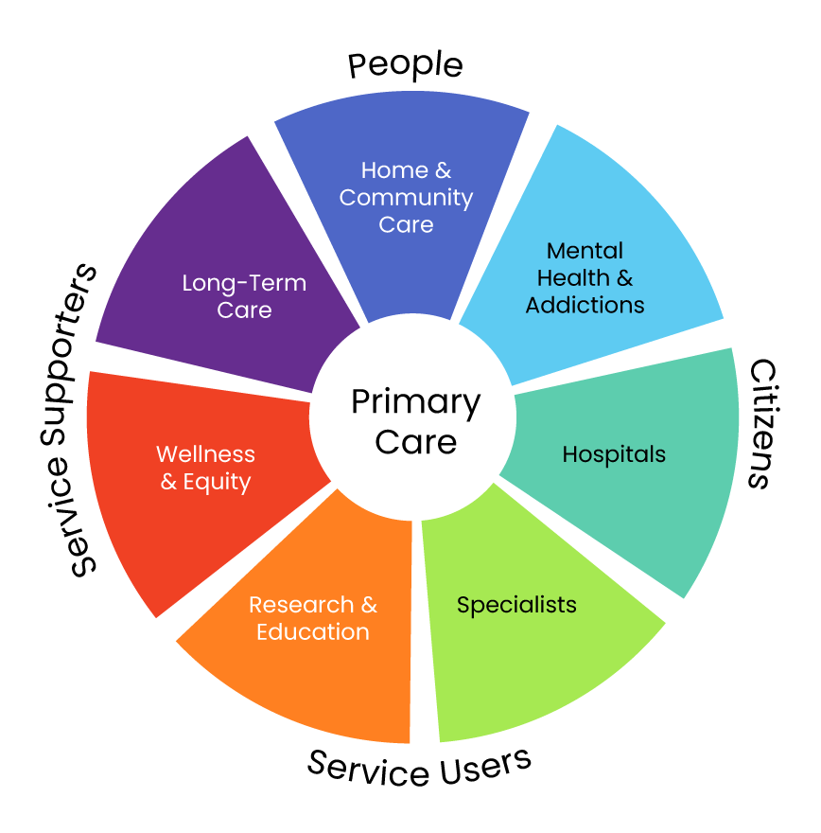
Frontenac Lennox Addington OHT

Slide 27


Slide 28
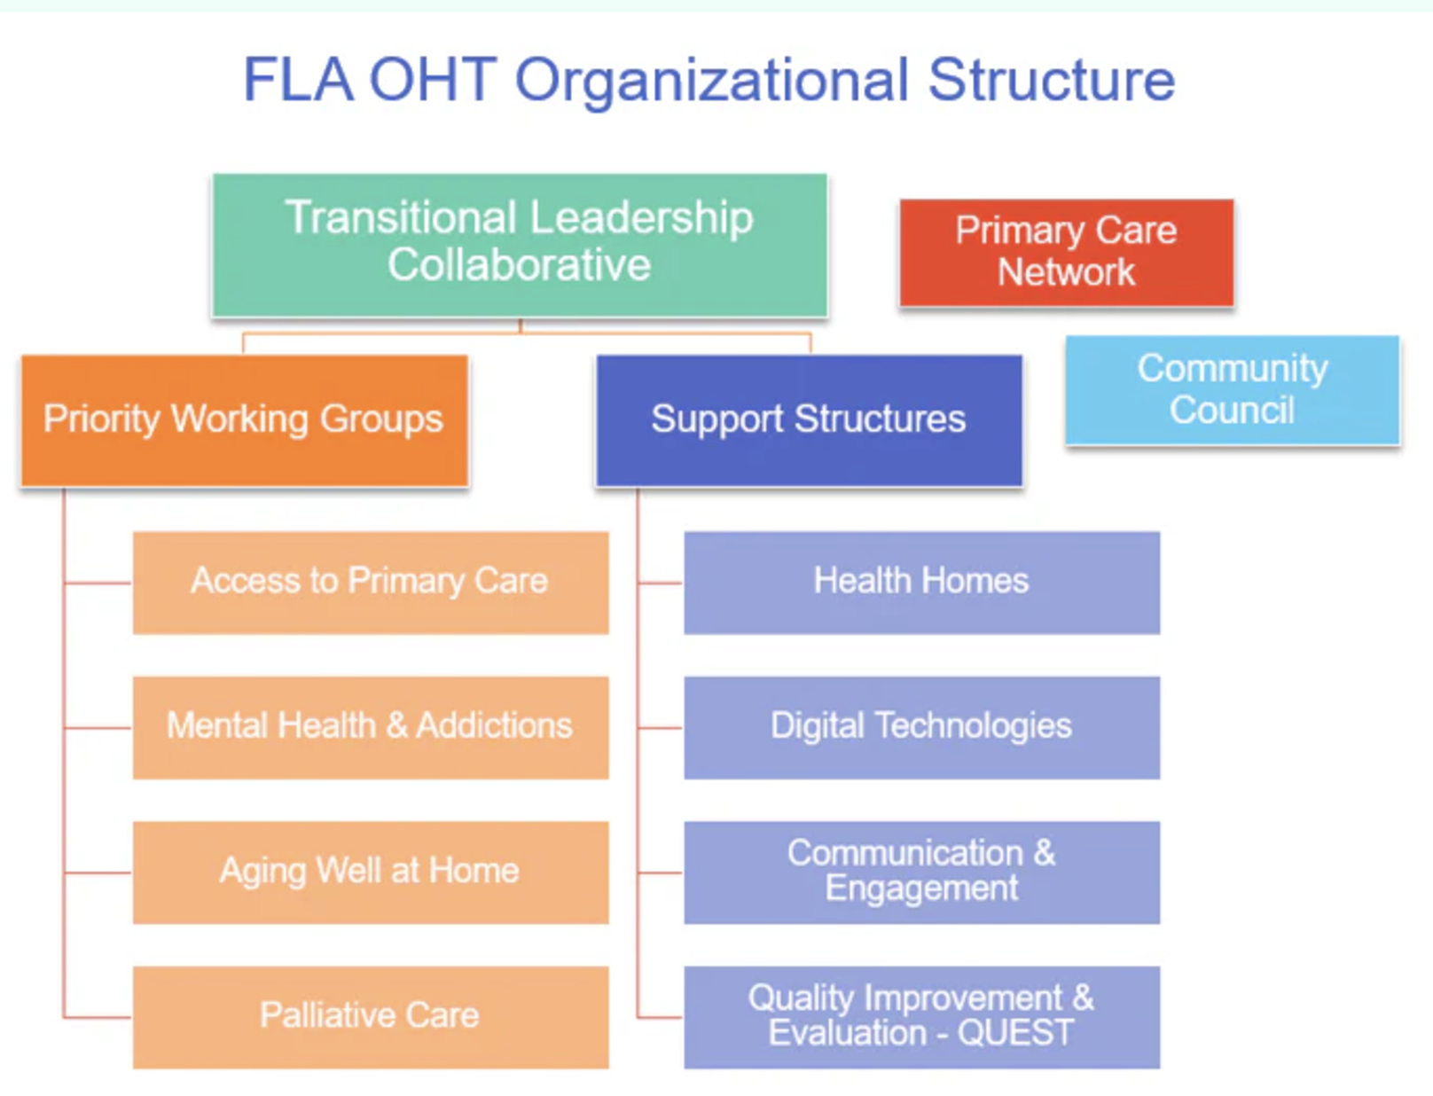

Slide 29


Application:
Priority Populations
and Indicators

Slide 30




Application: FLA-OHT Priority Populations
People aging
People eligible for palliative services
People living with mental health
People at risk of hospitalization:

Slide 31

Application:
Priority Populations
and Indicators
Year 1: Logic Models
Stories of Success

Slide 32
Year 1: FLA-OHT Priority Populations
Community member
Primary care physician
Evaluation rep
People aging
People eligible for palliative services
People living with mental health
People at risk of hospitalization:

Slide 33
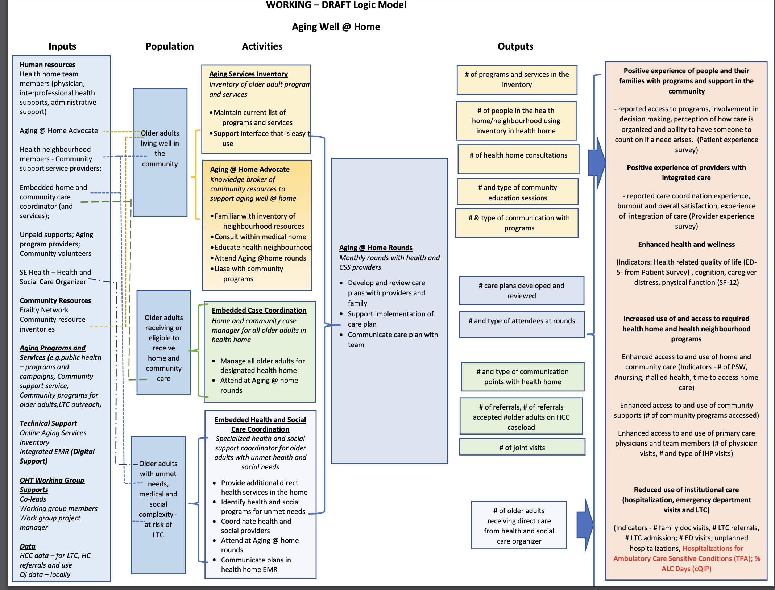


Slide 34
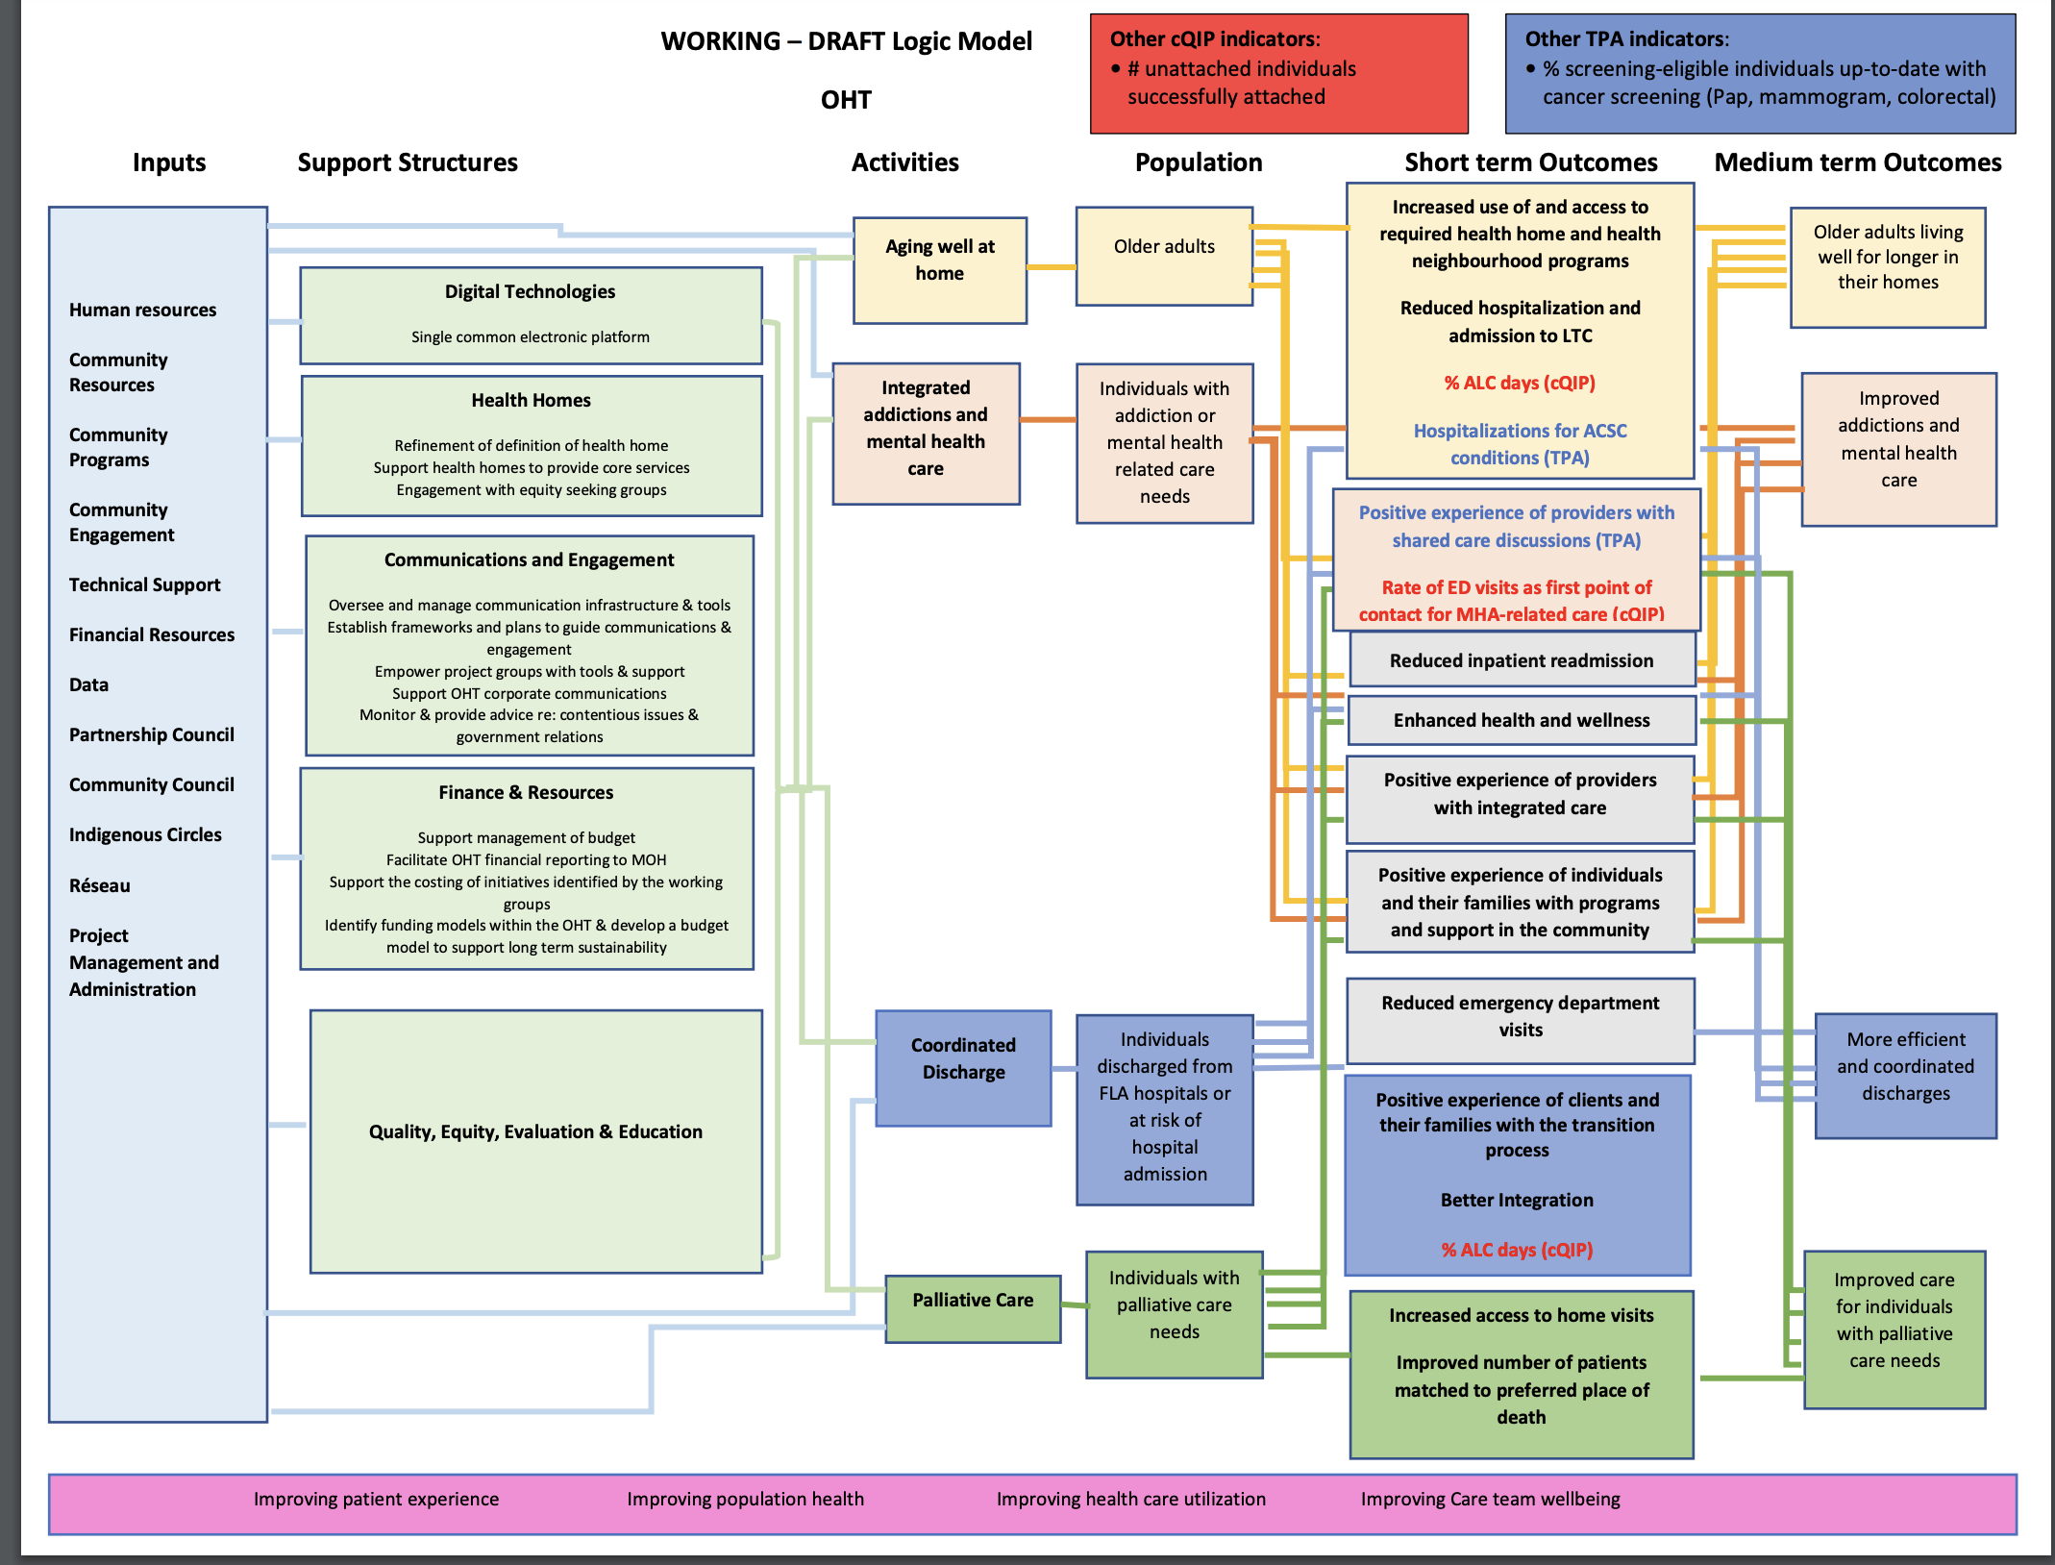

Slide 35

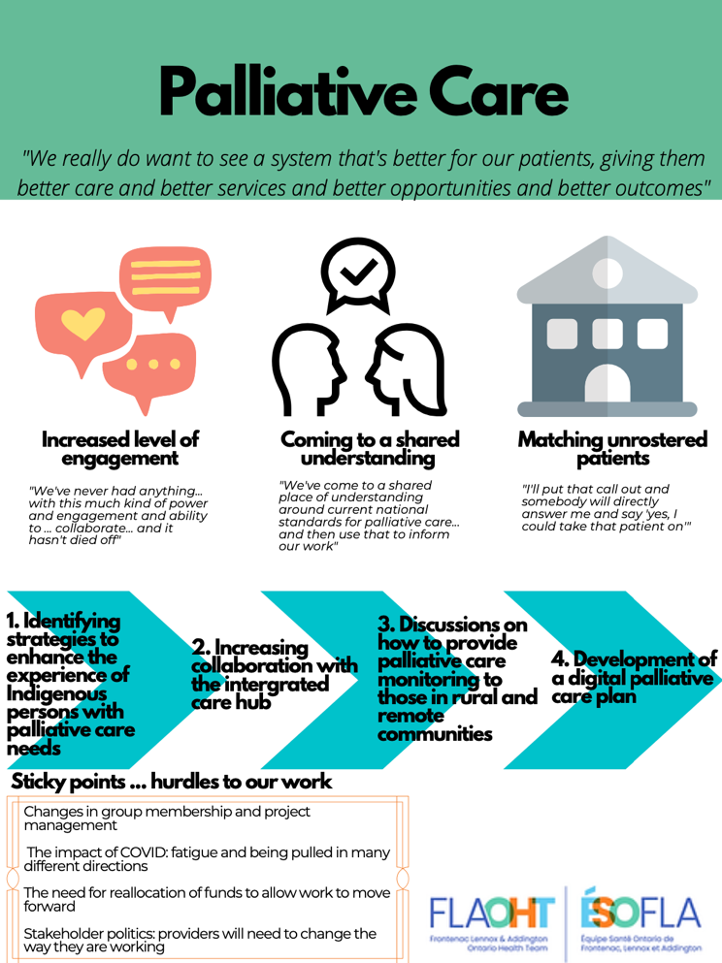
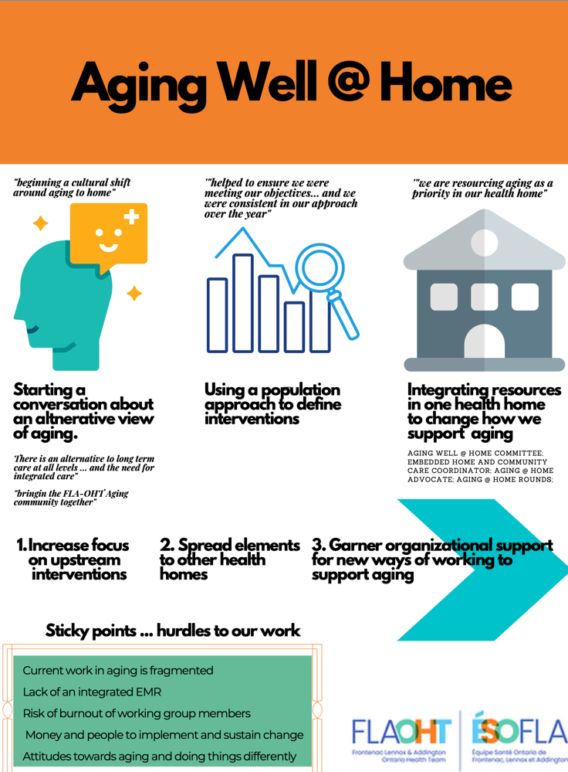
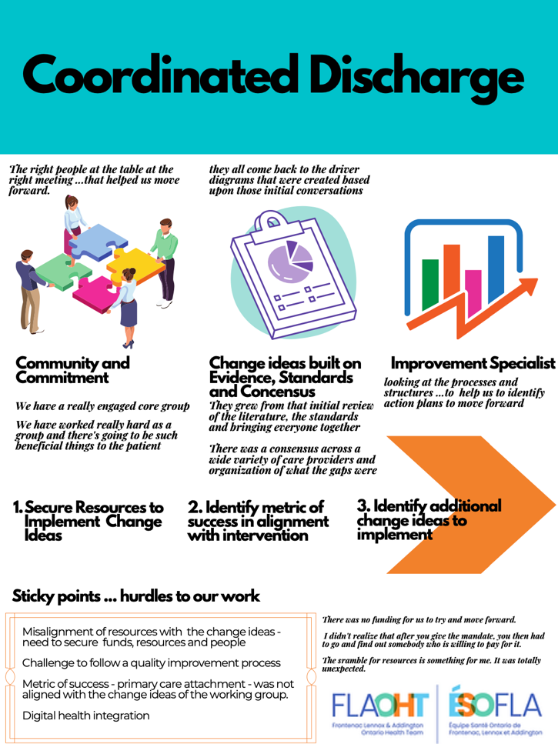


Slide 36
Application:
Priority Populations
and Indicators
Year 1: Logic Models
Stories of Success
Year 2-3: Data!??
Patient Experience
and Outcomes

Slide 37



Learning health system ---- Where’s the data??

Slide 38
Learning health system ---- Where’s the data??
We collected out own!

Slide 39
We collected our own!
Focusing on patient outcomes and experiences
Over 1,200 patients completed survey (October 2022 to March 2023)
Participating sites | Participating sites
 | Primary care clinics |  |  |  | Public health
 | Case 1 | Case 2 | Case 3 | Case 4 | Case 5
Survey platform | OCEAN | OCEAN | OCEAN | Qualtrics | Qualtrics
Distribution mechanism | Email | Email | Email | Tablets QR codes | Tablets QR codes
Frequency of survey distribution | Weekly | Weekly | Weekly | Immediately after visit | Immediately after visit
Frequency of reporting | Weekly | Weekly | Weekly | Biweekly | Biweekly
# completed surveys | 493 | 389 | 102 | 24 | 206
Response rate | 16.7% | 14.9% | --- | n/a | n/a

Slide 40
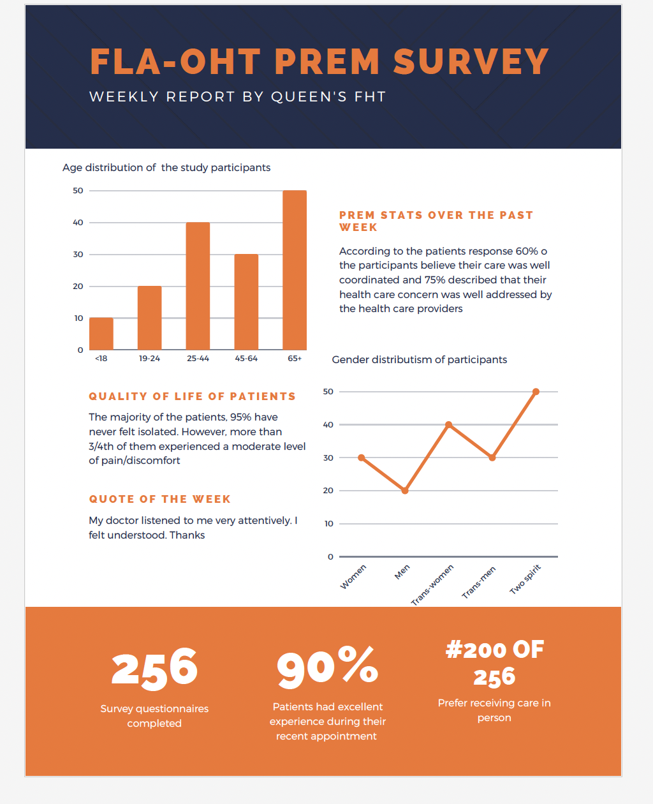

We gave clinics weekly/monthly data.

Slide 41



Flexibility
One size fits all approach will not work
Add questions for site-specific needs (e.g., local QI work) while also providing relevant data for population health planning
Supports
Resources and supports to: implement data collection, utilize the data, and ensure resources exist to provide appropriate referral and support if necessary
Culture shift
OHTs and partner organizations need to adopt a learning health system culture - the measurement of PREMs/PROMs is not enough
It is critical to provide supports to close the loop and improve patient care. Providers cannot do this on their own – they need interprofessional teams and quality improvement support.
Building efficiencies: combing PREM, PROM, demographic data into ONE tool
Combination of PREM, PROM and data to identify equity-deserving groups into one tool to not overburden patients with multiple data captures from multiple places, audiences, or needs

Slide 42
Application:
Priority Populations
and Indicators
Year 1: Logic Models
Stories of Success
Year 2-3: Data!?
Patient Experience
and Outcomes
Year 3-4: Health Homes

Slide 43
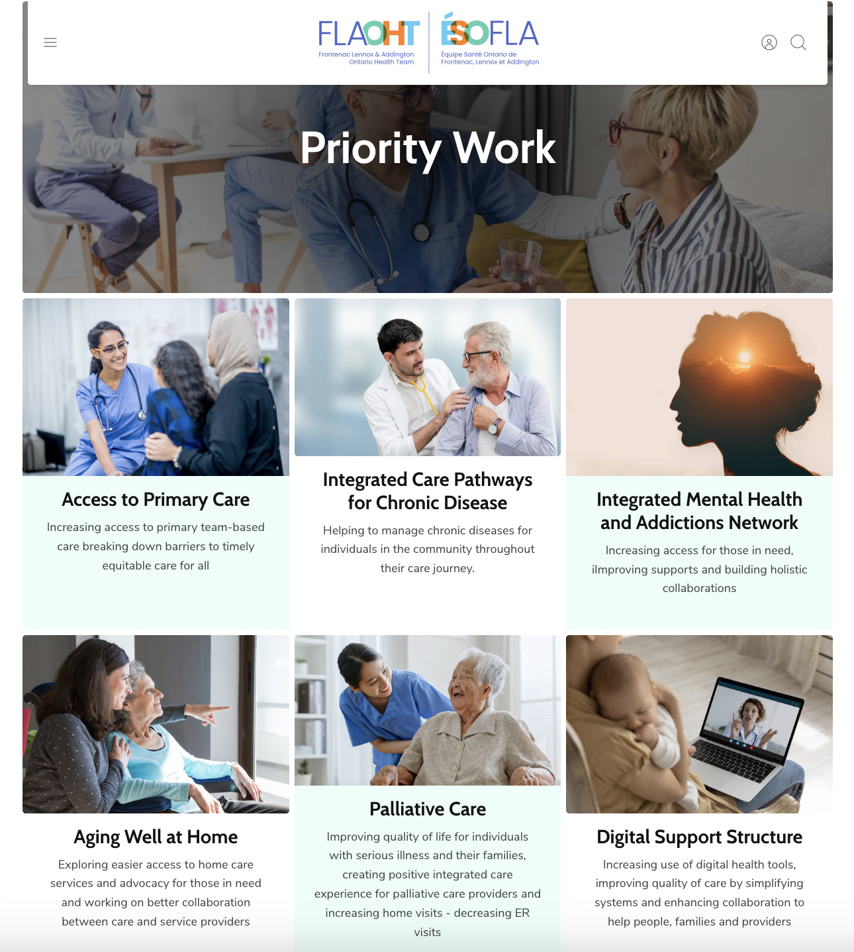
Year 3 and 4: Time to regroup and refocus.

Slide 44
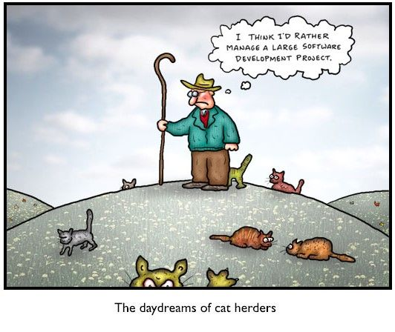
Year 3 and 4: Time to regroup and refocus.
The evaluation of an OHT

Slide 45
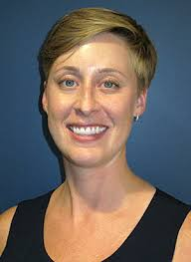



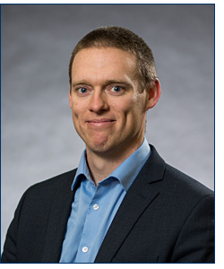

Year 3 and 4: Time to regroup and refocus.

Slide 46
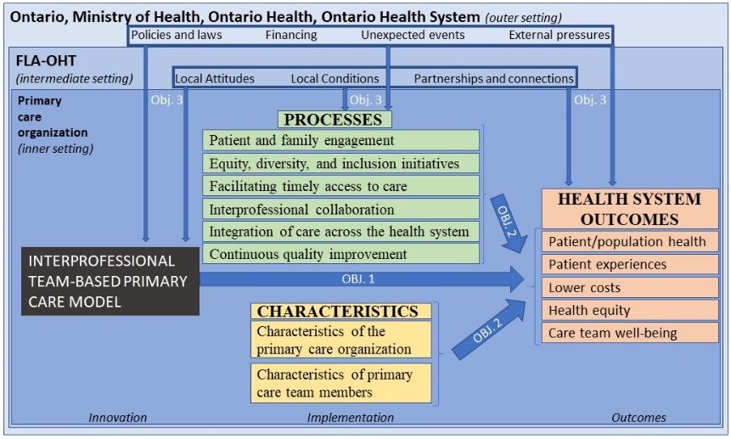
Year 3 and 4: Time to regroup and refocus.

Slide 47

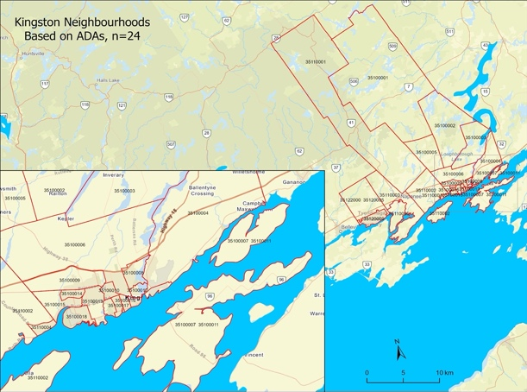

FLA-OHT - Patient Experience and Wellness Survey
Neighbourhood Mapping
(Community Health Profiles Partnership)
https://www.ontariohealthprofiles.ca/
Current State Assessment of Health Homes

Slide 48
Goals and Focus
Alignment of outcomes and indicators across projects when possible
Work with partners to coordinate data
Leverage evaluations being conducted in our FLA-OHT
Routine deployment (with support) of FLA-OHT Patient and Wellness Experience Survey across all Health Homes.
1. Stay focused:Have a plan. 2. Bite sized projects. 3. Build on your work - slowly over time

Slide 50

“It Is a Life-long Journey Of Measuring, Learning And Refining.” The Burlington OHT Approach to Evaluation as a Component of a LHS
Dr. Reham Abdelhalim
Manager, Population Health and Evaluation , BOHT

Slide 51
About the Burlington OHT
Plan & Engage
Monitor and improve
Asses impact, scale or re-design
230, 000 attributed population
Mostly Urban
25% of the Burlington OHT attributed population are 65+
We have 72 NORCs in our Community
Vulnerable seniors have been a priority population for the Burlington OHT since inception
A team of two working within a culture of understanding and commitment to evidence-based decision-making, measurement and continuous improvement

Slide 52





2
An example : The Community Wellness Hub
Community Wellness Hub (CWH) is an alliance of health, housing, and social service providers that coordinate and deliver services to seniors. CWHs are organized around naturally occurring retirement communities (NORCs)¹ or existing community housing facilities. This is an innovative approach to “aging at home” that centres:
Proactive, Holistic, & Integrated Care
Interdisciplinary Teams, Trusted Relationships, & Person-Centeredness
Serving Equity-Deserving Populations
Cost-Effectiveness & Scalability
  Proactively addresses medical and social determinants of health, supporting preventative care and social prescribing
Diverse experts coordinated through a central coordinator, intake-point, and care plan improves primary care attachment/access and meets seniors’ complex needs
  Co-design with residents and an adaptable model helps meet specific cultural, language, and accessibility needs
  Leverages collaboration efficiencies and reduces healthcare system pressures; CWHs have navigated funding silos, need few additional resources to implement, and are easily replicable
¹NORC-Report-FINAL.pdf | NORC Innovation Centre
¹NORC-Report-FINAL.pdf | NORC Innovation Centre

Slide 53

3
The Community Wellness Hub Model | Structure
Burlington OHT, Halton Community Housing Corporation, and interdisciplinary CWH Partners offer primary healthcare, housing, wellness and recreation, mental health, and system navigation featuring:
Community Paramedic
Psycho-therapist
Exercise Therapist
Community Connector
Physio-therapist
Occupational Therapist
Wellness Staff
Housing Community Support Specialist
HCCSS Care Coordinator
Assisted Living Services Coordinator
Dementia Support System Navigator
On-site Community Connector to identify member needs and connect members with service provider partners.
Interdisciplinary service providers providing home-based or on-site 1:1 and group services at no or low cost to members.
Service providers that work as a team to discuss member progress, address concerns, prevent service duplication, and provide HR and administrative resources (including in-kind).
Integrated Team
We started with one Hub, now we are at four buildings in Burlington, collaborated with CCHOHT to implement two hubs and GHHN to implement another two

Slide 54
Exciting? Promising? But the beginning was not like that, it took years!

Slide 55
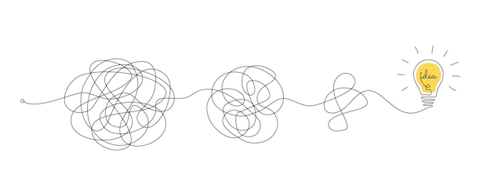



Community Wellness Hub
A Complex Intervention
Intervention targets many different groups & organizational levels
Many related & overlapping outcomes
Many interacting components
Did it work??
Participants are at all different stages of (behaviour) change
Lots of flexibility & tailoring of the intervention

Slide 56

Community Wellness Hub
A Complex Intervention
Program
Impact
But this assumption ignores all the underlying complexity…

Slide 57
Evaluation
Using A Logic Model
Inputs
Activities
Outputs
Impact
Outcomes
People
Resources
Culture and Vision
Intervention components
Operational metrics
Quadruple aim framework
Healthy Aging in Place
Do we have what we need to implement & achieve our vision?
Did we implement the vision as planned? What do we need to revisit?
How are we doing?
Are we making a difference?
Why & how?
Continuous Performance Monitoring
Impact Evaluation
Implementation Evaluation

Slide 58
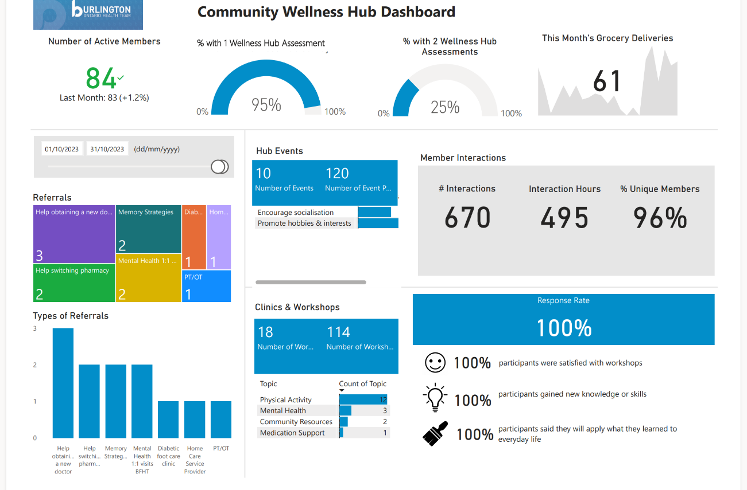
Continuous Performance Monitoring
How are we doing?
Are we meeting our targets?
Any trends? Positive negative?
Why?
What next?

Slide 59
Implementation Evaluation
Evaluation Questions:
Do we have what we need to implement & achieve our vision?
Did we implement the vision as planned? What do we need to revisit?
Evaluation Topics:
Definition
Vision
Operations
Impact
Methods:
Focus groups with leaders and providers
Document analysis
Observations

Slide 60
Why Evaluate?
Common Misconceptions
In Reality
Our program is too complex!
It takes time creating a logic model – but it’s well worth your investment to understand how your program works and whether it’s making a difference!
We already know what the problems are.
It’s important to hear from all stakeholders and considering all possible causes.
I’m so focused on running the program,
I don’t have time to evaluate.
Evaluation is not just a thought exercise – the outputs should be applied to improve the program!

Slide 61
Implementation Evaluation
Some Recommendations
Definition
  Create consistent branding; communicate widely
Vision
  Create shared vision, mission & value statements.
  Stay consistent
  Repeat
Operations
  Streamline operations; facilitate working as a team so we can provide more than the sum of our parts
Impact
  Create and implement an impact assessment matrix, collect data continuously and track over time
Notes:
Recreated the vision, mission, values, building blocks of the Hub via a co-design approach that included leaders and providers representing all the partner organizations
Created the Community Wellness Hub brand
Shared branding & templates widely across partner organizations and using change management principles
Adopted the motto, vision and mission statements, and building blocks in our everyday operations (e.g., meetings, communications)
Updated care plan
Umbrella consent
Streamlined intake process
One digital integrated care record
New evaluation matrix

Slide 62
Sharing the Evaluation Results
Enacting the Evaluation Results
It is our collective responsibility
LHS

Slide 63



Outcomes & Impact | Health Outcomes
8.6 Days
7.6 Days
Improved Self-Perceived Wellness¹
31% Lower Rate of Hospitalizations for ACSCs²
14% Fewer Less/Non-Urgent ED³ Visits⁴
Despite aging and conditions that worsen with time, members reported better or same self-perceived health and wellness after participating in CWH
Non-CWH members, similar in frailty and in home care, were 1.4x more likely to be hospitalized for ambulatory care sensitive conditions (ACSCs) with longer stays, compared to CWH members
CWH member ED visits that were less/non-urgent = 6%
vs
Ontario population aged 65+ ED visits that were less/non-urgent = 20%⁵
The estimated cost savings per year for ACSC hospitalizations per 100k people is $89,720,019
¹Wellness indicators include general health, pain and/or discomfort, loneliness, physical health, mental health, and feelings of anxiety or depression.
²See Appendix for further details and calculations.
³ED refers to Emergency Departments, sometimes referred to as Emergency Rooms (ERs).
⁴Based on Canadian Triage and Acuity Scale (CTAS); less/non-urgent ED visits represent CTAS 4 & 5. Fewer CTAS 4&5 ED visits helps improve system-wide problems of staffing shortages, closures, wait times, and delayed/missed diagnosis.
⁵OH dashboard/ OHTs reports, 2024

Slide 64





Outcomes & Impact | Member Experience & Equity
Accessible and adaptable services, trust and support, close-knit community¹
HUB MEMBER DEMOGRAPHICS²
“As a visually impaired person I find the assistance a huge asset….I have used the Hub for help reading and sorting my mail, getting a new family physician, appointment assistance, and much more.”
“We have monthly activities such as bingo, trivia, social teas, and arts & crafts. It’s nice to gather in a social group again. This makes me feel included and not alone”.
74
Average Member Age
$20,000
Average Member Income
7
“This program encourages me to get up and get active. It has been a wonderful way to be social and get to know the people in the building.”
“Having a person [Community Connector] available in the building daily is great for us, it’s nice to have someone who can help with things I find difficult to do.”
“I enjoy the fact that I can access most, if not all of the services onsite and within the comfort of the community I reside in”
Languages Spoken
11%
Hub Members with a non-English first language³
Hear more from members and providers in our video at: https://www.burlingtonoht.ca/community-wellness-hub/
¹See Appendix for detailed member experience survey results.
²Approximate Hub member demographics from four existing Hubs in Halton Region.
³ 26/235current hub members have a non-English first language.

Slide 65
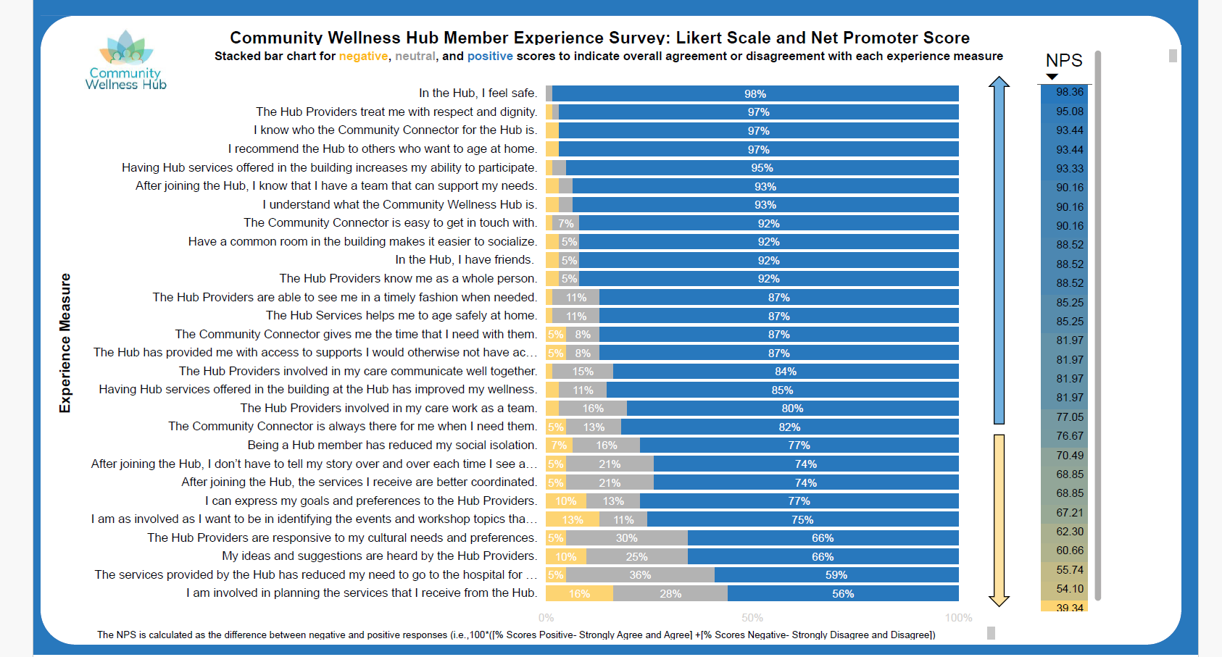
Translated to 5 languages

Slide 66
Outcomes & Impact | Provider Experience
Reduced travel, more patients served, improved communication, greater retention, collaboration efficiencies, economies of scale
“The Hub has allowed me to not only continue my patient care but build stronger bonds with my clients.”
“I develop connections, and I see changes in patient’s health and mental well-being, in real time.”
“We are more aware of who is doing what, so we do not to duplicate service or create redundancy, which was definitely happening before.”
“Resource sharing has been a huge success…we use each other and our unique strengths and knowledge to support residents in the best way possible.”
“I get to work with many community partners who are experts into their fields, this has provided me with valuable insights, and I see the difference we are making.”
“The Hub transformed our approach to providing care, we work as a team, not individual organizations. The hub helps us do our job more efficiently.”
”Partnering with other agencies in providing care has increased communication and awareness of services and programs.”
“…being seen daily lets the members know I [the Community Connector] am here to help them. It also helps me build relationships with other tenants and providers.”
Hear more from members and providers in our video at: https://www.burlingtonoht.ca/community-wellness-hub/
¹See Appendix for detailed member experience survey results.

Slide 67
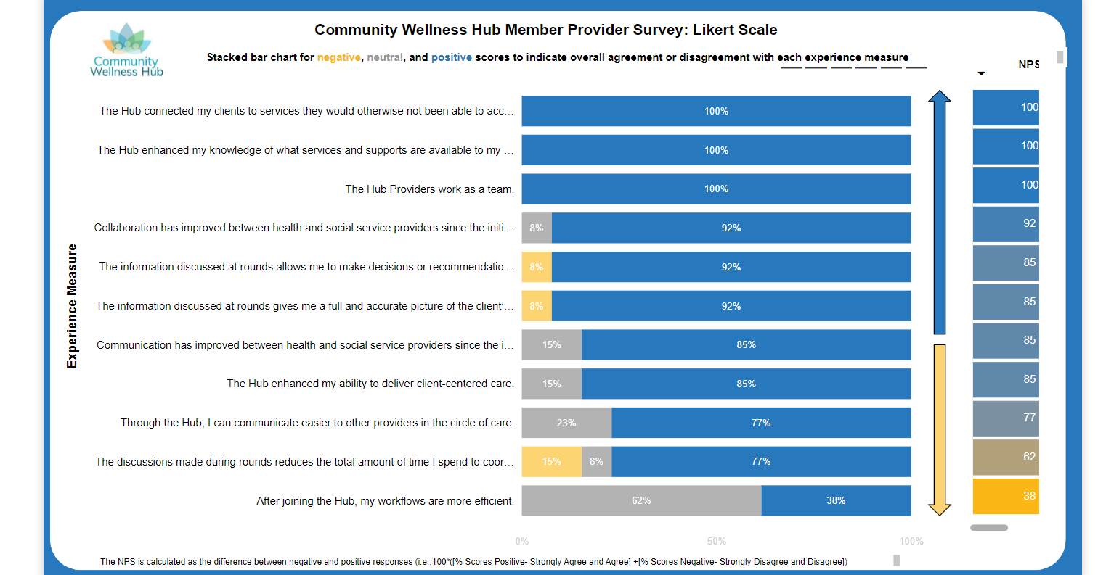
8
Annual

Slide 68

What does it take to implement evaluation findings?
Engagement from start to finish
Be open to innovation
A collaborative approach
Funding opportunities
Change management
Be open to fail forward
Create sense of urgency

Slide 69
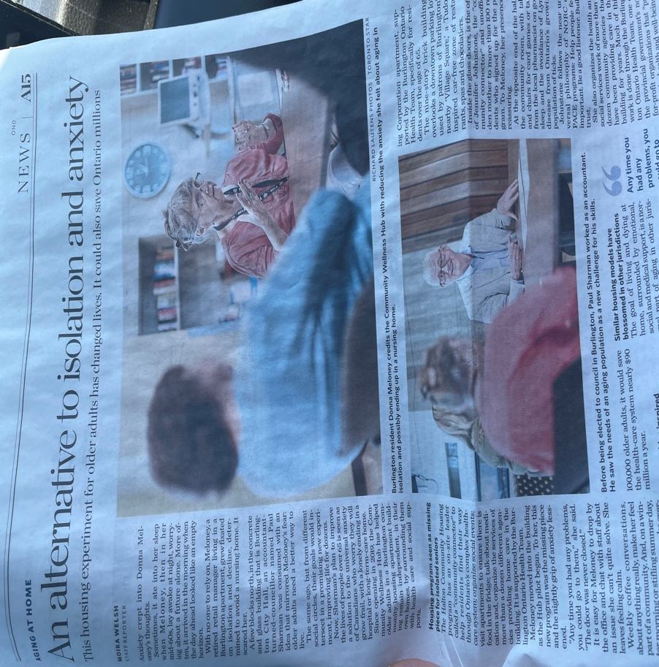


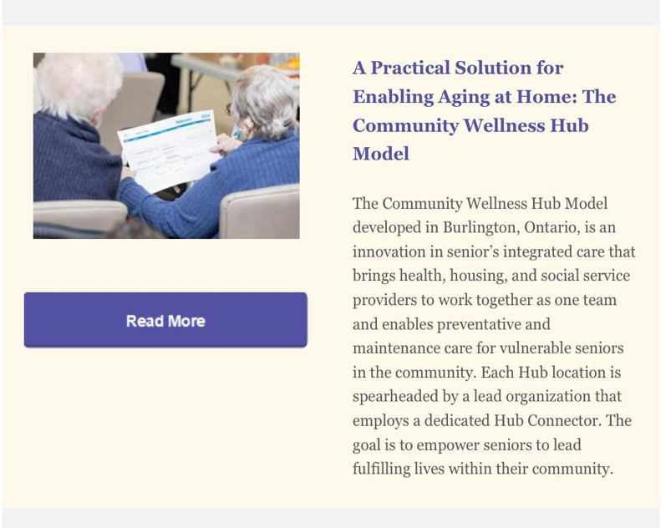
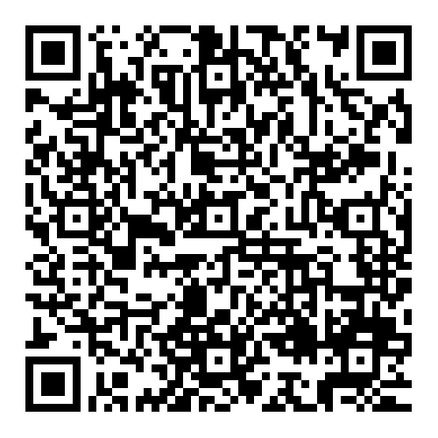
50 presentations over the last three years
Please Connect
Reham Abdelhalim
Meghan O’Neill
rabdelhalim@burlingtonoht.ca
moneill@burlingtonoht.ca

Slide 70



Evaluation in equity-centered learning health systems – experiences from Northern Ontario Health Teams
Brianne Wood, PhD bwood@nosm.ca
@Brianne Wood

Slide 71

Land acknowledgment
Northern Ontario includes six treaty areas:
Robinson-Huron, 1850, north of Lake Huron including Manitoulin Island;
Robinson-Superior, 1850, north of Lake Superior;
Manitoulin Island Treaty, 1862, Manitoulin Island excepting Wikwemikong Unceeded Indian Reserve #2;
Treaty 3, 1873, southern part of Northwestern Ontario;
Treaty 5, 1875, portion of area extends into western Ontario from Manitoba; and,
Treaty 9, northern two-thirds of Northern Ontario.
Reconciliation is a practice. We recognize the importance and contributions from Elders, Knowledge Keepers, and Indigenous knowledge systems. We acknowledge that these are likely different from traditional research approaches and practices.

Slide 72



Today’s talk
1
2
3
Learning Health Systems in Northern, rural, isolated settings
Two evaluation considerations
Learnings & take-homes

Slide 73


Motivation?
All of these recommendations still stand true 7 years later…
“[There is no] dedicated healthcare strategy that addresses all the north region’s unique challenges; this is critical for improving access to health care for Northern Ontario patients and for supporting … the delivery of services.”
“Programs for patients and health-care staff in Northern Ontario not regularly evaluated”
Northern Health Equity Strategy: https://www.hqontario.ca/System-Performance/Specialized-Reports/Health-Equity-in-Northern-Ontario
Ontario Auditor General’s Report 2023:
https://auditor.on.ca/en/content/annualreports/arbyyear/ar2023.html

Slide 74
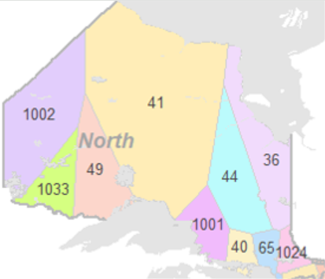
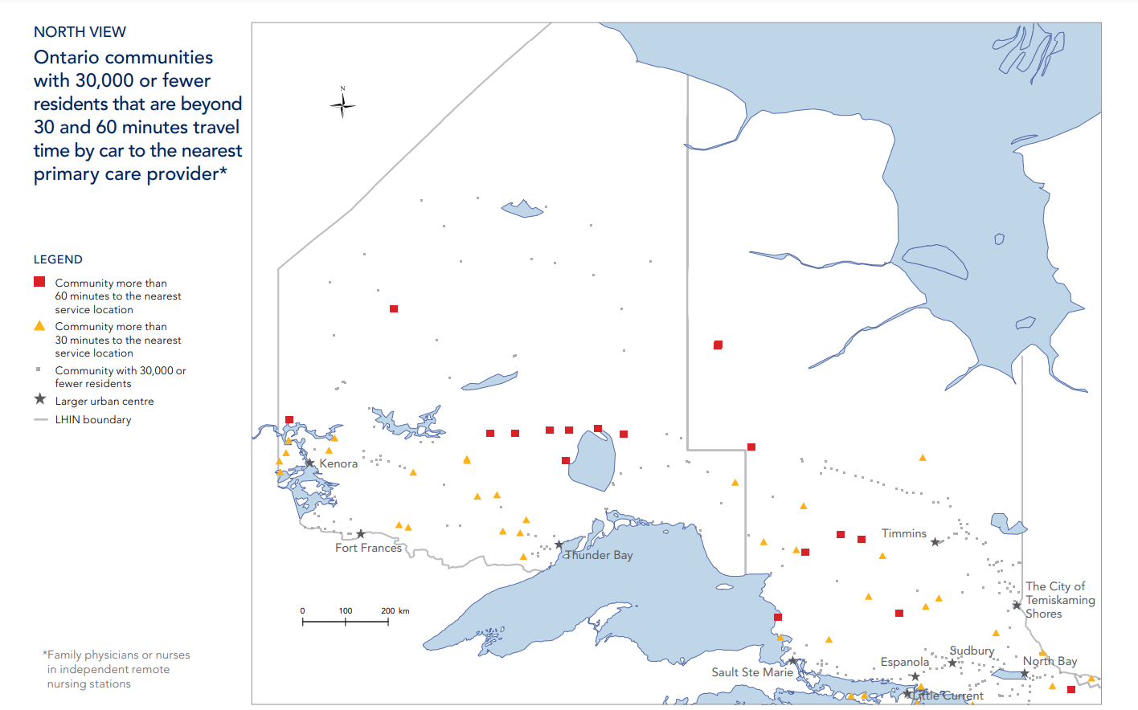
What is our context?
11 OHTs
Primary care
Range in size of patient population, partners, priorities. Three in i12.
Is sometimes the only local care, and it might be delivered in unexpected places
We collaborate
Diverse
Because we need to, and we always have.
Often painted as “the North”, we are not a singular population. We are also often “Othered” because of this.
Notes:
Northern as a structural determinant of health
Population size > 250,000 (significantly underrepresented for Indigenous population)
•Geographic landmass equivalent to 47% of Ontario
•Population has poorest health status and greatest health needs compared to all other Ontario regions
•Significantly lower life expectancy and higher rates of avoidable deaths
•Health human resource challenges; requiring collaboration over competition to ensure equitable care close to home

Slide 75
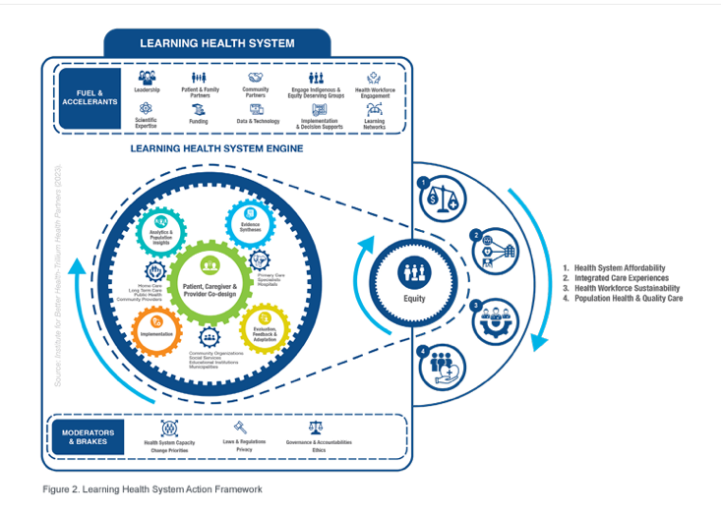


What’s unique about “learning” in northern, rural, remote contexts?
Smaller workforce -> Generalist expertise
Existing networks and relationships – working across OHTs
Different population health profiles and priorities
Academic institutions have explicit social accountability goals

Slide 76
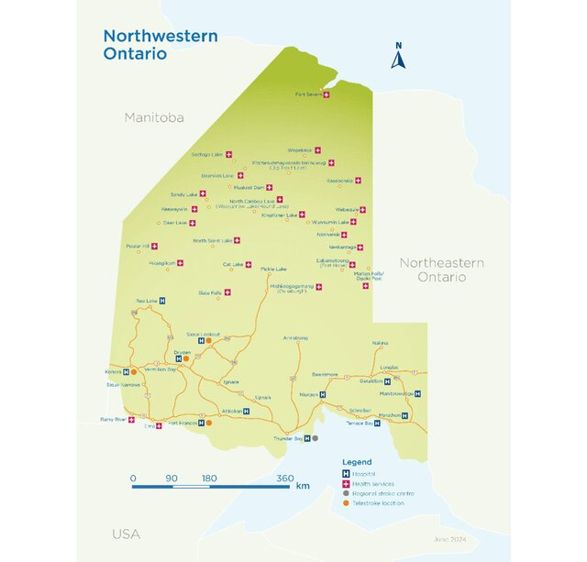

Case 1
The uniqueness of northern & rural health systems
Hassan A, Benlamri R, Diner T, Cristofaro K, Dillistone L, Khallouki H, Ahghari M, Littlefield S, Siddiqui R, MacDonald R, Savage DW. An App for Navigating Patient Transportation and Acute Stroke Care in Northwestern Ontario Using Machine Learning: Retrospective Study. JMIR Form Res. 2024 Aug 1;8:e54009. doi: 10.2196/54009. PMID: 39088821; PMCID: PMC11327622.

Slide 77
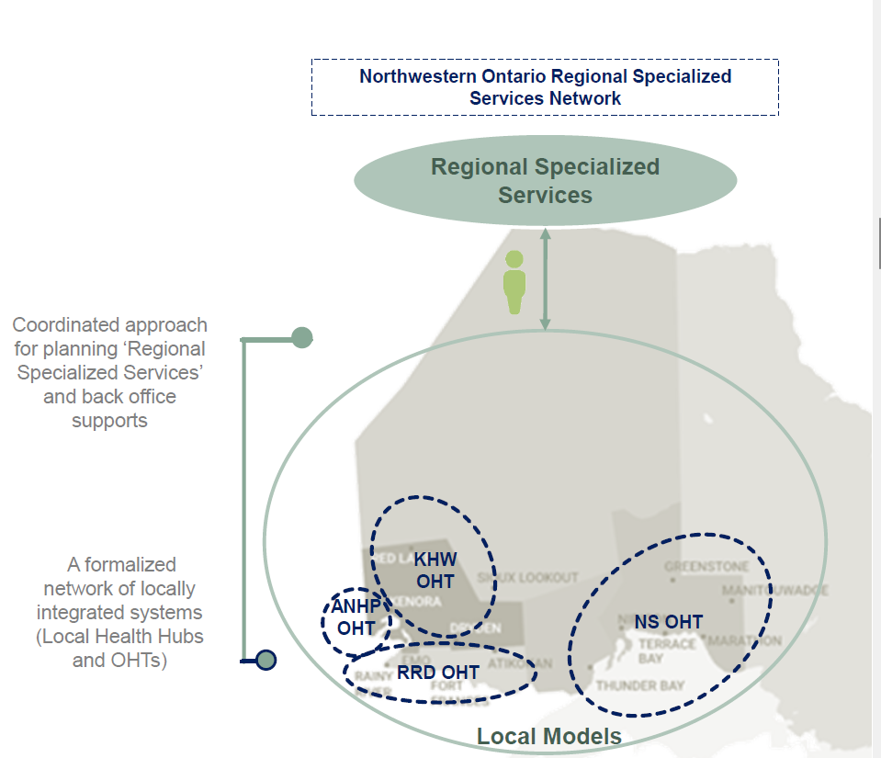
Situation: OHTs might not have (data, measurement) evaluation capacity on their team
Idea: create a structure that facilitates evaluation support and advisory with data-related efforts
Regional collaboration – a working group with a “Standing committee” of data, measurement, and evaluation expertise
Standing committee meets with OHT data, quality improvement, project managers + working group leads to plan evaluation (and performance measurement), determine metrics, coordinate data collection, supplement or aggregate analyses, and guide reporting

Slide 78

Regional data, measurement and evaluation group
Successes
Alignment across OHTs and “no one left behind”
Filling important gaps and expertise
Building capacity among others in the workforce
Alignment with regional digital efforts
Hot spots
Determining scope (OHTs are asked to do a lot of measurement, evaluation as part of PHM, on top of reporting for accountability)
All the meetings
Connecting local to regional in the right ways

Slide 79

Case 2
The uniqueness of the populations

Slide 80

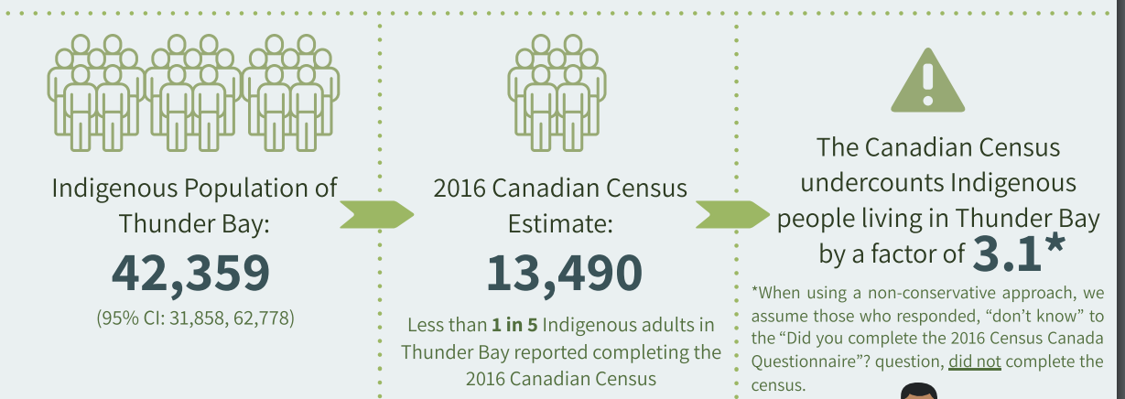
Situation: data reports, estimates, and publications do not reflect our (health and care) realities
Why? Small sample sizes across OHT, reliance on census data, OHIP billing, hospital, provincial data to infer population health status, large land mass
Indigenous data and knowledge sovereignty
Idea: Develop an equity-centered data strategy in collaboration with communities to supplement existing data sources to be owned by the communities themselves
Strategy will focus on the types of information that is needed and approaches to acquire the information, while recognizing FAIR and CARE principles
McConkey, S., Brar, R., Blais G., Hardy, M., Smylie, J. (2022). Indigenous Population Estimates for the City of Thunder Bay
Notes:
A lot of the time (we even do it too, look at the last couple of slides), we try to centralize activities like data collection, analysis, reporting, because it helps to standardize which is important for comparability, consistency, rigour, transparency. Particularly in the OHT space, and other

Slide 81

Northern data strategy
Successes
Interest and commitment to collectively work on this
Will allow us to answer questions about whether we make meaningful change
A collective, coordinated approach to advance regional and provincial programs
Hot spots
Sometimes “good enough” still isn’t good enough (e.g., law of large numbers doesn’t work when it’s the wrong population)
How do we resource this while still doing all of the other work?

Slide 82




Learning from evaluation with Northern OHTs
Team-based works best
Make capacity-building part of the strategy
Data collection is inevitable
Know the “so what” ahead of time
Needs to be done carefully, strategically, and with transparent governance.
Share the work, bring others along, use resources wisely
Commit to the action, know your why
Helps to manage the power dynamics too

Slide 83





Thank you for listening
Brianne Wood, PhD
Associate Scientist, Social Accountability and Learning Health Systems (bwood@nosm.ca)

Slide 84
Up Next
HSPN webinar series
  4th Tuesday of the Month: 12:00 – 1:30 pm
Upcoming January 2025:
Brakes and Accelerators for the Learning Health System

Slide 85
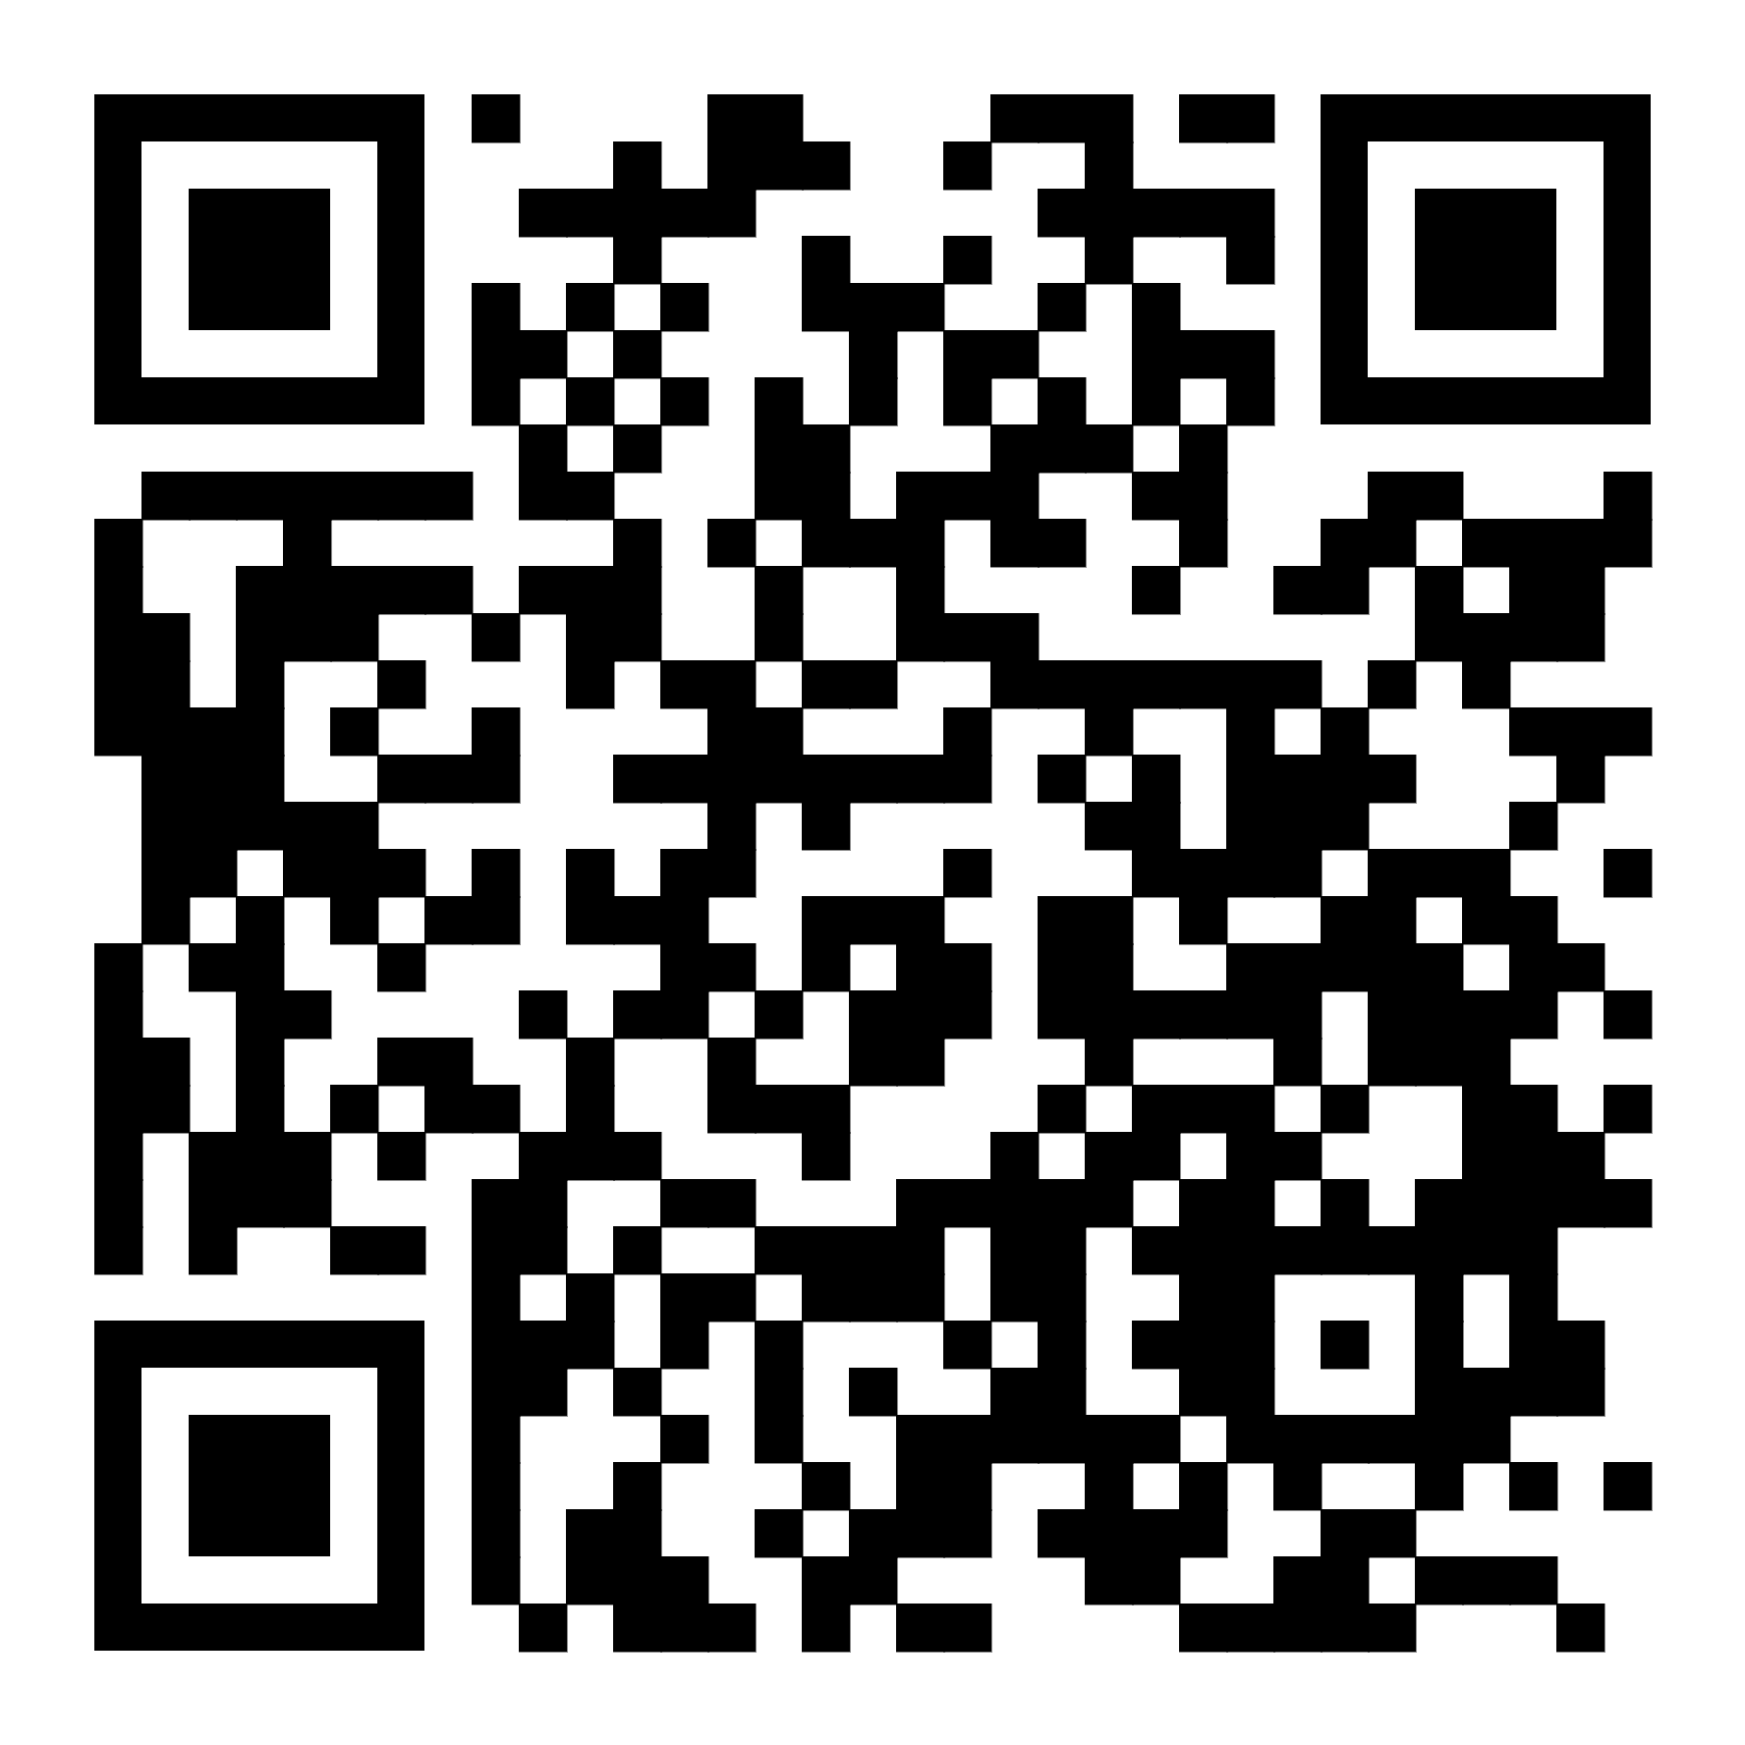
Can you share some feedback? Scan here! (or click link in chat)

Slide 86




THANK YOU!
@infohspn
hspn@utoronto.ca
The Health System Performance Network
hspn.ca

