Slide 1
Advancing the Learning Health System in Ontario
Part 7: Measuring LHS capabilities
+ Enablers and Barriers
(Fuel, Accelerants, Moderators and Brakes)
HSPN Monthly Webinar
January 28, 2025

Slide 2
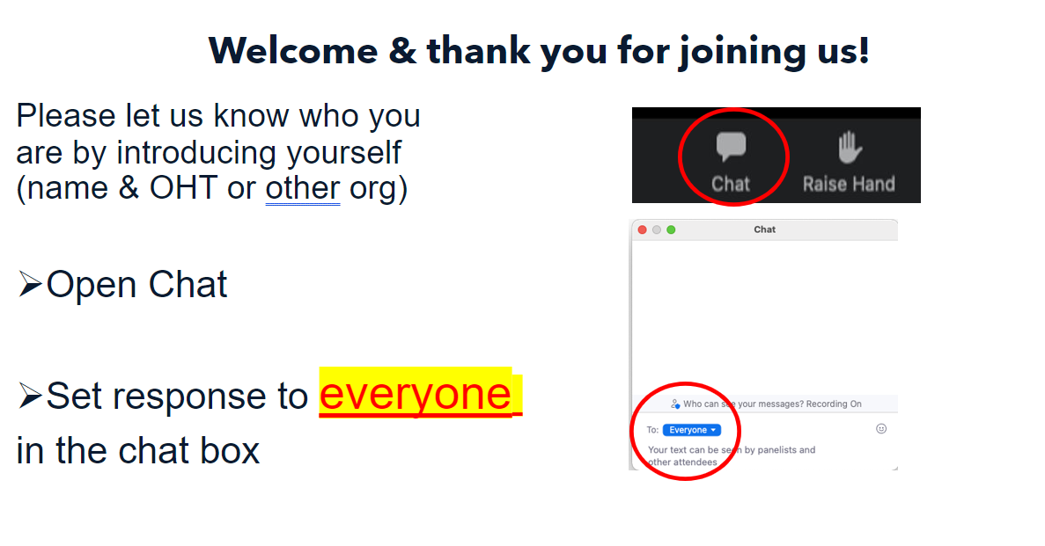

Slide 3
Land Acknowledgement
​
We wish to acknowledge this land on which the University of Toronto operates. For thousands of years it has been the traditional land of the Huron-Wendat, the Seneca, and the Mississaugas of the Credit. Today, this meeting place is still the home to many Indigenous people from across Turtle Island and we are grateful to have the opportunity to work on this land.

Slide 4
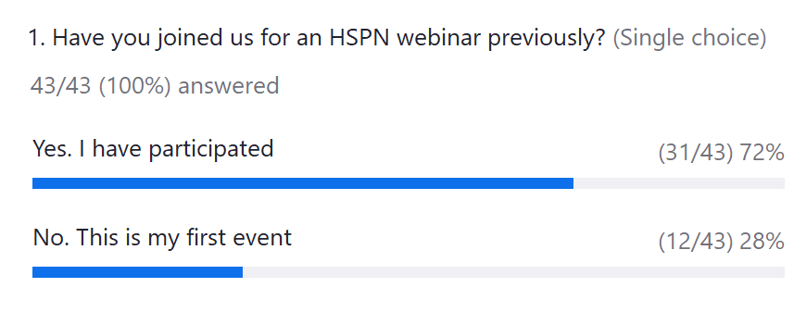
Poll 1

Slide 5
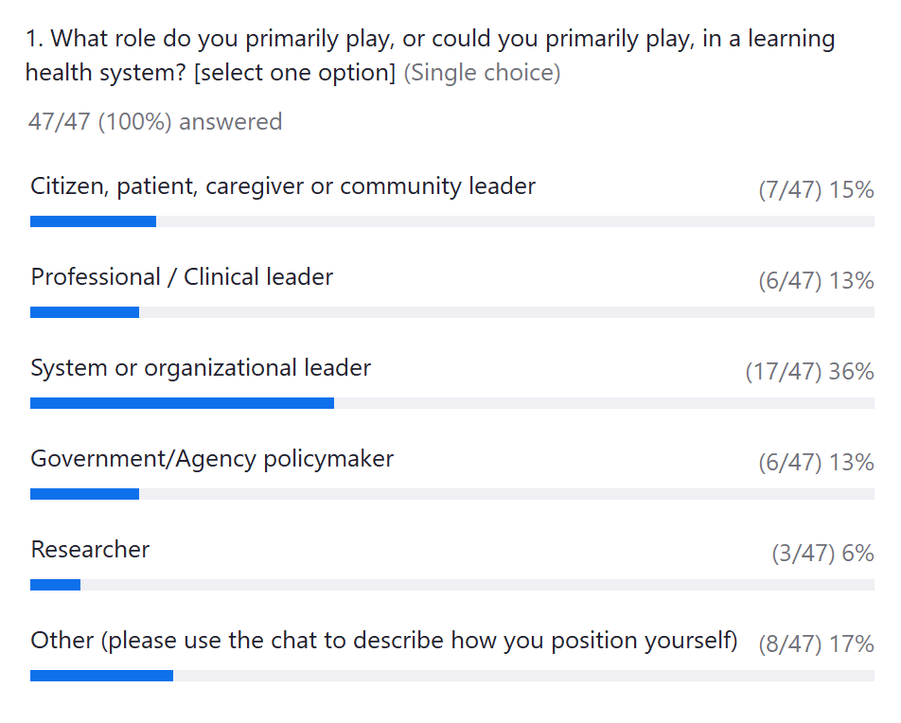
Poll 2

Slide 6
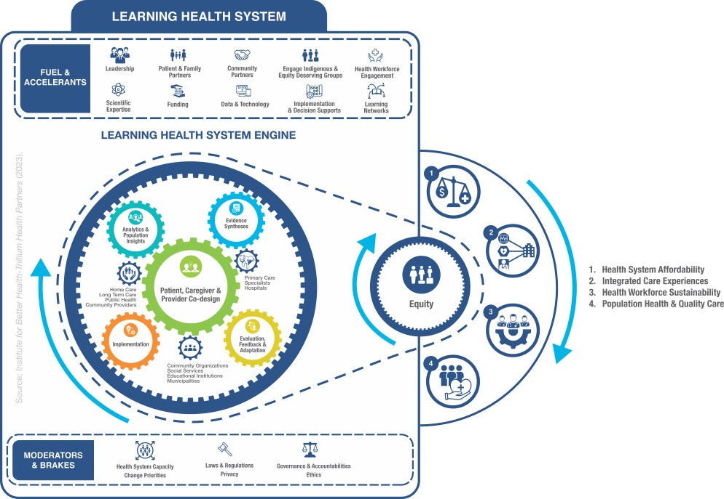

LEARNING HEALTH SYSTEM ACTION FRAMEWORK
SOURCE: Institute for Better Health-Trillium Health Partners (2023).
Notes:
Here is the LHS Action Framework that we have been building and refining at IBH with the help of leaders, patients and community members across Ontario. This is the framework we are now consistently using at IBH and THP.
The framework is presented as a learning engine (a clean engine of course!) that creates motion in a production line. For this engine, the products are the quintuple aim – population health, good health care experiences for patients and caregivers, a sustainable work life for health care providers, affordability, and of course, equity across our communities.
The engine has 5 learning gears and 3 health system gears that describe the intersections of research and care delivery. These gears intersect with each other and result in sustained motion.
Like any engine, the LHS engine requires a constant infusion of fuel and accelerants.
And of course it has brakes and moderators that keep it on course and safe.
The next slides focus on the gears and outputs, as well as the fuels, accelerants, brakes and moderators.

Slide 7
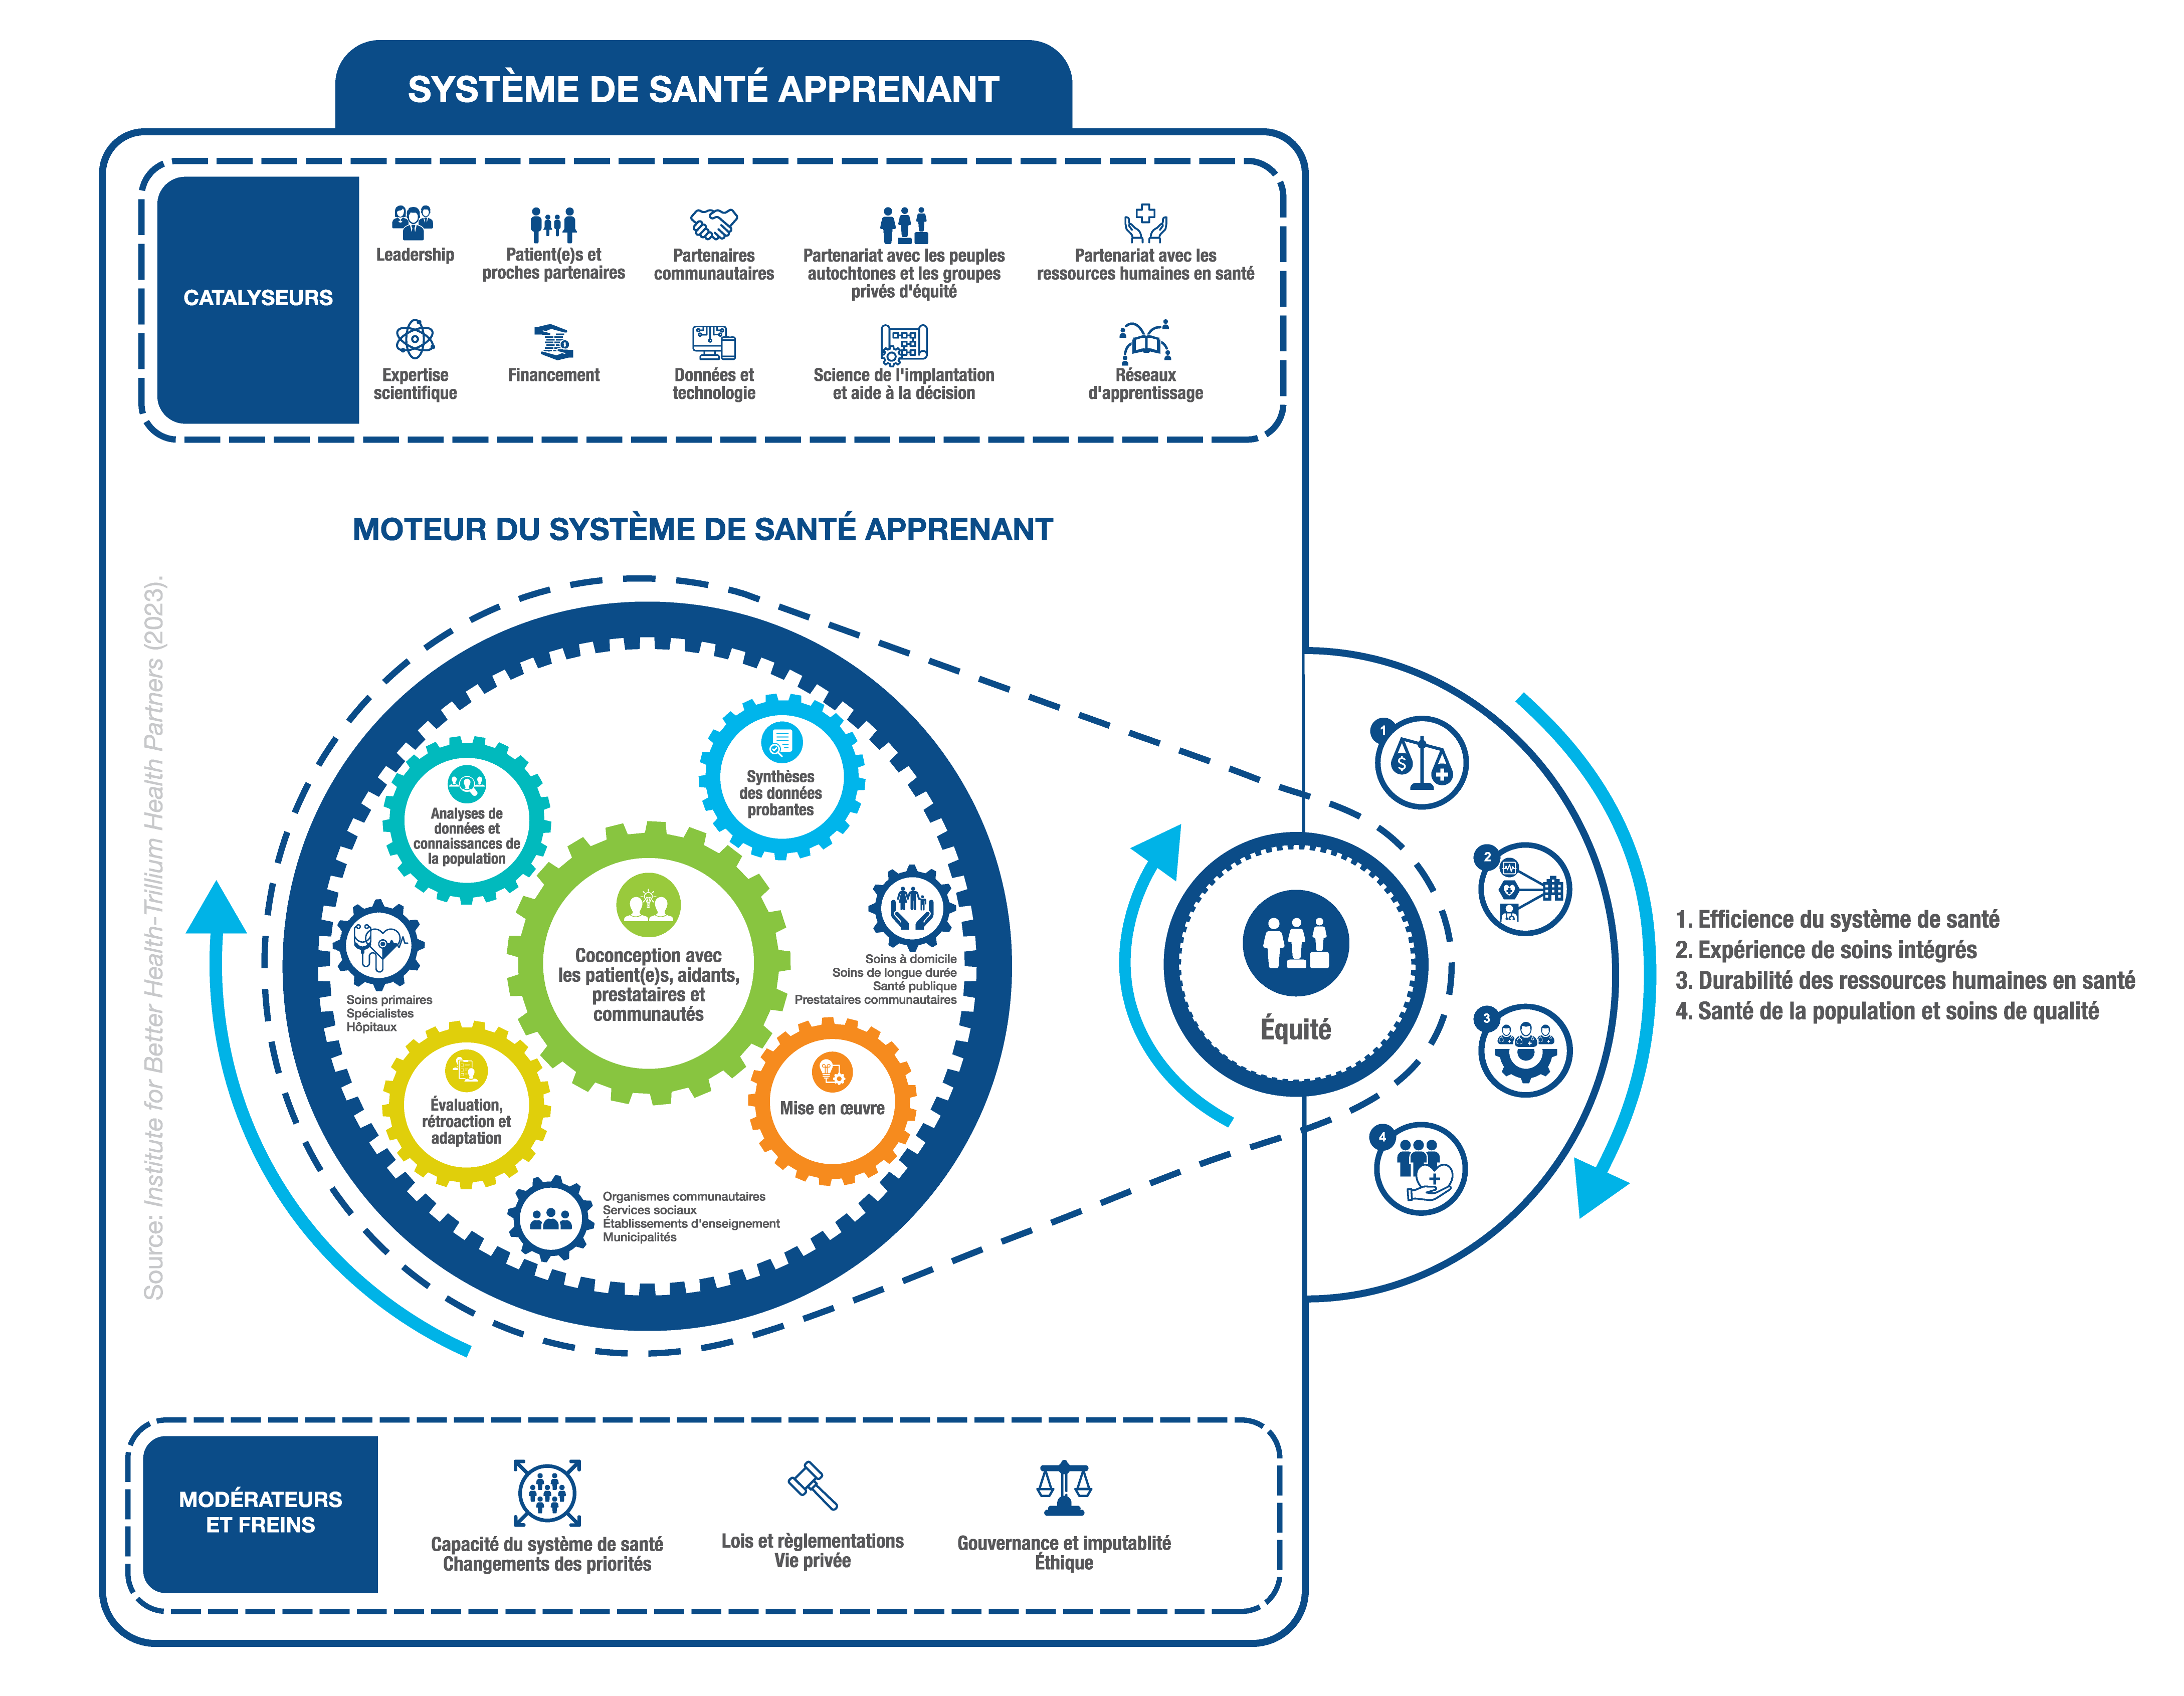
AUSSI
DISPONIBLE
EN FRANCAIS
(merci
Soutien Quebec)
SOURCE: Institute for Better Health-Trillium Health Partners (2023).
Notes:
Here is the LHS Action Framework that we have been building and refining at IBH with the help of leaders, patients and community members across Ontario. This is the framework we are now consistently using at IBH and THP.
The framework is presented as a learning engine (a clean engine of course!) that creates motion in a production line. For this engine, the products are the quintuple aim – population health, good health care experiences for patients and caregivers, a sustainable work life for health care providers, affordability, and of course, equity across our communities.
The engine has 5 learning gears and 3 health system gears that describe the intersections of research and care delivery. These gears intersect with each other and result in sustained motion.
Like any engine, the LHS engine requires a constant infusion of fuel and accelerants.
And of course it has brakes and moderators that keep it on course and safe.
The next slides focus on the gears and outputs, as well as the fuels, accelerants, brakes and moderators.

Slide 8



We Can Assess Capability on this Framework
Introduction to LHS Capability Assessment Instrument
Purpose
Structure
Development methods
Pilot test results
Discussion Topics & Feedback
  Data visualization options
  Application methodology
  Results: planning for improvement

Slide 9


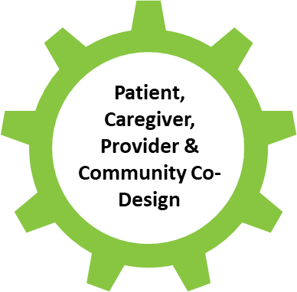


What does it do?
How is it structured?
Measures LHS capabilities: mapped across the LHS “gears”
To be completed by interprofessional collaborators (executive leaders, managers, frontline clinicians, implementation & QI leads, evaluation/data, researchers, operational supports, etc.)
Enables LHS self-assessments for a shared understanding of current state of development (team, program, or organizational level)
Survey instrument
  Understandable terminology across disciplines
  Generalizable across settings
  Easy-to-use, low measurement burden (~20 minutes)
Likert-scale, 40 items:
  Quantitative: measures of capability levels (i.e., extent to which LHS gears are enacted in practice)
  Qualitative: open-ended comments (i.e., barriers, opportunities, challenges, facilitators, change ideas, examples)
Measurement Instrument
Reid et al 2024 – “Actioning the Learning Health System: An applied framework for integrating research into health systems”. SSM - Health Systems; Volume 2, (June 2024)

Slide 10
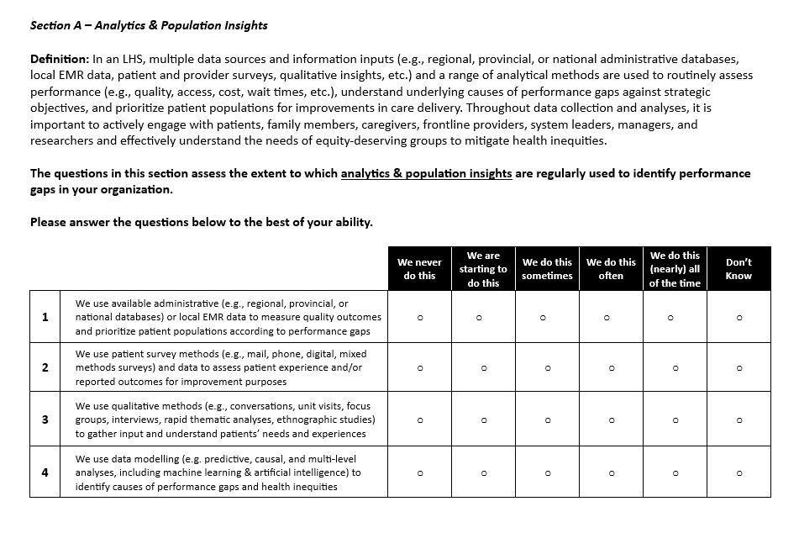

Slide 11
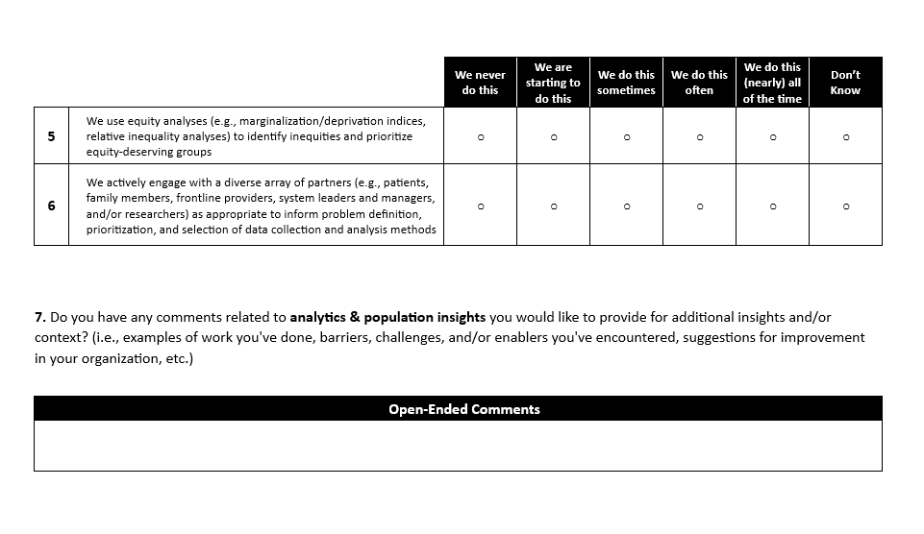

Slide 12
Measurement Instrument: Capability Assessment Attributes
1. Analytics and Population Insights | 2. Evidence Synthesis | 3. Patient, Caregiver, & Provider Co-Design | 4. Implementation | 5. Evaluation, Feedback, & Adaptation | 6. Organizational Enablers
Descriptive Clinical-Administrative Data Analysis | Evidence Syntheses Question Definitions | Engagement with Partners for Co-Design | Implementation Solutions Alignment | Evaluation Methods | Leadership and Strategy
Patient-Reported Data Analysis | Evidence Syntheses Methods | Co-Design Methods and Techniques | Operational Support for Implementation | Evaluation Agility and Frequency | Operational and Technological Supports
Qualitative Data Analysis | Use of Evidence Syntheses Findings | Mitigation of Participation Barriers and Power Imbalances | Resources and Accountability for Implementation | Use of Evaluation Findings | Community Engagement and Learning Networks
Data Modelling | Engagement with Partners for Evidence Syntheses |  | Participatory Leadership for Implementation | Evaluation Scope | Short-Term and Long-Term Funding
Equity Analysis |  |  | Engagement with Partners for Implementation | Engagement with Partners for Evaluation | Laws, Regulations, & Ethical Oversight
Engagement with Partners for Analytics

Slide 13
Pilot Test – Health Care Network
Horizontal
1. We never do this
2. We are starting to do this
3. We do this sometimes
4. We do this often
5. We do this (nearly) all of the time
Mean = 3.10
Mean = 3.57
LHS Gears
Mean = 2.90
Mean = 3.53
Mean = 2.94

Slide 14
Advancing the Learning Health System:
7 Part Series
Introduction to Learning Health System Action Framework and 5 gears
Gear 1: Population data insights
Gear 2: Evidence gathering and synthesis
Gear 3: Co-design
Gear 4: Implementation
Gear 5: Evaluation and Feedback
Review
+ Enablers and Barriers: Fuel, Accelerants, Moderators and Brakes
+ Measuring capabilities for Learning Health System

Slide 15
Advancing the Learning Health System:
7 Part Series

Slide 16
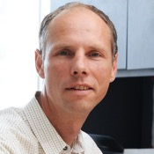


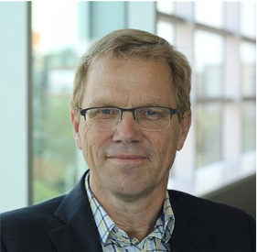

Today’s event
What is a Learning Health System
Host
Walter Wodchis
Principal Investigator HSPN
Presenters
John Lavis
Co-Lead RISE
Maureen Smith
Citizen Partner
Rob Reid
Co-Lead RISE
Kelly Smith
Chair in Patient-Oriented Research
HSPN Monthly Webinar co-hosted by RISE and HSPN
April 23, 2024
Notes:
ROB -1 min

Slide 17
Seven features of a learning health system
The combination of a health system and research system that, at all levels, is
anchored on patients’ / clients’ needs, perspectives and aspirations (1)
driven by timely data (2) and evidence (3)
supported by appropriate decision supports (4) and aligned governance, financial and care / service delivery arrangements (5)
enabled with a culture of (6), and competencies for (7), rapid learning and improvement
Notes:
John

Slide 18
Two actions at the heart of a learning health system
Use ‘learning and improvement cycles’ – in all ‘layers’ and especially with patients / clients (1), organized around tests of change, drawing on many forms of evidence (2 & 3), and involving research | operations | patient/client and family partnerships at the many ‘coalfaces’
Make ‘any change for the better’ the ‘new normal’ (and not yet another pilot project) – with appropriate decision supports (4), aligned governance, financial & care/service delivery arrangements (5), and both culture (6) and competencies (7)
Notes:
John

Slide 19
Who are the evidence ‘trades’ supporting learning and improvement cycles and making any change for the better the ‘new normal’?
Data analytics (and modeling)
  Who is providing the data analytics, including about equity-centred quadriple-aim metrics? (e.g., IC/ES, INSPIRE-PHC, RISE-NOSM)
Evaluation
  Who is doing the rapid evaluations of ‘tests of change’?
Behavioural / implementation research
  Who is doing the behavioural / implementation research to address barriers to accessing care and to changing practice?
Qualitative insights
  Who is systematically capturing qualitative insights from patients/clients and citizens and from clinicians?
Evidence synthesis
  Who is providing ultra-rapid contextualized evidence syntheses? (e.g., RISE-MHF)
Health technology assessments
  Who is accessing reports from OTAC, CADTH, etc. or preparing their own?
Guidelines
  Who is sourcing, assessing and adapting OH quality standards and guidance documents or preparing their own?
Notes:
John

Slide 20
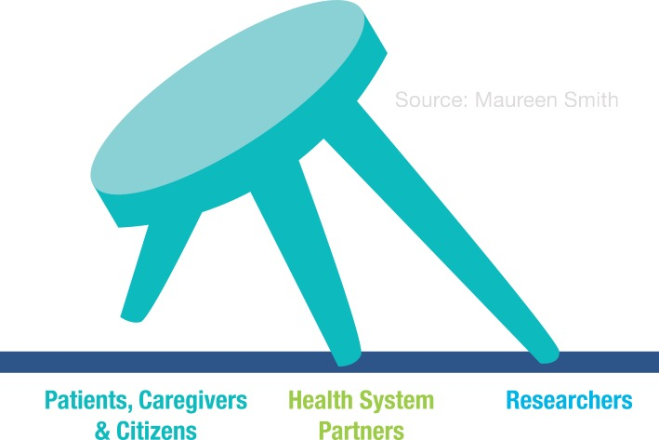
Patients are more than data donors
Learning health system (LHS): Embedding research into health systems, continuously learning from data and translating findings into care / services in real time – means much more than data donors!
A scoping review of LHS articles from 2016 to 2020 found articles discussing the level of patient involvement in LHS were scarce
No common language, tools or frameworks for discussing and operationalizing LHS exist, making it likely that many healthcare institutions are using this approach without explicitly naming it as such
Tools that exist are often not suited to engaging people and communities with diverse voices and needs, particularly those from equity deserving groups
SOURCES:
Lee-Foon NK, Smith M, Greene SM, Kuluski K, Reid RJ. Positioning patients to partner: exploring ways to better integrate patient involvement in the learning health systems. Research Involvement and Engagement. 2023;9(1):1-5.
Zurynski Y, et al Mapping the learning health system: a scoping review of current evidence. Sydney: Australian Institute of Health Innovation. 2020
Kuluski K, Guilcher SJ. Toward a person-centred learning health system: understanding value from the perspectives of patients and caregivers. Healthcare Papers. 2019;18(4):36-46.
Page 20

Slide 21
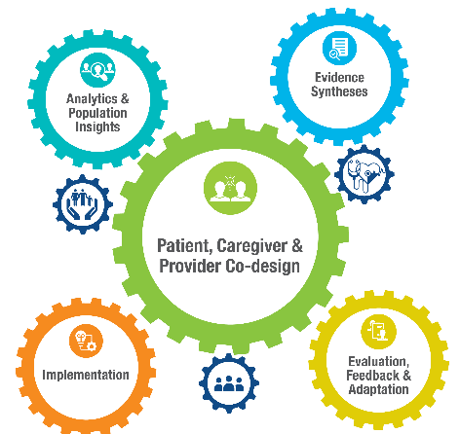
Review of the 5 Gears

Slide 22

Learning Gear 1: Analytics & Population Insights
Description: Using comprehensive data (quantitative & qualitative) and advanced analytic approaches on populations served to understand health service needs, gaps, inequities, preferences & aspirations.
Sample Questions: Where are system gaps & what’s driving them? Where are the inequities? What priorities are we addressing (or what problems are we solving)? What are patient, caregiver, community preferences & aspirations?
Health System Affinities: business intelligence functions, data decision & analytics supports, program planning groups, clinical informatics, patient and family advisory councils, etc.
Notes:
Here is the LHS Action Framework that we have been building and refining at IBH with the help of leaders, patients and community members across Ontario. This is the framework we are now consistently using at IBH and THP.
The framework is presented as a learning engine (a clean engine of course!) that creates motion in a production line. For this engine, the products are the quintuple aim – population health, good health care experiences for patients and caregivers, a sustainable work life for health care providers, affordability, and of course, equity across our communities.
The engine has 5 learning gears and 3 health system gears that describe the intersections of research and care delivery. These gears intersect with each other and result in sustained motion.
Like any engine, the LHS engine requires a constant infusion of fuel and accelerants.
And of course it has brakes and moderators that keep it on course and safe.
The next slides focus on the gears and outputs, as well as the fuels, accelerants, brakes and moderators.

Slide 23

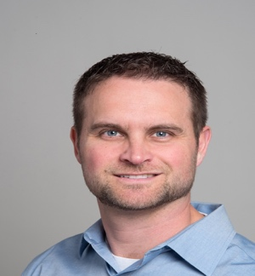



Today’s event
LHS Analytics and Insights
Host
Presenters
Dr. Matthew Meyer
Senior Director of Population Health Management
London Health Sciences and London-Middlesex OHT
Emmi Perkins
Director of Transformation
Guelph-Wellington OHT
Dr. Sara Shearkhani
Scientist
Michael Garron Hospital and East Toronto Health Partners
Sarah-Grace Bebenek
Project Manager
South Georgian Bay OHT
HSPN Monthly Webinar
May 28, 2024

Slide 24
What We Know
Slides shared with the MLOHT
(then Western OHT)
Coordinating Council in 2019
Our attributed population (MoH data unless otherwise stated)
514,024 people
  92,045 (17.9%) >65yrs
  199,332 (38.7%) >50
  23,011 Frail Adults >65 (Canadian Frailty Network projection)
148,784 (28.9%) live outside of London
9,252 (1.8%) Francophone (SW LHIN)
  Arabic most common language besides English
87,384 (17%) visible minority (SW LHIN)
88,412 (17.2%) living in poverty (SW LHIN)

Slide 25
What We Know
8/10 include sig comorbidities
Total spend on these 8 = $413.1M

Slide 26
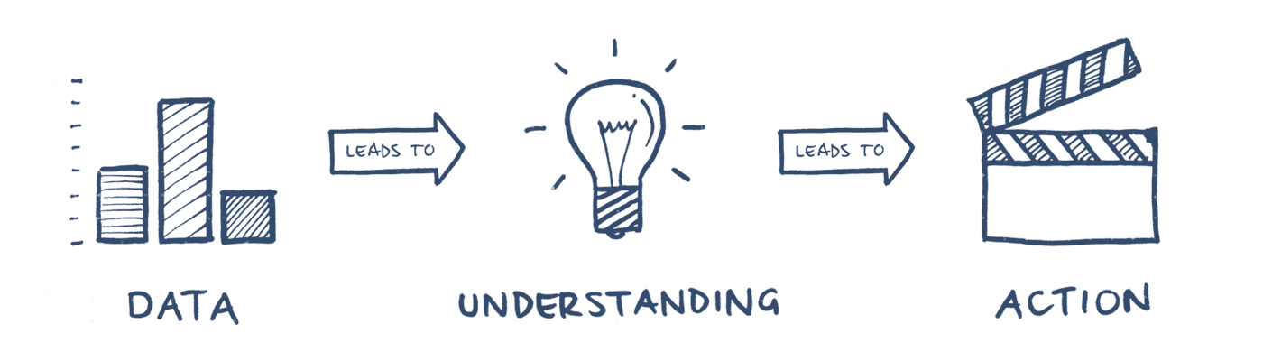
Data for Improvement
Notes:
Additional data

Slide 27

Patient Experience Survey Outcomes
Survey Themes
Actions
How to help support patients who are marginalized/vulnerable
Assessing the patient experience for those with no family doctor or nurse practitioner
Access to services/care
Patient/caregiver involvement as a member of the care team
Use of digital tools to support care
Understanding the demographics of our population
SGB OHT Clinic for unattached population
Development of a patient handbook
Furthering patient and caregiver advocacy work
Patient tools to support use of digital tools
Improving accessibility to
communications around services
Data to inform SGB OHT decision making and resource allocation

Slide 28
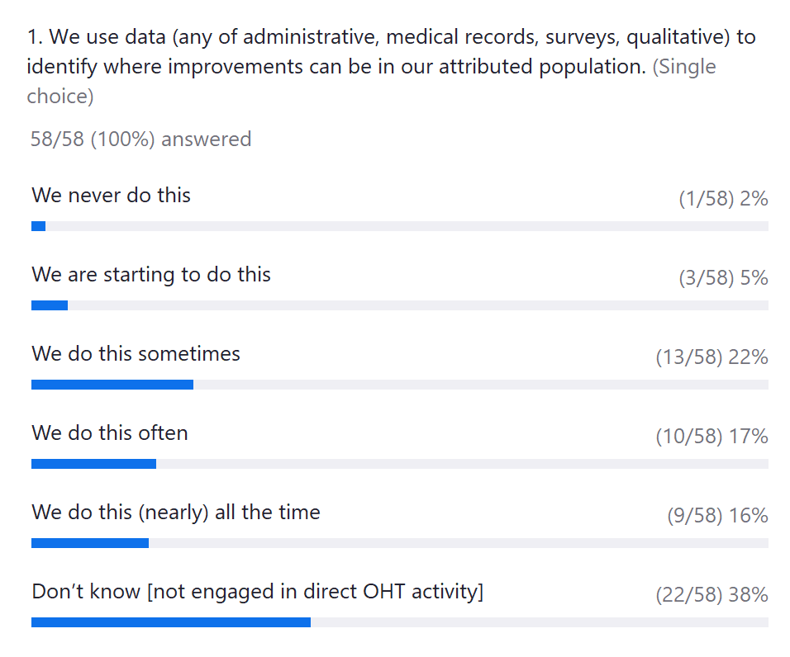
Poll 3

Slide 29
LHS Gears Capabilities – Analytics and Population Insights

Slide 30

Learning Gear 2: Evidence
Description: Rapid syntheses of existing evidence to understand the success or failure of solutions to similar problems tested elsewhere as well as barriers and promoters.
Sample Questions: What has worked and not worked elsewhere? What are key components & adaptable periphery? What conditions and contextual issues are key? What barriers need to be addressed?
Health System Affinities: Health system librarians, clinical guideline development teams, provincial & federal evidence synthesis supports, Cochrane collaboration, SPOR Evidence Alliance, global evidence consortia
Notes:
Here is the LHS Action Framework that we have been building and refining at IBH with the help of leaders, patients and community members across Ontario. This is the framework we are now consistently using at IBH and THP.
The framework is presented as a learning engine (a clean engine of course!) that creates motion in a production line. For this engine, the products are the quintuple aim – population health, good health care experiences for patients and caregivers, a sustainable work life for health care providers, affordability, and of course, equity across our communities.
The engine has 5 learning gears and 3 health system gears that describe the intersections of research and care delivery. These gears intersect with each other and result in sustained motion.
Like any engine, the LHS engine requires a constant infusion of fuel and accelerants.
And of course it has brakes and moderators that keep it on course and safe.
The next slides focus on the gears and outputs, as well as the fuels, accelerants, brakes and moderators.

Slide 31
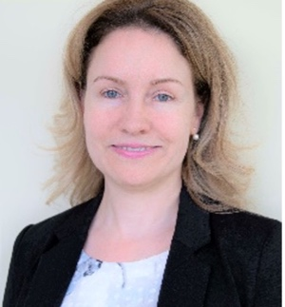

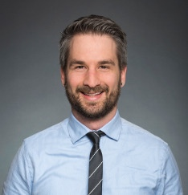

Today’s event
LHS Evidence Syntheses & More
Host
Presenters
Dr. Diana Urajnik
Director
Centre for Northern and Rural Health Research
John Hogenbirk
Associate Director
Centre for Northern and Rural Health Research
Dr. Justin Presseau
Program Director
Scientific Lead Knowledge Translation
Ottawa Methods Centre
Kaelen Moat
Managing Director, Senior Scientific Lead
Evidence Products and Processes
McMaster Health Forum
HSPN Monthly Webinar
June 25, 2024

Slide 32




Areas of expertise
Patient-oriented research & training (with an equity, diversity, inclusion, Indigeneity lens)
Minority and marginalized populations
Learning Health Systems (embedded partner in OHTs and member of the OSSU LHS WG)
Health service access and use
Human resources for health
Digital / Virtual care
CRaNHR is an OSSU Centre under the Strategy for Patient-Oriented Research initiative. CRaNHR is the only such centre in northern Ontario.

Slide 33


Centre for Implementation Research
Established in 2018, assembles world-leading interdisciplinary implementation scientists with expertise in:
Audit and feedback
Decision aids
Clinical practice guideline development/evaluation
Evidence synthesis
Integrated knowledge translation and community partnerships
Health care professional behaviour change
Behaviour change in patients/general public
Health economic evaluation
Qualitative, survey, and consensus methods
Intervention evaluation
Barriers/enablers assessment
Intervention co-development

Slide 34
Enabling evidence-informed learning and improvement processes
Kaelan Moat, PhD
Managing Director/Senior Scientific Lead, McMaster Health Forum and Assistant Professor (Part-Time), McMaster University
25 June 2024
Notes:
John

Slide 35





Five prompts for being systematic and transparent when drawing on existing evidence syntheses in rapid learning and improvement
5. Know where to go to find high-performing evidence-support units, by form of evidence and topic area, and how to set standards for those supporting the flow of new evidence
4. Know what to look for in the existing evidence, especially for evidence synthesis:
- currency (or recency)
- quality
- local applicability
(e.g., including for equity-deserving groups)
3. Leverage the right evidence repositories (and living evidence syntheses) for the form of evidence and topic area you’re interested in
2. Use a framework to generate a mutually exclusive and collectively exhaustive (MECE) list to work with
1. Confirm that research evidence (or another type of information) is actually what is needed
Keep in mind
How far and how fast evidence support has moved
How these new developments can help you do your work more efficiently and/or with greater confidence
How easy it is for people outside your organizations to assess documents it puts in the public domain
An example of a two-page prompts sheet is available upon request

Slide 36
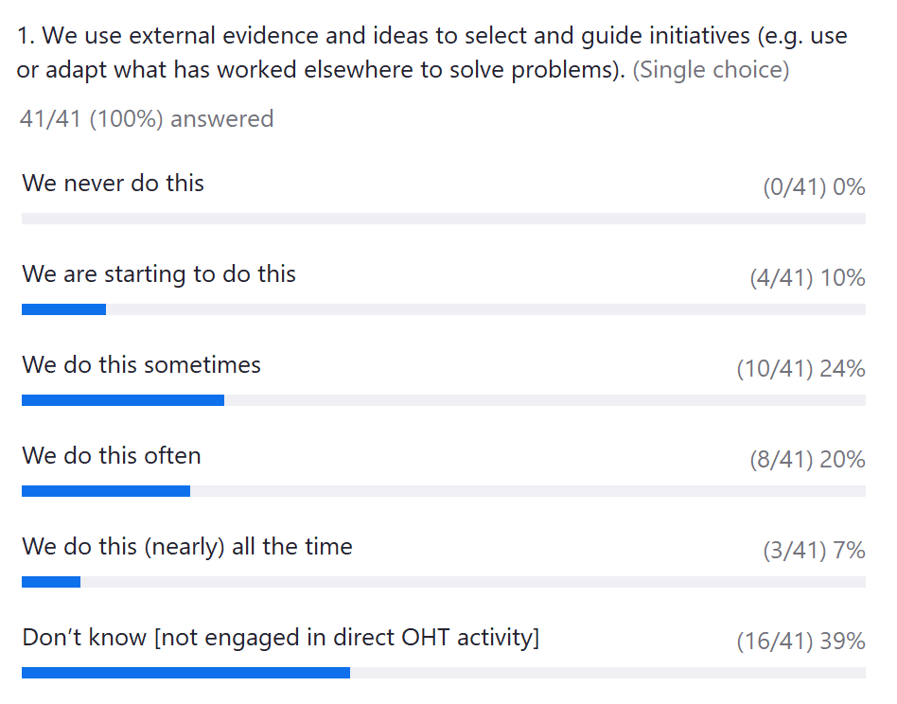
Poll 4

Slide 37
LHS Capabilities – Evidence Synthesis

Slide 38
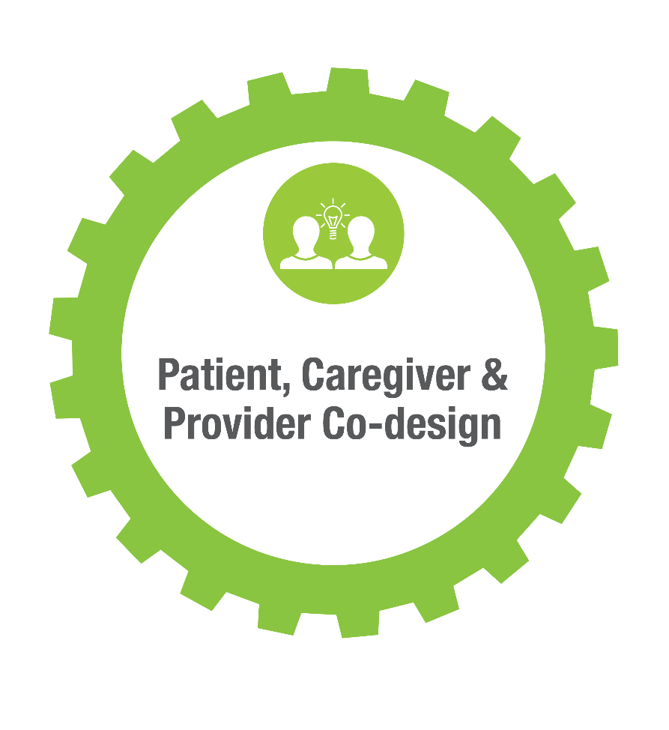
Learning Gear 3: Patient, Caregiver and Provider Co-design
Description: Direct engagement and co-design with patients, caregivers, care providers and community members impacted by the health problem alongside those who can move co-designed services towards successful implementation.
Sample Questions: what are user centered design conditions (providers, patients, caregivers, community members)? What design considerations are most important? How can technology be used? How do requirements differ for equity deserving groups? What are the feasibility constraints?
Health System Affinities: innovation & user centered design experts/teams, clinical programs/networks, health informatics programs, patient & family experience councils, community groups, health system leaders/regulators etc.
Notes:
Here is the LHS Action Framework that we have been building and refining at IBH with the help of leaders, patients and community members across Ontario. This is the framework we are now consistently using at IBH and THP.
The framework is presented as a learning engine (a clean engine of course!) that creates motion in a production line. For this engine, the products are the quintuple aim – population health, good health care experiences for patients and caregivers, a sustainable work life for health care providers, affordability, and of course, equity across our communities.
The engine has 5 learning gears and 3 health system gears that describe the intersections of research and care delivery. These gears intersect with each other and result in sustained motion.
Like any engine, the LHS engine requires a constant infusion of fuel and accelerants.
And of course it has brakes and moderators that keep it on course and safe.
The next slides focus on the gears and outputs, as well as the fuels, accelerants, brakes and moderators.

Slide 39






Today’s event: Learning Health System Co-design with Patients, Caregivers and Providers
Host
Presenters
Dr. Kerry Kuluski
Associate Professor at the Institute of Health Policy, Management and Evaluation, University of Toronto
Frances Henderson
Caregiver Advisor for Mississauga Health
Dr. Laura Harild
Clinical Co Lead for Ontario Health, Central Region, Division Head and Medical Director
Mississauga Health OHT
Yasmin Sheikhan
Vice Chair, Chair of Patient and Caregiver Advisory Council, Mid-West Toronto Ontario Health Team
Edward Aust
Director, Corporate Planning Mid-West Toronto Ontario Health Team Secretariat
Dipti Purbhoo
Executive Director at The Dorothy Ley Hospice
Mississauga Health OHT
HSPN Monthly Webinar
July 23, 2024

Slide 40
Stages of co-design
Engage- build relationships, take steps to understand the problem
Plan- stages of the work, logistics, assess needs, goals, methods to use, etc.
Explore- learn about experiences and priority areas
Develop- co-design/co-redesign improvement (intervention, process, product)
Decide- what to prioritize and refine/seek additional feedback
Change- turn improvement ideas into action
Adapted from Kiss et al (2024)- see Figure 2

Slide 41
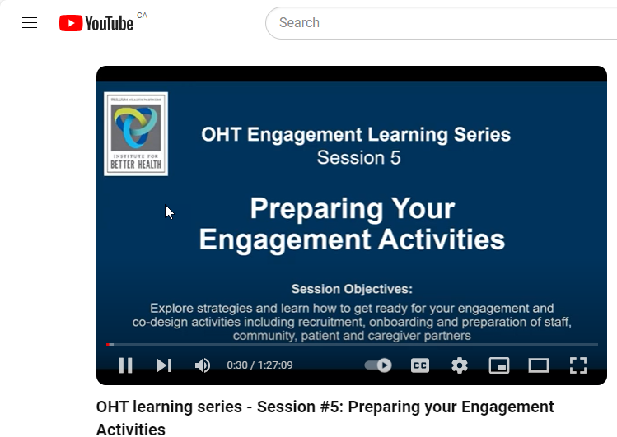
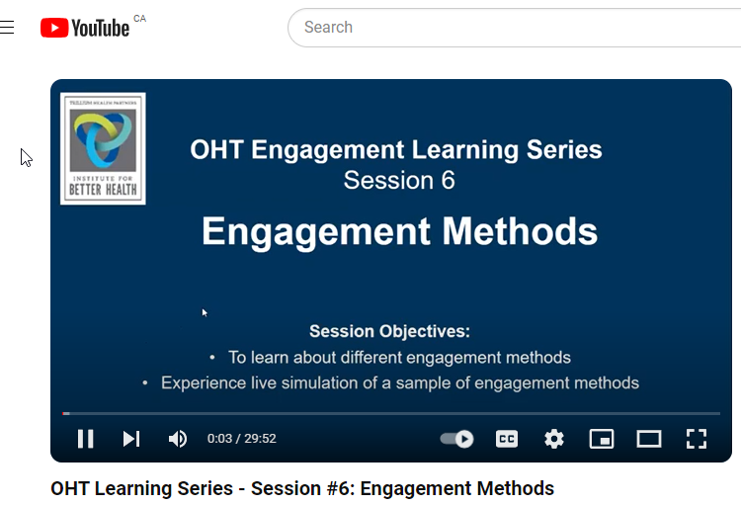
Check out our two co-design webinars!
https://www.youtube.com/watch?v=EA0A2QyK9rc
https://www.youtube.com/watch?v=FBk18YphCrY
To access the full 7-part series and workbooks:
https://www.instituteforbetterhealth.com/portfolio-items/patient-caregiver-and-community-engagement-learning-series/

Slide 42


Guiding Principles
Ministry of Health Patient, Family and Caregiver Declaration of Values
Mississauga Health Community Health Advisory Network
Purpose
To create space for the diverse voices of patients, clients, and their support networks to provide guidance on our journey of creating an inclusive care system that we can all navigate.
Role of a Community Advisor
Share experiences and those of their communities
Participate and inform key decisions and health system solutions
Make recommendations on help make our care system better for all
Review or help create resources/ materials
Help the Mississauga Ontario Health Team engage with diverse communities
Encourage members of our local communities to get involved in opportunities

Slide 43
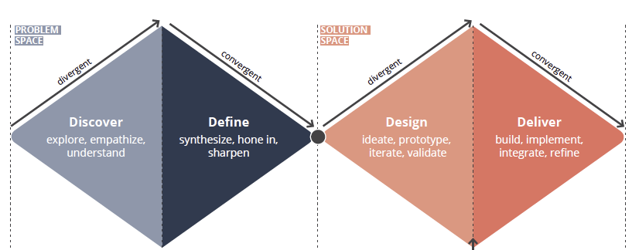
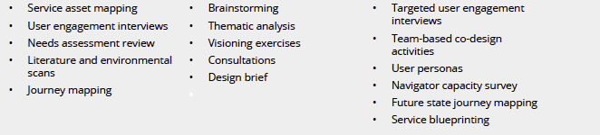
Key Components of Co-Design
Notes:
Traditionally in health care, we see people being able to participate in traditional ways
Folks be at the table and involve them in the work
Going to people in the places where they will safe
Example offer language support and peer support

Slide 44
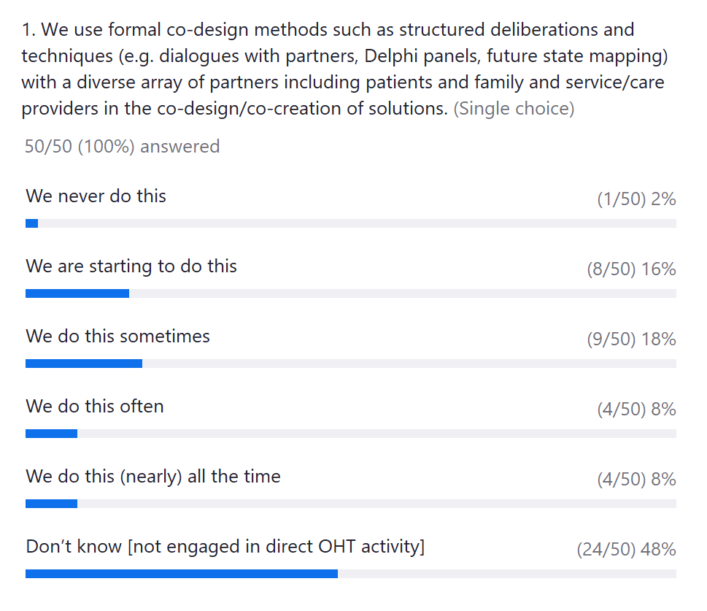
Poll 5

Slide 45
LHS Gears Capabilities – Patient and Provider Co-Design

Slide 46
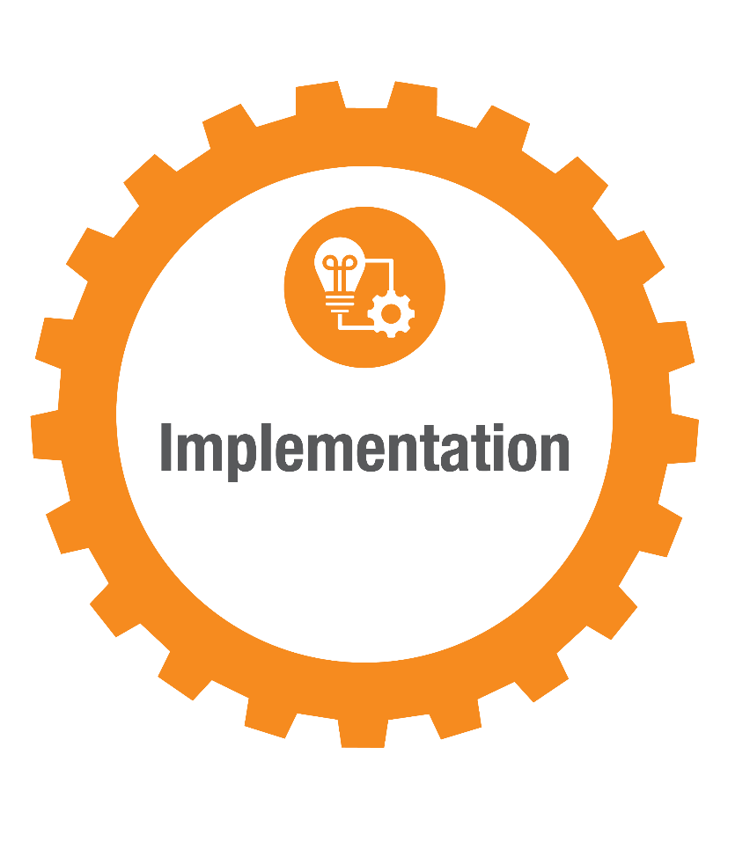
Learning Gear 4: Implementation
Description: Systematically converting research findings and other evidence-based practices into routine and “sticky” practices that enhance the quality and impact of health services.
Sample Questions: How to stage implementation? What implementation/change management methods & communication channels should be used? How can behavioral motivation built? How to best train people for new work, or new ways of receiving care?
Health System Affinities: Quality improvement teams, Lean/Six Sigma leaders, project management teams, health informatics, change management trainings etc.
Notes:
Here is the LHS Action Framework that we have been building and refining at IBH with the help of leaders, patients and community members across Ontario. This is the framework we are now consistently using at IBH and THP.
The framework is presented as a learning engine (a clean engine of course!) that creates motion in a production line. For this engine, the products are the quintuple aim – population health, good health care experiences for patients and caregivers, a sustainable work life for health care providers, affordability, and of course, equity across our communities.
The engine has 5 learning gears and 3 health system gears that describe the intersections of research and care delivery. These gears intersect with each other and result in sustained motion.
Like any engine, the LHS engine requires a constant infusion of fuel and accelerants.
And of course it has brakes and moderators that keep it on course and safe.
The next slides focus on the gears and outputs, as well as the fuels, accelerants, brakes and moderators.

Slide 47



Today’s event:
Implementation: From Research to Routine Practice
Host
Presenters
Dr Tina Fahim
Scientist
Knowledge Translation Program, St. Michael’s Hospital
Marjorie Hammond Geriatrics Nurse Specialist
Jeanette Cooper
Research Coordinattor
Knowledge Translation Program, St. Michael’s Hospital
HSPN Monthly Webinar
September 24, 2024

Slide 48
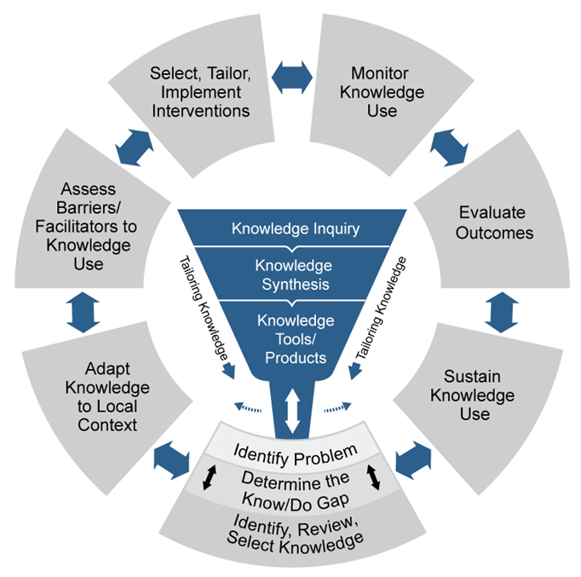
The Knowledge-to-Action model describes a process for dissemination and implementation of research
Graham ID, Logan J, Harrison MB, Straus SE, Tetroe J, Caswell W, Robinson N. Lost in knowledge translation: time for a map? J Contin Educ Health Prof. 2006 Winter;26(1):13-24. doi: 10.1002/chp.47. PMID: 16557505.
48
Notes:
MC: This webinar will focus on (click) the “evidence funnel” of the KTA.

Slide 49
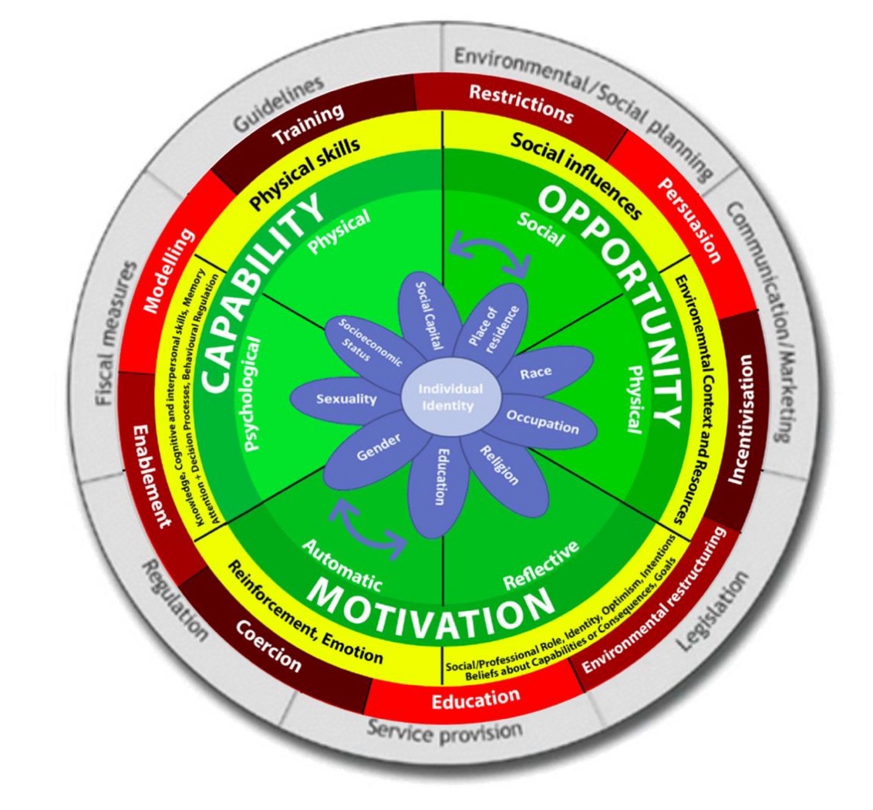
Why would people change (or not)?
Organize barriers and facilitators using theoretical frameworks
Use theories and frameworks to LINK barriers and facilitators to corresponding strategies
Source: Michie, van Stralen, & West (2011). Implementation Science; 6(1):42. doi: 10.1186/1748-5908-6-42.
49

Slide 50

STEP 1: Identify your WHAT
STEP 2: Identify your WHO
STEP 3: Understand the WHY
STEP 4: Identify your HOW
STEP 5: PLAN for evaluation and sustainability

Slide 51
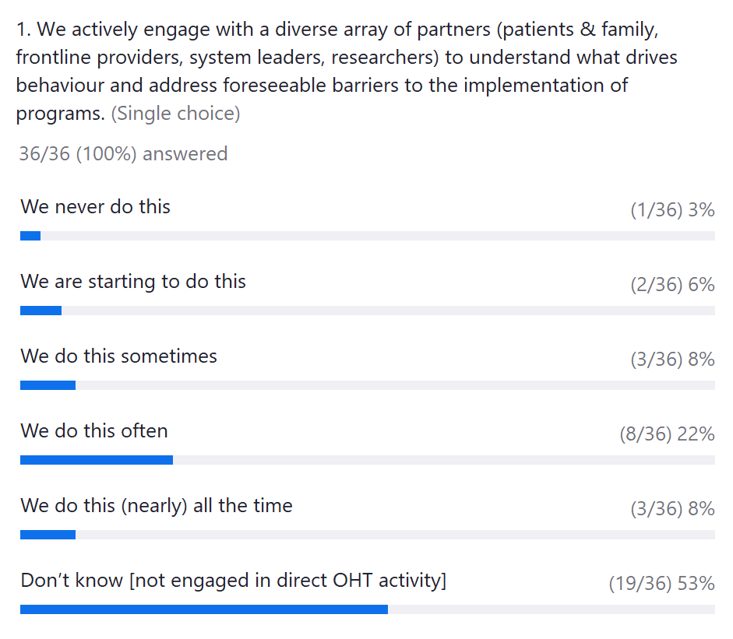
Poll 6

Slide 52
LHS Capabilities – Implementation

Slide 53

Learning Gear 5: Evaluation, Feedback & Adaptation
Description: Using multiple evaluation methods to measure how well a multicomponent intervention is working on a population and under what conditions. Constant feedback via intervention data is used to adapt the intervention to match patient needs.
Sample Questions: What evaluation logic model should be used? Are change processes being cemented? What degree of “reach” across equity-deserving groups? Are hypothesized outputs/early outcomes being achieved? Are there unintended consequences? What adaptations are needed to cement & scale?
Health System Affinities: Quality Improvement teams, performance management, business Intelligence/decision support/evaluation teams, clinical informatics etc.
Notes:
The last LHS learning gear is rapid cycle evaluation, feedback and adaptation. LHS evaluators rely heavily on realist evaluation methods, using a combination of qualitative, quantitative, and hybrid approaches, staged at the developmental, formative, and summative stages of implementation.
A central focus is to measure how well a multicomponent invention is working for what patient population, and under what conditions. To enable rapid cycle change, early feedback of preliminary data to implementation teams is key so that early changes can be made to the intervention and or implementation strategy.

Slide 54

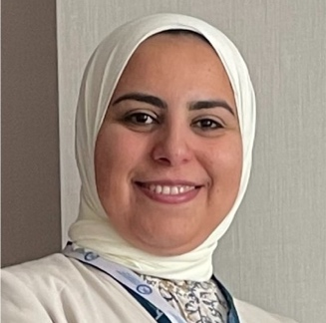

Today’s event:
Supporting Evaluation in Learning Health Systems: What do OHTs need to know?
Host
Presenters
Dr Catherine Donnelly
Associate Professor
Queen’s University
FLA OHT
Dr. Reham Abdelhalim
Manager, Population Health and Evaluation
Burlington OHT
Dr. Brianne Wood
NOSM
RISE
HSPN Monthly Webinar
November 26, 2024

Slide 55
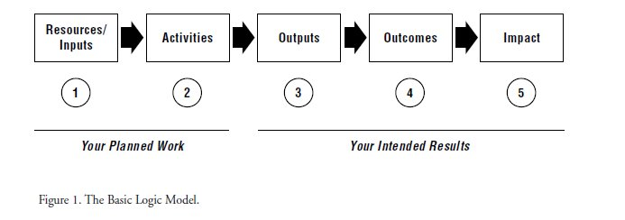
What is a logic model?
Logic models visually summarize how a program is expected to work by listing: what resources will be used, what activities will be completed, and how the activities will lead to outcomes

Slide 56
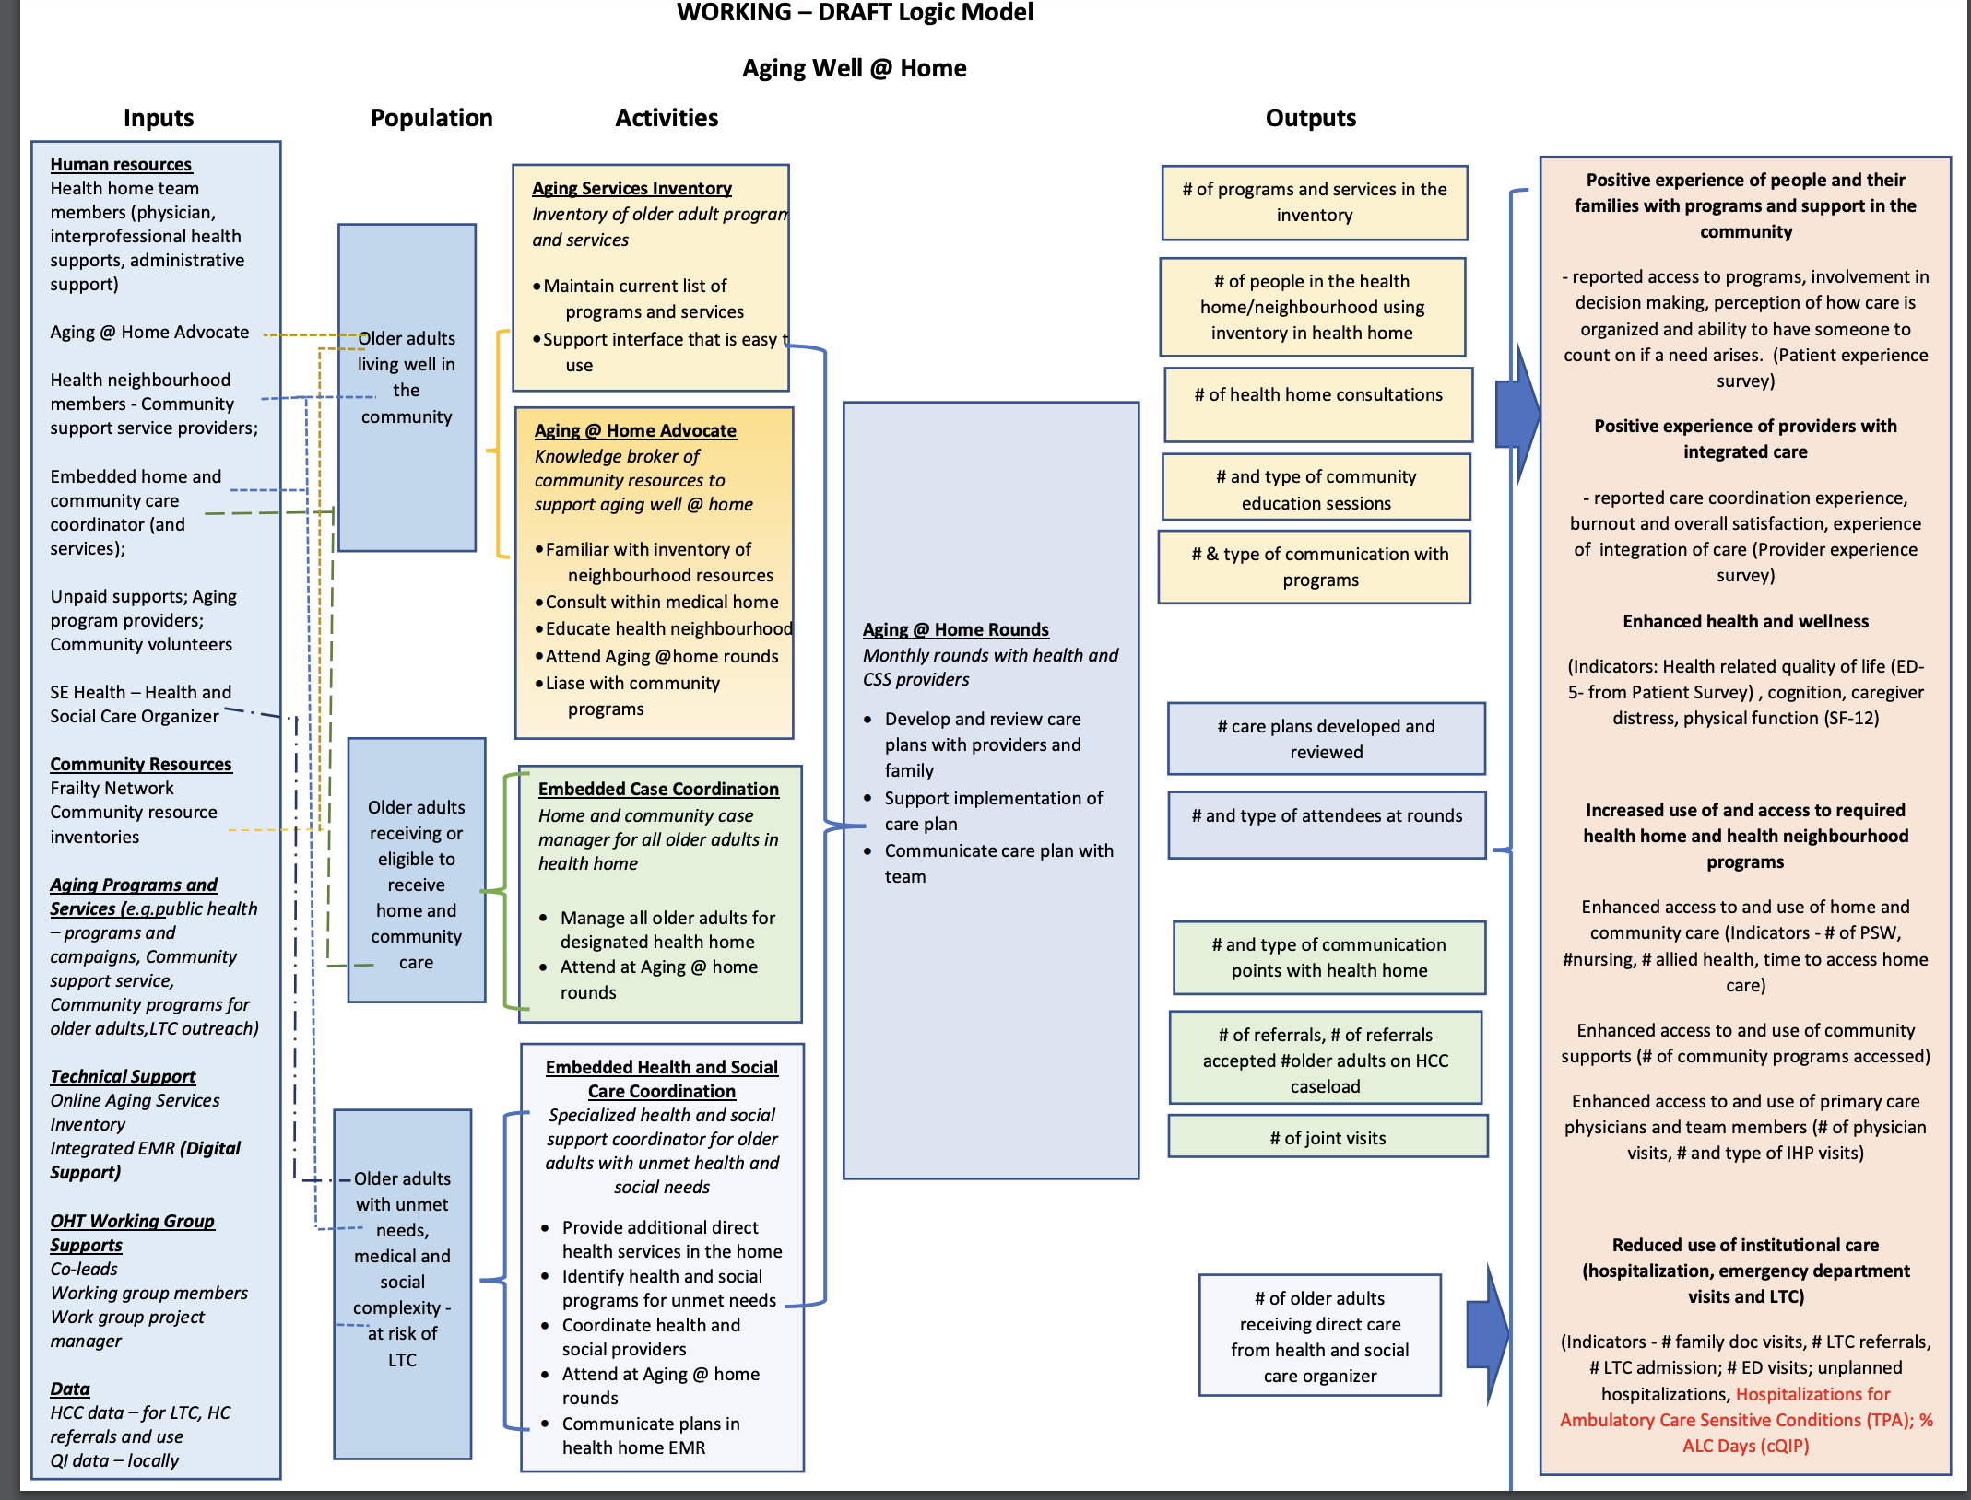


Slide 57





Community Wellness Hub
A Complex Intervention
Intervention targets many different groups & organizational levels
Many related & overlapping outcomes
Many interacting components
Did it work??
Participants are at all different stages of (behaviour) change
Lots of flexibility & tailoring of the intervention

Slide 58







Learning from evaluation with Northern OHTs
Team-based works best
Make capacity-building part of the strategy
Data collection is inevitable
Know the “so what” ahead of time
Needs to be done carefully, strategically, and with transparent governance.
Share the work, bring others along, use resources wisely
Commit to the action, know your why
Helps to manage the power dynamics too

Slide 59
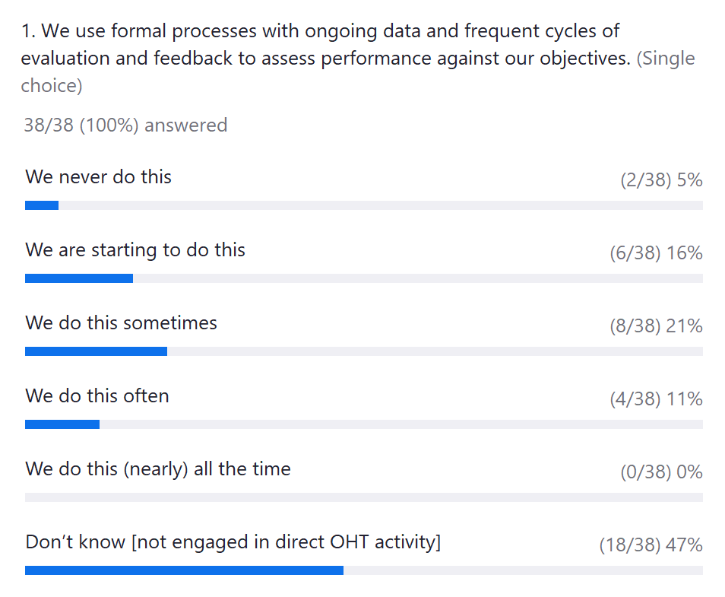
Poll 7

Slide 60
LHS Capabilities – Evaluation

Slide 61



Open-Ended Comments: Opportunities and Strengths
Action-Plans
Inadequate staffing and high turnover: “For work that impacts my area, inadequate staffing and lack of succession planning has been one of the many barriers for researchers requesting data for scientific investigations” (Manager, Program 2)
Investigate root causes of high turnover
Make case for data analyst position
Develop succession plan and resources to facilitate work of new-hires (e.g. training material)
Lack of resources for qualitative data analysis: “One barrier is that we have many more resources dedicated to quantitative analyses compared with qualitative analyses” (Director, Program 3)
Make case for hiring qualitative data analyst
Train analysts in qualitative analysis methodology
Systematic process for recommendation/guideline development: “We have developed a phased approach to developing our program recommendations and guidance (…) which includes systematic reviews of the evidence (..) and quality of the evidence followed by an expert panel step (…) as well as people with lived experience to contextualize the evidence to the Ontario setting and inform program decisions (Director, Program 2)
Disseminate best practices for guideline development to ensure uptake across programs
Opportunity to engage with diverse patients, families, and caregivers in co-design activities: “Improving the diversity of the patient and family advisors involved in co-design is an ongoing desire and challenge for us.” (Vice President, Program 1)
Pilot test co-design initiative for patient engagement: document and disseminate best practices

Slide 62

Today’s event:
Enablers and Barriers
(Fuel, Accelerants, Moderators and Brakes)
+ Measuring LHS capabilities?
Co-Hosts
Dr. Victor Rentes
Post-Doctoral Fellow
HSPN
HSPN Monthly Webinar
January 28, 2025

Slide 63
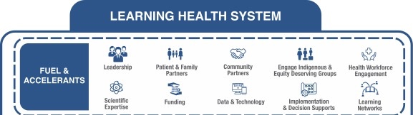
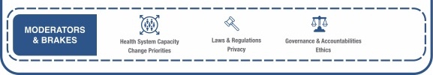
Fuel, Accelerants, Moderators and Brakes
Building a sustainable infrastructure
Notes:
Like any engine, the LHS engine requires a constant infusion of fuel and accelerants.
And of course it has brakes and moderators that keep it on course and safe.

Slide 64
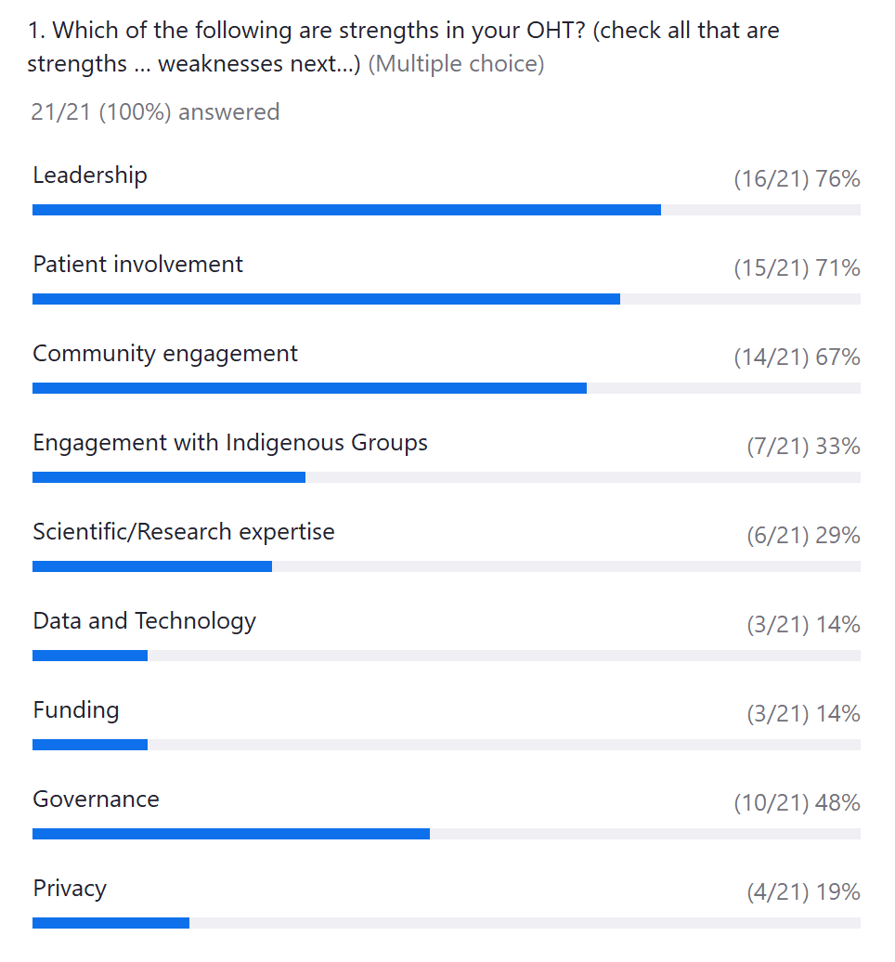
Poll 8a

Slide 65
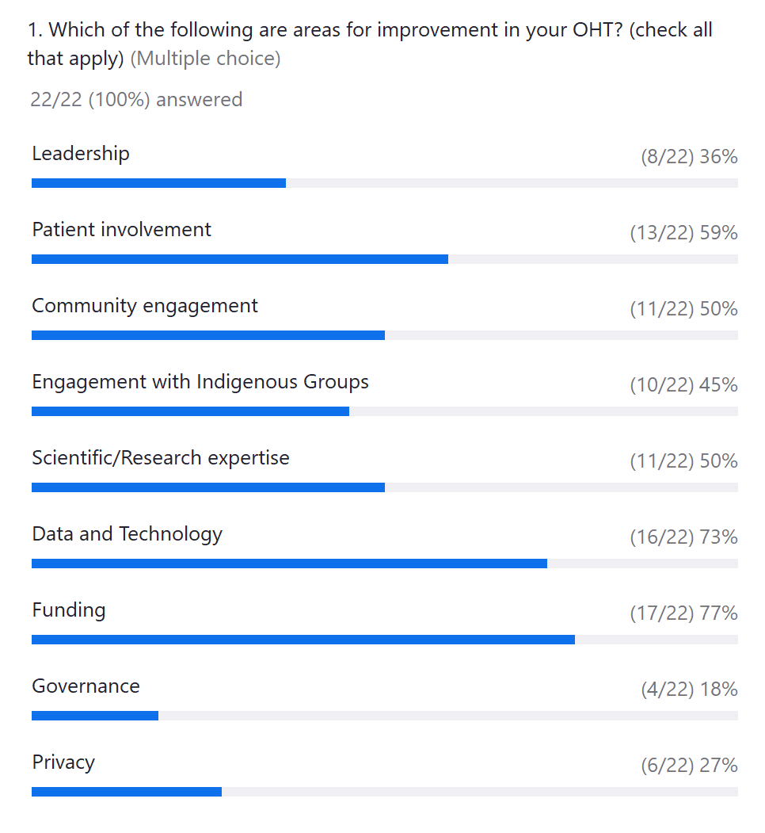
Poll 8b

Slide 66
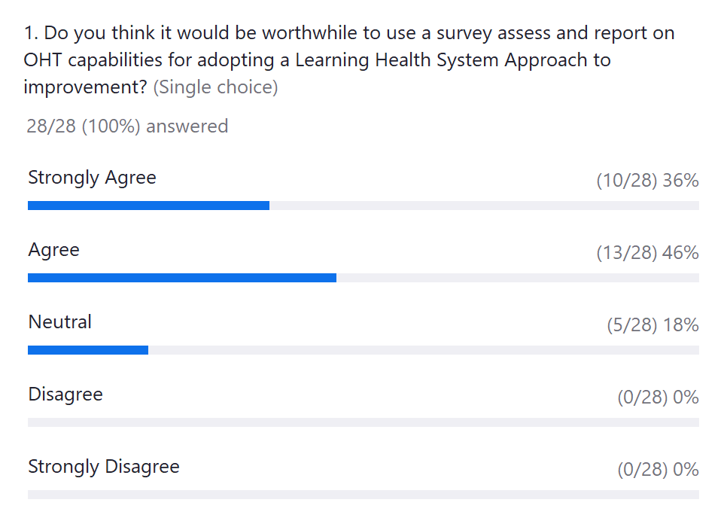
Poll 9

Slide 67
Discussion Topic
What questions do you have about adopting a Learning Health System Approach to advancing your OHT priorities?
What challenges do you foresee in adopting a Learning Health System approach to your local OHT initiatives?

Slide 68
Many thanks to all the contributors to our series on Learning Health System
Reham Abdelhalim (BOHT)
Edward Aust (MWT OHT)
Sarah-Grace Bebenek (SGBOHT)
Jeanette Cooper (Unity)
Catherine Donnelly (FLA OHT)
Christina Fahim (Unity)
Marjorie Hammond (Unity)
Laura Harild (MOHT)
Frances Henderson (MOHT)
John Hogenbirk (CRaNR)
John Lavis (RISE)
Matthew Meyer (LM OHT)
Kaelen Moat (RISE/MHF)
Emmi Perkins (GW OHT)
Justin Presseau (OHRI)
Dipti Purbhoo (MOHT)
Robert Reid (RISE)
Victor Rentes (HSPN)
Sara Shearkhani (ETHP OHT)
Yasmin Sheikhan (MWT OHT)
Kelly Smith (ETHP OHT)
Maureen Smith (OSSU)
Diana Urbanik (CRaNR)
Brianne Wood (RISE/NOSM)

Slide 69
Up Next
HSPN webinar series
  4th Tuesday of the Month: 12:00 – 1:30 pm
Upcoming February 2025:
Patient Reported Outcome and Experience Measures: Results from the OECD Patient Reported Indicator Survey (PaRIS)

Slide 70

Can you share some feedback? Scan here! (or click link in chat)

Slide 71




THANK YOU!
@infohspn
hspn@utoronto.ca
The Health System Performance Network
hspn.ca

