Slide 1
Population Insights from Patient Reported Data : PREMs and PROMs
(Patient Reported Experience Measures
Patient Reported Outcome Measures)
HSPN Monthly Webinar
February 25, 2025

Slide 2
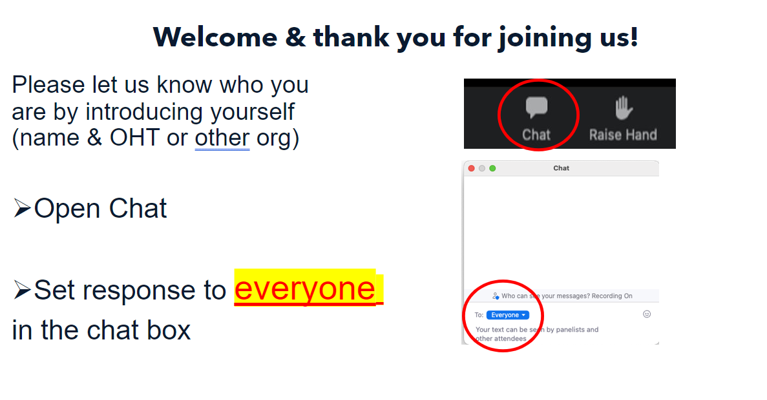

Slide 3
Land Acknowledgement
​
We wish to acknowledge this land on which the University of Toronto operates. For thousands of years it has been the traditional land of the Huron-Wendat, the Seneca, and the Mississaugas of the Credit. Today, this meeting place is still the home to many Indigenous people from across Turtle Island and we are grateful to have the opportunity to work on this land.

Slide 4
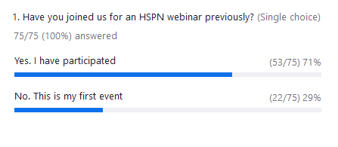
Poll 1

Slide 5






Today’s event
PREMs and PROMs
Host
Presenters
Dr. Grace Spiro
Post-Doctoral Fellow
HSPN
Yasmin Sheikhan
Patient Partner
PhD Candidate, UofT
Dr. Marie-Eve Poirtras
Chaire de Recherche
Pratiques Professionnelles Optimales en Soins Primaires
Emily Hamovich
PhD Student, UofT
HSPN Monthly Webinar
June 25, 2024

Slide 6
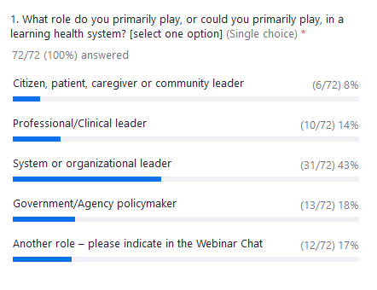
Poll 2

Slide 7

Capturing Patient and Caregiver Experience
The Health System Performance Network (HSPN) has been involved in many efforts to capture and report on patient and caregiver experience:
  1999-2009, the Hospital Report Research Collaborative provided hospital-level reporting on patient satisfaction in an annual Hospital Report.
  In 2013, HSPN participated in the Quality and Costs in Primary Care (QUALICOPC) in 34 countries
  In 2018, HSPN developed a new Home Care Client and Caregiver Experience Survey. Currently fielded to over 9,000 clients each month.
  In 2021, HSPN developed and launched the Ontario Health Team (OHT) Patient Survey to collect Patient Reported Outcome (PROM) and Experience (PREM) data.
  In 2023, HSPN joined the OECD Patient Reported Indicator Survey (PaRIS) international survey in primary care.

Slide 8
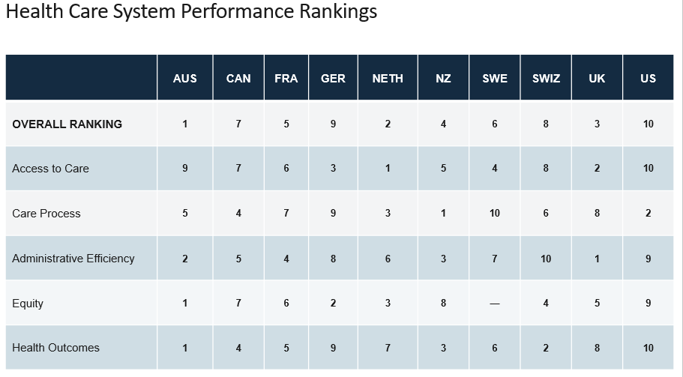
We all know how poorly Canada performs

Slide 9
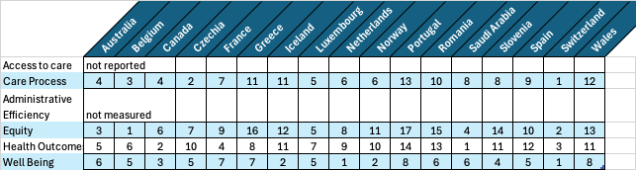

But maybe it depends on what questions you ask?

Slide 10
QUALICOPC – How well did we do in 2013?
Scale Effects when we only ask
Yes or No
(here showing percent Yes)
QUALICOPC (Quality and Costs of Primary Care) Canada – A focus on the aspects of primary care most highly
rated by current patients of primary care practices © 2014 Canadian Foundation for Healthcare Improvement.

Slide 11
QUALICOPC – What mattered to Canadians in 2013?
QUALICOPC (Quality and Costs of Primary Care) Canada – A focus on the aspects of primary care most highly
rated by current patients of primary care practices © 2014 Canadian Foundation for Healthcare Improvement.

Slide 12
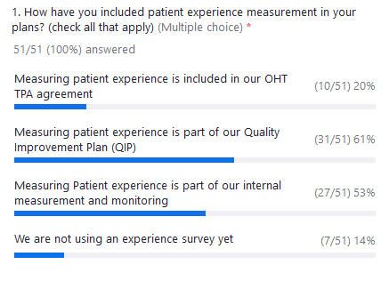
Poll 3

Slide 13
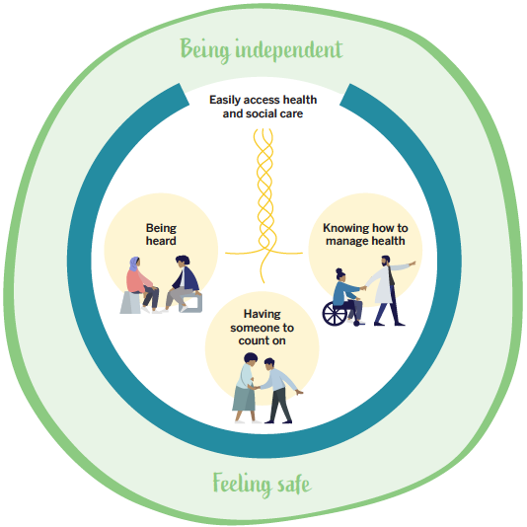
What is important to patients & caregivers ?
https://hspn.ca/hsprn-practice-guide-on-implementing-integrated-care/

Slide 14
Measuring Patient Experience
the HSPN Patient Experience
Survey

Slide 15

Quadruple Aim- Patient Experience
HSPN Presentation – April 26, 2022
Sara Grace Bebenek

Slide 16
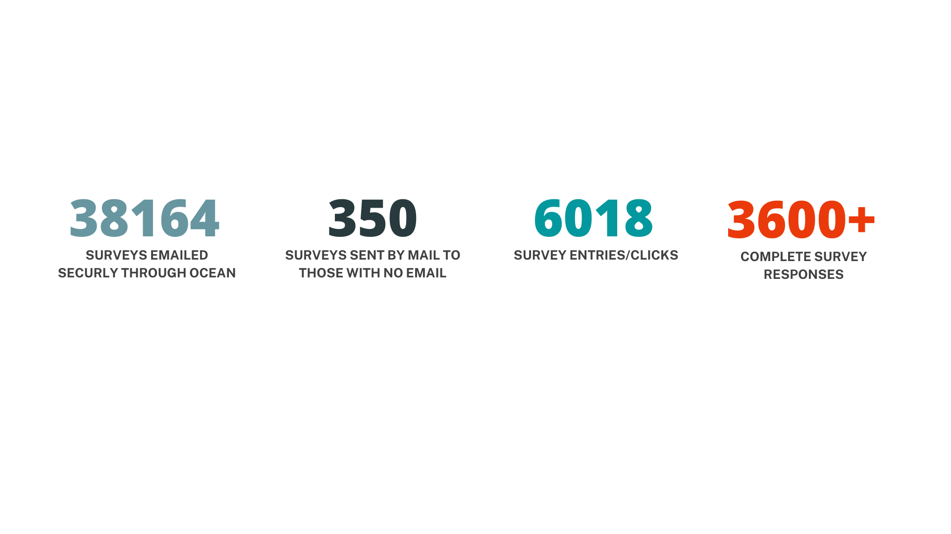

South Georgian Bay Survey Response
Notes:
As indicated on the slide, through the distribution of the HSPN survey by secure messaging and mail, we were able to yield a statistically significant response rate to inform the work of our SGB OHT PFAC and OHT more broadly. This high survey completion rate provides us with valid data, which will be very important to inform future program development and identify gaps and areas for improvement through the SGB OHT.
In addition to the survey response rate, we thought it was notable to mention that when the survey was sent out electronically and by mail, we also saw an increase in traffic on our SGB OHT website, and received many phone calls and emails with excitement about completing the survey, and gratitude for the opportunity to provide their input to share our local health system.

Slide 17
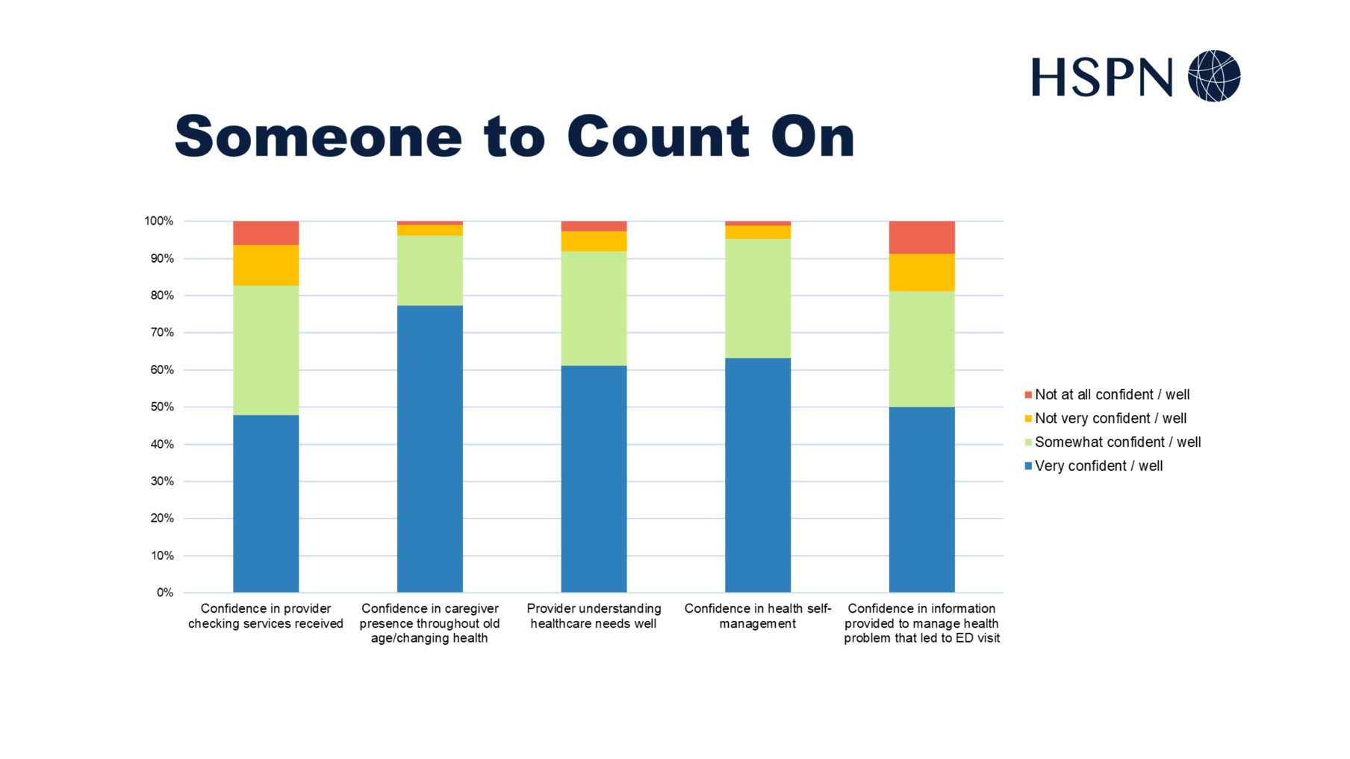
How will the data be used?
Notes:
This slide provides some early results of the South Georgian Bay OHT Patient Experience Survey developed by HSPN and illustrates patient confidence in their health care professional: providing them with the needed care, looking after them as they age, understanding their healthcare needs, and their confidence in knowing what they need to take care and manage their own health.
Overall, these results are positive but there is still work to do to increase patient experience and confidence. Through the SGB OHT all survey results, including these, will be evaluated using a population health segmentation approach by our SGB OHT PFAC to identify gaps and identify driving factors for these gaps, and opportunities of how we can work together through the SGB OHT to address these by working on specific population health projects to ultimately increase the patient experience. With the support of HSPN we plan to survey our population annually to evaluate change in service delivery and the patient experience over time.

Slide 18
Equity assess
all measures
e.g.
Income
&
Access

Slide 19
Applying an equity lens to patient reported experience and outcomes in an integrated care setting
Grace M. Spiro, PhD
February 2025
Notes:
Today I will be speaking on

Slide 20
Background
Measuring patients’ experiences of care is one of the aims of the Quadruple Aim Framework.
By collecting Patient Reported Experience Measures (PREMs) and Patient Reported Outcome Measures (PROMs), OHTs can identify and address patient experiences and fill the gaps in care.
Measuring social determinants of health (SDOH) will allow OHTs to better address health inequities.
20

Slide 21

Background
OHT Case Example:
Attributed Population = 50-100k
Racialized Population = 3%
Low Income Population = <5%
Unemployment Rate = 11%
Population Density = 51/km²
21

Slide 22
Background
  We use the Material Deprivation Score from the Ontario Marginalization Index to assess equity in OHT indicators across socioeconomic status.
Indicators
Proportion of the population aged 25 to 64 without a high-school diploma
Proportion of families who are lone parent families
Proportion of total income from government transfer payments for population aged 15+
Proportion of the population aged 15+ who are unemployed
Proportion of the population considered low-income
Proportion of households living in dwellings that are in need of major repair
22

Slide 23
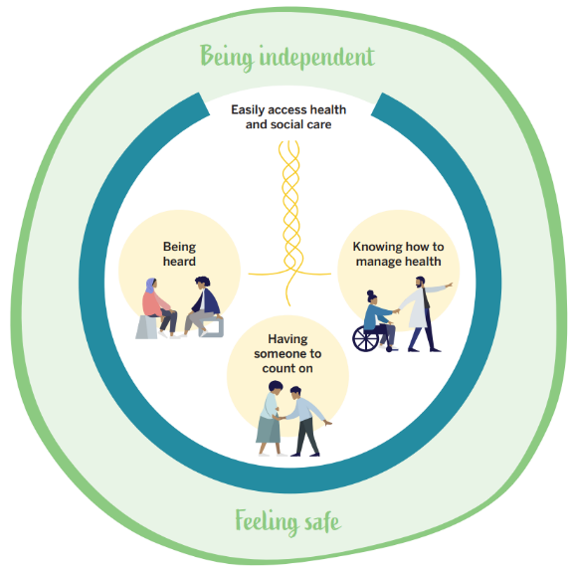
Survey Development
Six Attributes of Patient Centredness:
To be heard, appreciated and comfortable;
To have someone they can count on;
To know how to manage health and what to expect;
To easily access health and social care;
To be independent; and
To feel safe.
Other Measures:
Health services and digital use
Transitions in care
Age, gender, race/ethnicity, sexual orientation
Income, food and housing security
Retrieved from Kuluski K, Steele Gray C, Wodchis WP, Shaw J, Baker GR. How can we better understand and meet the needs of patients and caregivers? A practice guide. Toronto: Health System Performance Research Network; 2019².
23

Slide 24
Variable of Interest
Equity | Patient Reported Experience Measures | Patient Reported Outcome Measures
Age Race Gender Sexual Orientation Income Security Food Security Housing Security | Overall Experience (Health Services) Length of Time (Healthcare Provider) Coordination of Care Confidence (Healthcare Provider) Confidence (Managing Health) Needs Understood (Healthcare Provider) Listens Carefully (Healthcare Provider) | Self-Reported Health
24

Slide 25
Methods
Data Collection
Surveys were distributed electronically via Family Health Team registry
Paper surveys were sent to patients without email on file
Timeframe: December 2023 – March 2024
25

Slide 26
Methods
Data Analysis
Descriptive statistics
Multivariable logistic regression
26

Slide 27
Results
Characteristic | Frequency | % of Respondents
Age (N=2,673)
18-44 years old | 285 | 10.7
45-64 years old | 713 | 26.7
65+ years old | 1668 | 62.4
N/A or Missing | 7 | 0.3
Gender identity (N=2,638)
Woman | 1,613 | 60.3
Man | 1012 | 37.9
N/A or Missing | 48 | 1.8
Sexual orientation (N=2,574)
Heterosexual (Straight) | 2,484 | 92.9
LGBTQA2+ | 82 | 3.1
N/A or Missing | 107 | 4.0
Race/Ethnicity (N=2,746)
White | 2,466 | 92.3
Multi race | 107 | 4.0
Non-white | 50 | 1.9
N/A or Missing | 50 | 1.9
27

Slide 28
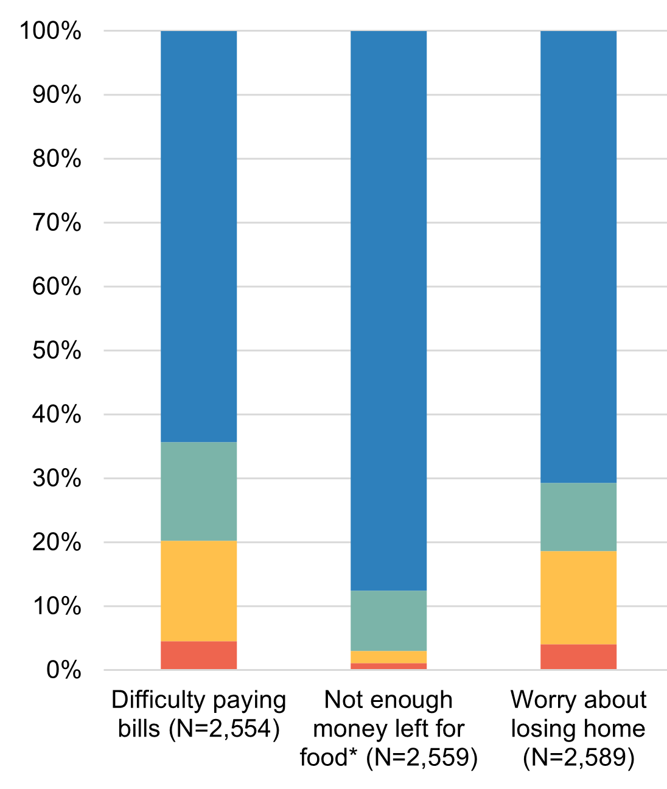

Results
28

Slide 29
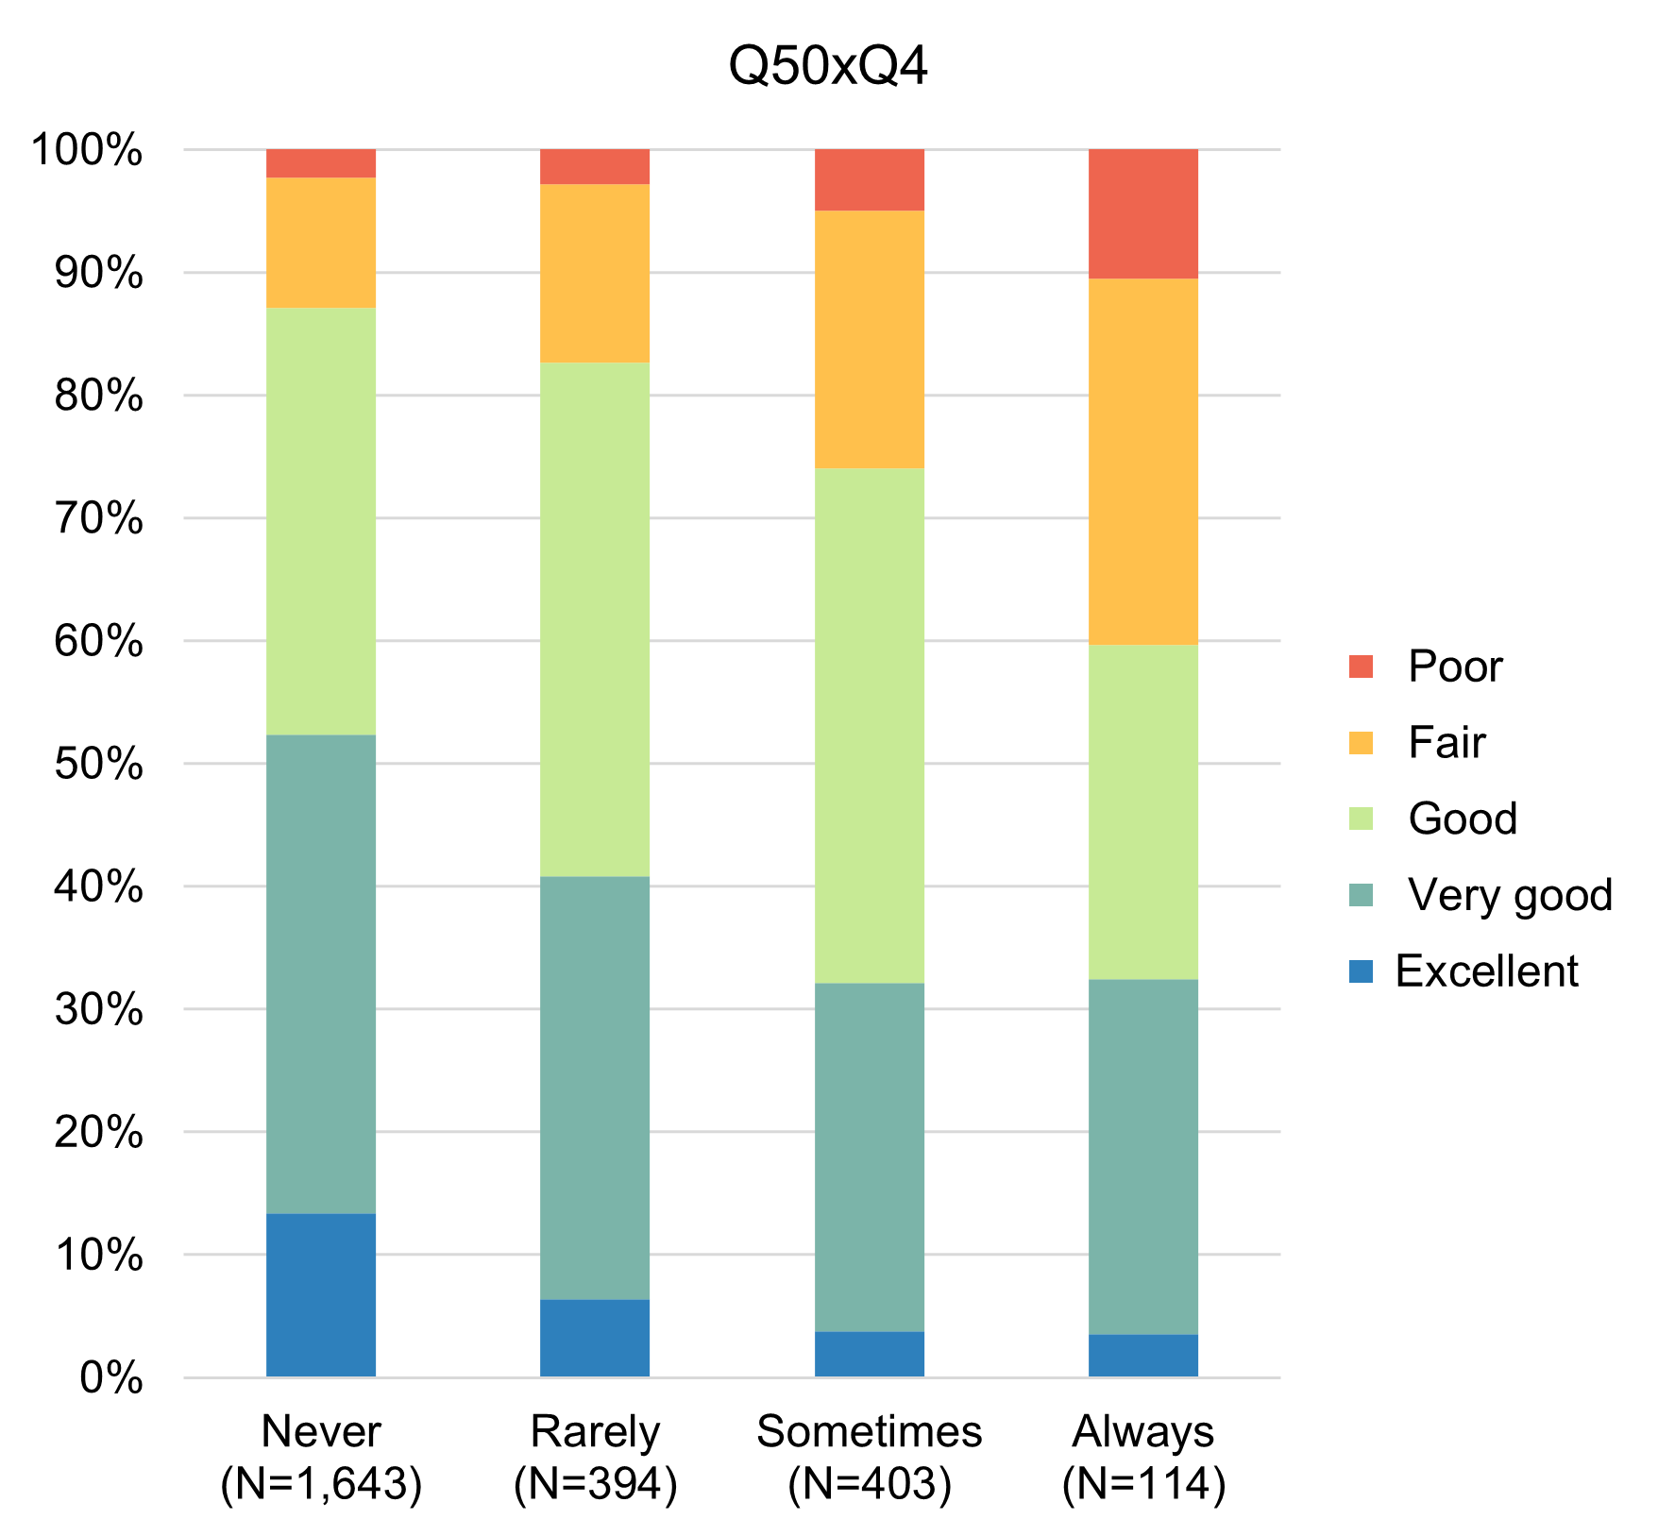
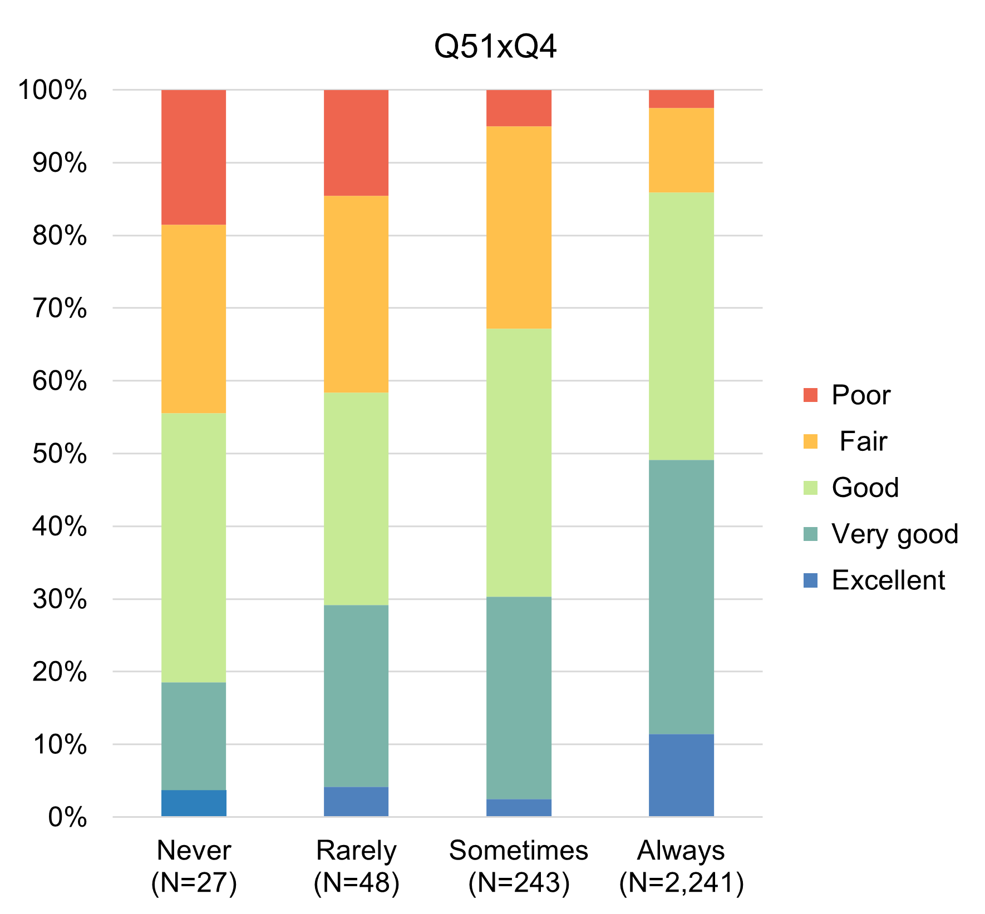
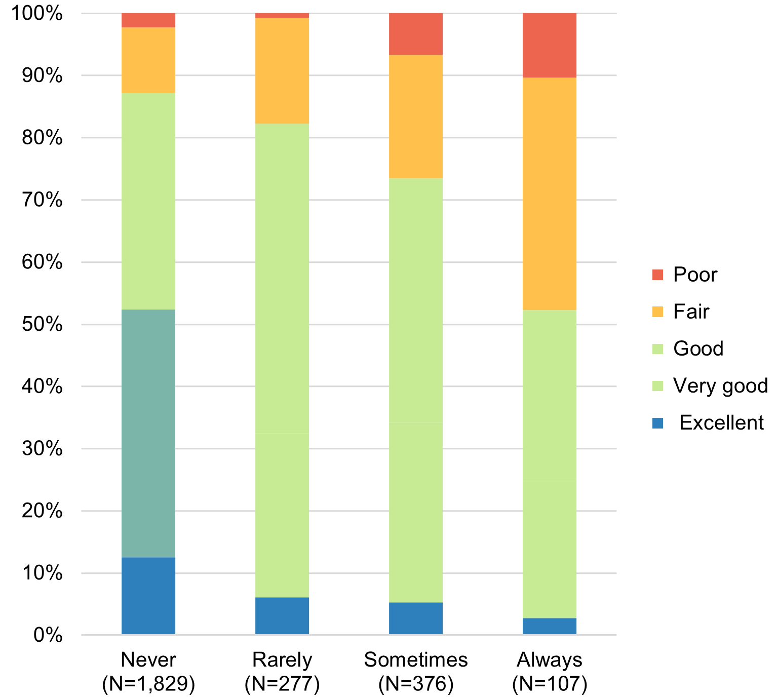
Results
Self-reported health by:
Income Security* Food Security Housing Security
* significant at p < 0.05, ** significant at p < 0.01
29

Slide 30
What factors are associated with patient experience with 8 aspects of primary care?
In the last 12 months, how would you describe the length of time it took to access your regular healthcare provider?
In general, how well do you feel your healthcare providers understand your healthcare needs?
In general, would you say your regular healthcare provider or other healthcare professionals listen carefully to you?
When you consider how you and all your healthcare providers help you take care of your health, how coordinated would you say your overall healthcare is?
In general, how confident are you that your regular healthcare provider or other healthcare professional checks to make sure you receive the healthcare you need?
In general, how confident are you that you know the things that you need to do to take care of and manage your health?
Overall, how was your experience accessing those services?
In general, how would you describe your own health?
30

Slide 31
In the last 12 months, how would you describe the length of time it took to access your regular healthcare provider?
31

Slide 32
In the last 12 months, how would you describe the length of time it took to access your regular healthcare provider?
Variable | Length of time to access(n(%)) | Unadjusted
 |  | OR | 95% CI
Gender Male Female | 1012 (37.9) 1613 (60.3) | 1.096 Reference | 0.9-1.335
Age 18-44 45-64 65+ | 285 (10.7) 713 (26.7) 1668 (62.4) | 0.714 0.517 Reference | 0.516-0.989* 0.410-0.627**
Race Multirace Non-white White | 107 (4.0) 50 (1.9) 2466 (92.3) | 1.384 0.740 Reference | 0.838-2.287 0.381-1.438
Sexual Orientation LGBT2A+ Heterosexual | 82 (3.1) 2484 (92.9) | 0.610 Reference | 0.372-1.002
Income Security Insecure Secure | 517 (19.3) 2031 (76.0) | 0.791 Reference | 0.609-1.026
Food Security Insecure Secure | 483 (18.1) 2031 (76.0) | 1.111 Reference | 0.595-2.069
Housing Security Insecure Secure | 74 (2.8) 2479 (92.7) | 0.750 Reference | 0.575-0.977*
* significant at p < 0.05, ** significant at p < 0.01
32

Slide 33
In the last 12 months, how would you describe the length of time it took to access your regular healthcare provider?
Compared with those aged 65+, younger adults were more likely to indicate that the length of time was somewhat or much too long. (Age 18-44 were 39% more likely and age 45-64 were 49%)
Compared with those who rarely/never worried about having a place to live, those who sometimes or always worried about housing were 25% more likely to indicate that the length of time was somewhat or much too long.
33

Slide 34
Results - Age
Statistically significant regression results for 8 experience items by equity stratifier:
Younger adults had lower odds of:
  perceiving their wait time as “about right”
  feeling that their healthcare provider understood their health needs
  reporting that their healthcare provider listened carefully to them sometimes, often or always
  perceiving their healthcare as coordinated
  being confident that their healthcare provider checks to ensure they receive needed care
  feeling confident in managing their health
  reporting ease of accessing healthcare services
  describing their health as good, very good, or excellent
34

Slide 35
Results - SES
Statistically significant regression results for 8 experience items by equity stratifier:
Those insecurely housed had lower odds of:
  perceiving their wait time as “about right”
  feeling that their healthcare provider understood their health needs
  feeling confident in managing their health
Those with lower income security had lower odds of:
  reporting that their healthcare provider listened carefully to them sometimes, often or always
  feeling confident in managing their health
  reporting ease of accessing healthcare services
  describing their health as good, very good, or excellent
Those with lower food security had lower odds of:
  feeling that their healthcare provider understood their health needs
  feeling confident in managing their health
35

Slide 36
Results – Gender & Sexuality
Statistically significant regression results for 8 experience items by equity stratifier:
Men had lower odds of:
  feeling that their healthcare provider understood their health needs
No statistically significant associations between sexual orientation and PREM/PROMs included
36

Slide 37
Limitations
Generalizability to the greater population
Non-response bias
Lack of diversity
37

Slide 38
Discussion
Given the current widespread focus on addressing the social determinants of health to achieve greater equity, understanding the patient experience within integrated care setting is critical.
Focusing on PREM/PROMs in the context of integrated care promotes person-centered health care.
Policymakers are increasingly recognizing the value of PREM/PROMs in many future trends of health systems, such as personalized care, shared decision-making, quality improvement, health systems efficiency, and transparency.
More attention should be placed on the barriers and enablers to strengthening the collaboration of primary care and community support services in order to narrow the equity gap and reduce current prevalent social inequalities in the health system.
38

Slide 39
Questions?
grace.spiro@utoronto.ca
oht.evaluation@utoronto.ca
39

Slide 40
OECD PaRIS Results
Patient Reported Information System

Slide 41


PaRIS
PaRIS is the Organization for Economic Cooperation and Development (OECD)’s Patient-Reported Indicator Surveys initiative where countries work together on developing, standardising and implementing a new generation of indicators that measure the outcomes and experiences of healthcare that matter most to people.
PaRIS fosters a dialogue with policy makers, healthcare providers, and patients about how to improve the performance and people-centredness of primary care services.
https://www.oecd.org/en/about/programmes/patient-reported-indicator-surveys-paris.html

Slide 42
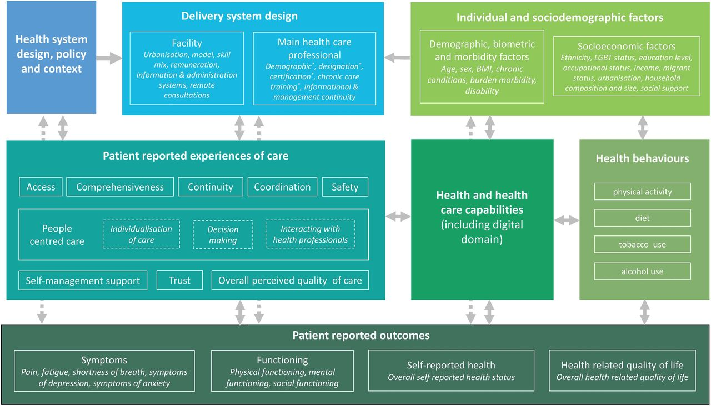


Patient Reported Indicator Surveys (PaRIS) conceptual framework.
Very comprehensive
Final survey ~ 137 items
Jose M Valderas et al. BMJ Qual Saf doi:10.1136/bmjqs-2024-017301
Copyright © BMJ Publishing Group Ltd and the Health Foundation. All rights reserved.
Notes:
Patient Reported Indicator Surveys (PaRIS) conceptual framework. BMI: Body Mass Index.

Slide 43

The PaRIS10 Indicators
Patient Reported Outcome Measures | Patient Reported Experience Measures
Physical Health | Confidence to Self-Manage
Mental Health | Experienced co-ordination
Social Functioning | Person-centred Care
General Health | Experienced Quality
Well Being | Trust in Healthcare System

Slide 44
The PaRIS10 Indicators
Patient Reported Outcome Measures
Physical Health | ability to carry out everyday physical activities, degree of pain and fatigue
Mental Health | perception of quality of life, mood and ability to think, satisfaction with social activities and relationships, emotional distress
Social Functioning | extent to which a person can carry out their usual social activities and roles
General Health | degree to which a person feels positive in terms of their mood, vitality and fulfilment
Well Being | overall measure of general health

Slide 45
The PaRIS10 Indicators
Patient Reported Experience Measures
Confidence to Self-Manage | degree of confidence to manage one’s own health and well-being
Experienced Co-ordination | extent to which a person experiences a seamless and continuous journey through different healthcare practices and settings
Person-centred Care | extent to which a person’s health needs are managed holistically, ensuring their preferences and needs are central to the care received
Experienced Quality | overall measure of how a person rates the care they have received over the past 12 months
Trust in Healthcare System | degree to which a person trusts the healthcare system overall

Slide 46
Some summary descriptive statistics:
OECD Results span 107,014 primary care users (aged 45 years and older) and 1814 primary care practices in 19 countries.
19 countries, of which 17 were OECD members: Australia, Belgium, Canada, Czechia, France, Greece, Iceland, Italy, Luxembourg, Netherlands, Norway, Portugal, Slovenia, Spain, Switzerland, United States and Wales (United Kingdom). Romania and Saudia Arabia also participated.
Canada does not have a national registry of practising primary care practices and therefore, patient responses were drawn with a census approach from a convenience sample of practices.
81% of respondents reported having at least one chronic condition, with 52% having multimorbidity (two or more conditions)

Slide 47
Canada and Ontario Participation in PaRIS
Health Canada agreed to participate in OECD PaRIS Survey and supported the program through 1) research coordination office and 2) data management support.
Data collection within each province was supported by local funding. In Ontario, HSPN and the Ontario SPOR Support Unit (OSSU) provided support for data collection.
In Canada, a total of 4,490 patients either partially (n=738) or entirely (n=3,752) completed the survey from 52 practices.

Slide 48
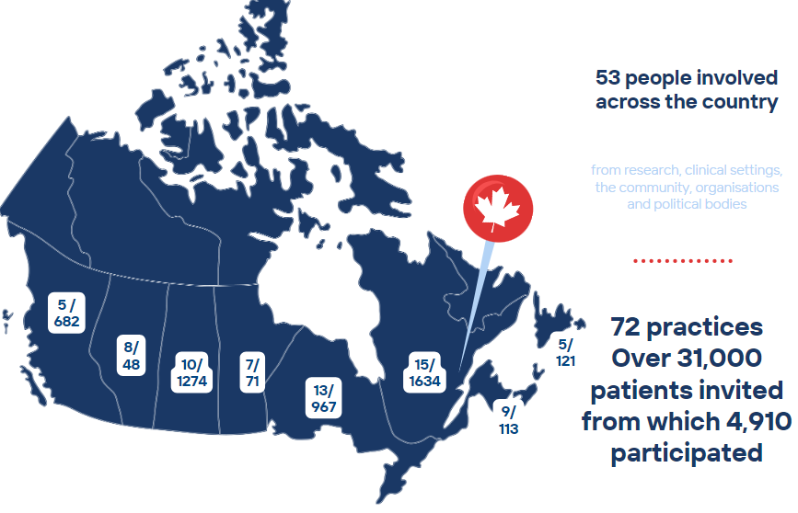

Results
Results:
4,490 patients
(52 practices) who answered within the time period

Slide 49
PaRIS: National, Provincial and Practice Reports

Slide 50
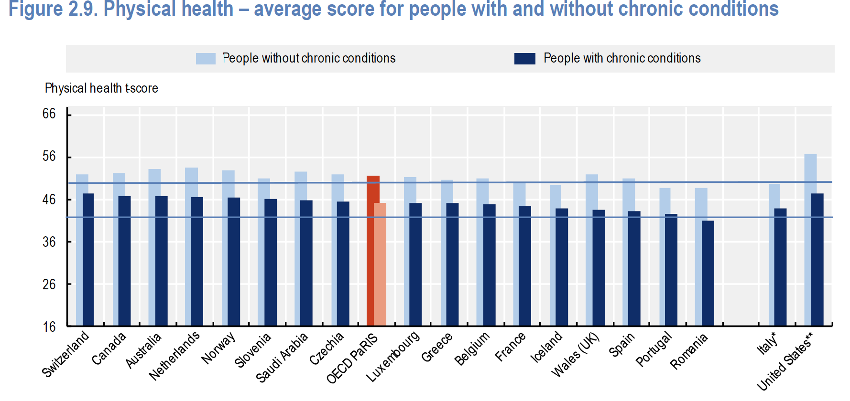
OECD PaRIS Results

Slide 51
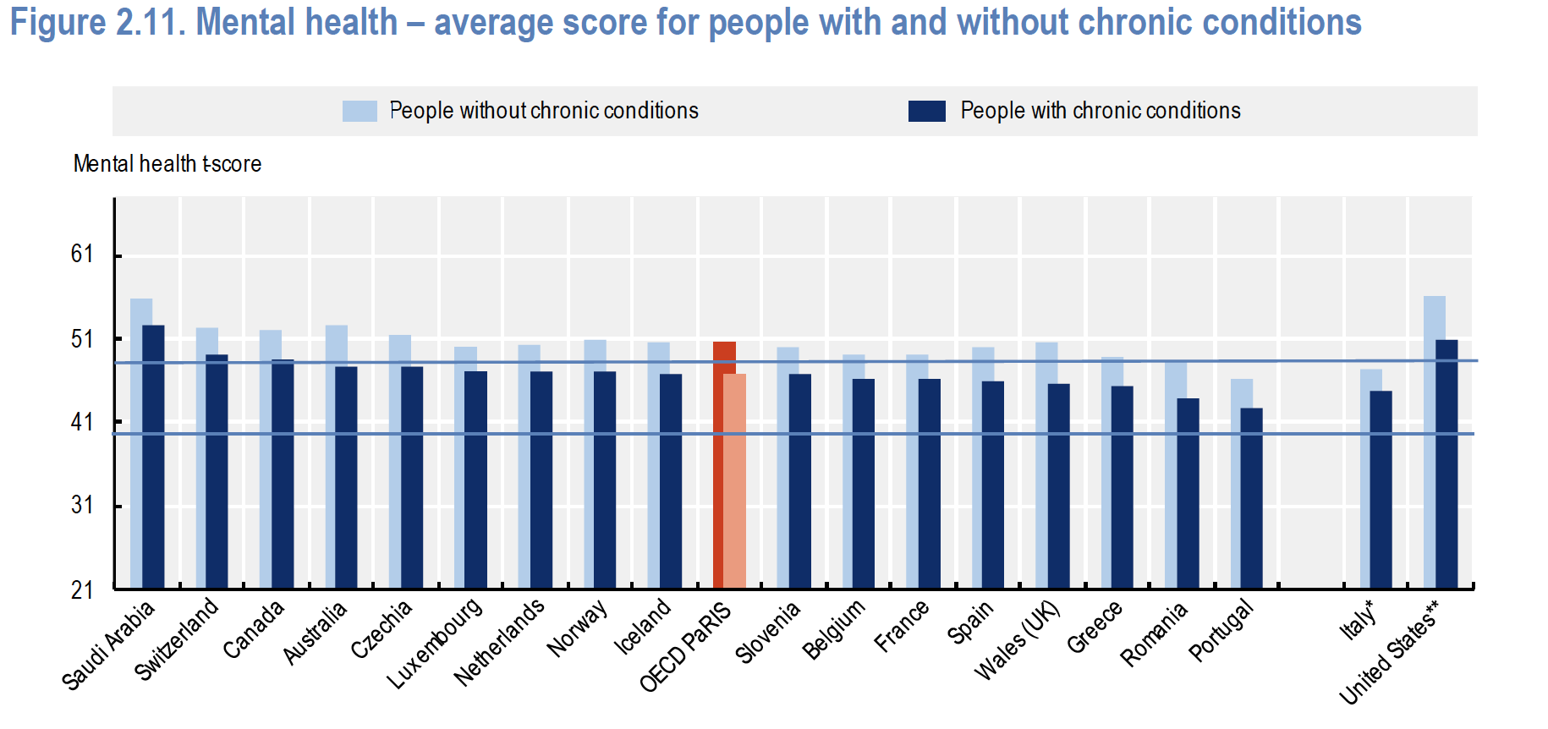
OECD PaRIS Results

Slide 52
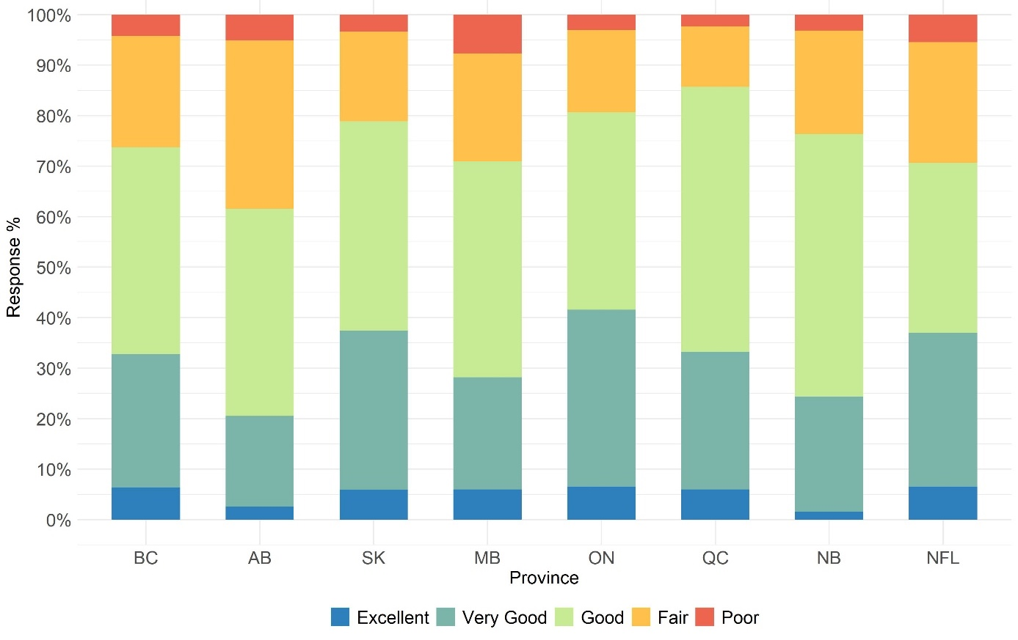
National Results: Self-Reported Physical Health

Slide 53
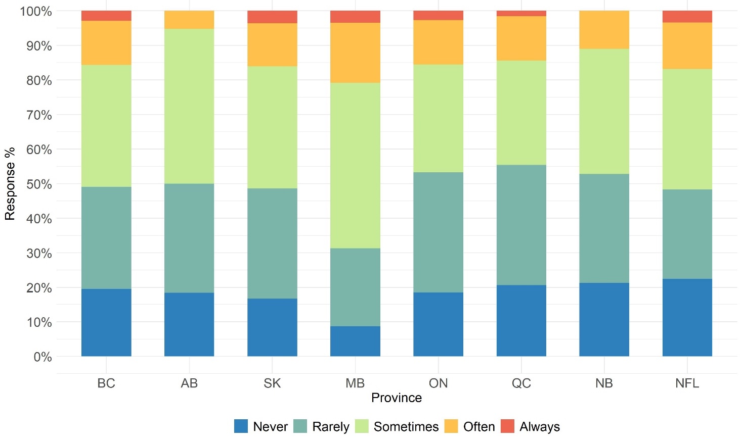
National Results: Bothered by Emotional Problems

Slide 54
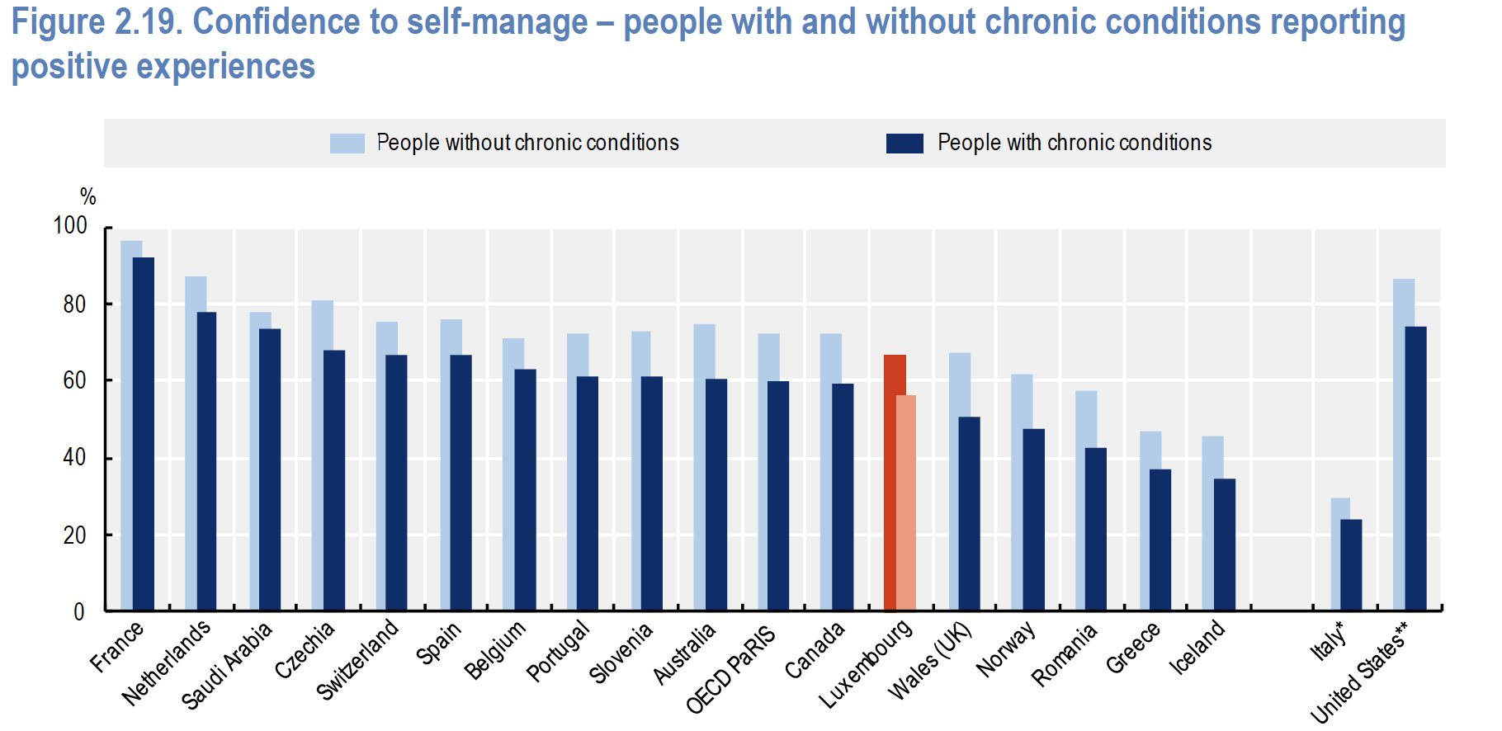
PaRIS Results

Slide 55
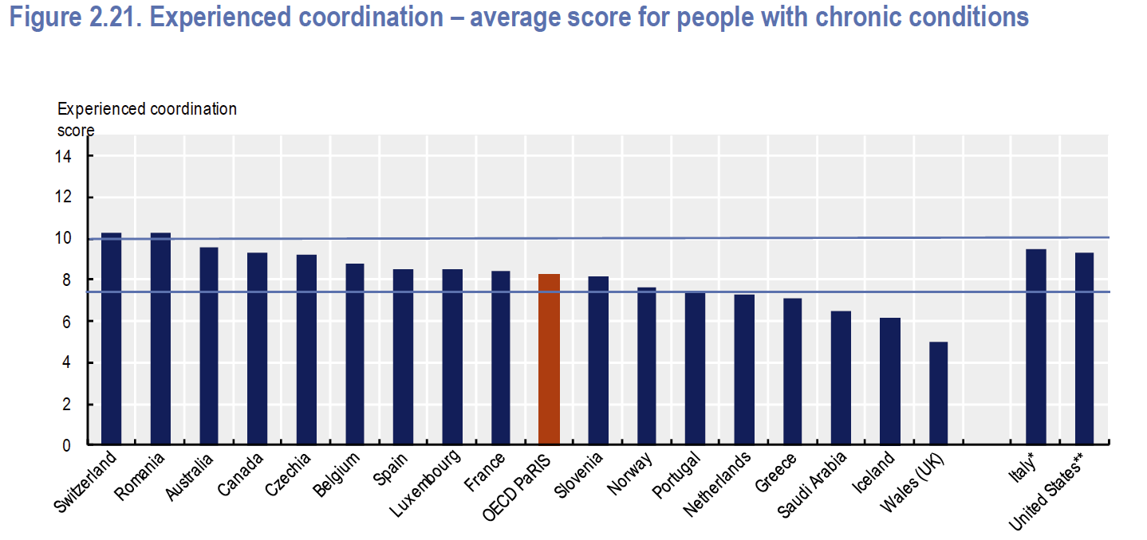
PaRIS Results

Slide 56
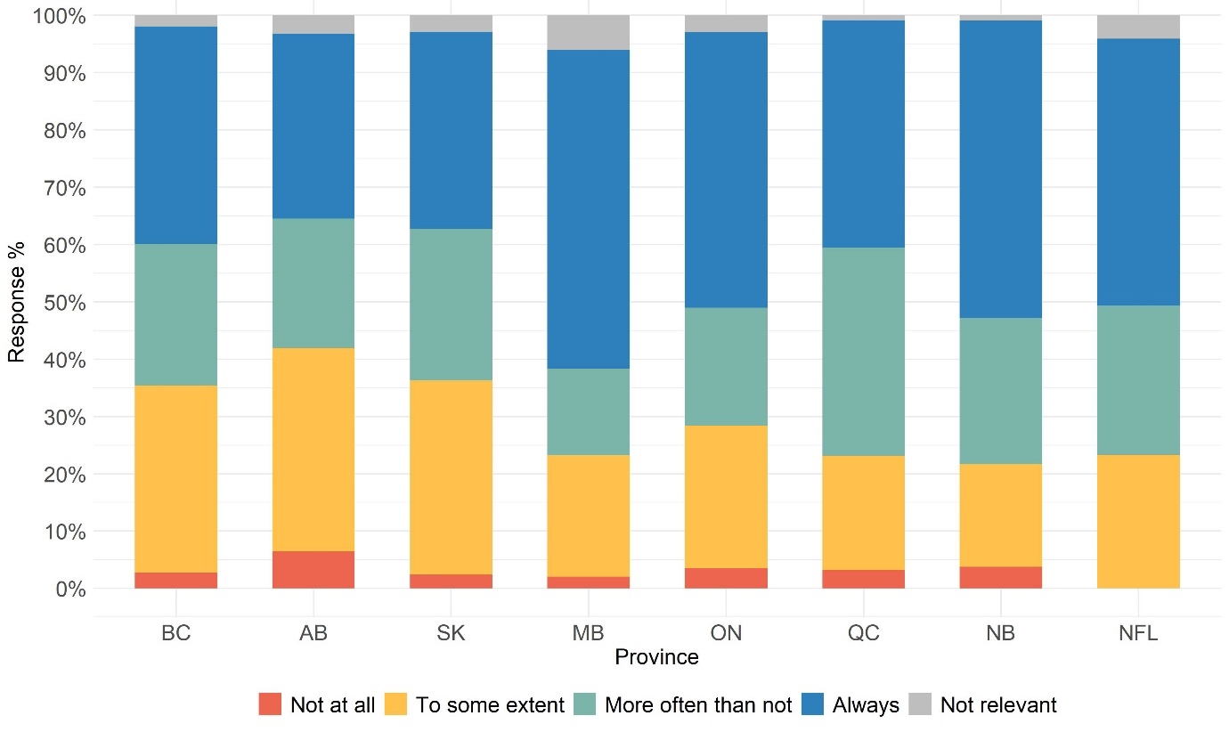
National Results: Patients discussed what is most important to managing health and well-being.

Slide 57
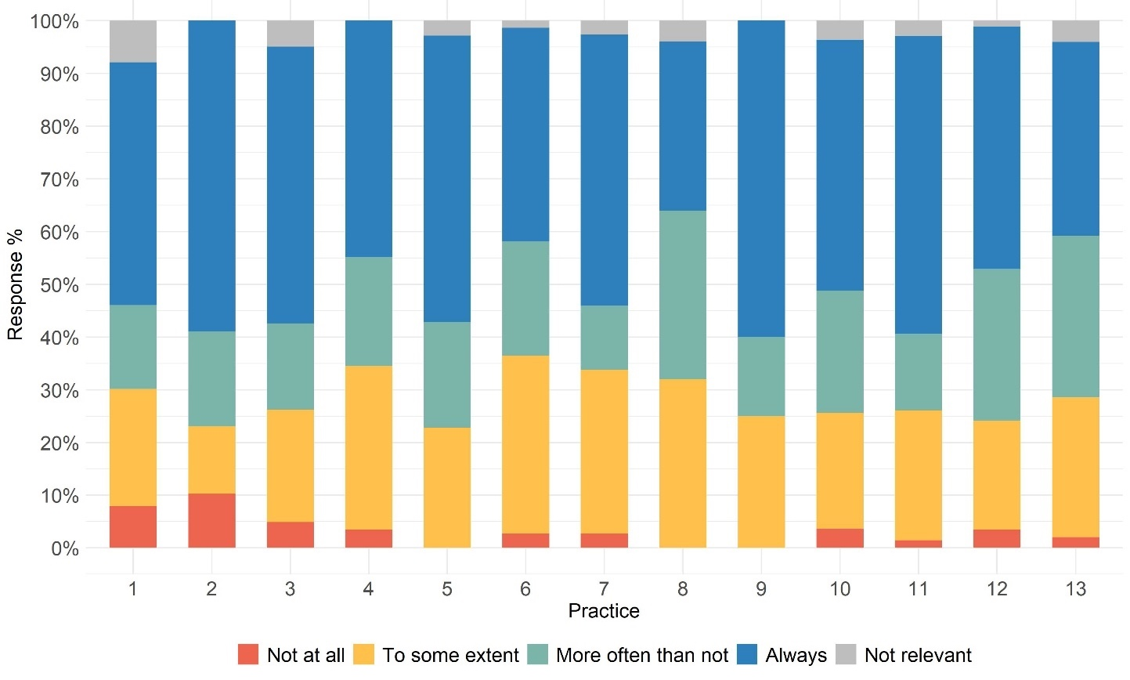
Ontario Provincial Results: Patients discussed what is most important to managing health and well-being.
Some practices are engaging
with patients more than
others:
Practice #2 ~ 58% Always
Practice #8 ~ 35% Always

Slide 58
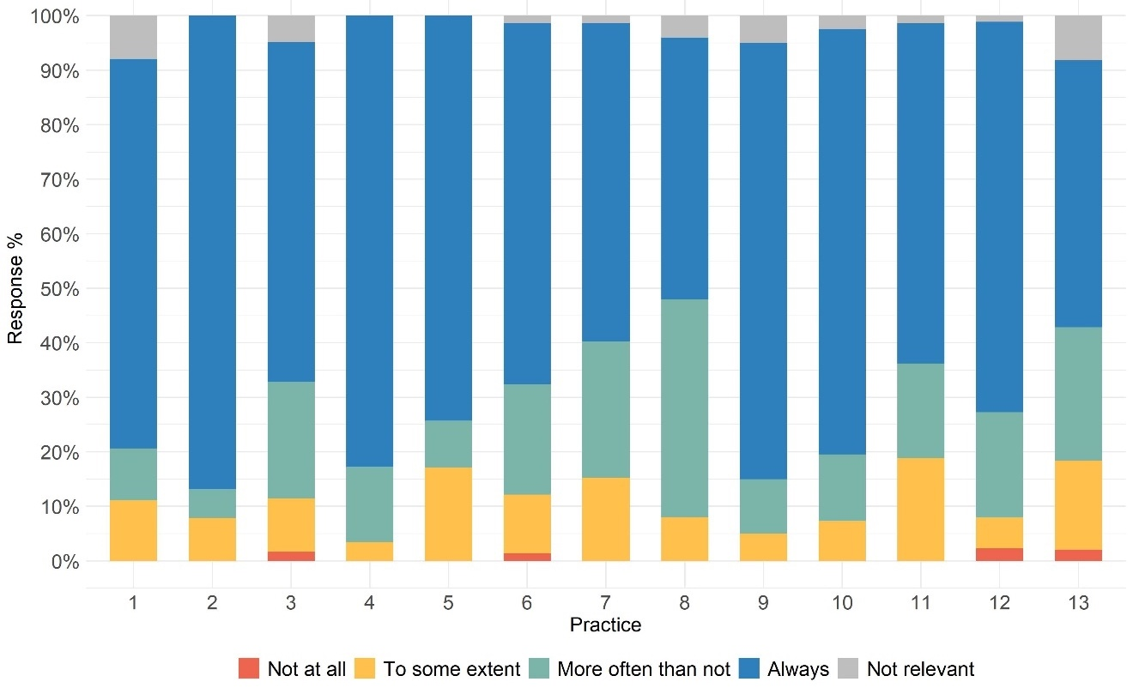
Ontario Provincial Results: Patients Are Involved “as much as they want to be” in care decisions
Some practices are engaging
with patients more than
others:
Practice #2 > 85% Always
Practice #8 ~ 45% Always

Slide 59

Patient Partner Reflection

Slide 60


Slide 61
Themes Arising From First Patient Engagement
Surveys as a valuable feedback tool in primary care
The need for systemic and organizational accountability
Promoting transparency and data sharing

Slide 62

For Patients, Caregivers, Citizens
Thursday March 27th
9:30 – 11:30 PST
12:30 - 14:30 EST
13:30 – 15:30 AST
Register
Now

Slide 63



PaRIS – Canada
Shaping primary care through incorporating patient-reported experiences and outcomes into performance reporting
Marie-Eve Poitras RN. Ph.D.
Associate Professor, Junior Researcher 2 Université de Sherbrooke, Department of Family and Emergency. Holder of the CRMUS Research Chair on optimal professional practices in primary care
S T. Wong, V T. Vaillancourt, Émilie Morneau-Guérin, Amélie Fournier and PaRIS-Canada team

Slide 64


Background
Achieving the quintuple aim in primary care is challenging due to limited patient-reported data on experiences and outcomes
Targeted interventions, including professional education and patient engagement tools, are needed to eliminate low-value practices and improve care¹
Despite their high potential, PREMs and PROMs remain underutilized in primary care^{2,3,4,5}
Canada participates in the OECD PaRIS survey, assessing patient outcomes and experiences in chronic disease management⁶
Références: 1- Wensing, M., Grol, R. BMC Med 17, 88 (2019). 2- Canadian Institute for health information, 2017. 3- Veillard J, & al. Milbank Q. 2017 Dec;95(4):836-883. 2017. 4- Roux-Levy, PH., Sasseville, & al. (2024). Québec: Commissaire à la santé et au bien-être; 2024 5- Lowry V, & al. Journal of Patient Reported Outcomes. Accepted. September 2024 6- Wong, S. T., & al. (2023). Canadian family physician, 69(12), 827–828.

Slide 65
Objectives and methods
Study Design (June 2023 - March 2024)
Populations studied: Patients (>45 years, ≥1 contact in 6 months), healthcare professionals
Recruitment: Through the Canadian Primary Care Research Network
Tools: Patient surveys (121 items) & practice surveys (34 items)
Objectives
Identify opportunities for improving primary care practices
Create reports based on patient-reported experience and outcomes to enhance clinical practice
Data Collection & Analysis
Methods: Surveys, coordinator logbook, national meetings, learning sessions
Evaluation: (RE-AIM & ECO-normalization frameworks): Impact,
challenges, solutions
3-month follow-up: PREMs/PROMs applications, engagement, barriers
Analysis
  Qualitative: Identifies barriers & facilitators for dashboard integration
  Quantitative: Assesses session acceptability & professional engagement

Slide 66





Creation of the dashboard
65 practices and 4,630 patients participated across Canada, contributing data to create dashboards
National coordinator and principal investigators selected dashboard items based on relevance and priority for healthcare and quality improvement
List was submitted for review to the national team (research assistants, patient partners, and investigators)
National coordinator updated the list and, with a scientific graphic designer, co-created a bilingual (French-English) template using Canva
End user reviewed the template and provided recommendations on layout, graph types, and content length to enhance provider clarity
4-page final template was shared with each participating province

Slide 67


Virtual or in-person learning session overview
Scientific committee created the PowerPoint slides to support reflective practice
One province requested an accredited learning session (60-90 minutes) for continuous education credits
Providers received a paper copy of the dashboard just before the learning session
Presentation plan
Meeting objectives
PREMs and PROMs: concepts & utility
PaRIS study summary
Clinic dashboard presentation
Discussion: results relevance & quality improvement opportunities

Slide 68
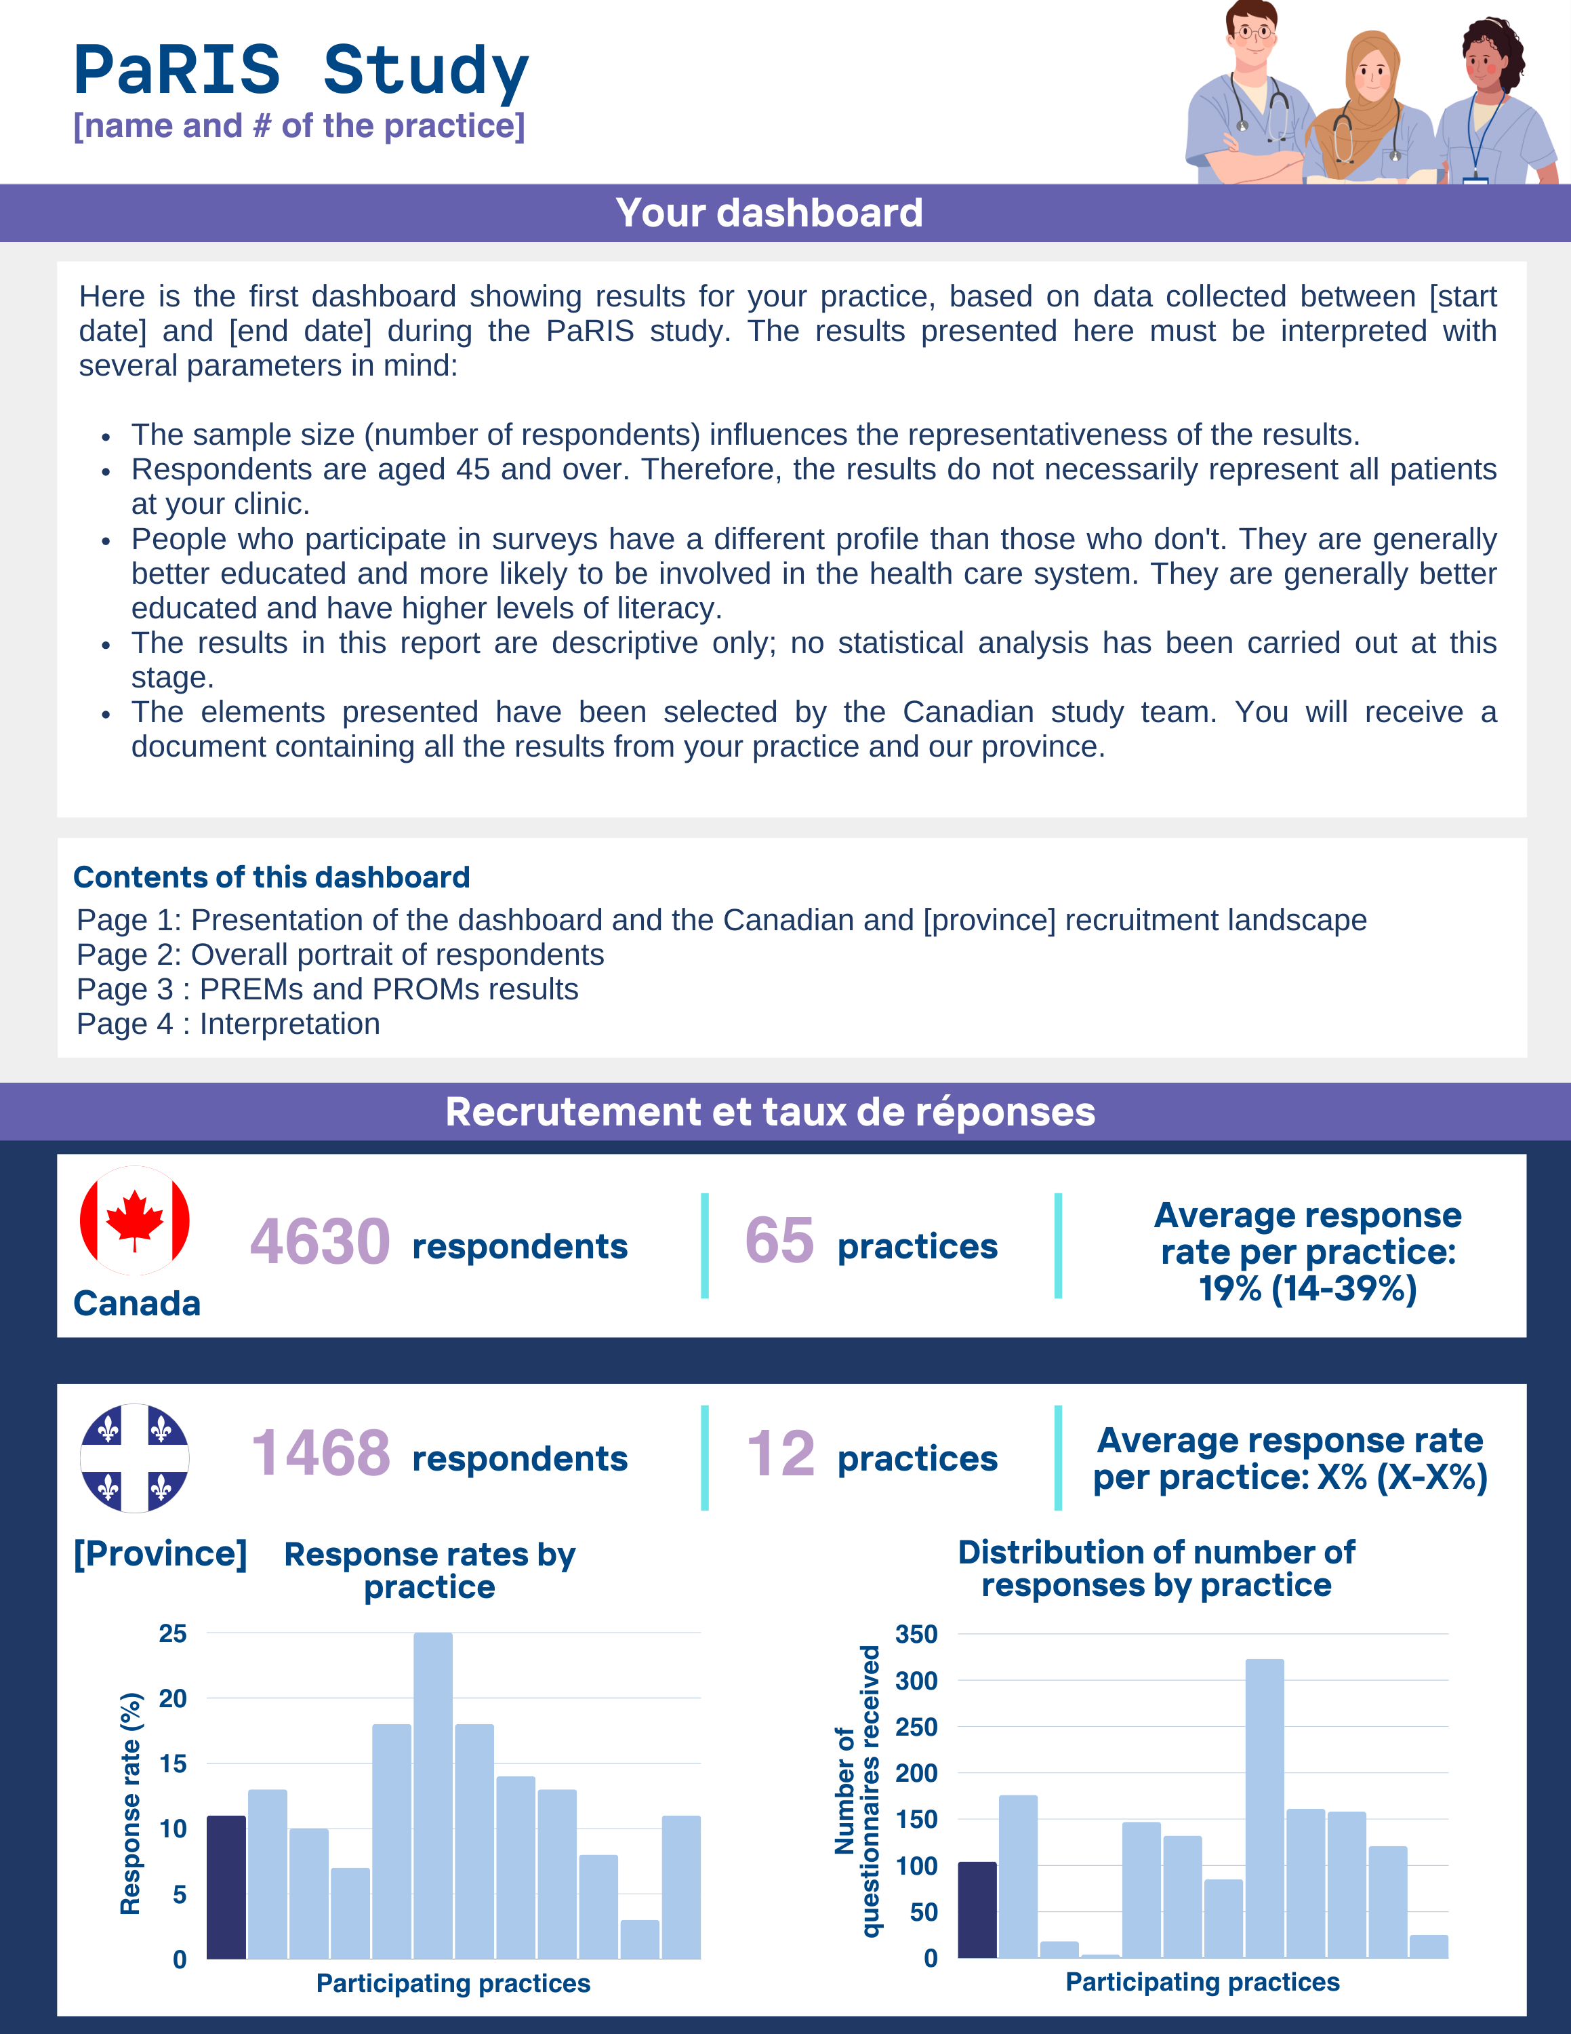
Dashboard template: Example from the Quebec province
Enrollment and response rate

Slide 69
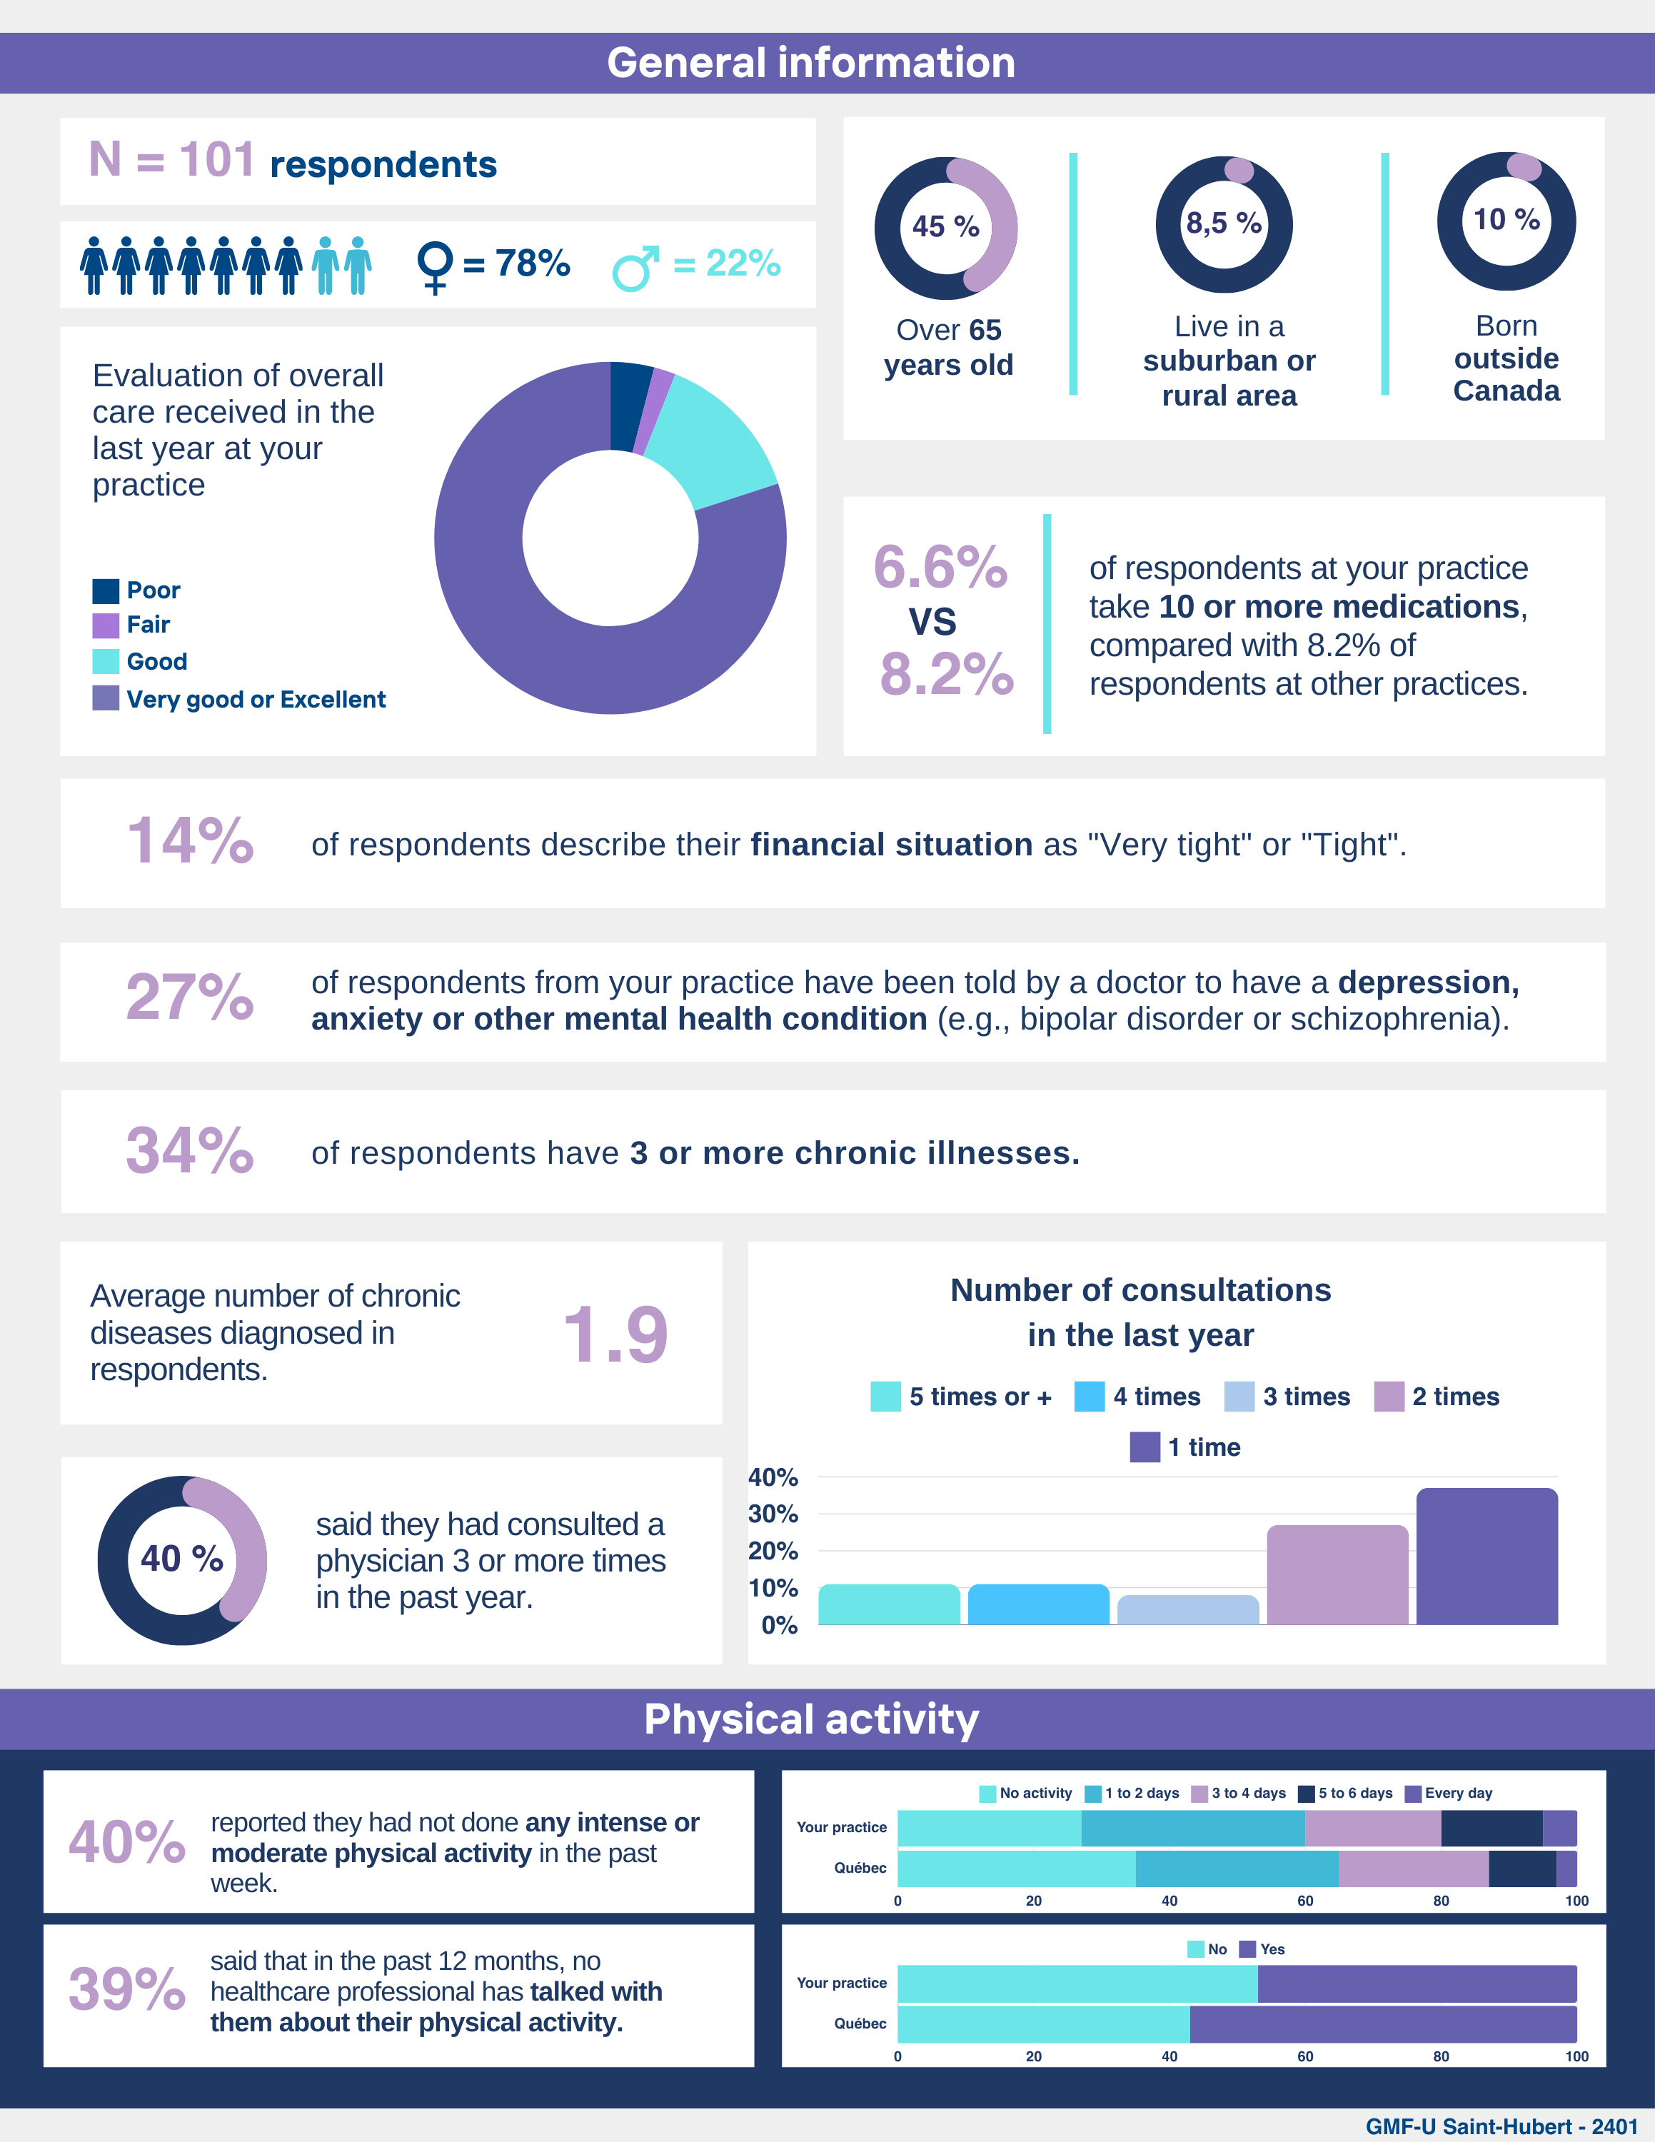
Dashboard template

Slide 70
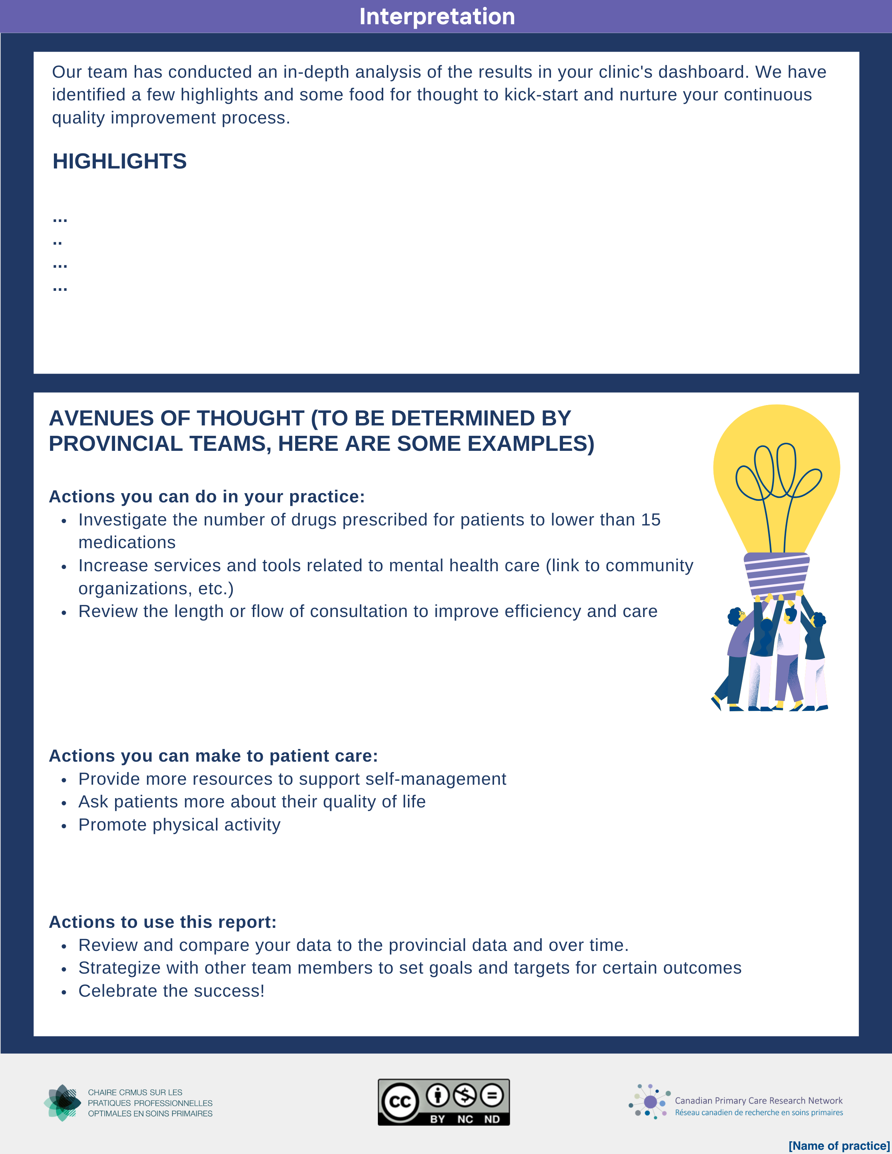
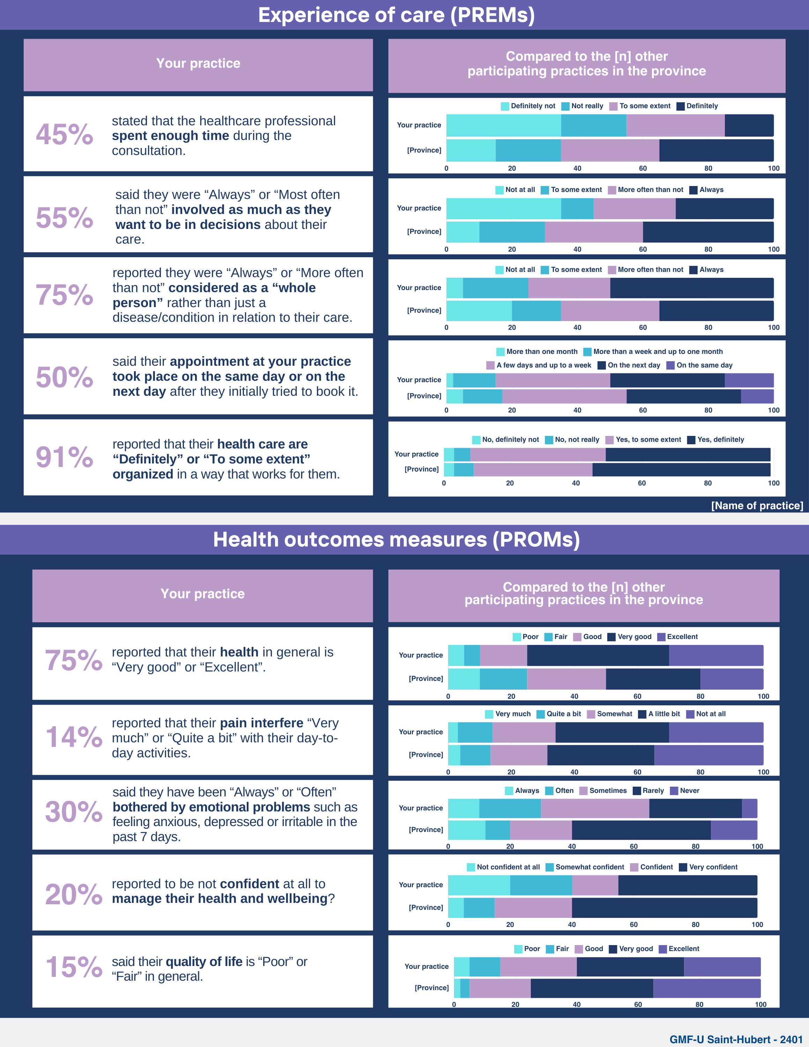

Slide 71
Overview of feedback and observations from the research team
  «
  We always like to receive input on the services we provide and especially appreciate the avenues for improvement that your approach has offered us.
Accreditation was a key factor in motivating participation in learning sessions
The providers question the relevance of creating an identical framework for all practices. Their needs vary, and the relevant items are different for all
In 95% of cases, the explanations and support offered to the people we met helped them to understand and reflect on the elements reported
  «

Slide 72


Overview of feedback and observations from the research team
A diversity of healthcare professionals participate in the learning sessions
Few providers could name a change of practice to be made, but 92% did select one to prioritize from among the courses of action we presented to them
Providers could identify quality improvement actions in training students
  «
  I believe that certain changes will be a quick win
  Aiming to make patients feel more like individuals
  «

Slide 73
Overview of feedback and observations from the research team
Improving care coordination for complex patients could enhance follow-ups and clarify roles among healthcare professionals
Increasing patient awareness and education could support engagement and better health outcomes
8,1
Agreed 91,9

Slide 74

Discussion and conclusion
…
PDF dashboards are appreciated by providers and are effective in illustrating PREMs and PROMs data
Even if providers are interested in PREMs and PROMs data, they need support in identifying courses of action and mechanisms for transposing these data into their professional practice and the organization of services within their practice
Improving patients’ experiences in primary care can be facilitated by providing PREMs/PROMs back to practices
Other learning sessions or tools are needed to support providers in taking concrete actions

Slide 75




Thank you
For your commitment!
For any questions or additional information,
please contact
Dr Marie-Eve Poitras
marie-eve.poitras@usherbrooke.ca
Follow us on our networks!

Slide 76
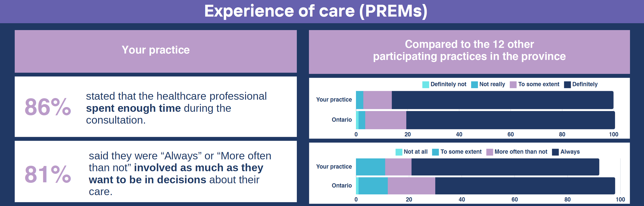
E.G. Ontario Practice Reports
This practice had more individuals reporting that their provider ‘Definitely” spent enough time and that they were “Always” involved as much as they wanted to be in decisions about their care compared to other participating practices in Ontario.

Slide 77
Factors Associated with Patient Satisfaction In Primary Care Settings

Slide 78

Background
Patient-reported outcome and experiences are well-recognized for quality monitoring and improvement.
  PROMs gather information related to health, functioning, and quality of life (QOL)
  PREMs focus on patients' experiences while receiving care, which reflect organizational care processes
  Address inconsistencies between patients' and healthcare providers' assessments of patient needs
However, such measurement is limited in primary care

Slide 79

Satisfaction with Care
The OECD launched the Patient-Reported Indicators Surveys (PaRIS) to build capacity for PROMs and PREMs in primary care
→ Allows for capturing patient satisfaction with care
Research needed on practice-level and other provider level factors that influence both outcomes and experiences and contribute to satisfaction with care
This research explores patient and practice-level characteristics associated with satisfaction with health care

Slide 80

Sample
Convenience sample of patients and their providers were surveyed across 16 practices in Ontario
Eligibility criteria for patients: aged 45 years + who visited their provider in the past 6 months
1 representative from each practice was surveyed to collect practice-level data
Distribution: patient surveys were sent through a generic link via their practice

Slide 81
Data Collection
Practice survey: 34 questions about practice characteristics (e.g. location; practice type; funding model; team composition; and services provided)
Patient survey: 121 items covering four domains: (1) health status and symptoms; (2) managing health; (3) experiences of primary health care services; and (4) experiences of other health care services, and sociodemographic characteristics
PREMS | PROMS
Access Comprehensiveness of care Quality of care Person-centredness Care continuity Self-management support Safety Trust | Symptoms Functioning Self-reported health status Mental health Pain Sleep disturbance Fatigue Physical functioning Satisfaction in social roles Self-management capacity

Slide 82
Data Analysis
Exposures:
Sex
Income
Health status
Wait times for appointments,
Ability to pay rent
Ability to buy healthy meals
Ability to pay for electricity
Physician’s professional background
Development of care plans
Outcome:
Satisfaction with Care
(“When taking all things into consideration in relation to the care you have received, overall, how do you rate the medical care that you have received in the past 12 months from your primary care clinic?”)
Model= random effects multivariate ordinal logistic regression

Slide 83
Results: Patient Demographics

Slide 84
Results: Provider Demographics

Slide 85
Regression Results
Predictor | Response option | Odds Ratio [95% CI] | P-Value
Annual household income Ref category: <=60,000 | $60,000-$99,000 | 0.935 [0.599, 1.461] | 0.769
 | $99,000 or more | 0.745 [0.476, 1.168] | 0.199
 | Don’t know | 0.806 [0.261, 2.494] | 0.709
 | Prefer not to say | 0.606 [0.383, 0.959] | 0.033**
Frequency of being worried or stressed about having enough money to pay rent or mortgage Ref category: Never | Always | 0.659 [0.470, 0.925] | 0.016**
 | Usually | 0.469 [0.231, 0.954] | 0.037**
 | Sometimes | 0.967 [0.458, 2.039] | 0.929
 | Rarely | 0.911 [0.472, 1.758] | 0.782
Self-reported health Ref category: Good | Poor | 0.613 [0.239, 1.576] | 0.310
 | Fair | 0.918 [0.583, 1.446] | 0.712
 | Very Good | 1.563 [1.092, 2.237] | 0.015**
 | Excellent | 2.533 [1.270, 5.052] | 0.008***
Length of time that appointment took place after booking Reference category: More than one month later | More than a week and up to one month later | 1.403 [0.858, 2.293] | 0.177
 | A few days and up to a week later | 2.577 [1.558, 4.263] | <0.001****
 | On the next day | 4.711 [1.997, 11.111] | <0.001****
 | On the same day | 2.772 [1.274, 6.033] | 0.010**
 | Can’t remember | 2.109 [0.901, 4.937] | 0.085*
Professional background Ref category: Physician in family medicine | Nurse Practitioner | 1.768 [1.176, 2.657] | 0.006***

Slide 86
The role of financial instability in primary care
Financial instability → low patient satisfaction
Potential primary care interventions to address poverty as a social determinant of health:
  Screening tools to assess social needs
  Welfare rights services (social prescribing)
  Food insecurity interventions
  Promoting healthcare’s involvement in affordable housing.
The potential of such interventions is limited→ primary care lacks strong linkages with social services, and navigating such systems can be complex

Slide 87

Wait Times
Shorter wait times → higher satisfaction
Accessibility and availability are important characteristics of efficient and effective primary healthcare systems.
Strategies to address the problem:
  Incentives for family physicians to provide additional services on evenings and weekends
  Advanced access/ open access scheduling
  Use of teams in primary care practices (include nurse practitioners and allied workers)
  Use of electronic/telephone follow-ups

Slide 88
Provider Background
Patients who were seen by a nurse practitioner had significantly higher satisfaction scores than those who saw a physician
Other research shows that higher satisfaction scores for nurse practitioners were found for items relating to length of consultation, reassurance about symptoms, information on coping with disease and attention to the impact of disease on daily life
Nurse practitioners have been integrated into primary care settings
→ incorporate activities to target SDH vulnerable populations
→ Increased access to care & cost savings

Slide 89

Conclusion
Structuring primary care in ways that address the following may enhance patient satisfaction:
  Social determinants of health
  Drawing on the skills and leadership of multidisciplinary teams
  Creating efficient systems for reducing wait times
  Attending to patients’ perceptions of their health and ability to function in their daily lives

Slide 90
Discussion Topic
What questions do you have about adopting Patient Reported Measurement to advance your OHT priorities?
What challenges do you foresee in implementing Patient Reported Measurement in you OHT?

Slide 91
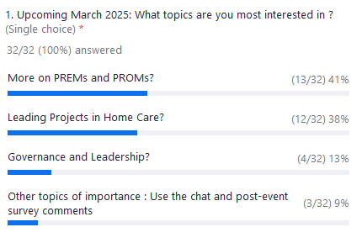
Poll 4

Slide 92
Up Next
HSPN webinar series
  4th Tuesday of the Month: 12:00 – 1:30 pm
Upcoming March 2025:
What do you think?
    More on PREMs and PROMs?
    Leading Projects in Home Care?
    Governance and Leadership?
    Other topics of importance : Use the chat and post-event survey comments

Slide 93




THANK YOU!
@infohspn
hspn@utoronto.ca
The Health System Performance Network
hspn.ca

