Slide 1
Leading Projects Baseline Preliminary Results
Quantitative Indicators
April 2024

Slide 2
Purpose of Preliminary Results
Show calculated baseline results based on identifiable comparable eligible populations for each of the programs.
Discuss validity of results compare to expectation or alternative sources.

Slide 3
Population definition
General criteria: Individuals who received home care* and home care services in fiscal year 2022/23.
Individuals receiving palliative care were included/excluded based on comprehensive definition, extending beyond home care.
*Excluding Nipissing Wellness OHT, where individuals did not need to be receiving home care.

Slide 4
Cross Project Indicators
Name | General Definition
Service volume | Number of home care services provided per month in HC.
Service time per patient-month | Service unit-time for services provided per month in HC.
Time receiving home care | Average length of home care enrollment per admission.
Timeliness of service initiation (referral to first service within 3 days) | Proportion of admissions where the patient waited more than 3 days between referral and first HC service.
Average wait time from referral to service | Average number of days between referral and first HC service.
Average wait time from assessment to service | Average number of days between assessment and first HC service
Change in health status | Change in MDSHSI score among home care clients that had two interRAIHC assessments in a 365-day period.
Total cost | Average attributable total government health care spending per individual, per month alive.
Homecare costs | Average attributable government health care spending per individual, per month alive for homecare costs.
ED visits for conditions best managed elsewhere | Percentage of patients or clients who visited the emergency department (ED) for conditions “best managed elsewhere".
Unplanned hospitalizations | Percentage of home care clients who experienced an unplanned admission to hospital for medical reasons.
Alternate level care days | Proportion of days in acute inpatient care that were spent in alternate level of care (ALC).
Alternate level of care conversion | Proportion of hospitalisations which had ALC days.
Caregiver distress | Percentage of home care clients who reported that their primary informal caregiver expressed continued feelings of distress, anger or depression over a six-month period.

Slide 5
Palliative Indicators
Name | General Definition
ED visits in the last 30 days of life | The proportion of decedents that had one or more unplanned emergency department visits in their last 30 days of life.
Proportion of decedents receiving palliative home care in the last 90 days of life | The proportion of decedents that had one or more palliative home care services (excluding care management and placement services) in their last 90 days of life.
Days spent at home in the last 6 months (180 days) of life | Average days at home (180 minus total days in hospital, emergency department, inpatient rehab and complex continuing care) in the last 6 months of life.
Deaths in hospital | The proportion of decedents that died in a hospital setting (defined as acute or psychiatric care institution, emergency department, inpatient rehab or complex continuing care.

Slide 6
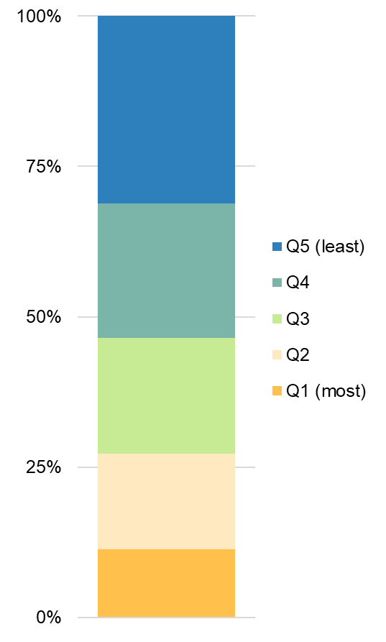
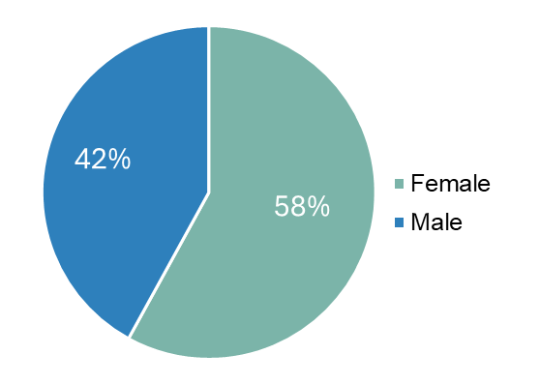
Demographics
Age (n=6,772)
Access to material resources (n=6,743)
Mean (SD): 75.6 (14)
Median (IQR): 78 (68-86)
Interpretation:
Q1 would be living in neighbourhoods with the most access to material resources and Q5 with the least access.
Sex (n=6,772)

Slide 7
Indicator: Service volume per patient-month
Average number of home care services received per patient-month in eligible reporting period.
Numerator: Total number of services in the reporting period.
Denominator: Total person-months in the reporting period.
Leading project (anonymized)

Slide 8
Indicator: Proportion of service volume by type
Reporting categories:
Physio or occupational therapy: Service = 5, 6 (visit)
Nursing: Service = 1 (visit), 2 (hours)
Personal services, homemaking, or both: 11, 12, 13 (hours)
Social work or case management: 8, 10, 14 (visit)
Other: all other codes
Leading project (anonymized)

Slide 9
Indicator: Service time per patient-month
Average service unit-time per month in home care.
Visits without a recorded time have been counted as 1 hour.
Leading project (anonymized)

Slide 10
Indicator: Wait time of 3 days or less between referral and service
Proportion of individuals who waited 3 days or less between referral and first HC service.
Numerator: Number of patients who waited no more than 3 days between referral* and first service. Patients must have been referred in reporting period.
Denominator: Total number of patients referred in reporting period.
Leading project (anonymized)
*If in hospital, start of count is date discharged.
**Data suppressed

Slide 11
Indicator: Average wait time from referral to service
Average number of days between referral and first HC service.
Numerator: Number of days between referral and first service. Patients must have been referred in reporting period.
Denominator: Total number of patients referred in reporting period.
Leading project (anonymized)

Slide 12
Indicator: Average wait time from assessment to service
Average number of days between assessment and first HC service.
Numerator: Number of days between assessment and first service. Patients must have been referred in reporting period.
Denominator: Total number of patients referred in reporting period.
Leading project (anonymized)

Slide 13
Indicator: Change in health status
Change in MDSHSI score among home care clients that had two interRAIHC assessments in a 365-day period.
Numerator: Total change in MDSHSI in eligible population.
Denominator: Total population with an interRAIHC assessment in the observation period (index assessment) and a second interRAIHC assessment within 365d prior.
Leading project (anonymized)

Slide 14
Indicator: Monthly government spending
Average attributable government health care spending per individual, per month alive in FY22-23.
Numerator: Total eligible patient costs.
Denominator: Total number of patient-months.
Leading project (anonymized)

Slide 15
Indicator: Proportion of inpatient days that were ALC
Proportion of days in acute inpatient care that were spent in alternate level of care (ALC).
Numerator: Total number of inpatient days designated as ALC in the reporting period.
Denominator: Total number of inpatient days in the reporting period.
Leading project (anonymized)

Slide 16
Indicator: Proportion of hospitalisations with ALC days
Proportion of hospitalizations which became ALC.
Numerator: Total number of hospitalizations which became ALC.
Denominator: Total number of hospitalizations.
Leading project (anonymized)

Slide 17
Indicator: Unplanned hospitalizations
Percentage of home care clients who experienced an unplanned admission to hospital for medical reasons.
Numerator: Total number of patients who had an unplanned hospitalization.
Denominator: Total number of patients in cohort.
Leading project (anonymized)

Slide 18
Indicator: ED visits for conditions best managed elsewhere
Percentage of patients or clients who visited the emergency department (ED) for conditions “best managed elsewhere".
Numerator: Total number of patients who had an unplanned ED visit.
Denominator: Total number of patients in cohort.
Leading project (anonymized)

Slide 19
Indicator: Caregiver distress
Percentage of clients who reported that their primary informal caregiver expressed continued feelings of distress, anger or depression over a six-month period.
Numerator: Total number of patients who reported that their primary informal caregiver expressed continued feelings of distress, anger or depression.
Denominator: Total population with an interRAI assessment in observation period that had a caregiver.
Leading project (anonymized)

Slide 20
Palliative care indicators
ED visits in last 30 days
Palliative home care visit in last 90 days
The percent of decedents with 1 or more emergency department visits in the last 30 days of life.
The percent of decedents receiving a palliative home care visit in the last 90 days of life.

Slide 21
Palliative care indicators
Days spent at home in last 6-months of life
Deaths in hospital (alternate to deaths in location of choice)
Days spent at home in the last 6 months (180 days) of life.
The percent of decedents that died in a hospital setting.
21

Slide 22
Notes
This research was supported by a grant from the Ontario Ministry of Health and Long-Term Care (MOHLTC) to the Health System Performance Research Network. This study was supported by ICES, which is also funded by an annual grant from the MOHLTC. The opinions, results and conclusions reported in this paper are those of the authors and are independent from the funding sources. No endorsement by ICES or the Ontario MOHLTC is intended or should be inferred. Parts of this material are based on data and/or information compiled and provided by CIHI. However, the analyses, conclusions, opinions and statements expressed in the material are those of the author(s), and not necessarily those of CIHI. Parts of this material are based on data and information provided by Ontario Health (OH). The opinions, results, view, and conclusions reported in this paper are those of the authors and do not necessarily reflect those of OH. No endorsement by OH is intended or should be inferred. We thank the Toronto Community Health Profiles Partnership for providing access to the Ontario Marginalization Index.

Slide 23
Technical Appendix

Slide 24
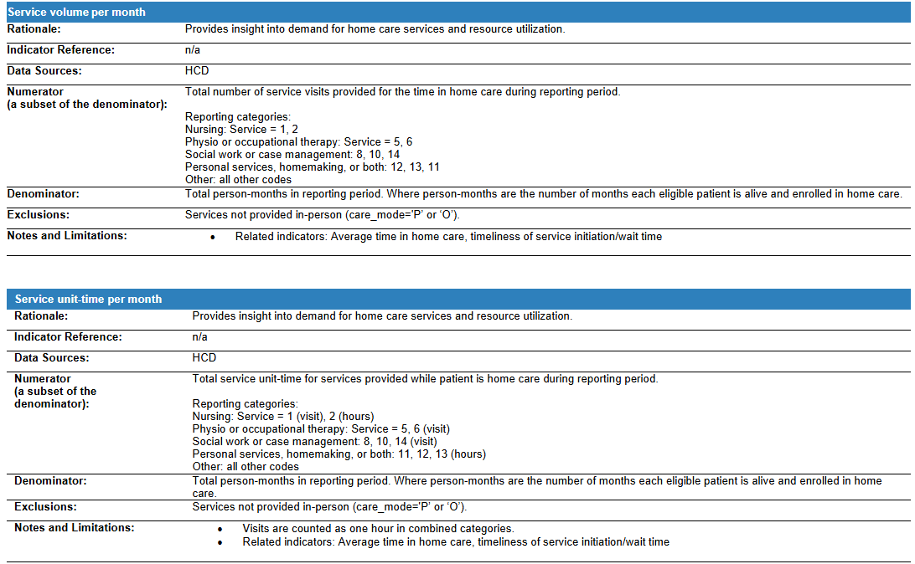

Slide 25
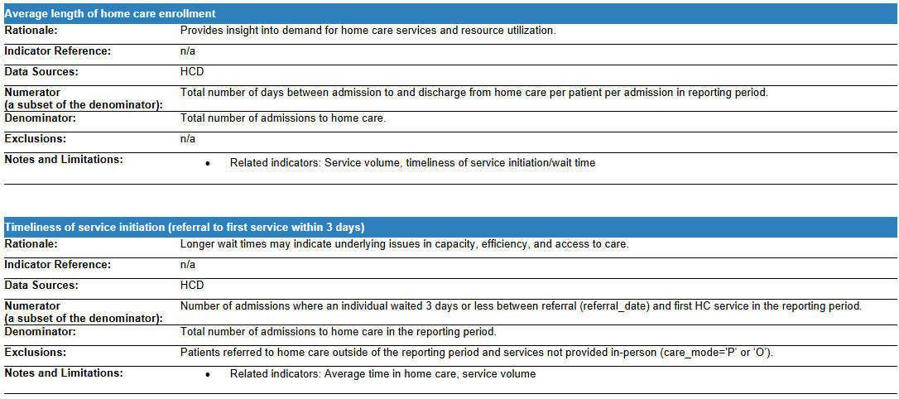

Slide 26
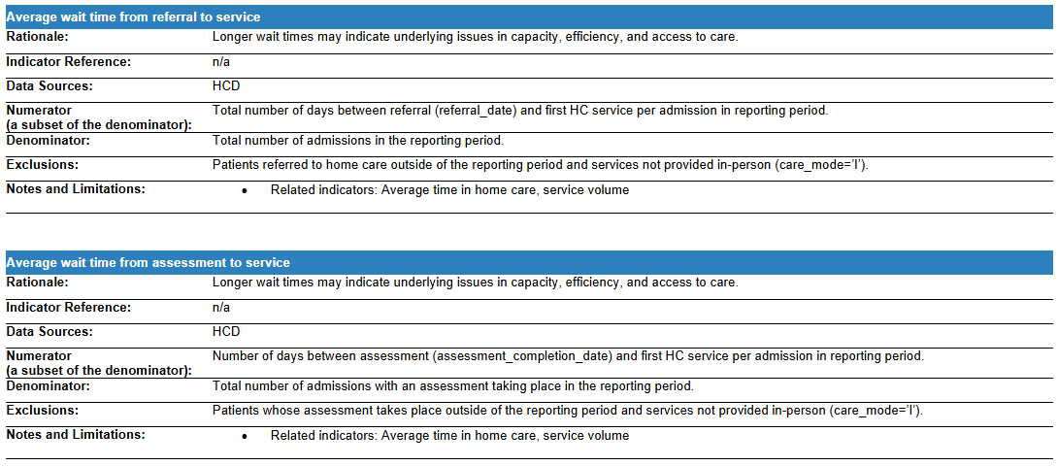

Slide 28
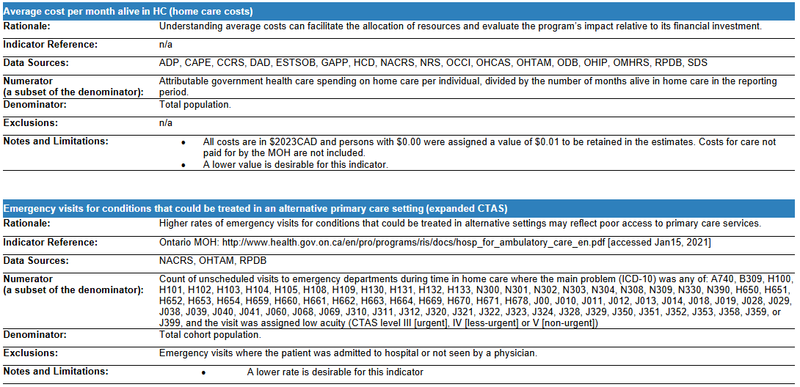

Slide 29
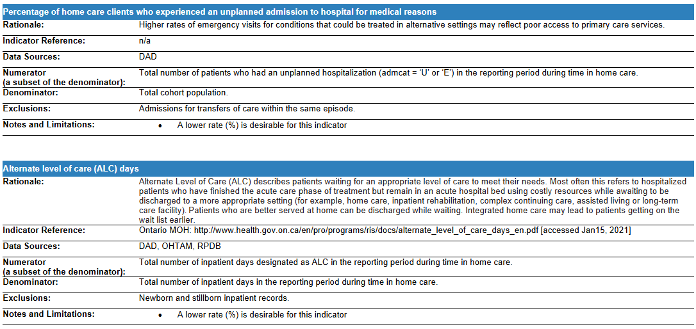

Slide 30
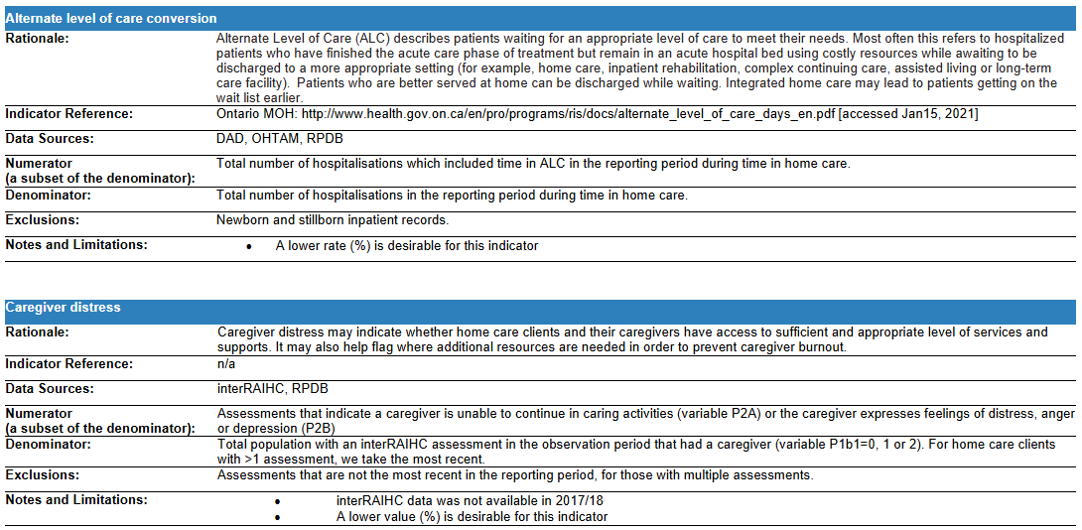

Slide 31
